Slide 1
Weaknesses of The Articles of Confederation
Political Science

Slide 2
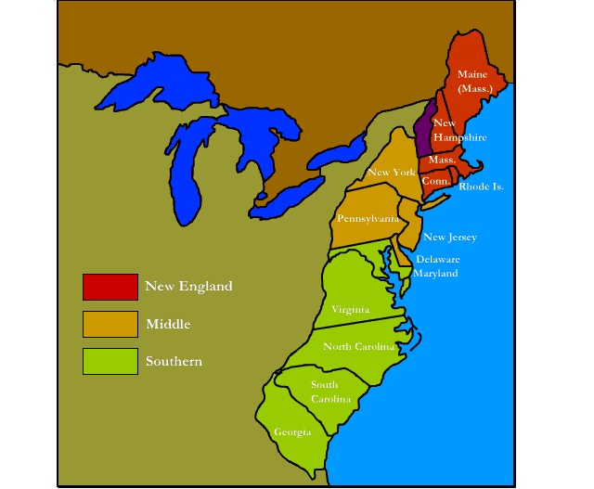
1. One vote for each state, regardless of size
Each individual person is not represented equally
Larger states don’t like this.

Slide 3
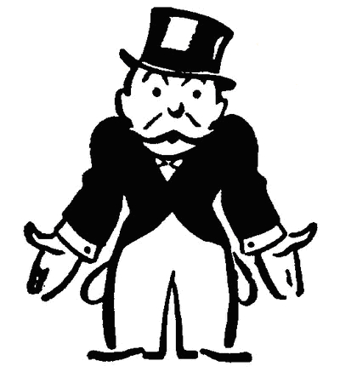
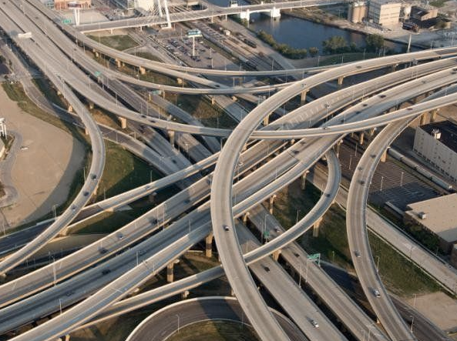
2. Congress has no power to collect taxes
Debts to pay from fighting war with Great Britain
No money to provide services to the people like roads, bridges, etc

Slide 4
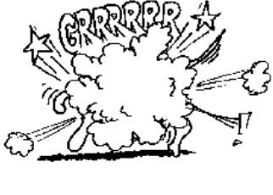
3. Congress has no power to regulate trade
Import and export taxes were not uniform and created unfair advantages for some states

Slide 5
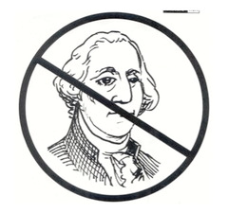
4. No President to enforce acts of Congress
No check on the power of the legislative branch
No vision for nation
No leader

Slide 6
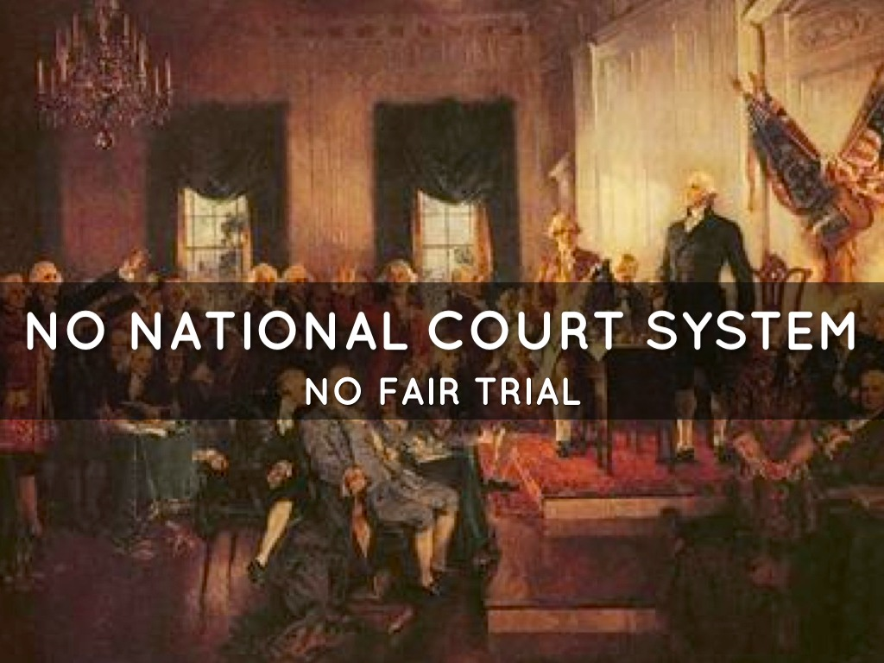
5. No National Court System
No body to interpret laws meaning
No body to settle disputes between states

Slide 7
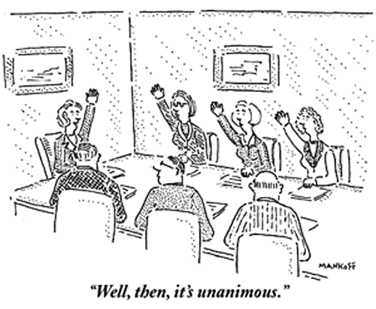
6. Amendment only with consent of ALL states
Difficult to make any necessary changes – how often can you get 100% of the people to agree.

Slide 8
7. A 9/13 Majority required to pass all laws
Very difficult to pass laws to improve the nation
9/13

Slide 9
8. Articles only a “firm league of friendship”
States lacked unity in economy, government, society and culture.
No cohesive vision for the nation
Only a loose alliance for military protection from outside attack.

Slide 10
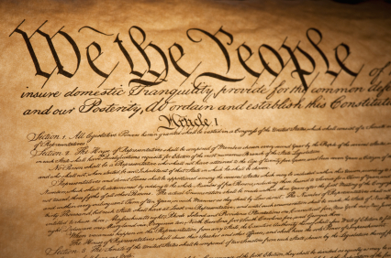
Time for a Change
Delegates will meet in Philadelphia, Pennsylvania
Meeting is called Constitutional Convention
A proposal to abolish the articles and start over!

