Slide 1
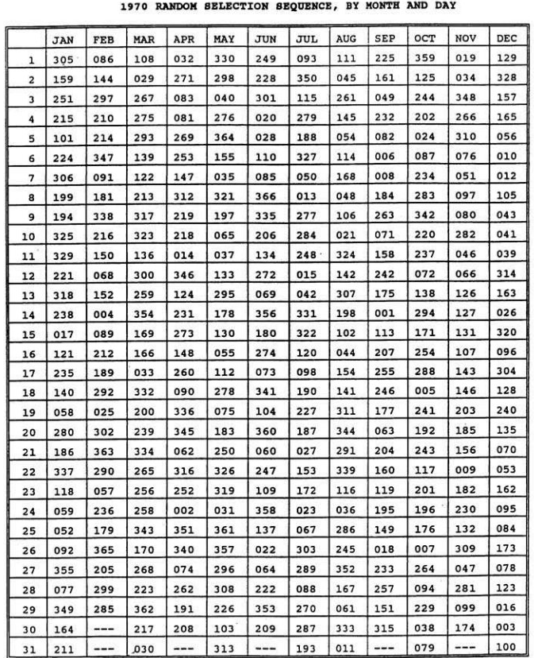
Use your birthday to find your corresponding draft number.
We will go around and record everyone's number in the class.

Slide 2
Mock Draft
Numbers were put in order
The lower the number you had the more likely you were to get drafted.
Now check to see if you actually would have been drafted.
https://www.usatoday.com/vietnam-war/draft-picker

Slide 3
Draft Follow Up Questions
Class Draft
Were you drafted?
Was it fair? Explain.
Were you happy or resentful with the draft results?
Real Draft
Would you have been drafted?
Was it fair? Explain.
Were you happy or resentful with the draft results?

Slide 4
Overview of the Selective Serivce
Read document B
Annotate and take notes as you read
Answer the following questions
Describe the Selective Service’s lottery system for drafting soldiers into the military.
Give your opinion about the fairness of the system.
Would you be willing to serve if you were drafted under this system, or would you use a deferment? If you chose to defer, which deferment would you use, and why?"

Slide 5
Oral Histories of Vietnam Veterans
Use the following videos to fill out the chart.
https://illinois.pbslearningmedia.org/resource/9f9895cb-41c3-4b81-a573-b81a505bb019/a-different-kind-of-lottery-understanding-the-draft-during-the-vietnam-war-media-gallery/#.WtS0AE2ou1s

