Slide 1
The Business of Business Is Business
U.S. History – Unit 2

Slide 2
Guided Questions
What was the age after the Civil War called and why?
What is the fear of monopoly to our capitalist system?
Explain the ways in which a business can become “big.”
What is the difference between a captain of industry and a robber baron?
What were the justifications for the wealth that these men accumulated?

Slide 3
“The Gilded Age”
Era after Civil War/Reconstruction
A phrase coined by Mark Twain
It was an era of enormous growth, wealth, opportunity, innovation, etc.
However, it was also an era of political corruption, scandals, greed, child labor, materialism, racial discrimination, etc.
So it was “gilded” – Bright and shiny on the outside, but just ordinary or even nasty on the inside. Or think of a beautiful, shiny, red apple… that is rotten on the inside.
GQ: What was the age after the Civil War called and why?

Slide 4
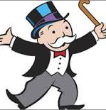
“Big Business”
As America industrialized, there became a new wealthy elite that ran these industries.
An important aspect of America’s capitalist economic system is the belief that the nation’s economy is strongest when there is true competition between businesses.
As these businesses grew, they started to become very large and…
Generally the problem with “Big Business” over the years has been the fear of Monopoly:
“Complete control over an industry’s production, wages, and prices”
GQ: What is the fear of monopoly to our capitalist system?

Slide 5
“Big Business”
Monopolies are bad in a capitalist economy because you want competition to drive down prices for consumers.
However, too many laws, tariffs, and regulation can choke business and cause other problems
Therefore it is up to the government to ensure that monopolies do not exist, but not interfere too much into the economy
GQ: What is the fear of monopoly to our capitalist system?

Slide 6
How does a Business get “Big?”
“Mergers”
“Trusts”
Consolidating business with a stock Market buyout of another business
Sometimes, intimidation or shady business tactics would be used to try and ruin the business of a private company
Sometimes Mergers are executed by “Holding Companies” –a company whose sole purpose is to purchase stock in other companies
Consolidating business by having participating companies turn their stock over to a group of “trustees” (people who ran the separate companies as one large corporation)
Each company would then split the profits made by the entire Trust
GQ: Explain the ways in which a business can become “big.”

Slide 7
How does a Business get “Big?”
Business owners should consolidate as much as possible in order to control their costs of production to make more profit.
Two ways to do this:
Vertical integration: Buying out suppliers, shipping, and distribution in order to control all facets of a business
Horizontal Integration: Consolidation of companies that produce similar products
Paying employees extremely low wages; Dangerous conditions
Driving competitors out of business by selling at a lower price than it costs to produce.
After control of the market is achieved, hiking prices up above original levels
GQ: Explain the ways in which a business can become “big.”

Slide 8
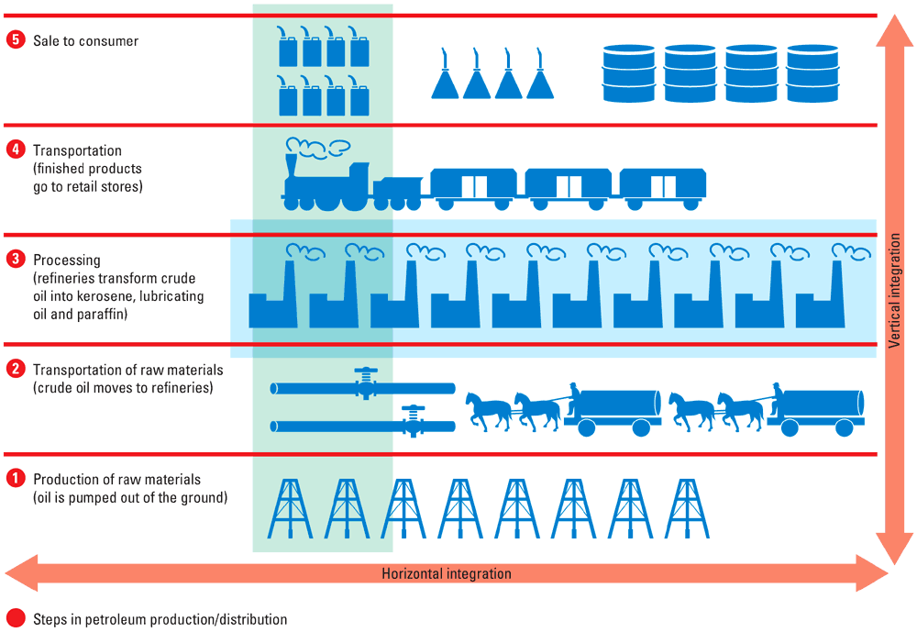

Slide 9
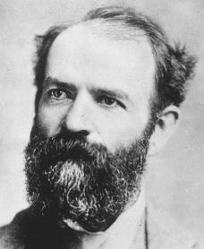
The Men Who Profited
There were several men who used this new era of business to become powerful and wealthy including:
John D. Rockefeller – Oil industry
Andrew Carnegie – Steel industry
Cornelius Vanderbilt – Shipping industry
J.P. Morgan – Financial industry
Jay Gould – Railroad industry

Slide 10
How wealthy were the these men compared to Microsoft founder Bill Gates?

Slide 11
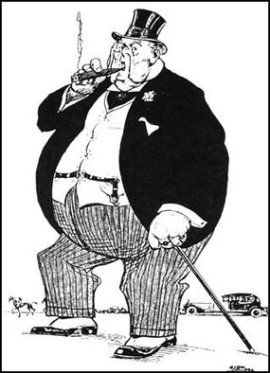
Robber Barons or Captains of Industry?
Robber Baron
Capt. Of Industry
Exploited workers
Corrupted the government
Greedy
Created Jobs
Increased production
Provided cheap products
Gave money back to the community
GQ: What is the difference between a captain of industry and a robber baron?

Slide 12
Justification for the Industrialists’ Wealth
Social Darwinism
Gospel of Wealth
Herbert Spencer
Based on Charles Darwin’s theory of evolution
Those who are rich are more fit, than those who are poor
Attempted to use science to explain social classes
Andrew Carnegie
God gave wealth to the most capable people
It is the duty of the wealthy to give money to help the poor
Carnegie gave millions of dollars away to establish libraries, colleges, and museums (Carnegie Hall in NY)
GQ: What were the justifications for the wealth that these men accumulated?

Slide 13
Essential Question
During this period of U.S. History, explain how these industrialists and their businesses help/transform America and how they also perhaps harm America.

Slide 14
Gilded Age Analysis
Directions:
Choose one of the political cartoons and analyze it using APPARTS.
Be sure to look over EVERY part of the picture, there’s a lot packed into one cartoon!

Slide 15
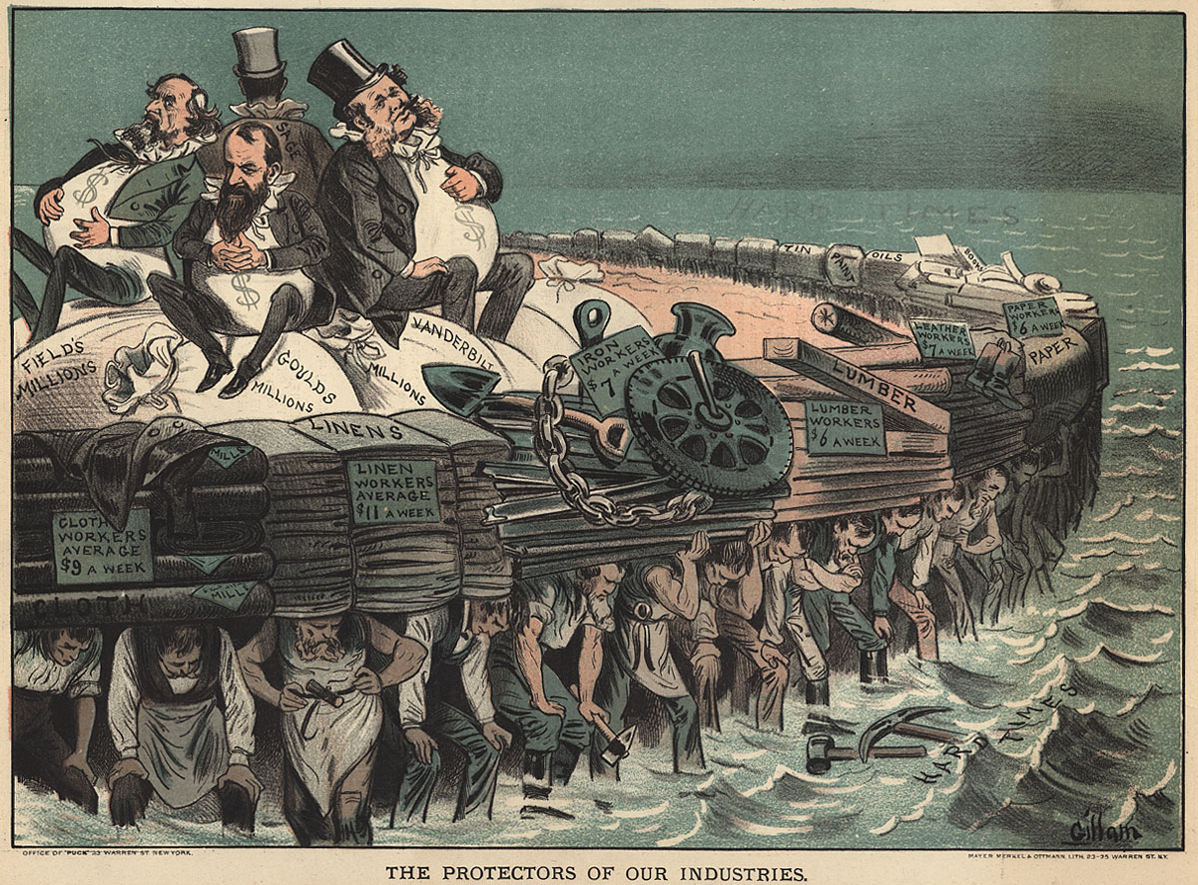

Slide 16
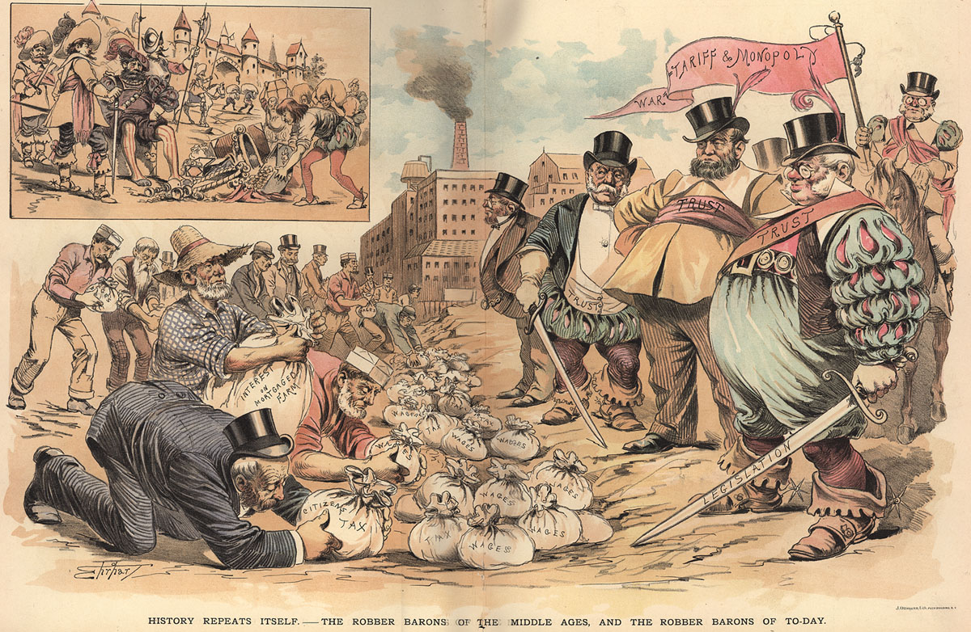

Slide 17
