Slide 1
Northern Manufacturing
Review:
The North had always been geared more towards industry
The South was more agricultural
This divide will continue after the Civil War
One of the reasons for the North winning the Civil War was it’s industrial might
American Industrial Revolution:
Before the Civil War, America was mostly agricultural
By 1920, America became an industrial powerhouse – Just 60 years later!
How?

Slide 2
FACTORS FOR INDUSTRIAL GROWTH
Natural Resources
Capital (gold, silver and banking)
US Government support
Desire: Creative inventors and industrialists
Transportation System
Labor force (immigrants)
1. What factors allowed for the American Industrial Revolution?

Slide 3
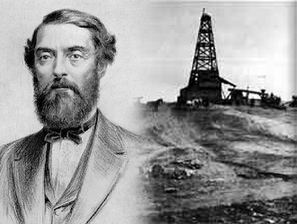
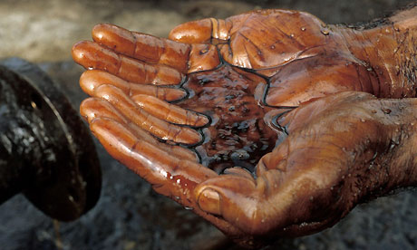
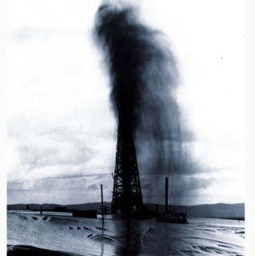
Natural Resources Fuel Industrialization
In 1859, Edwin L. Drake used a steam engine to drill for oil near Titusville, PA
Started an oil boom throughout the nation.
Entrepreneurs began to transform the oil into kerosene (lamps/heating fuel)
Gasoline will become the most important product of oil after the automobile became popular
2. Why was oil a major find?

Slide 4
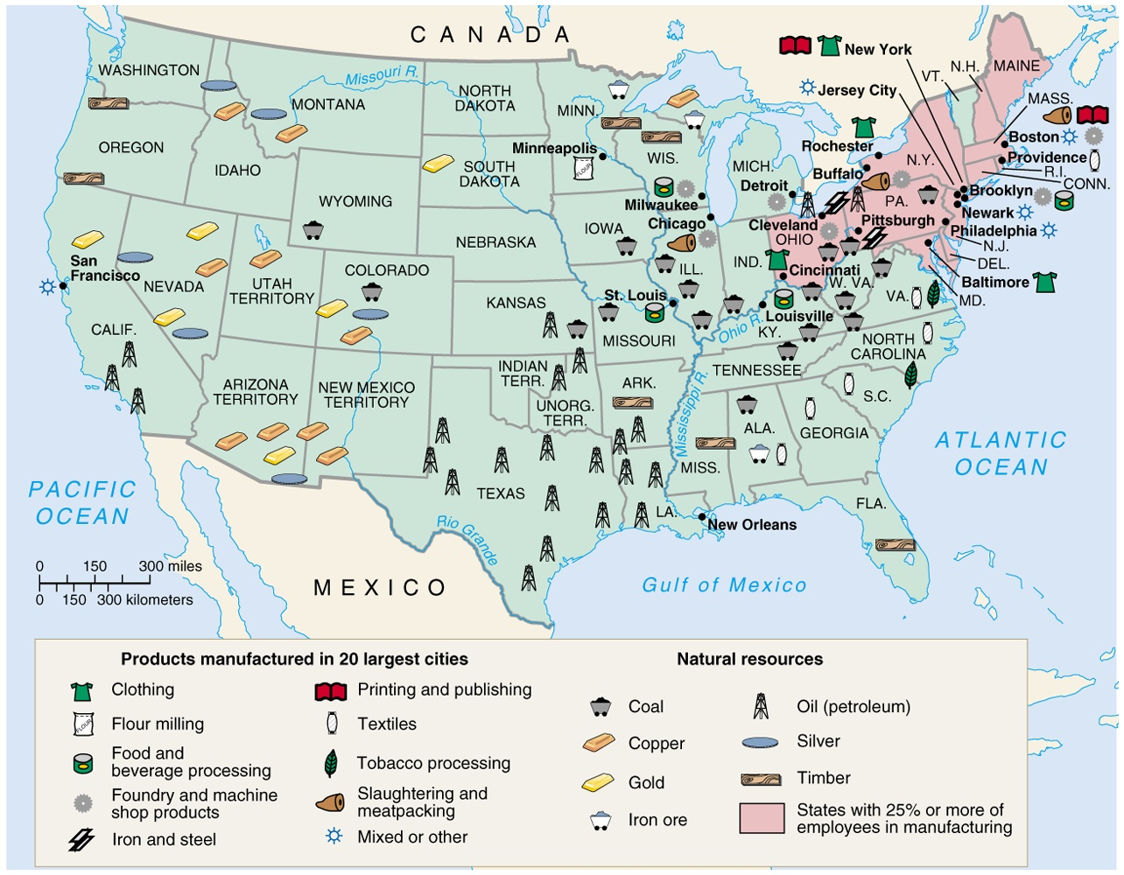

Slide 5
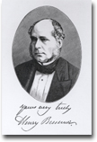
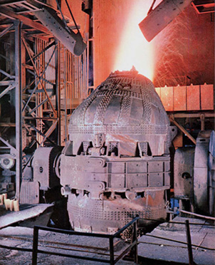
BESSEMER PROCESS
In 1856 Henry Bessemer devised a way of converting iron into steel on a large scale.
His invention involved blowing air through molten iron in a converter, or furnace, in order to burn off the excess carbon.
His invention revolutionized the Industrial Age.
New Uses for Steel
Steel used in railroads, barbed wire, farm machines
Changes construction: Brooklyn Bridge; steel-framed skyscrapers
3. How did the Bessemer Process help fuel the growth of America?

Slide 6
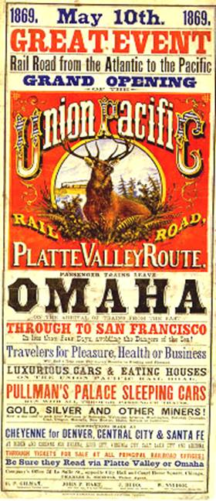
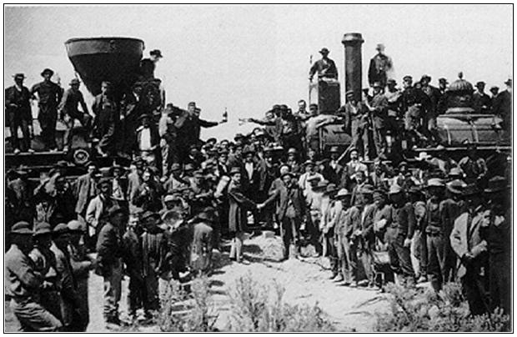
1st TRANSCONTINENTAL RAILROAD
May 10, 1869 at Promontory, Utah
“The Wedding of the Rails”
Central Pacific and Union Pacific
3. How did the Bessemer Process help fuel the growth of America?

Slide 7
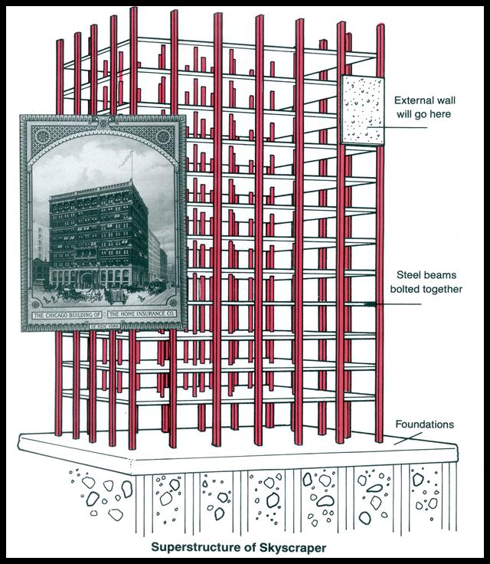
With the Bessemer Process and Carnegie steel, Skyscrapers revolutionized the building industry…..
Major city skylines would be dotted with this new type of building as the 1900’s begin.
3. How did the Bessemer Process help fuel the growth of America?

Slide 8
NEW INDUSTRIES
Oil
Mining
Sugar
Steel
Meatpacking
Beef/Cattle
Construction
Telegraph
Telephone
Railroad
Marketing
Sewing Machine
Vacuums
Typewriters
Automobile
Salt
Coal
Agricultural
4. List 5 new industries in America.

Slide 9
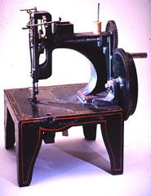
KEY INVENTIONS
BETWEEN 1860 TO 1900
Elevator---1852
Bessemer Process---1852
Sewing Machine---1853
Dynamite---1867
Typewriter---1868
Levi Blue Jeans/Basketball---1873
Telephone---1876
Phonograph---1878
Light bulb and cash register---1879
Zipper---1883
Gasoline automobile and skyscraper---1885
New York City---first city to have electricity--1890
Radio---1895
Subway---1897
X-ray---1900
Between 1800 to 1900, US Govt. issued 500,000 patents

Slide 10
Some other inventions created during Gilded Age
Cola-Cola (1886)
Streetcars (1888)
Record Player (1877)
Skyscraper (1885)
Airplane (1903)

