Slide 1
Who killed Reconstruction?
North or South?

Slide 2
Guided note questions-copy these into your notes
Why were Southerners frustrated?
Why would the KKK want to destroy to Republican party?
From what viewpoint is the above political cartoon written from? How do you know?
Why is it problematic to remove federal troops from the South?
How does the election of 1876 mark the end of Reconstruction?
(E.Q.) Was Reconstruction a failure? Who was at fault?
Each question should be at least 3 sentences and use direct information from the lesson.

Slide 3
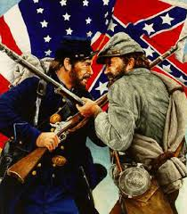
Southern Resentment
Refused to register to vote
Frustrated over the loss of political power and economic issues
Violence used to intimidate African Americans
Ku Klux Klan (KKK)
1. Why were Southerners frustrated?

Slide 4
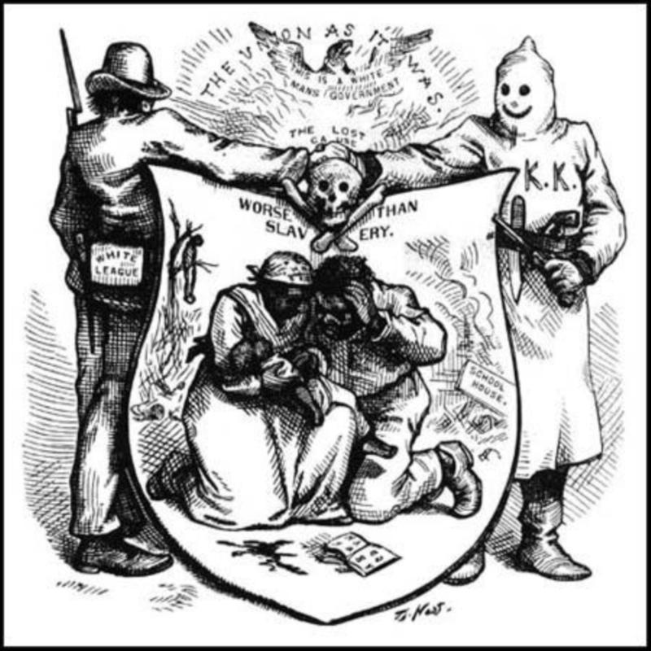
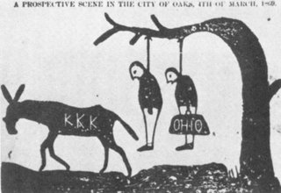
Ku Klux Klan
Goals
Destroy the Republican party
Throw out Reconstruction governments
Aid planter class
Prevent African-Americans from exercising their political rights
Actions
Killed thousands, and used other means of violence as intimidation
Refused to hire Africa-American workers
2. Why would the KKK want to destroy to Republican party?

Slide 5
Congress Reacts
Passed a series of Enforcement Acts (1870, 1871)
Provided federal supervision of southern elections
Gave the President power to use federal troops where the KKK was active

Slide 6
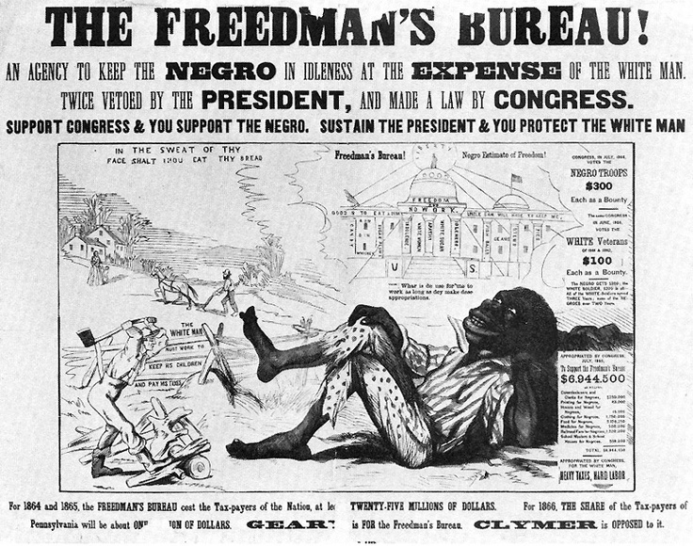
Southern Democrats rise
Amnesty Act (1872)
Returned the right to vote and hold federal/state positions to about 150,000 former Confederates
Freedmen’s Bureau allowed to expire
All paved way for Democrats to regain political power
3. From what viewpoint is the above political cartoon written from? How do you know?

Slide 7
Fading of Republicans and Reconstruction
The unity of the Republican party started to fade, which made it harder for Radicals to impose the Reconstruction plan
Further hurt by the Panic of 1873
Series of bank failures trigger a 5 year depression
Diverts northern attention away from southern problems
Supreme Court began to undo political changes made by the Radicals
Led to Republicans retreating from Reconstruction policies

Slide 8
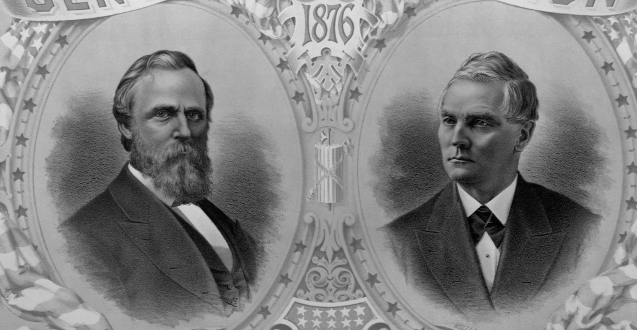
Democrat Redemption
With the Republican’s hold on the South loosening, the Democrats are able to regain the region
This couldn’t have been more evident than it was during the Presidential Election of 1876

Slide 9
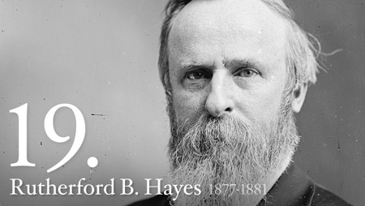
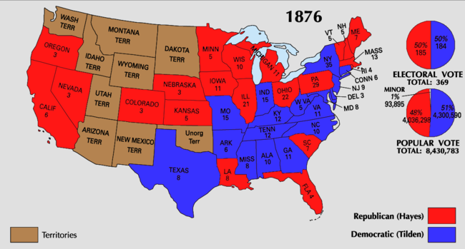
Election of 1876
Democrat Samuel J. Tilden wins popular vote, one short of the electoral college vote
Southern Democrats agree to accept Republican Rutherford B. Hayes if federal troops are withdrawn from the South
Marks the end of Reconstruction
4. Why is it problematic to remove federal troops from the South?
5. How does the election of 1876 mark the end of Reconstruction?

Slide 10
Essential Question
Was Reconstruction a failure? Who was at fault?

