Slide 1
Northern Occupation of the SOuth
Reconstruction Begins

Slide 2
Bell Ringer
Discuss with a neighbor what Lincoln’s plan for Reconstruction was.

Slide 3
Guided note questions-copy these into your notes
What is Reconstruction?
Compare and contrast the 3 plans for Reconstruction.
Describe the 3 motivations behind the Radical Republicans.
Describe the trouble the Republican party faced as a result of the opposing views of scalawags, carpetbaggers, and African-Americans.
(E.Q.) Was Reconstruction fair to the southern states?
Each question should be at least 3 sentences and use direct information from the lesson.

Slide 4
What is Reconstruction?
Goal=Rebuild the US after the Civil War
Lasted from 1865 to 1877
Also refers to the process the government used to readmit the Confederate States into the Union.
Clashing ideas of Lincoln, Johnson, and the Radical Republicans (Congress) made things difficult.
What is Reconstruction?
Notes:
A political, physical, and economical rebuild of the south.

Slide 5
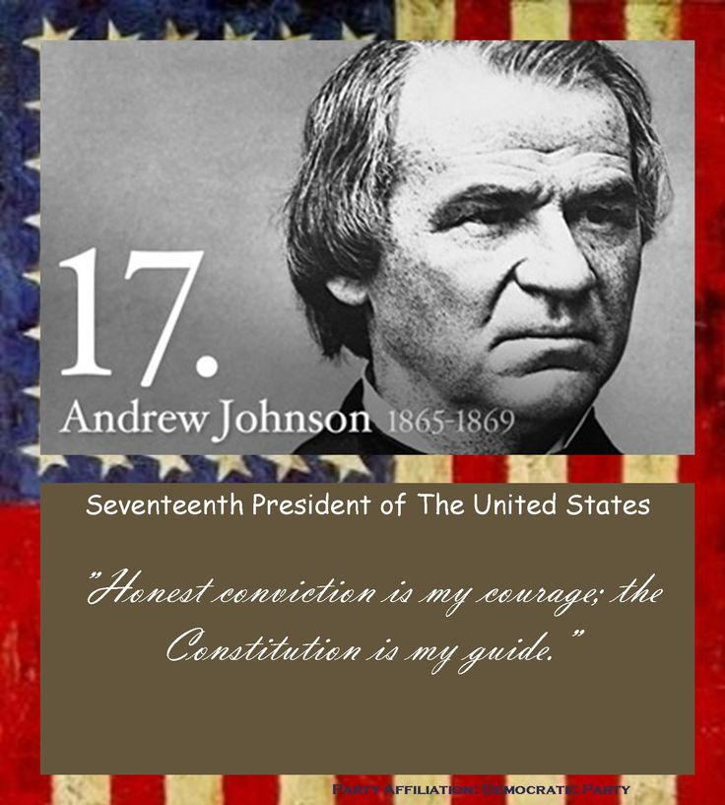
Johnson vs Radical Republicans
Johnson
Differed slightly from Lincoln’s
Pardons granted to anyone waking a loyalty oath
No pardons to high ranking Confederate officials/anyone owning property valued over $20K
State must abolish slavery before being readmitted
State must repeal its succession ordinance before being readmitted
Notes:
Johnson took over as President after Lincoln’s assassination. Wanted to break the power of the rich plantation owners. Got a lot of flack from the Radical Republicans on Congress

Slide 6
Radical Republicans
Motivated by 3 main factors
1)Revenge
2)Concern for freedmen
3)Political concerns
14th amendment
15th amendment
Impeachment of Johnson
Compare and contrast the 3 plans for Reconstruction.
Describe the 3 motivations behind the Radical Republicans.
Notes:
Revenge-a desire amoung some to punish the south for causing the war
Concern for freedmen- some believed that the federal government had a role to play in the transition of freedmen from slavery to freedom
Political concerns- Radicals wanted to keep the Republican Party in power in both the North and the South. Wanted to maintain their war time agenda (protective tariffs, pro bussiness national banking system, liberal land policies for settlers, federal aid for railroad).

Slide 7
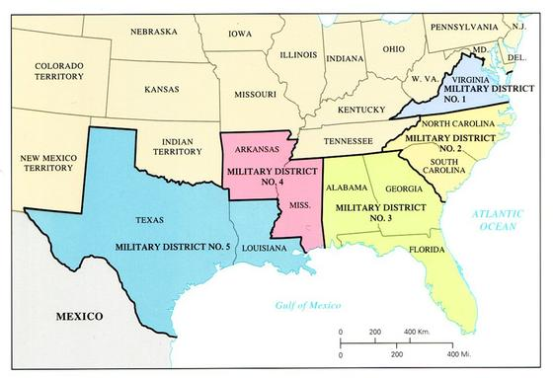
Reconstruction Act of 1867
Didn’t recognize southern state governments
Divided the Confederate states into 5 military districts
States required to grant African-Americans the right to vote
States required to ratify the 14th amendment

Slide 8
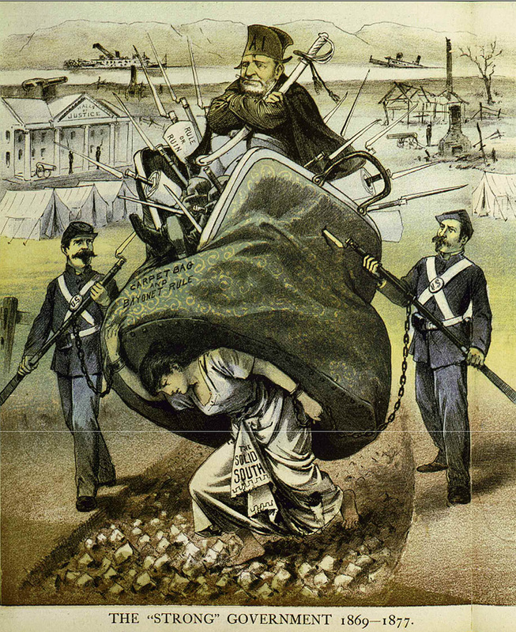
Republicans Restructure (Southern) Society
Southern voters elected new Republican dominated governments
Republican governments set out to repair physical damage of the war and provide social services

Slide 9
Political Opposition
Southern Republicans split into 3 groups
Carpet baggers
Scalawags
African-Americans
Differing goals created a lack of unity throughout the Republican party
4. Describe the trouble the Republican party faced as a result of the opposing views of scalawags, carpetbaggers, and African-Americans.
Notes:
Ex. many white southerners still didn’t accept the new status of African-Americans

Slide 10
1) African-Americans
Eager to exercise new right to vote
9/10 supported Republican party
2) Scalawags- Southerners who joined the Republican party
Mostly small farmers looking to improve their economic positions
Didn’t want wealthy plantation owners to regain power
3) Carpetbaggers- Northerners who moved south after war
Looked to profit from the southern misfortune

Slide 11
Essential Question
Was Reconstruction fair to the southern states?

