Slide 1
The Impact of Abraham Lincoln

Slide 2
Objective
Explain the events of the Civil War, Reconstruction, the African-American racism struggle, and the various inventions and big business of the late 19th and early 20th century

Slide 3
Guided Note Questions copy these into your notes
What put Lincoln on the national stage leading up to the 1860 election?
Explain the South’s reaction to the election of Abraham Lincoln.
What was Lincoln’s impact – as president – during the Civil War?
Does Abraham Lincoln deserve to be called “The Great Emancipator?” Why?
(E.Q.) How should Abraham Lincoln be remembered?
Each question should be at least 1 to 3 sentences and use direct information from the lesson

Slide 4
Kansas-Nebraska Act of 1854
Stephen A. Douglas, a Democratic Senator from Illinois, helped to pass the Kansas-Nebraska Act in 1854
this act included an idea of popular sovereignty (people rule)
popular sovereignty led to pro and anti-slavery groups to rush to states to pass laws that matched their political beliefs
this act helped to spread slavery

Slide 5
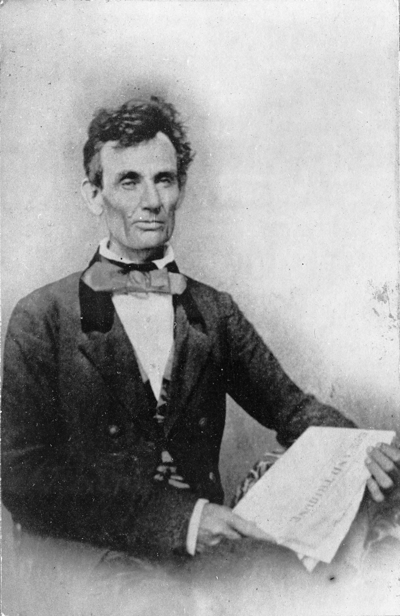
Lincoln speaks against Douglas’ Act
before 1854, Lincoln believed slavery would eventually die out
Lincoln believed the Kansas-Nebraska Act would spread, not kill, slavery
“Nearly eighty years ago we began by declaring that all men are created equal; but now from that beginning we have run down to the other declaration, that for some men to enslave others is a 'sacred right of self-government. These principles cannot stand together.”
He eventually opposed Douglas in the Illinois senatorial election of 1858

Slide 6
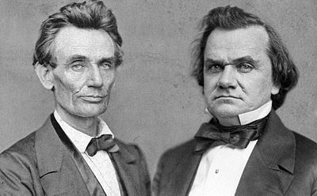
Abraham Lincoln:
1858 Senatorial Race
“So plain, that the most dumb and stupid
slave that ever toiled for a master, does
constantly know that he is wronged. So
plain that no one, high or low, ever does
mistake it, except in a plainly selfish way;
for although volume upon volume is
written to prove slavery a very good
thing, we never hear of the man who
wishes to take the good of it, by being a
slave himself.”
During the 1858 Illinois senatorial election, Lincoln ran against Stephen Douglas, a pro-slavery Northern Democrat

Slide 7
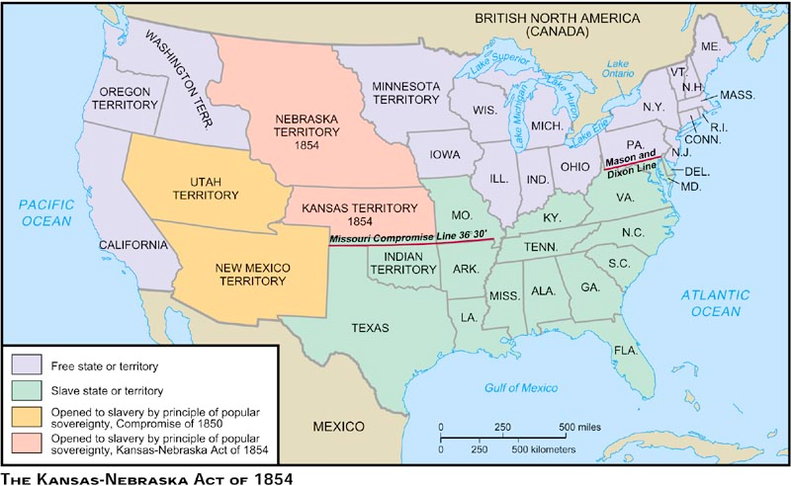
Abraham Lincoln:
Abolition in England
“I have not allowed myself to forget that
the abolition of the Slave-trade by Great
Britain, was agitated a hundred years
before it was a final success… that all
these opponents got offices, and their
adversaries got none. Remembering
these things I can not but regard it as
possible that the higher object of this
contest may not be completely attained
within the term of my life. But I can not
doubt either that it will come in due
time.”
During the 1858 Illinois senatorial election, Lincoln notes the difficulties of abolishing slavery in the United States

Slide 8
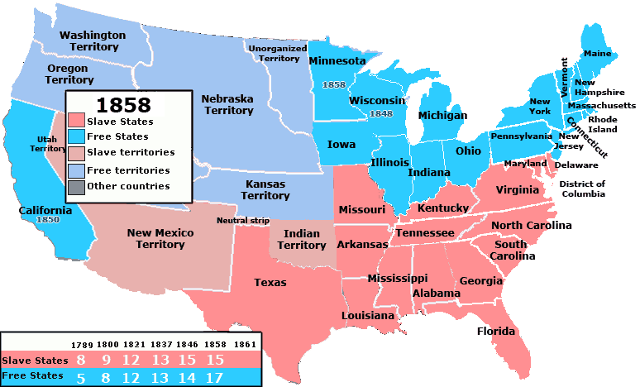

Slide 9
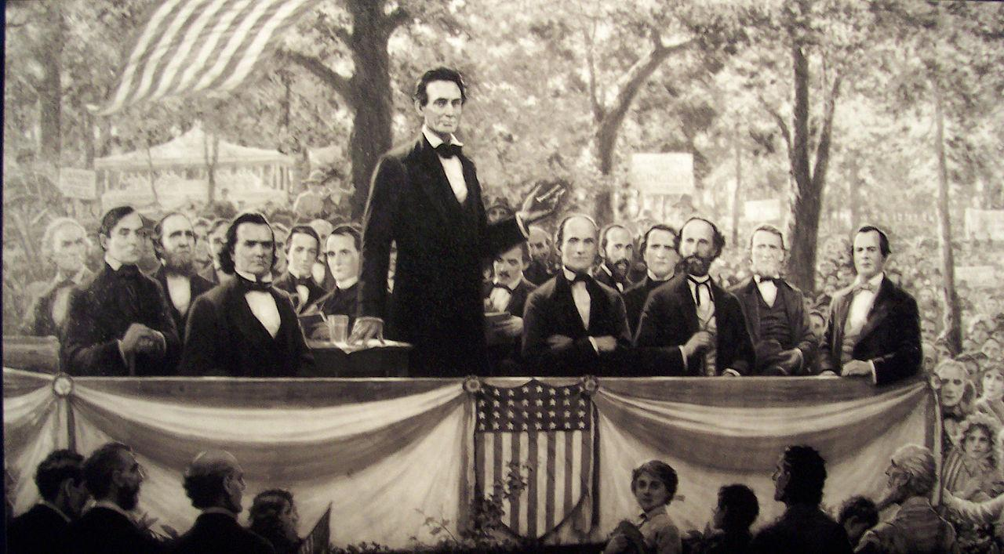
Lincoln Loses Senate Race; Gains National Attention
throughout the campaign for the
senate seat, Douglas and Lincoln
held seven debates that drew
crowds from outside the state of Illinois, including the national press
Stephen A. Douglas won the senate race despite losing the popular vote
the high media coverage of the debates propelled Lincoln to the national stage
Guided Question 1: What put Lincoln on the national stage leading up to the 1860 election?

Slide 10
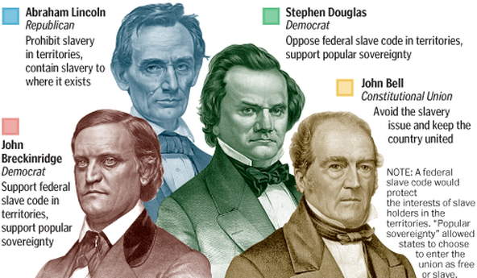
Lincoln Wins the Presidency in 1860
Lincoln was nominated by the Republican party to run for president
ran against Stephen A. Douglas
(Northern Democrat), John
Breckinridge (Southern
Democrat), and John Bell
(Constitutional Union party)
Southern Democrats argued an
election of Lincoln would lead
to the secession of states opposed to Lincoln’s anti-slavery rhetoric
Lincoln wins the election by more than 100 electoral votes

Slide 11
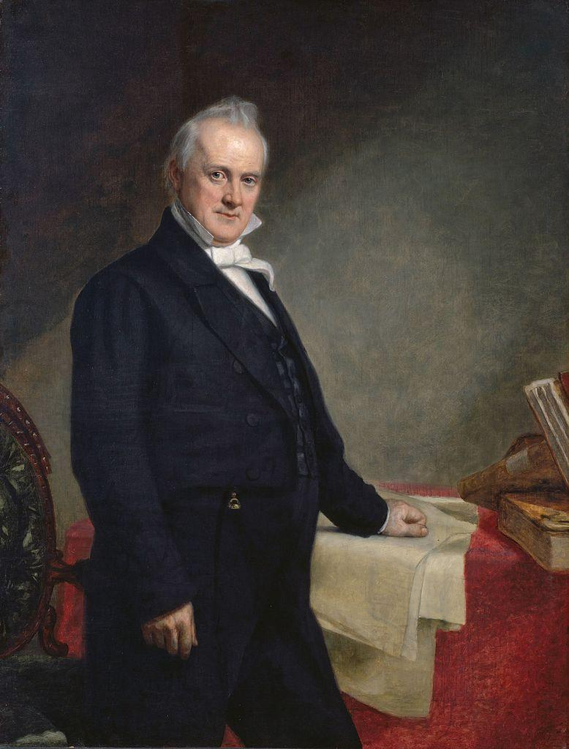
A Proposed Thirteenth Amendment to Prevent Secession, 1861
Slaveholding states of the American South, led by South Carolina, began withdrawing from the nation after Lincoln’s election
President James Buchanan, still in office until Lincoln’s inauguration, tried to reassure the South that their slave property would remain safe
Buchanan asked congress to write an amendment to the Constitution that would recognize the right of states to sanction human bondage and allow slaveholders to retain their human property

Slide 12
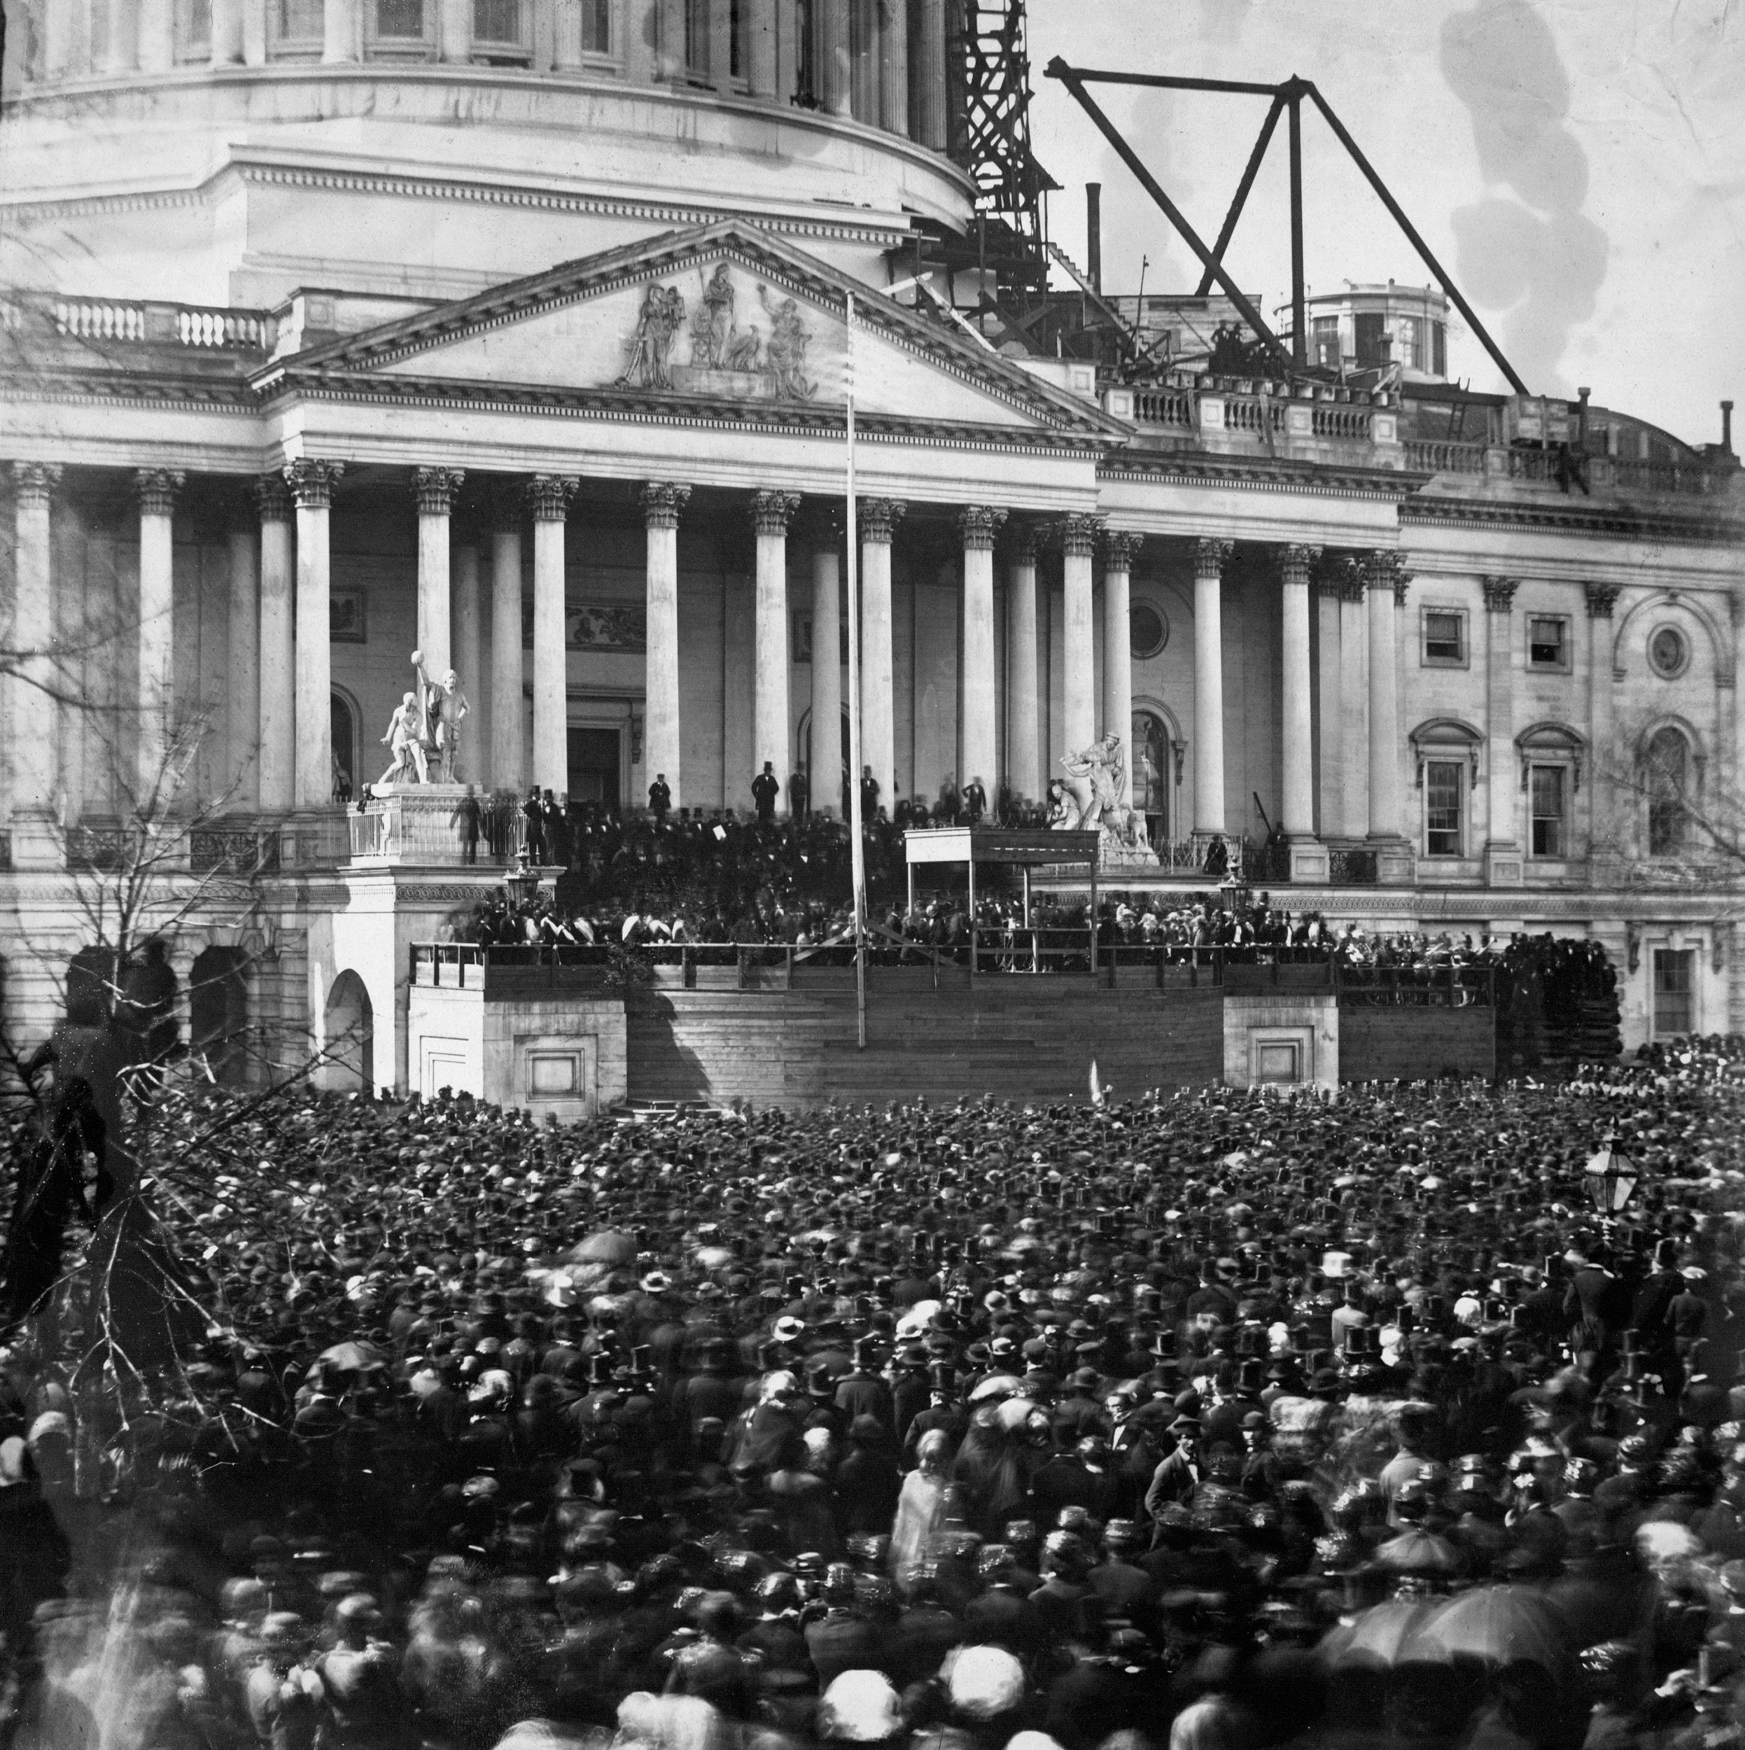
Lincoln and Southern Secession
the election of Abraham Lincoln in 1860 was the immediate cause of southern resolutions of secession
anti-slavery expansion platform
refused to acknowledge the right to secession
he would not yield federal property within Southern states
Guided Question 2: Explain the south’s reaction to the election of Abraham Lincoln

Slide 13
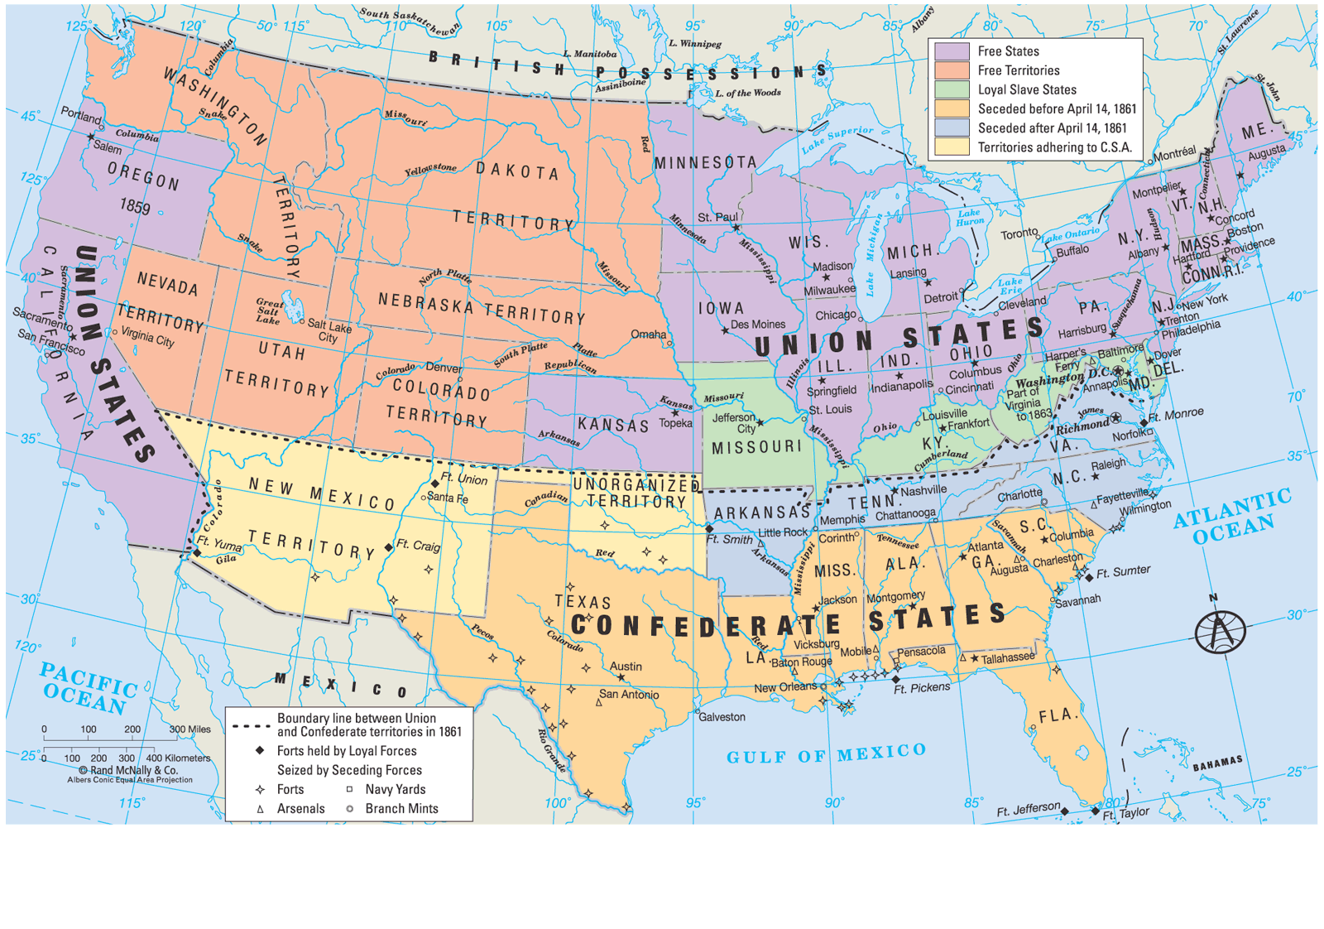

Slide 14
Lincoln’s Inaugural Address
Lincoln pledged not to interfere with
slavery in the South and pleaded with
the Confederate states to reconcile
with the North
Lincoln used the word “union” twenty-three times to reiterate the importance of remaining one nation
“In your hands, my dissatisfied
fellow countrymen, and not in
mine, is the momentous issue of
civil war. The government will not
assail you. You can have no
conflict, without being yourselves
the aggressors. You have no oath
registered in Heaven to destroy
the government, while I shall
have the most solemn one to
‘preserve, protect and defend’ it.”
- Lincoln, Inaugural address,
March 4, 1861

Slide 15
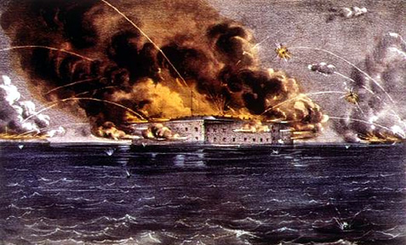
Lincoln and the Presidency
Civil War begins on April 12, 1861.
soon after, Lincoln authorized his military commanders to suspend the Writ of Habeas Corpus
Lincoln cited the following from the Constitution: "The privilege of the writ of habeas corpus shall not be suspended, unless when in cases of rebellion or invasion the public safety may require it."

Slide 16
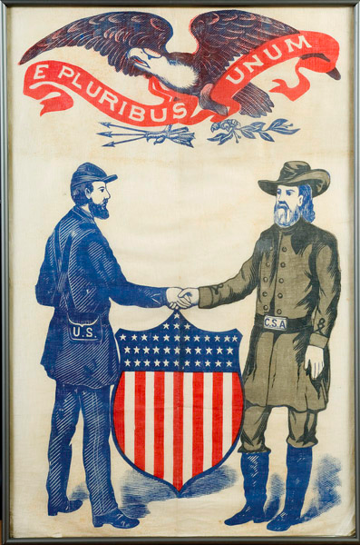
Lincoln’s Keys to Union Victory
finding the right generals who could press the North's advantages in men and resources by engaging the enemy and winning battles
positioning the American economy to meet the tremendous war needs
dealing with dissent on the home front without destroying the
democratic freedoms upon which the nation was founded.
preventing foreign recognition of the Confederacy.
dealing with the problem of slavery in a war that slavery had caused, in a nation in which most whites were antiblack.
Guided Question 3: What was Lincoln’s impact as president during the Civil War?

Slide 17
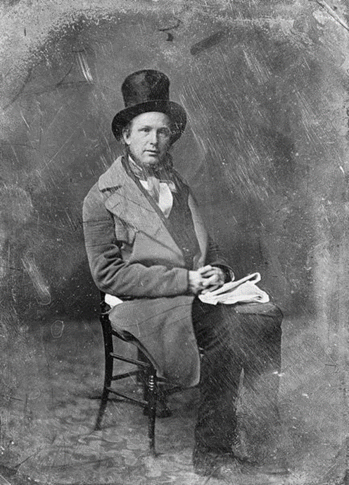
Lincoln and the “Slavery” Issue
Lincoln wrote a letter to
Horace Greeley (editor of
New York Tribune) in
response to Greeley’s
editorial about Lincoln’s
lack of direction

Slide 18
Letter to Horace Greeley
“My paramount object in this struggle is to save the Union, and
is not either to save or to destroy slavery. If I could save the
Union without freeing any slave I would do it, and if I could save
it by freeing all the slaves I would do it; and if I could save it by
freeing some and leaving others alone I would also do that.
What I do about slavery, and the colored race, I do because I
believe it helps to save the Union; and what I forbear, I forbear
because I do not believe it would help to save the Union. I shall
do less whenever I shall believe what I am doing hurts the
cause, and I shall do more whenever I shall believe doing more
will help the cause.”

Slide 19
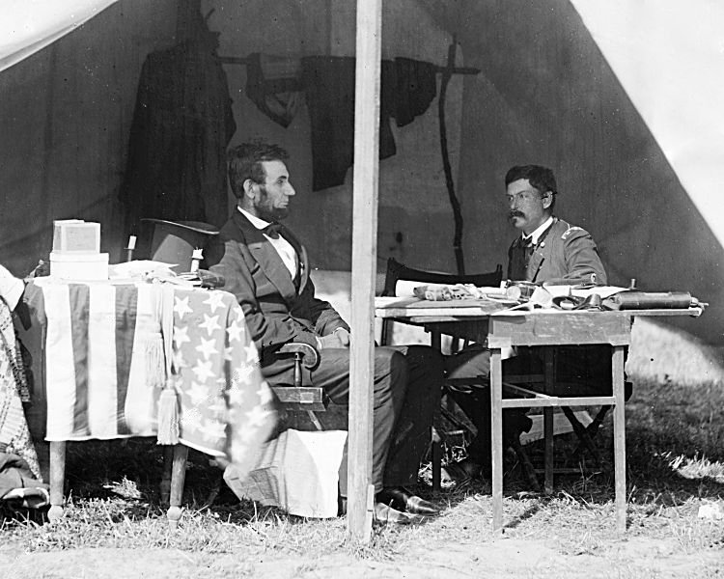
Emancipation and Political Capital
the Lincoln administration believed that slavery was the basis of the Confederate economy and that victory required its
destruction
in the summer of 1862, Lincoln had come to see that he must broaden the base of the war (outside of the US)
Lincoln believed he had to free slaves at the right time to garner more support
slavery, in Lincoln’s opinion, was his most valuable political weapon

Slide 20
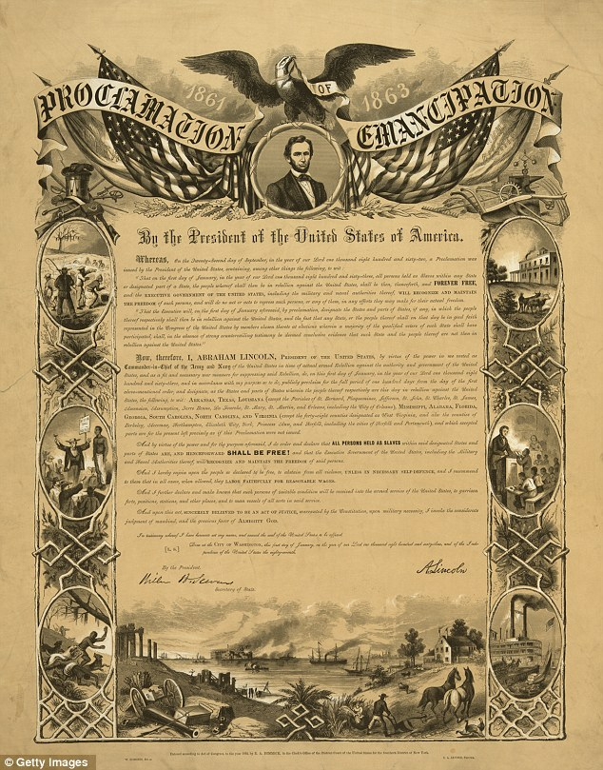
Emancipation Proclamation
it changed the federal legal status of more than 3 million enslaved people in the the South from slave to free.
it did not cover slaves in Union areas that were freed by state action (Missouri, Kentucky, West Virginia, and Maryland).
used his power to suppress rebellion to proclaim emancipation.
could not include these states because they were not under “area of rebellion.”
Guided Reading 4: Does Abraham Lincoln deserve
to be called “The Great emancipator”? Why?

Slide 21
Essential Question
How should Abraham Lincoln be remembered?
Answer should be three (3) sentences

Slide 22
Objective
Explain the events of the Civil War, Reconstruction, the African-American racism struggle, and the various inventions and big business of the late 19th and early 20th century

