Slide 1
Marginalized Groups 1492-1850
Question 1: How did relations between Native Americans and the French, British, & Spanish differ?
Question 2: What was the impact of African-Americans on the United States?
Question 3:Explain how women impacted the early history of the United States.

Slide 2
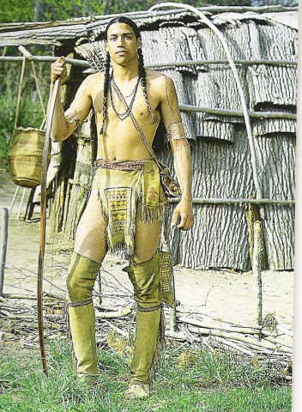
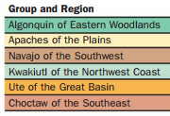
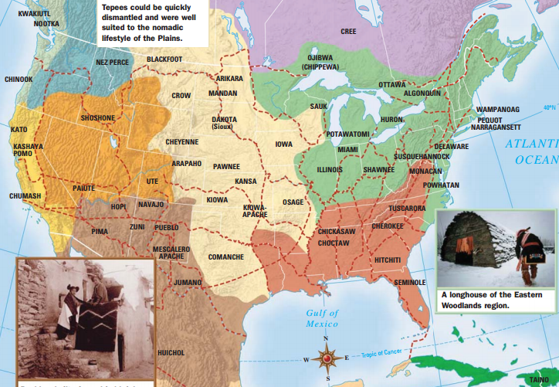
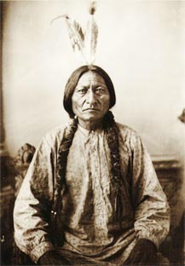
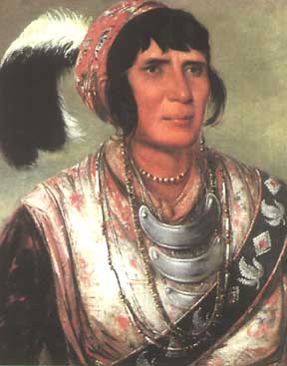
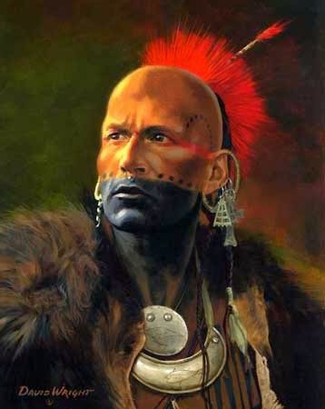
Native Americans & The United States
The original inhabitants of the “New World”
Territorial, but believed in common land usage
Shamanistic or Animistic Religious beliefs
Centered on the Family Unit: Clans/Tribes
Susceptible to European Diseases
Often allied with Europeans against one another
Sometimes ending up on the “wrong sides” of wars

Slide 3
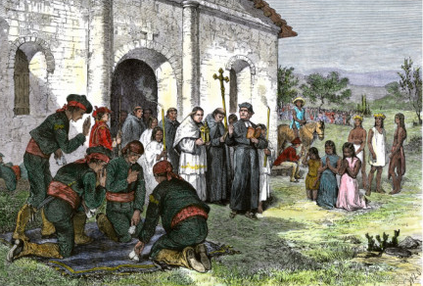
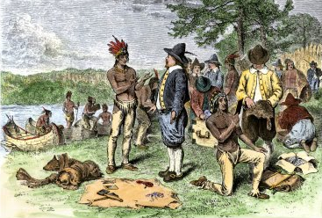
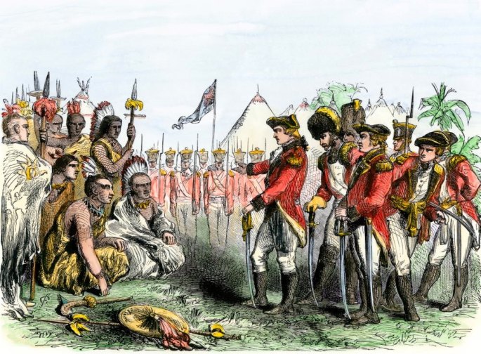
Native Americans & The United States
Native Americans & The Spanish
Of all the “colonizers” the Spanish end up making some of the most lasting changes to Native Americans
Interracial Relationships were frequent leading to a mestizo population
Large scale conversion to Catholicism (Latin America has the largest population of Catholics to this day)
Coerced Labor on Spanish Haciendas (Plantations)
Native Americans & The French
Of all the “colonizers” Native Americans had the best relationship with the French…why?
French came to trade furs, not permanently settle at first
French negotiated on equal terms with Native Americans
French fur traders intermarried with the Native Americans
Native Americans & The British
British relations with Native Americans change as the American Colonies become more and more independent.
Most settlers wanted to remove Native Americans from desirable land (a process that continues as the United States emerges)
Some conversion to Christianity takes place, but on nowhere near the level of Spanish conversion
Native Americans end up playing crucial roles in conflicts like the French & Indian War and the Revolution. (Usually by siding with the loosing side)
How did relations between Native Americans and the French, British, & Spanish differ?

Slide 4
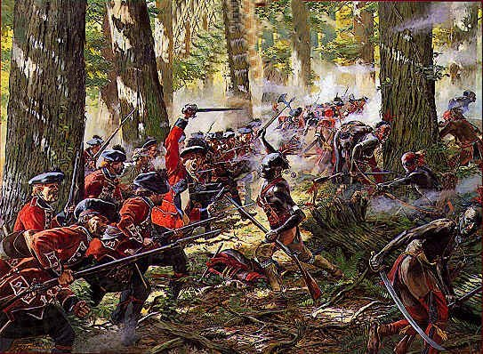
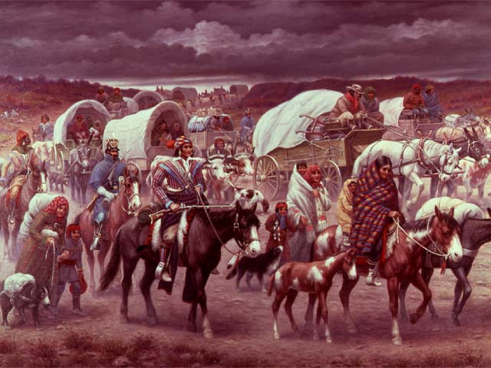
Native Americans & The United States
Colonial Interaction with Native Americans:
1637: Pequot War in New England
1676: King Phillip’s War in New England
Regional Conflicts that included Native Americans:
1754-1760: The French and Indian War
1775-1783: The American Revolution
The United States Expands Westward and Pushes Native Americans onto Reservations:
1794: Battle of Fallen Timbers
1803: Louisiana Purchase
1812: War with Britain
1830’s-1840’s: Indian Removal Act (Trail of Tears)
Manifest Destiny
French and Indian War
Trail of Tears
How did relations between Native Americans and the French, British, & Spanish differ?

Slide 5
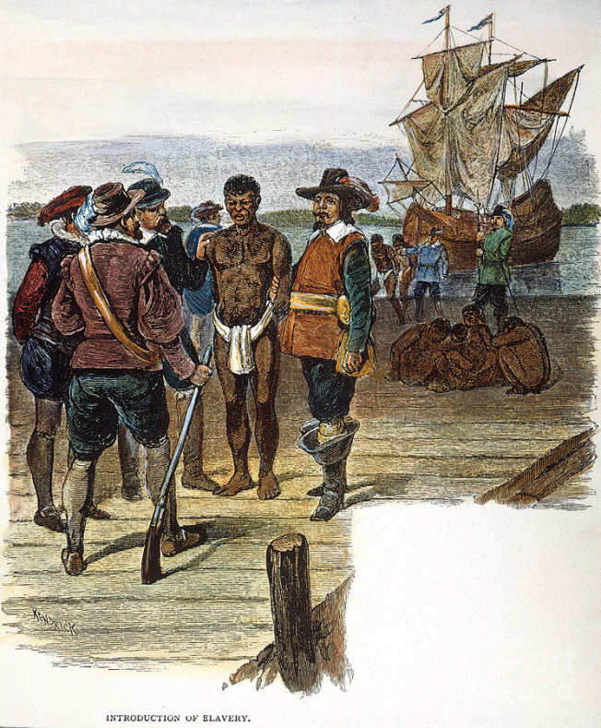
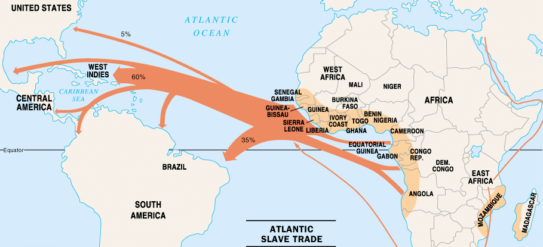
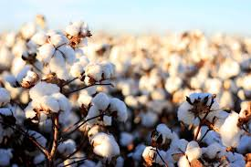
African-Americans & The United States
Africans first come to the new world in 1619 as slaves.
Estimates range from 11-12 Million people taken from Africa to the New World.
Spreads throughout the southern colonies and Caribbean along with cash crop agriculture: tobacco, sugar, and eventually cotton.
While the vast majority of African Americans during this time period were slaves, a growing free population was also present.
Many thousands were freed during the Revolution and also saw gradual abolition in Northern States.
Slave Owners sometimes freed slaves in their wills.
Slaves ran away and rebelled throughout all of American history.
Examples: Northern States, Canada, & Spanish Florida
Rebellions: Nat Turner & The Amistad
Eventually African-Americans made up one-third of the Southern population by the start of the American Civil War.
What was the impact of African-Americans on the United States?

Slide 6
Women & The United States
During the early colonial period woman made up a smaller portion of groups entering the N. American colonies.
Spanish Conquistadors were exclusively men.
Jamestown was also settled exclusively by men.
As more colonies were established in N. America families with Women and Children began to arrive.
The roles of Colonial Women were determined by their wealth, religion and status.
Early women colonists and settlers were expected to help the men in a variety of hard labor tasks in order to survive.
As time passed they took on more traditional roles and rules were established regarding their rights:
Colonial Women did not have the right to vote
Colonial Women did not have the right to hold and form of public office
Colonial Women did not have the right to serve on juries
Explain how women impacted the early history of the United States

Slide 7
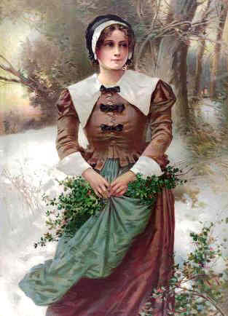
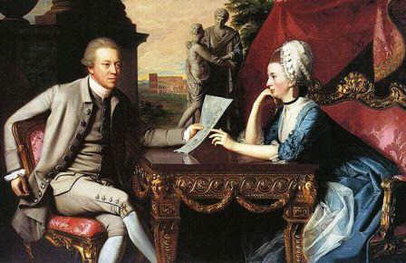
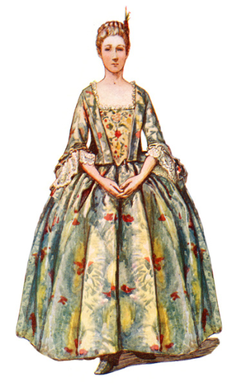
Women & The United States
Puritan Women (New England)
Women in Puritan colonies were expected to be subservient to men in every way. Adulterers could be whipped or executed.
Wealthy Colonial Women
Wealthy women enjoyed a much higher status and could expect a better lifestyle. They often received a better education (learning to read and write).
Indentured Servants
80% of English Women in Colonial society were indentured servants who were contracted to work in the colonies in order to ay for passage
Unmarried Women/Widows
Women were generally married by the time they were 20. Unmarried or widowed women had few rights, but could own a business: tavern, printer, shops.
Explain how women impacted the early history of the United States

