Slide 1
Guided Questions:
Why did the first political divisions occur in the U.S.?
Explain how George Washington felt about political parties.
Explain the differences between the Democratic-Republicans and the Federalists.
Describe what happened to the Federalist Party after the election of Jefferson.
By 1820, what was the problem within the Democratic-Republican party?
What happened to the Dem-Reps in 1824 and why?
Explain what happened to the U.S. party system after the election of 1824.

Slide 2
The Formation of the Two-Party System
Unit 1 – U.S. History

Slide 3
Necessity is the Mother of Invention
G.Q.: Why did the first political divisions occur in the U.S.?
Our First Parties
Political parties emerged largely out of practical necessity
In 1787, parties began to form as citizens debated the ratification of the U.S. Constitution
Federalists and Anti-Federalists
Federalists – Wanted a strong federal government and ratification of the Constitution
Anti-Federalists – Wanted a weaker federal government with strong state governments and wanted a Bill of Rights to protect citizens from government

Slide 4
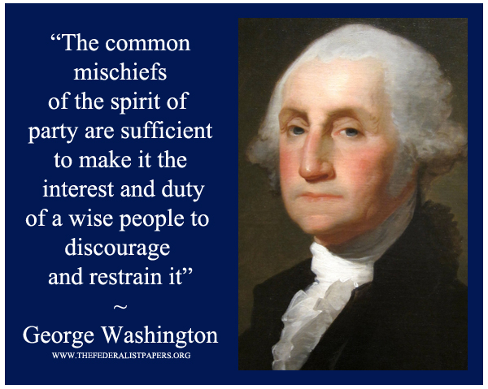
Washington’s Warning
G.Q.: Explain how George Washington felt about political parties.
Our First Parties
When the Constitution was ratified and put into place, George Washington became President
He was not a part of a party
In his farewell address, Washington warned about “the baneful effects of the spirit of party.” He went on to warn that, “a small but artful and enterprising minority" to "put in the place of the delegated will of the Nation, the will of a party” would be bad for all Americans
The idea that allegiance to a party would take precedence over allegiance to the nation as a whole.
After Washington left office, his V.P. (John Adams) became President and became a member of the Federalist Party.

Slide 5
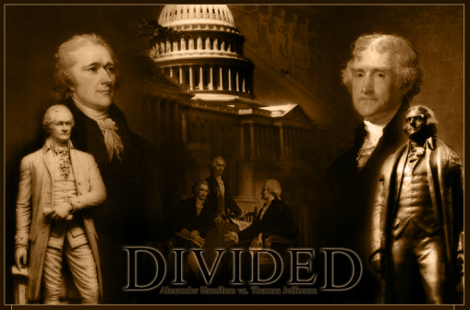
Let’s have a Party!
G.Q.: Explain the differences between the Democratic-Republicans and the Federalists.
The first two official political parties:
Federalists – John Adams & Alexander Hamilton
Promoted a strong central government
Supported by Northern businessmen, bankers, and merchants
Rule by wealthy, educated elites
Develop businesses in manufacturing and trade
Foreign policy aligned with Britain
Democratic-Republicans – Thomas Jefferson & James Madison
Thought the federal government had too much power
Supported by planters, small farmers, and artisans
Rule by the common man
Invest in agriculture
Foreign Policy aligned with Revolutionary France

Slide 6
Are you a Federalist or Dem-Republican?
Congress wants to build a canal to make it easier and more efficient to travel on rivers. This will benefit merchants who ship their products on rivers. In order to build the canals, they have to increase taxes for everyone. How would you vote?
Yes
No
If you said YES you are a Federalist
Federalists wanted to spend taxes on building roads, canals and banks that would benefit the manufacturing business.
If you said NO you are a Dem-Republican
Dem-Republicans thought the federal government spending should be limited.

Slide 7
Are you a Federalist or Dem-Republican?
A violent outbreak occurs because farmers don’t want to pay the increased tax for the canal you approved. Should you use the state militia to put down the rebellion?
Yes
No
If you said YES you are a Federalist
Federalists thought the federal government should be responsible for administering order.
If you said NO you are a Dem-Republican
Dem-Republicans thought a state militia infringed on their individual liberties.

Slide 8
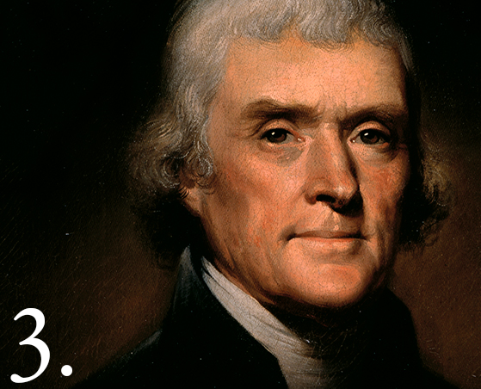
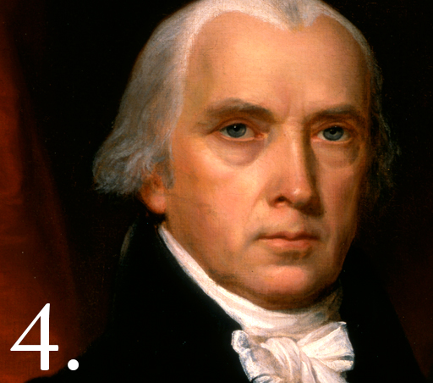
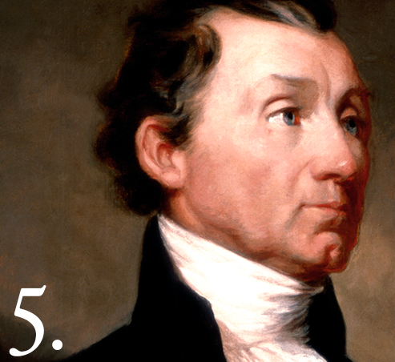
Jeffersonian Democracy
G.Q.: Describe what happened to the Federalist Party after the election of Jefferson.
In 1800, Adams (Federalist) lost the Presidency to Jefferson (Democratic-Republican)
The Federalist party lost national power and never regained it
Jefferson replaced almost all Federalists in the national government
Jefferson’s Inaugural Address:
“But every difference of opinion is not a difference of principle. We have called by different names brethren of the same principle. We are all Republicans, we are all Federalists.”
After Jefferson - James Madison (1809-1817) & James Monroe (1817-1825) became President
“Era of Good Feelings” – No political opposition to Democratic-Republicans

Slide 9
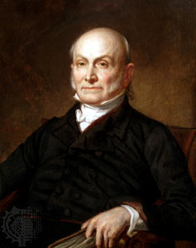
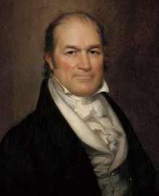
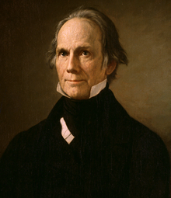
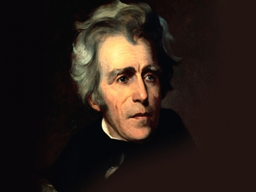
Problems Ahead
G.Q.: By 1820, what was the problem within the Democratic-Republican party?
By 1820, American political life was being influenced by sharp differences of opinion between sections of the country.
Slave-holding planters of the South
Frontier farmers of the West
Manufacturing and banking industries based in the North
Each wanted the government to follow a different course of action
This split was felt in 1824 when 4 Dem-Reps ran for President:
John Quincy Adams, Secretary of State
William Crawford, Secretary of the Treasury
Henry Clay, Speaker of the House
Andrew Jackson, military hero (Battle of New Orleans)

Slide 10
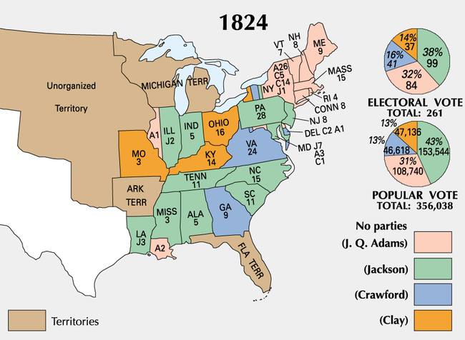
The Split
G.Q.: What happened to the Dem-Reps in 1824 and why?
The election of 1824 created a violent split in the Democratic-Republican Party.
Supporters of Adams (National Republicans)
Supporters of Jackson (Democratic Republicans)
It was a nasty campaign and in the end no candidate got a majority of the Electoral College vote
Adams and Jackson were the front-runners and the election had to be decided by the House of Representatives
Henry Clay was Speaker of the House
“Corrupt Bargain” – Clay hated Jackson, formed alliance with Adams and in the end, Clay was appointed Secretary of State
Jackson was furious!

Slide 11
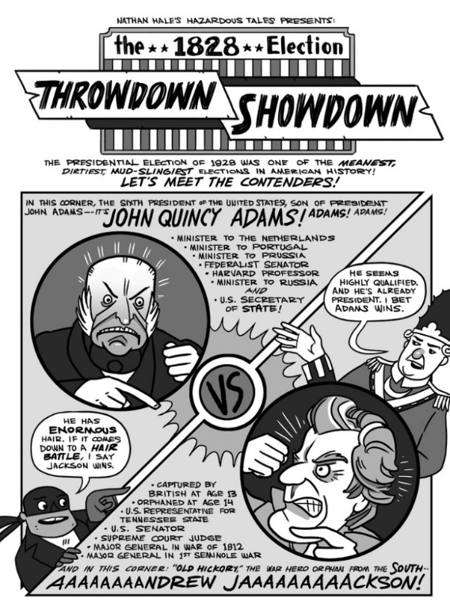
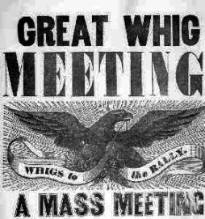
Democrats & Whigs Emerge
G.Q.: Explain what happened to the U.S. party system after the election of 1824.
Between 1824 and the election of 1828, Jackson campaigned and mobilized voters. He defeated “King Caucus” (elite rule) with a populist “revolution.”
Formed the Democratic Party
Stressed ties to the common people
Great support in the South and West
Defeated JQ Adams in 1828
People who had once been Federalists joined with anti-Jackson Democrats to form the Whig Party
Between 1836 and 1852, Whigs gave Democrats strong opposition
Northerners, city dwellers, entrepreneurs

