Slide 1
Guided note questions-copy these into your notes
Was the Mexican Government justified in being concerned with the Texan settlers wanting more freedoms? Why or Why not?
How would the idea of Manifest Destiny inspire President Polk and America into going to war with Mexico?
3. How does the country change shape (both geographically and politically) during the movement West in the 1950’s?
(E.Q.) How have the ideals of Manifest Destiny impacted the trajectory of American History post 1820?
Each question should be at least 3 sentences and use direct information from the lesson.
Notes:
Have this on the board for when students enter. They should know to copy these down in their notes in preparation for today’s lesson.

Slide 2
Manifest Destiny
America Moves West

Slide 3
Manifest destiny
Definition: the 19th-century doctrine or belief that the expansion of the US throughout the American continents was both justified and inevitable.
What does that mean?
Discuss with partner/group for 30 seconds and write your answer in your notes.
Notes:
*Have student read aloud the dictionary definition to the class.
*Prompt students to discuss what they believe Manifest Destiny means.
*Bring class together for a quick discussion (3 volunteers to share out-1:30 Tops)

Slide 4
What does manifest destiny mean?
*IT BECOMES THE JUSTIFICATION FOR AMERICAN EXPANSION WEST BASED ON THE BELIEF THAT AMERICA WAS DESTINED TO GROW AND TAKE WHAT IS THEIRS
Notes:
*Read the explanation aloud
*Ask students to hypothesize who these people are and why it ties into the lesson
-Westward pioneers and explorers taking advantage of the ideals of Manifest Destiny by pushing West through the Rockies.

Slide 5
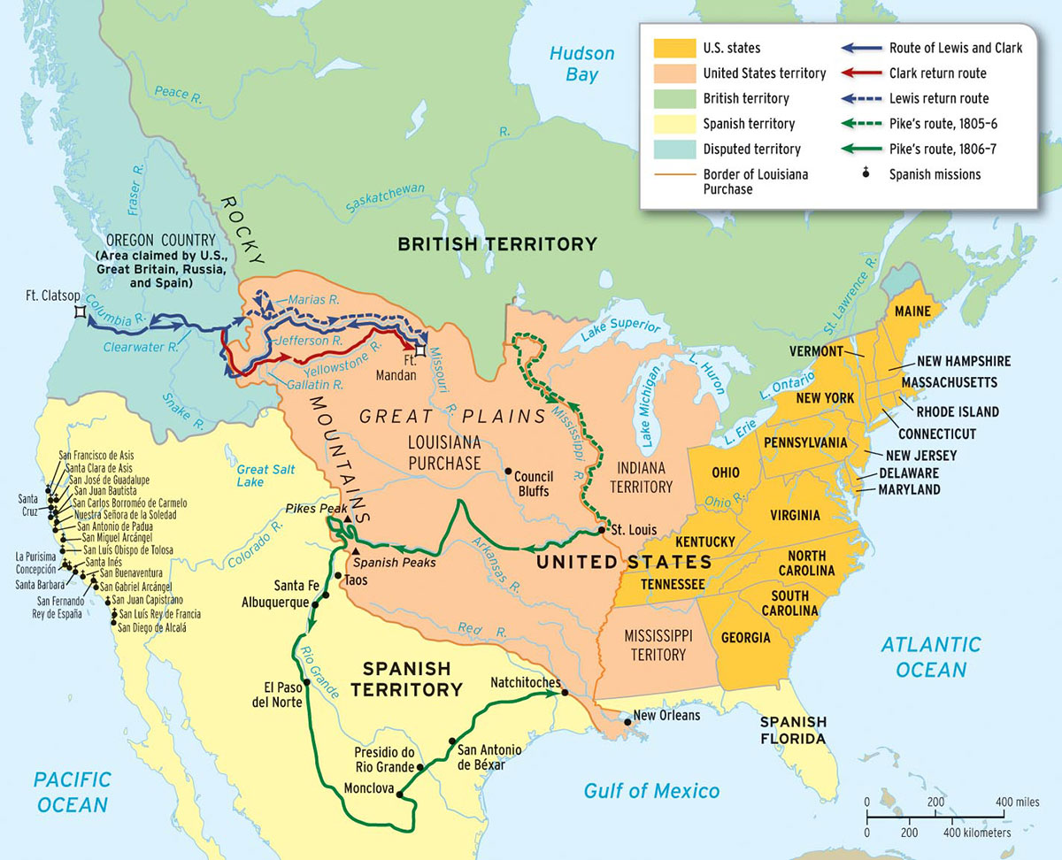
North America 1820
Notes:
*Pause breifly here. Set up the idea that this is what America looks like in 1820. Outline or point out that America does not stretch to California yet, but end at the Rockies.

Slide 6
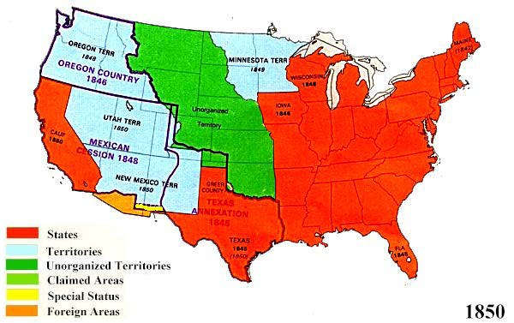
America 1850
Notes:
*Show them the progression of America only 30 years later. Ask them what ideal might have helped prompt this dramatic change?
-Manifest Destiny
Today’s lesson is all about the events spurred on by Manifest Destiny that allows America to grow by 30% in 30 years.

Slide 7
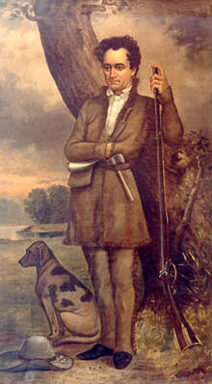
Westward expansion
*Westward expansion begins in 1821 with Stephen Austin traveling with settlers to the Northern Mexican Territory of Tejas per the invitation of the Mexican government.
*These settlers were primarily farmers and quickly spread across the rolling plains of current day Texas.
*The Texan settlers did not want to be part of the country of Mexico but rather have more self governance. This would lead to the Texan uprising against the Mexican Government.
*Stephan Austin would find himself thrown into a Mexican jail for “rebellious ideas”
Was the Mexican Government justified in being concerned with the Texan settlers
Wanting more freedoms? Why or Why not?
Notes:
*Drive home that the Texan settlers were AMERICANS and that they were moving into a territory held by another country. While the Mexican government invited settlers in, the American Texans poured in at a faster pace than was expected starting the friction between the two groups.
*Where do we Stephan Austin’s impact now? (Austin, TX)
*Give students time to think and reflect on the question. Allow for students to share their responses if they choose to.

Slide 8
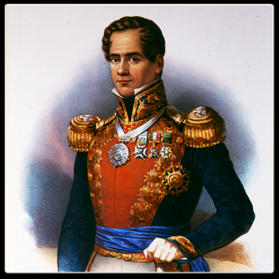
War for Texas independence
*The Texas Revolution actually begins with the imprisonment by Mexican President Santa Anna of Stephen Austin for his proposal of more self governing in the Texas Territory.
*The war following only last about 6 months (1835-1836) and would be a huge factor in American expansion West. If the Texans won, America would be free to annex the territory and continue pushing other powers out of N.A.
*After a call to arms for Texans from Austin, Santa Anna and the Mexican forces descended upon San Antonio
President Antonio López de Santa Anna
Notes:
*Santa Anna believed that the Texans were slowly taking land for the United States and were being treasonous. The Texan settlers were NOT the only people living in Texas. This, plus the fragile state of the Mexican government, prompted Santa Anna’s quick response.
*Santa Anna did not see this as a war with Texas, but as a war with whom?
-United States

Slide 9
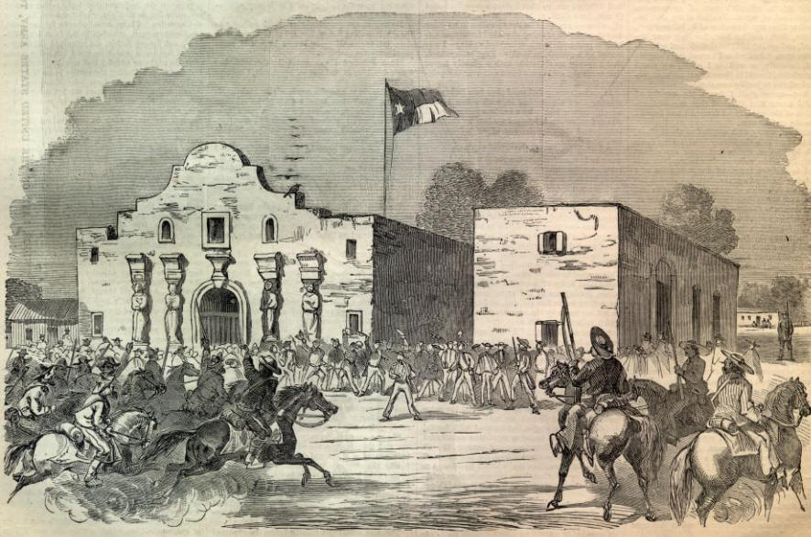
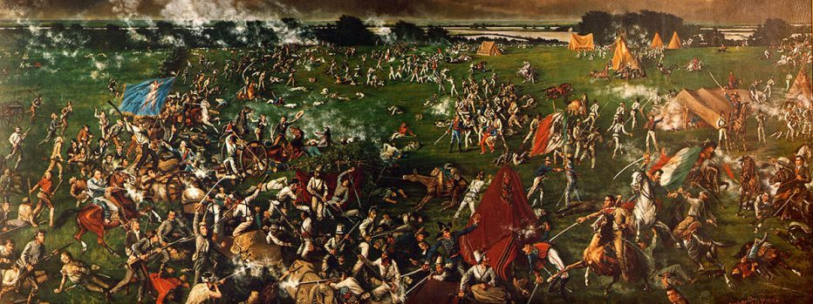
Remember the alamo!!
*The second battle of the Revolution would end up being the most infamous, where 187 Texan troops would hold out from a 14 day siege by the Mexican army
*On the 14th day the Mexican Army would scale the walls and kill all 187 Texan troops stationed inside.
*From this defeat, and the mass executions at Golidad, Commander in chief Sam Houston would lead the Texan rebels at the Battle of San Jancito where the Texans would Capture Santa Anna and force him to sign the Treaty of Valasco giving Texas their independence.
Notes:
*Famous Westward explorers like Davey Crockett and Jim Bowie died at the battle of the Alamo. Both Explorers were famous in the United States as forging trails through the Appalachian Mountains and exploring West. Their deaths shook the country hard and American’s strongly backed the Texan cause.

Slide 10
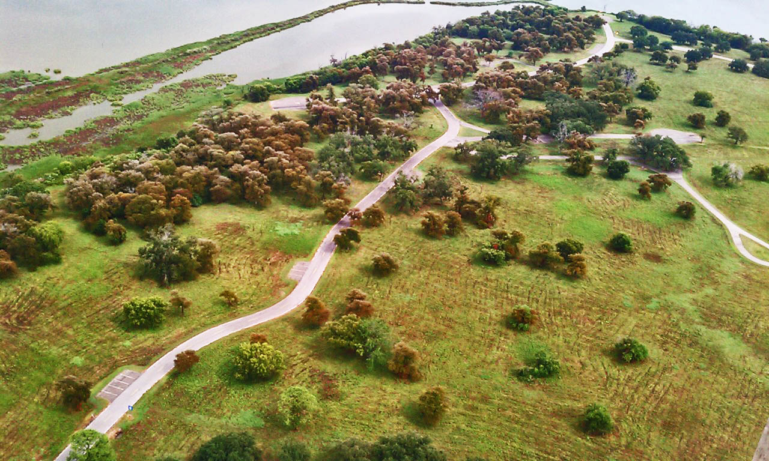
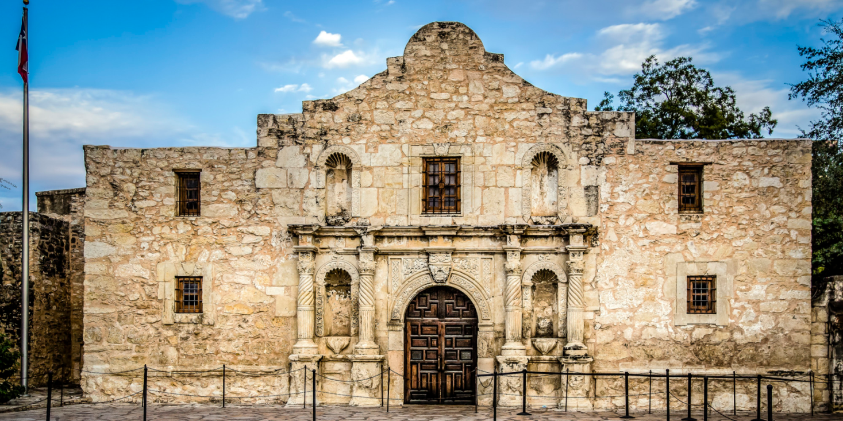
Notes:
Bottom Left: The Alamo as it stands today
Top Right: Place where Battle of San Jancito took place.

Slide 11
Mexican-American war
*After their freedom, Texas began negotiations with the United States on annexation. This would anger Mexico and act as the spark for the Mexican-American War.
*Driven by the ideals of Manifest Destiny, President Polk believed that war with Mexico would not only secure Texas but also help gain the Mexican territory of California
*America provoked war by sending troops into California and beyond the Nueces River (A more Northern River to the Rio Grande that served as the first border between Texas and Mexico)
*Due to Mexico’s continued political turmoil and weakened military state, the United States won very quickly and suffered very few losses during the war.
*The Mexican-American War would be ended by the signing of the Treaty of Guadalupe Hidalgo. Mexico would cede not only Texas, but New Mexico and California as well while the United States would pay a total of $25 mil for land taken.
2. How would the idea of Manifest Destiny inspire President Polk and America into going
to war with Mexico?
Notes:
*Prompt the students to think about why the annexation of Texas would make the Mexican Government upset.
-The Mexican Government really didn’t believe that Texas was free after the Texas Revolution, instead they believed once they had reestablished their government that they would bring Texas (Tejas) back into the fold.

Slide 12
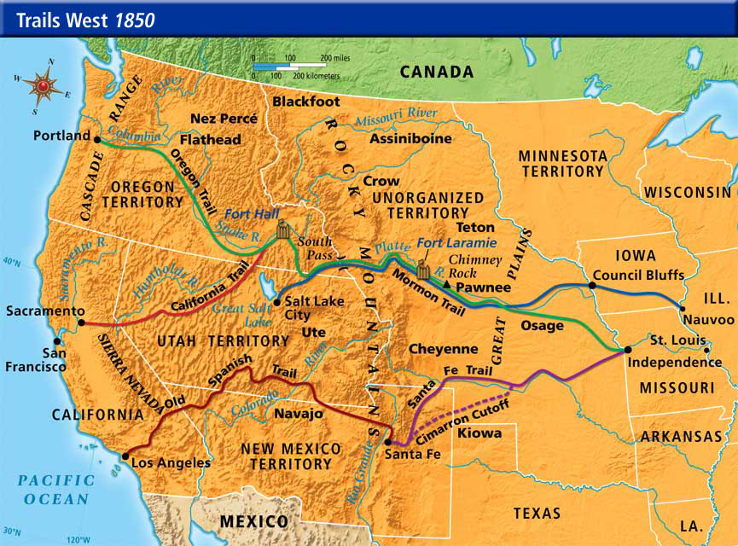
Trails west/California gold rush
*Much like early colonization, moving West took place for different reasons for different settlers.
-Farming, religion, gold, expansion of slavery
*Many trails became popularized by this rapid expansion westward going through different regions of the West.
*One of the largest reasons for moving West after 1849 was the discovery of gold in California.
*People rushed to California in large numbers to try and strike it rich by finding gold. They became known as “Forty-Niners”
*California’s economy and urban growth would be centered around the Gold Rush and cities like San Francisco would explode overnight because of it
3. How does the country change shape
(both geographically and politically)
during the movement West in the
1950’s?

Slide 13
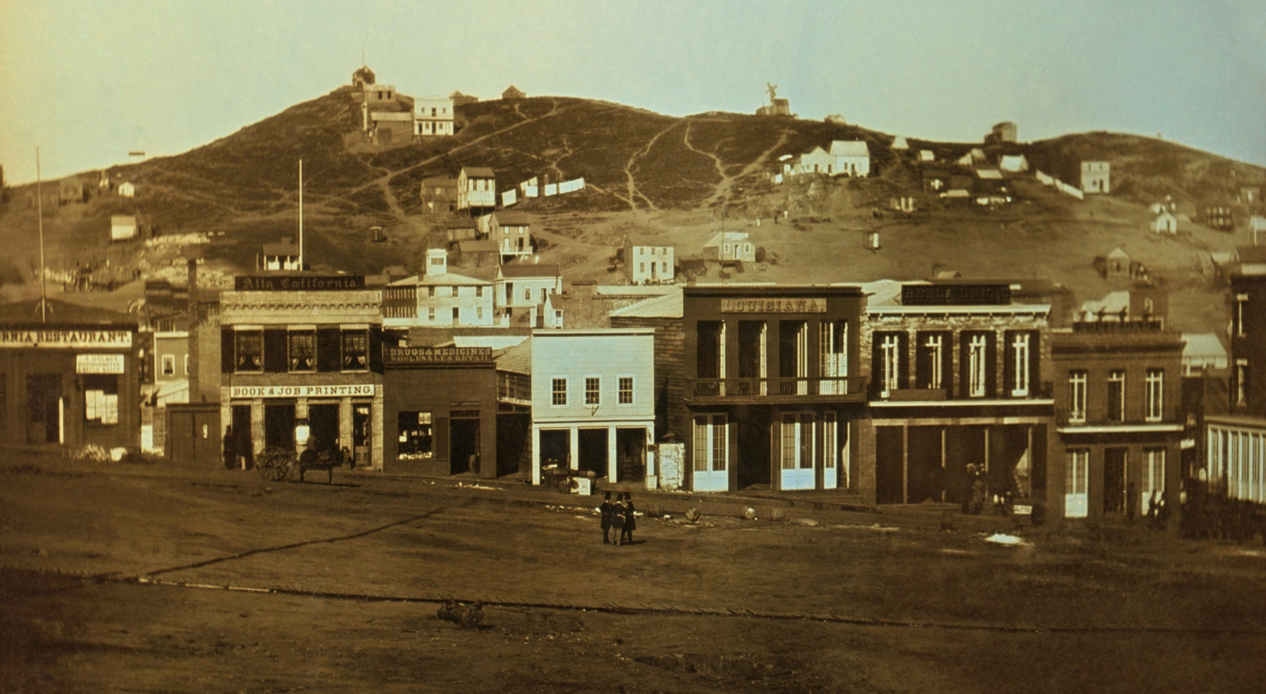
Portsmouth Square, San Francisco 1851
Notes:
*Have students reflect how this picture looks different as compared to the San Francisco of today

Slide 14
Essential question
*How has the ideals of Manifest Destiny impacted the trajectory of American History post 1820? (You may use any examples you can think of)
*Remember to use at least three sentences in your reflection along with specifics from the lesson to earn full points.

