Slide 1
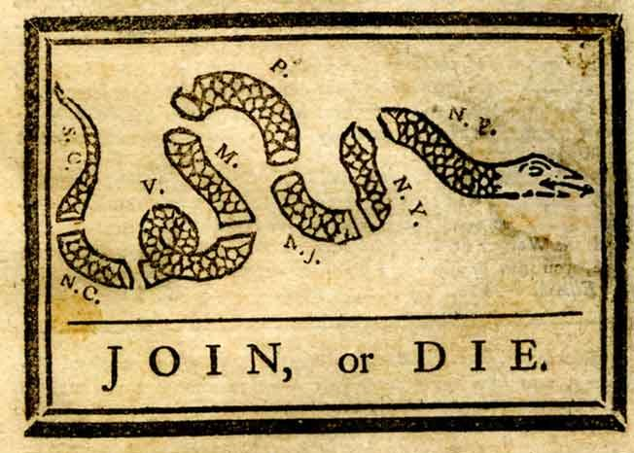
Causes Of the Revolution
What led to the Declaration of Independence?

Slide 2
Guided note questions-copy these into your notes
How is the build up to the Revolution like gun powder slowly being piled up near an open flame?
Describe the lasting impact the French and Indian War had on the colonies.
Are each of the reactions the colonists had to the British actions justifiable? Explain why or why not?
Explain why it is important for the Declaration of Independence to be voted on unanimously by the delegates.
(E.Q.) Do you think that the British acted wisely in their dealings with the colonies? Support your answer.
Each question should be at least 3 sentences and use direct information from the lesson.

Slide 3
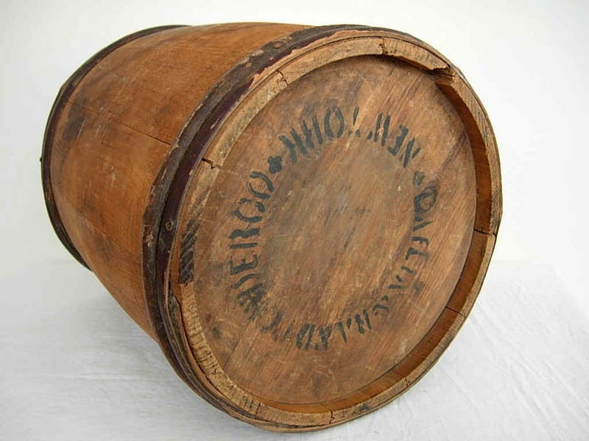
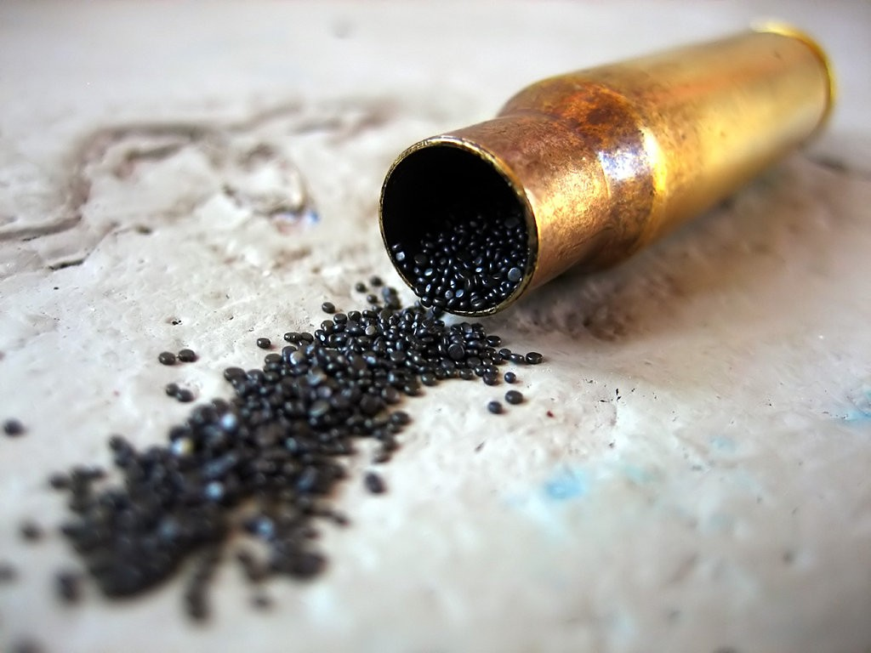
How is the build up to the Revolution like gun powder slowly being piled up near an open flame?
Notes:
Gun powder/Powder keg analogy. The build up to the revolution is like a pile of gunpowder near an open flame. As more and more gunpowder is added to the pile it gets closer to the flame until one spark finally sets it all off. Each event leading up to the DoI creates more and more distaste for the British until the colonist have finally had enough.

Slide 4
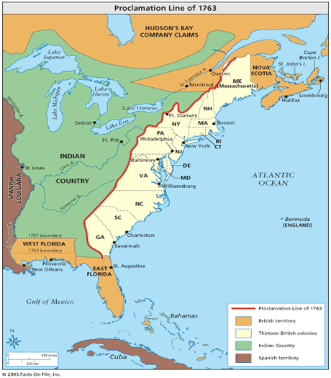
Fallout of the French and Indian War
Colonial needs ignored
Colonists couldn’t expand West due to the Proclamation of 1763
British War debt
Britain enacted many new laws to solve their financial crisis, the burden fell on the colonies
Describe the lasting impact the French and Indian War had on the colonies.
Notes:
Colonists thought winning the War would be very beneficial to them. They wanted to expand westward (new land, resources, opportunities), but were unable to because of the Proclamation Line. Colonists weren’t allowed to settle west of the Appalachians.
The British targeting the colonies to solve to issue of the war debt alleviates the financial stress on mainland Britain.
Solutions to the British debt-Sugar Act, Stamp Act, Townshend Acts, ect

Slide 5
Stamp Act (1763)
Britain’s Action | Colonists’ Reaction
Britain passes the Stamp Act. Colonists are now required to purchase special stamps to prove payment of tax. | Colonists harass stamp distributers, boycott British goods, and prepare a Declaration of Rights and Grievances.
3. Are each of the reactions the colonists had to the British actions justifiable? Explain why or why not?

Slide 6
Townshend Acts (1767)
Britain’s Action | Colonists’ Reaction
Certain colonial imports begin to be taxed, and troops are stationed at major colonial ports to protect British custom officers. | Protests are held throughout the colonies behind the rallying point of “no taxation without representation”, and the colonists organize a new boycott of imported goods.
3. Are each of the reactions the colonists had to the British actions justifiable? Explain why or why not?

Slide 7
Boston Massacre (1770)
Britain’s Action | Colonists’ Reaction
British troops fire into crowd after being taunted by an angry mob of colonists. Five colonists are killed. | The public labels the conflict as a massacre, and is depicted throughout the colonies dramatically as a act of violence.
3. Are each of the reactions the colonists had to the British actions justifiable? Explain why or why not?

Slide 8
Tea Act (1773)
Britain’s Action | Colonists’ Reaction
Colonial tea merchants are shut out when the British give the East India Company special concessions in the colonial tea business. | Colonist in Boston rebel and dump thousands of pounds of tea into the Boston Harbor.
3. Are each of the reactions the colonists had to the British actions justifiable? Explain why or why not?

Slide 9
Intolerable Acts (1774)
Britain’s Action | Colonists’ Reaction
King George III tightens control over the Massachusetts Colony by closing the Boston Harbor and quartering troops. | The first Continental Congress is formed between colonial leaders, and a declaration of colonial rights is drawn up.
3. Are each of the reactions the colonists had to the British actions justifiable? Explain why or why not?

Slide 10
Lexington and Concord (1775)
Britain’s Action | Colonists’ Reaction
Hearing of a stock pile of colonial weapons, British troops are ordered to march to Lexington, Massachusetts. | Minutemen intercept the British, and both sides engage in battle.
3. Are each of the reactions the colonists had to the British actions justifiable? Explain why or why not?

Slide 11
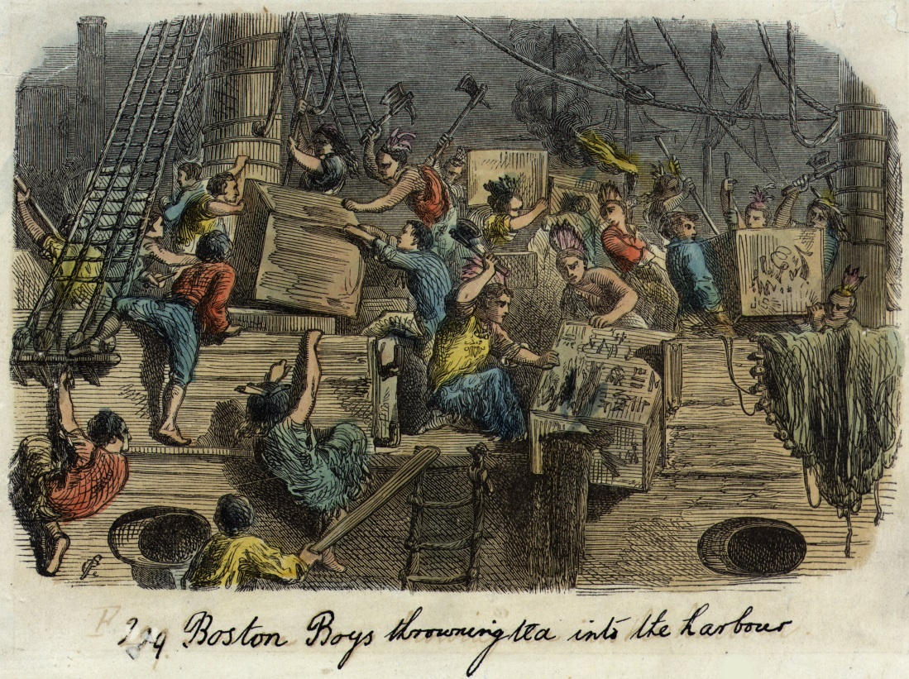
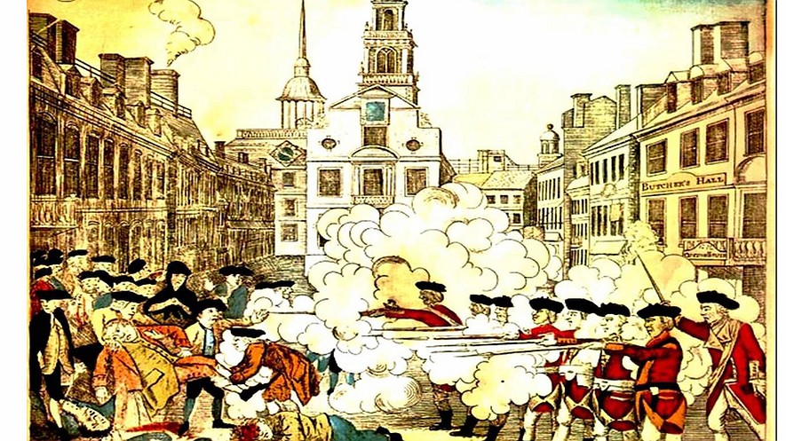
Notes:
Top Right: What event is this depicting? How do you know? What do you notice about how the people are dressed? Why would this be the case?
Bottom Left: What event is this depicting? Who are the two sides in the picture? What group comes off as the aggressor? What side do you think created this depiction?

Slide 12
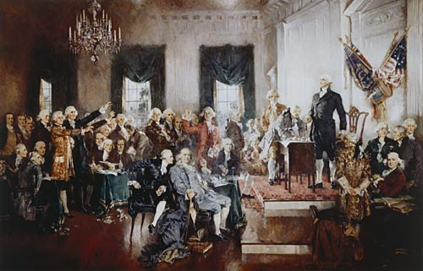
The Second Continental Congress (1775)
The colonist had reached their breaking point
Some wanted independence, while others still called for a reconciliation with the British
Ultimately, the Continental Army was recognized, and George Washington was appointed as commander
Notes:
Acted as the de facto national government. Ended up managing the colonial war effort throughout the Revolution.
Ben Franklin, John Hancock, Thomas Jefferson, etc

Slide 13
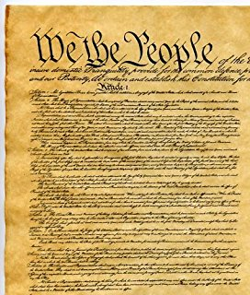
Patriots Declare Independence (1776)
Inspired by the ideas of John Locke and Thomas Paine, the Declaration of Independence is written by Thomas Jefferson
Delegates voted unanimously to declare freedom from Britain, and the Declaration of Independence was adopted.
4. Explain why it is important for the Declaration of Independence to be voted on unanimously by the delegates.
Notes:
On July 2, 1776, the delegates voted unanimously that the American colonies were free, and on July 4, 1776, they adopted the Declaration of Independence.

Slide 14
Essential Question
Do you think that the British acted wisely in their dealings with the colonies? Support your answer.

