Slide 1
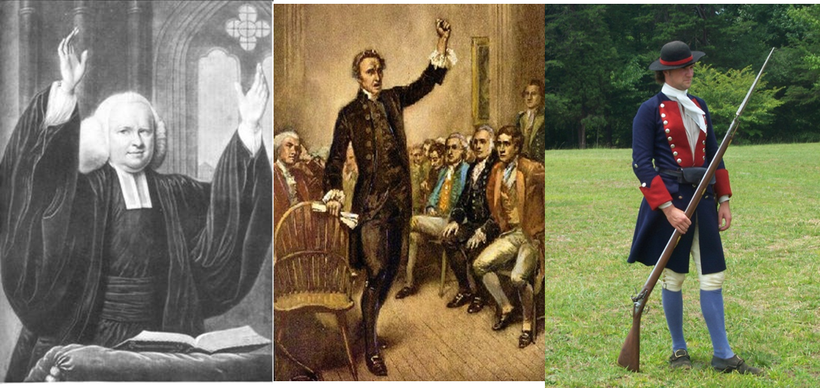
The 13 English Colonies Become more “American”
A scientific movement, a religious movement, and a war lead to a uniquely “American” culture
Notes:
Questions To Answer for Note-Taking:
Why would Economic Opportunity and Economic Mobility shape the American colonists into different people than their English cousins back in England?
If the Enlightenment Occurred in Europe first and came to the Americas, why is it so important as a vehicle for creating a unique “American Culture?”
Does it seem odd that the colonies can become both more religious and more scientifically curious at the same time? Do you suppose individuals could embrace BOTH the Enlightenment AND the Great Awakening at the Same Time?
What if the British had lost the French and Indian War?

Slide 2
Questions :
1. What was required for voting in the new world? How was this similar to England?
2. Where did colonists get their sense of superiority from?
3. What is the Enlightenment?
4. What is the Great Awakening?
5. What was the French and Indian War over? Who won?

Slide 3
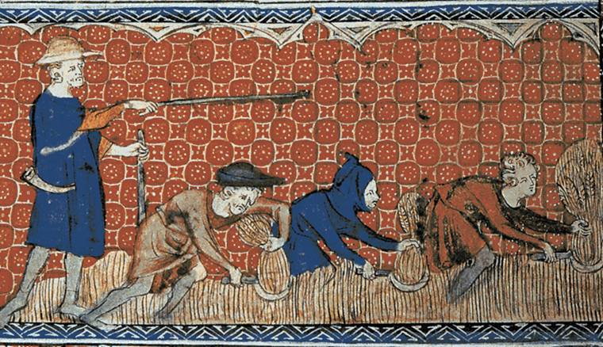
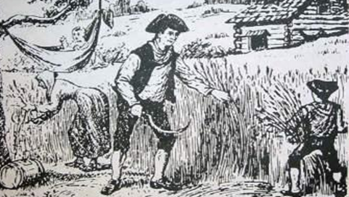
A Taste of Self Government
By the mid-1700’s, most colonies were similar in the structure of their governments (and similar to England)
Royal Governor (Chief Executive)
Advisory Council (Upper House)
Representative Assembly (Lower House)
Just as in England, Land Ownership is the standard requirement in order to vote
Owning land was a fantasy to a majority of Englishmen back in England
Numerous poor colonists gain the ability to vote in local elections once they own their own farms.
The effect of this is that by 1776 there are almost 2 million people living in the 13 colonies.
Notes:
Each Colony has a unique history and structure, so these are generalizations.
Most colonies began as a means of groups looking to escape the authority of the English crown, or at least as a profit enterprise. COLONISTS may come individually for different reasons.
By the mid 1700’s, the English crown has clamped down on each colony and instituted some regulation and control
VISUAL AID: The image on top is from a medieval tapestry showing SERFS working in the fields reaping the wheat with hand scythes. Backbreaking work. They do so at the direction of some sort of overseer/lord of the manor. The bottom image shows a typical American colonial frontier farmer doing equally backbreaking work, but the difference is that he’s doing it for himself rather than for a “Lord”
Finally, Chances are good that this farmer in the image on the bottom also has the ability to vote in local elections. This economic freedom and political power makes the rustic American colonist quite different from his English cousins.

Slide 4
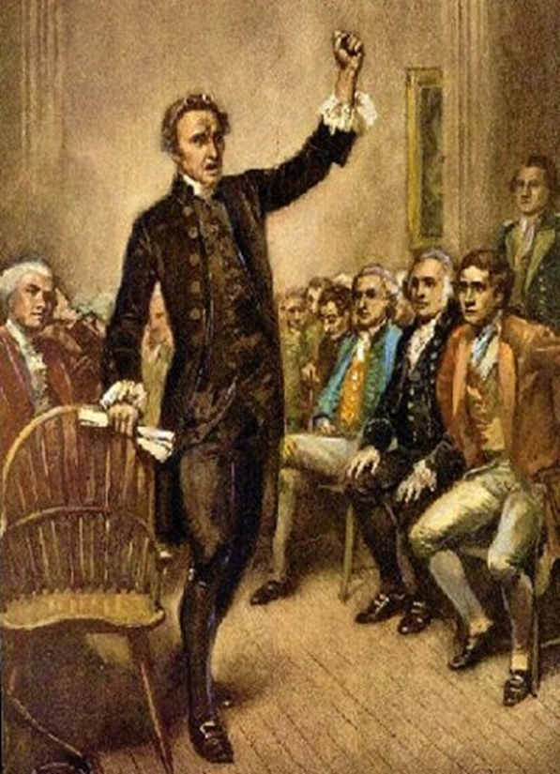
Character of an American Colonist
Economic opportunity and mobility
Political power
Locally, colonists, some with very modest backgrounds become lordly within their communities
Colony-wide, some men gain influence that they never could have had back in England
Sense of superiority due to being a part of the Constitutional Monarchy of the British Empire
Notes:
Recap of the notes and ideas from the previous slide.
The British style of government has been a Constitutional Monarchy since 1688. This process began as far back as the Magna Carta in 1215. The English are proud of the fact that their system of government has laws and that even the King isn’t necessarily above the law.
The Colonists SHARE this cultural pride in being an Englishman. This will become critically important during the causes of the American revolution, when they start demanding their full rights as Englishmen. (No Taxation without Representation in Parliament, No standing Armies housed in public buildings without consent…etc…)
VISUAL AID: This image is a painting of Patrick Henry delivering his famous “Give me Liberty or Give me Death” speech to the Virginia House of Burgesses on the Eve of the Revolution. I’m not sure of the origin of the image.

Slide 5
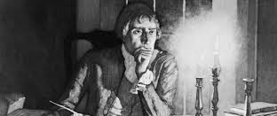
The Enlightenment
Scientific Movement that emphasizes the importance of reason and logic.
During the Renaissance, scientists looked beyond religious beliefs and traditional assumptions for answers about how the world worked.
These ideas about the nature led to a movement called the enlightenment
Philosophers applied Scientific Reasoning of the natural world to their social, political, and economic worlds.
High Colonial Literacy helped Spread Enlightenment Ideas
This “Enlightenment” spread quickly from Europe to the America’s through books and pamphlets.
American scientists such as Benjamin Franklin embraced the idea of obtaining truth through experimentation.
All traditional assumptions were subject to being questioned
The Enlightenment also had a profound effect on political Thought
Virginia Colonist, Thomas Jefferson, reasoned in a famous document, that humans are born with “natural rights” that governments must respect.
Enlightenment principles would eventually lead many colonists to question the authority of the British Monarchy
Notes:
In Europe, the Renaissance helped lead to the Scientific Revolution, which in turn helped lead to the Age of Reason..Also known as the Enlightenment.
Another way to view the Enlightenment is to see that Philosophers apply the ideas of scientific reasoning to all areas of life, not just nature. IE GOVERNMENT/ECONOMICS/SOCIAL INSTITUTIONS
Even European philosophers begin to question Monarchial forms of government. Jean Jacques Rousseau, the French Philosophe is one the more well known inspirations of American scholars
The Puritans in New England had High Literacy because they were so committed to primary school for children learning to read the bible. (Another unique cultural trait that makes American colonists slightly different than their English counterparts)

Slide 6
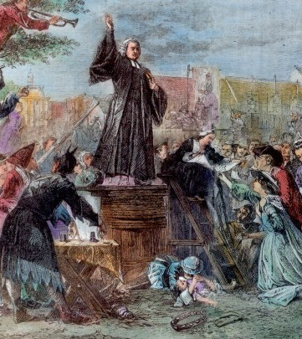
The Great Awakening
In New England, the Puritans had lost some of the influence and control they had enjoyed in the 1600’s.
This resulted in a series of religious revivals by the very pious so that the intensity and dedication of the early Puritan church would be re-awakened.
Ministers such as Jonathon Edwards and George Whitefield would travel from village to village and preach to large crowds.
These revivals sought to tap into colonists’ emotions and also challenged the traditional authority of the established churches.
New denominations, such as Methodists and Baptists were created.
Notes:
The Great Awakening is a RELIGIOUS MOVEMENT that started in New England and spreads quickly through the 13 colonies.
The Puritan influence over the culture of New England and all of the United States is still felt today.
The most obvious effect is that regular Church attendance in general increases from roughly 1 out of 6 to 1 out of 3.
Most of the Ivy League Schools were created during the Great Awakening as a reaction against the itinerant preachers who were preaching “dangerous” ideas. These colleges, Like Brown, Yale, etc… sought to train a new generation of minsters in the traditional way.

Slide 7
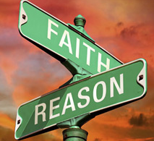
Opposite Movements can have some similar effects
Both Movements created a generation of people in 13 Colonies who grew up believing that it was natural to question authority.
The Enlightenment Taught them to question the old authorities of the natural world.
The Great Awakening taught them to question the traditional authority of the church structure in regards to their relationship to their God.
The Enlightenment
“…Unite, for the mutual preservation of their lives, liberties and estate…”
"The end of law is, not to abolish or restrain, but to preserve and enlarge freedom."
"Man was born free, and everywhere he is in chains.“
Great Awakening
“Lord, stamp eternity on my eyeballs.”
“Unconverted men walk over the pit of hell on a rotten covering.”
“Truth is the agreement of our ideas with the ideas of God.”
“Resolution One: I will live for God. Resolution Two: If no one else does, I still will.”
Notes:
A religious movement and a scientific movement certainly were opposite. And they had totally opposite effects. HOWEVER, they had one long term SIMILAR effect: Question Traditional Authority.
The quotes probably speak for themselves.

Slide 8
The French and Indian War
France and Britain fought numerous wars in Europe that usually affected their colonies too.
In 1754, a new conflict began over their competing claim of the Ohio River Valley.
The French tended to have better relations with the Native Americans due to their commercial relationship.
The British had some native allies, but not many as they were far more concerned with taking the land for settlement.
Britain outspends the French
Despite early French victories in the 1750’s, the British Prime Minister William Pitt borrows more and more money to raise more and more soldiers.
By 1759, the French colonial capital of Quebec was captured by the British.
By 1763 The Treaty of Paris ended the war with Britain the clear winner.
The British soldiers fought alongside the colonial militias and Native allies
Notes:
While North America is usually the side-show of much larger European wars, in this case, it actually is where this war started. Young George Washington leads the Virginia militia to the Ohio River Valley to seize it in the name of Virginia. (Under very dubious authority)
This “French and Indian War” is known as the “Seven Years War” in Europe.
The war isn’t really “won” in North America. It’s won in Europe. However, by taking Quebec in 1759, that gives England Leverage at the negotiation table to claim the right to take the whole thing.

Slide 9
Effects of the War
American Land Changes European Hands
Britain took Canada and most of North America east of the Mississippi River.
Britain also took Florida from Spain, which had allied itself with France.
Spain kept its lands west of the Mississippi and the city of New Orleans, which it had gained from France in 1762.
France retained control of only a few islands and small colonies near Newfoundland, in the West Indies, and elsewhere.
The Ottawa, led by Pontiac kept fighting
Captured eight 8 British forts around the Great Lakes.
Most Native groups negotiated treaties by 1766.
Proclamation of 1763 is passed in Parliament to avoid further costly conflict with natives.
Notes:
New Orleans has quite an interesting history: Founded by the French. Populated by transplanted Acadians from Nova Scotia, given to Spain in 1762. France will take it back under Napolean, then sell it to the United States.
The Defeat of Pontiac and his “rebellion” is where one of the many “plague blanket” stories comes from.

Slide 10
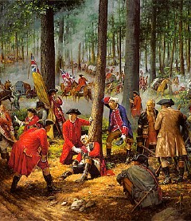
War Effects American Colonists
United the colonists against a common enemy
Benjamin Franklin made a famous political cartoon called Join or Die.
Franklin also wrote that the colonies should unite politically.
Many British Officers and Soldiers treated Colonial militia with disrespect
Animosity and bitter feelings are created towards British upper class/ruling elite.
Early British defeats cause colonists to questions British military skill.
Plunged Great Britain into financial debt as it borrowed large sums of money to finance the war.
Notes:
The image is from a modern artist’s version of the defeat and death of Edward Braddock. The British General who refused to listen to Colonial Militia leaders who tried explaining to him how dangerous it was to travel though the hostile territory of the forest without taking precautions. As they predicted, the Native allies of the French ambushed them and Braddock was killed. Good example of British Officers looking down at colonials as backwards.

Slide 11
Essential Question
What factors helped form the American Identity? Which factor do you think you is the most impactful? Why?

