Slide 1
Intro to Poli. Sci. – 2/1/16
Objective: SWBAT describe the various parts of the Constitution.
Agenda:
SAT Packet Qs
Review Constitutional Compromises
Start Constitution Notes
Class Constitution Outline

Slide 2
The Constitution of the United States
Mr. White

Slide 3
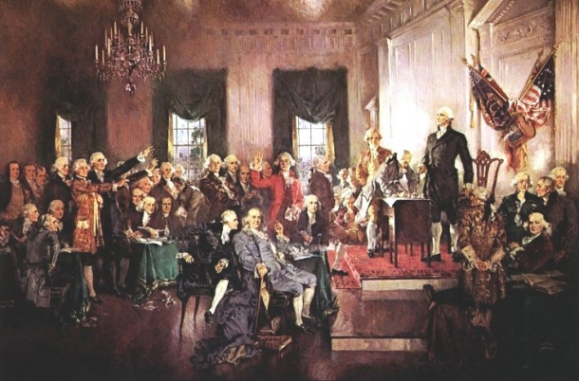
The Constitution: Important Dates
Written in 1787
Signed on Sept. 17, 1787
Ratification took place between 1787-1790
Delaware 1st
Rhode Island last
Took effect in 1789

Slide 4
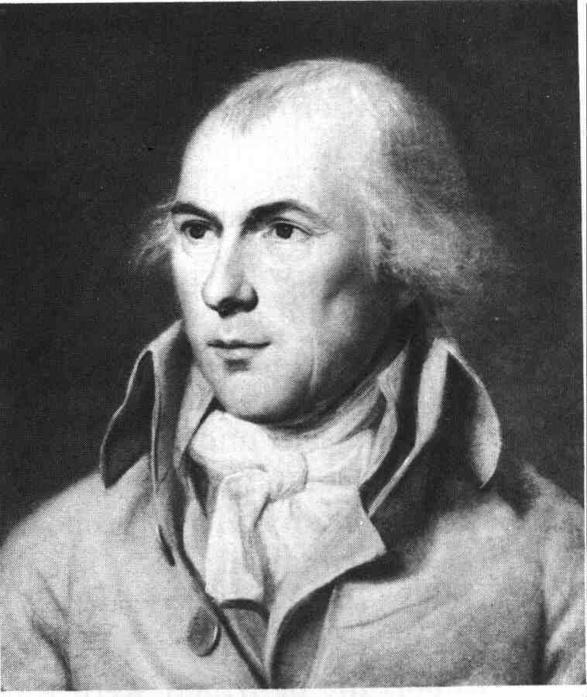
Supreme Law of the Land
The Constitution is the United States’ fundamental law.
It is “the supreme law of the land.”

Slide 5
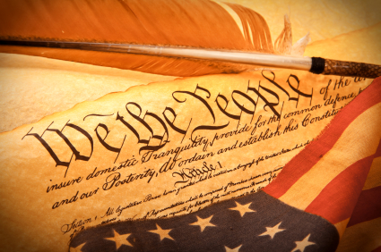
Key Facts About the Constitution
Purposes:
Lays out basic framework and procedures of our government
Sets the limits within which government must conduct itself
Length: 7,000 words (can be read in 30 minutes)
Strengths:
Deals with matter of principle
Is not weighed down with detailed provisions
Is organized in a simple, straightforward way

Slide 6
Think about any paper that you have written for an English class. What was contained in your first paragraph?
What was the purpose of having your paper begin with an introduction?

Slide 7
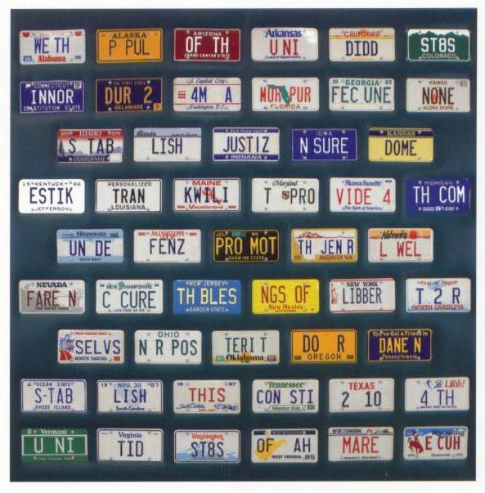
The Introduction of the Constitution
The Constitution has an introduction. It is known as the Preamble.
The Preamble serves as an introduction and also sets out the purposes and goals of the government.

Slide 8
The Preamble
“We the People of the United States, in Order to form a more perfect Union, establish Justice, insure domestic Tranquility, provide for the common defence, promote the general Welfare, and secure the Blessings of Liberty to ourselves and our Posterity, do ordain and establish this Constitution for the United States of America.”

Slide 9
Purposes of Govt. According to Preamble
Form a more perfect Union,
Establish Justice,
Insure domestic Tranquility,
Provide for the common defense,
Promote the general Welfare,
Secure the Blessings of Liberty to ourselves and our Posterity

Slide 10
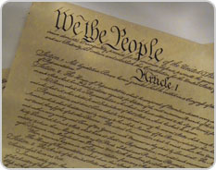
The Articles
Following the Preamble, the Constitution is divided into seven numbered sections called articles.
These articles explain various components of the government.

Slide 11
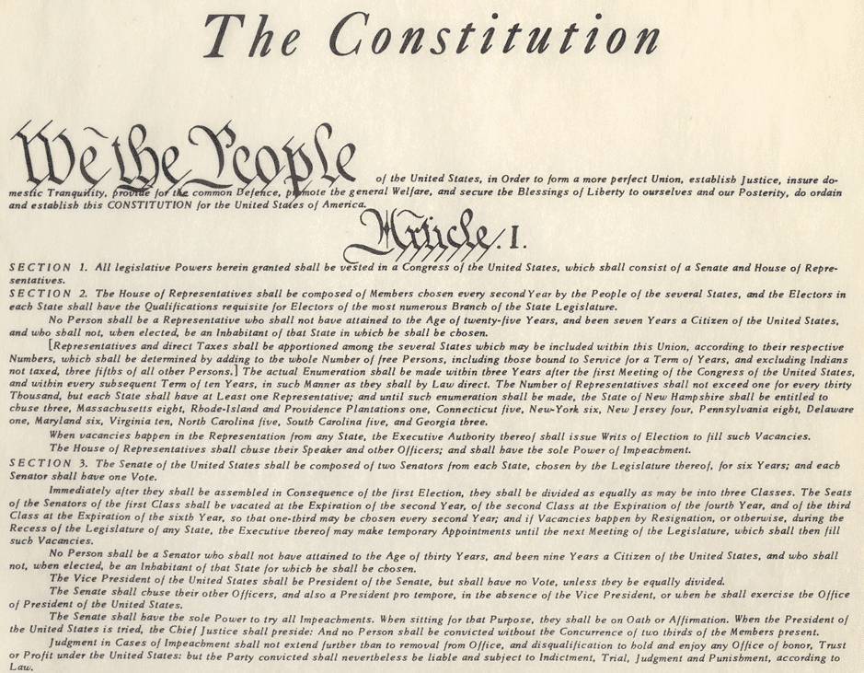
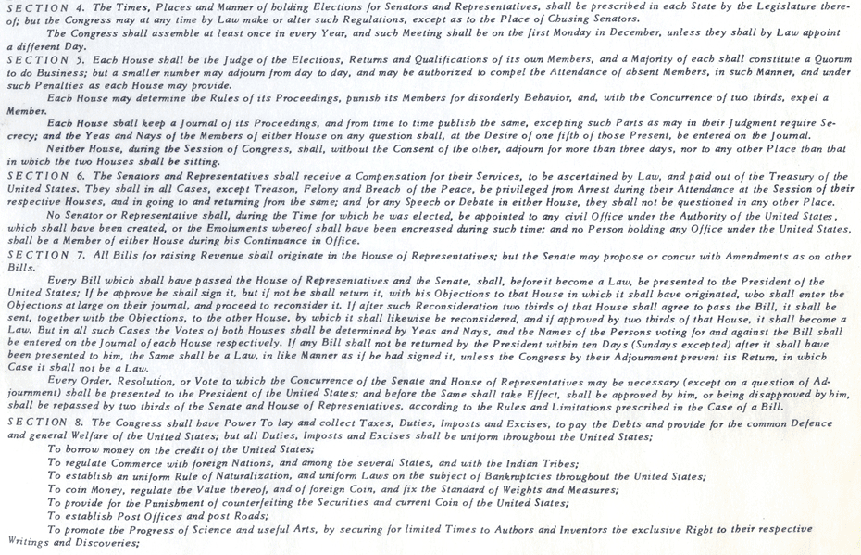
The Articles
Article I: Sets up Congress and explains its expressed powers (Legislative Branch).

Slide 12
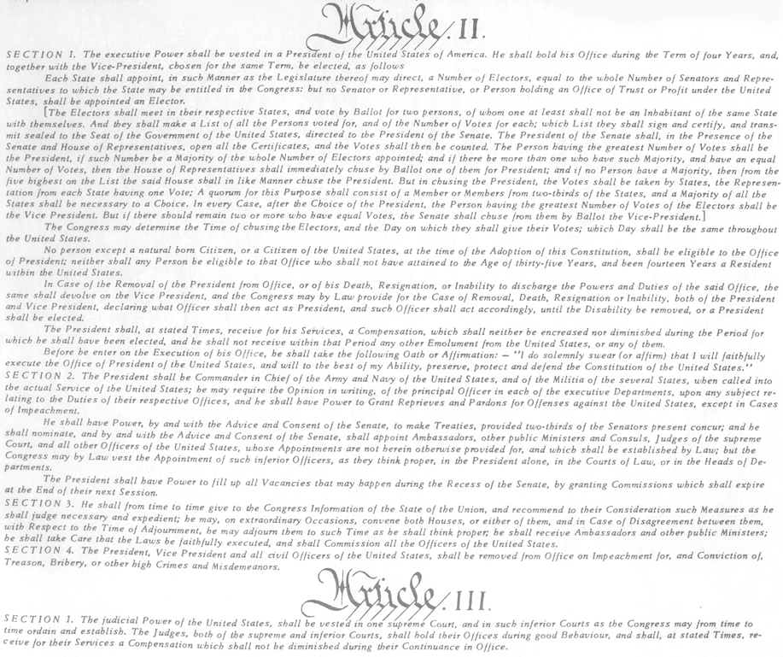
The Articles
Article II: Sets up the presidency and explains the President’s powers (Executive Branch).

Slide 13
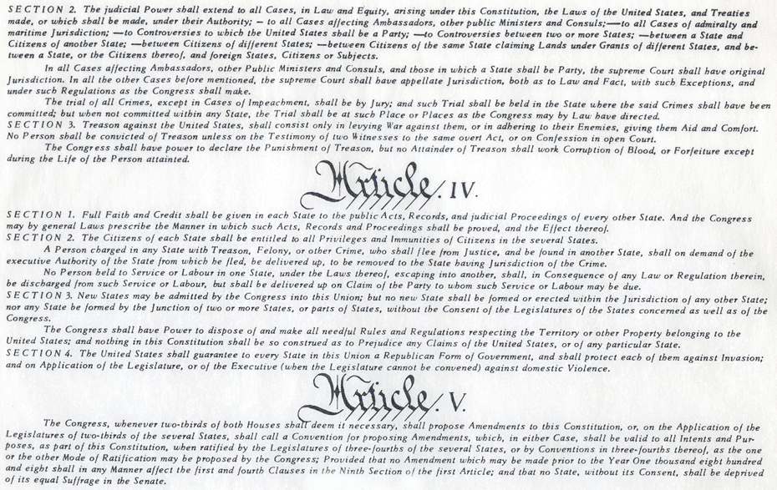
The Articles
Article III: Sets up the federal court system (Judicial Branch).
Article IV: Explains the relationship between the States and the federal government.
Article V: Explains how formal amendments can be added to the Constitution.

Slide 14
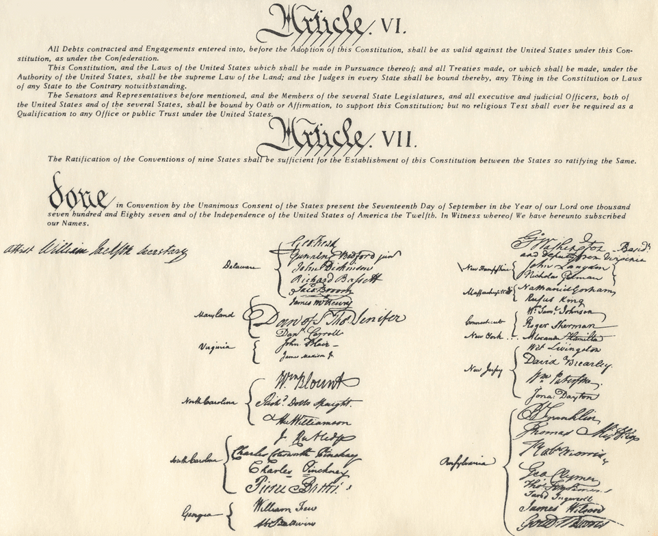
The Articles
Article VI: Declares that the Constitution is the supreme law of the land.
“Supremacy Clause”
Article VII: Explains how the Constitution may be ratified.

Slide 15
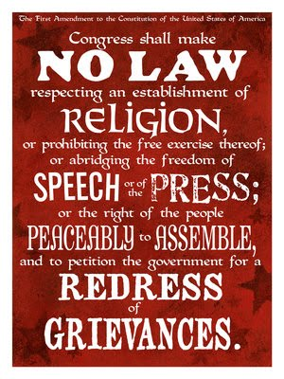
The Amendments
The articles of the Constitution are followed by the 27 formal amendments.
They are printed in the order that they were adopted.

Slide 16
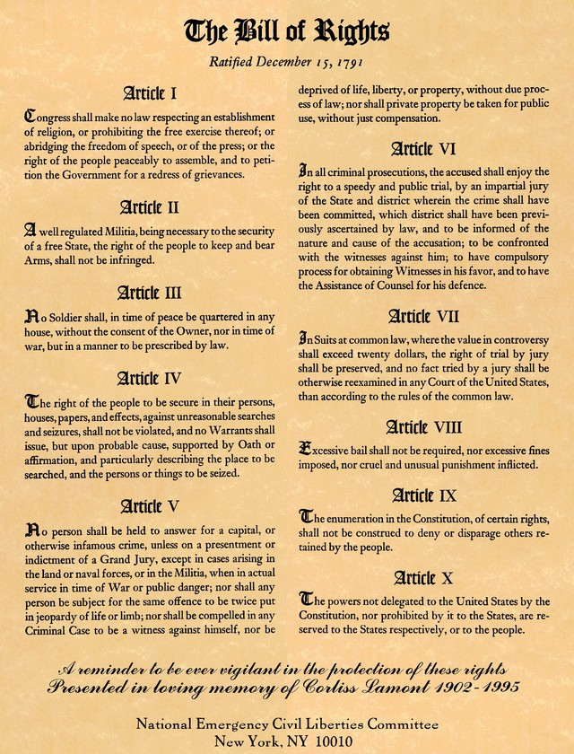
The Bill of Rights
The first ten amendments are known as the Bill of Rights.
Adding a Bill of Rights to the Constitution was the only way to get Anti-Federalists to support the Constitution’s ratification.

Slide 17
The Times, They Are A Changin’: Amending the Constitution

Slide 18
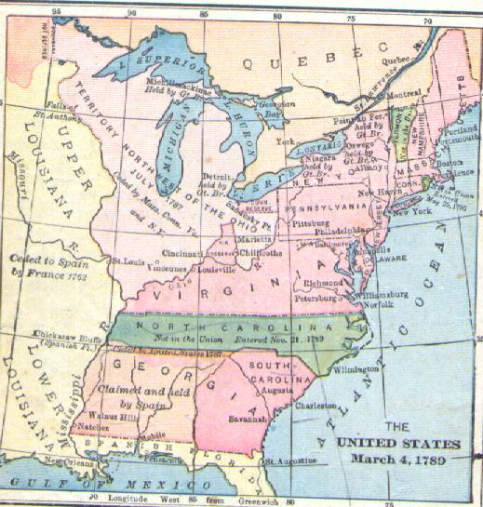
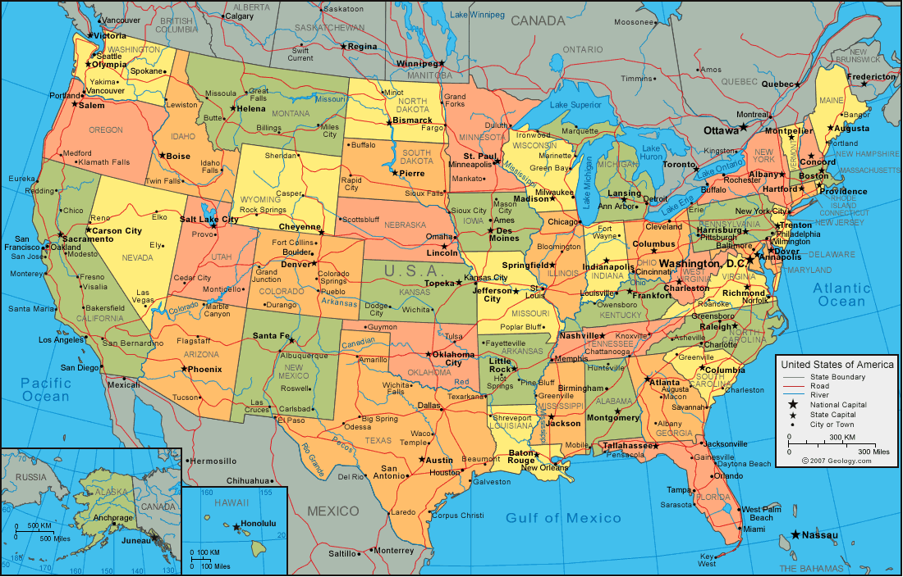
Why Would the Constitution Need Amending?
The United States
1789: small agricultural nation with less than 4 million people spread across the eastern seaboard
Today: world leader with over 300 million people spread from coast to coast

Slide 19
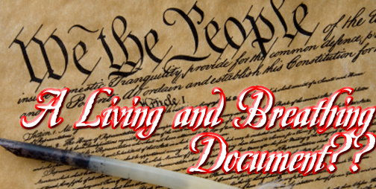
How Has the Constitution Kept Up?
The Constitution of today is and is not the document of 1787.
Words have been changed, added, or eliminated.
Meanings of words/phrases have changed as well.

Slide 20
Framer’s Foresight
The Framers knew that the Constitution would need to be modified in the future.
Formal Amendment
Informal Means
Amendment: a change in, or addition to, a Constitution or law

Slide 21
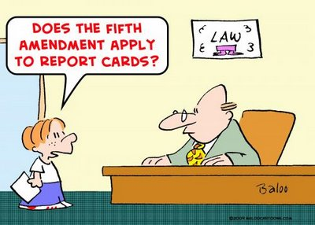
Formal Amendment Process
Formal Amendment: Changes or additions that become part of the written language of the Constitution itself.
There are four ways to formally amend the Constitution.

Slide 22
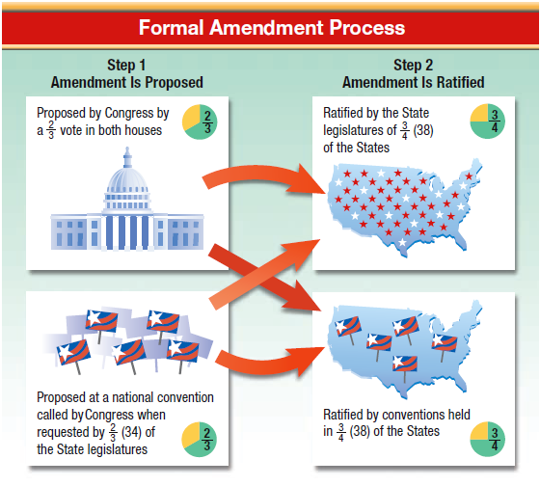
Formal Amendment Chart (pg. 73)
Know the chart!

Slide 23
Fun Facts
All 27 amendments have been proposed by 2/3 of Congress – never by a National Convention
26 Amendments were ratified by ¾ State Legislatures
Only the 21st Amendment was ratified by ¾ of States conventions
The President has no formal role to play in the amendment process.

Slide 24
So, proposing an amendment takes place at a national level, but ratification takes place on a State-by-State basis….
…which TWO Basic Principles of the Constitution could this represent?

Slide 25
Proposing Amendments
One restriction on Amendments:
The Constitution cannot be amended to deprive a state of its territory or to deprive any state of its equal representation in the Senate.
15,000 joint resolutions proposing an amendment have been proposed to Congress since 1789
Only 33 have been sent to the States for ratification
Only 27 have been approved

Slide 26
Constitutional Change By Other Means
There are five other ways to change the Constitution without changing its written words.
Passage of basic legislation by Congress
Actions taken by the President
Key decisions of the Supreme Court
Activities of political parties
Reform/Custom

Slide 27
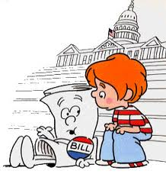
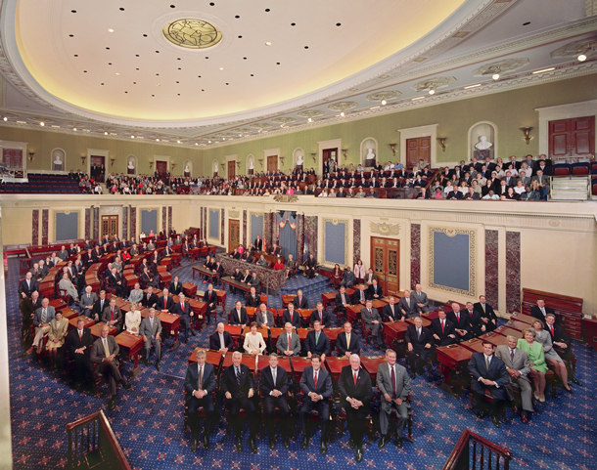
Basic Legislation
Congress has changed the Constitution in two ways:
Passed laws to spell out Constitutional provisions (flesh to the bones of the Constitution)
The way that Congress has used its power (added to it)

Slide 28
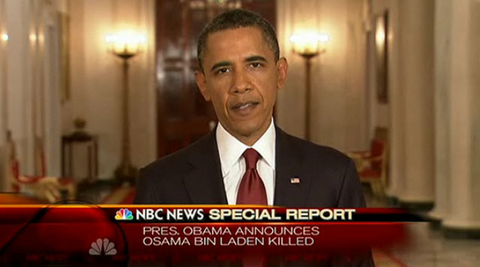
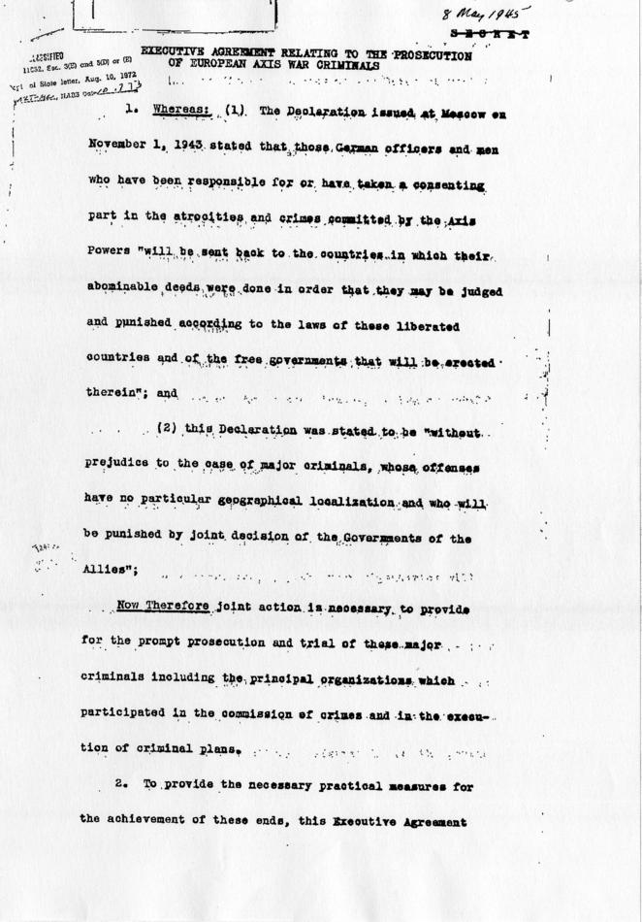
Executive Action
The ways Presidents have used their power has also contributed to the growth of the Constitution.
War Making Powers
Executive Agreements

Slide 29
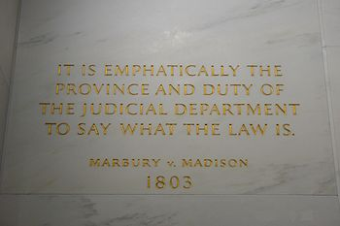
Court Decisions
The courts interpret the law. How they do so changes how we view the Constitution.
Marbury v. Madison

Slide 30
Party Practices
There is no mention of political parties in the Constitution.
Parties have grown immensely important over time.
Conventions
Nominations
Appointments

Slide 31
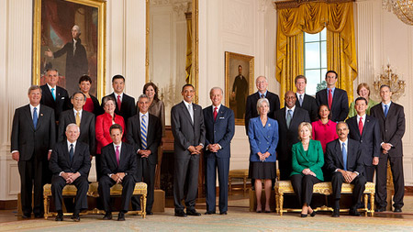
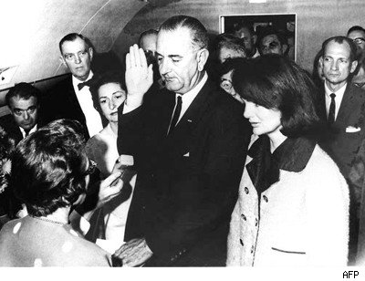
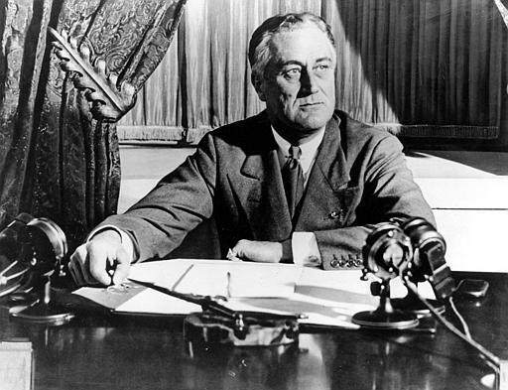
Reform/Custom
Certain unwritten rules have been followed over time.
President’s Cabinet
Succession to the Presidency
“no third term tradition”

Slide 32
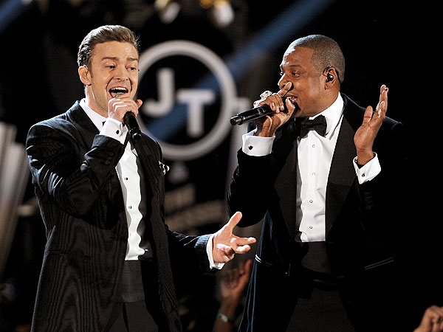
Yes, There Is a Bill of Rights rap.
http://www.youtube.com/watch?v=tlt6R1KD4E0
Ok, so maybe it’s not Magna Carta / Holy Grail, but it took some serious swag to do what the Founders did….

Slide 33
The Amendments
Freedom of speech, religion, press, petition & assembly
Right to bear arms
No quartering of troops
Searches & seizures
Due process, double jeopardy, eminent domain
Speedy, public trial by jury and right to attorney
Trial by jury in cases over $20
No cruel or unusual punishment or excessive bail and fines
Un-enumerated rights reserved for the people
Powers not listed reserved for the states

Slide 34
The Amendments
State cannot be sued by a citizen of another state, its own state or a foreign country
Electoral College fixes (VP and Pres. Voting)
Abolishes slavery
Rights and equal protection of all citizens
Right to vote cannot be denied based on race, color, or previous servitude
Income tax
Popular election of Senators
Prohibition of liquor
Women’s Suffrage

Slide 35
The Amendments
Terms of President (inauguration date)
Repeals 18th Amendment
Two term limit of President (up to 10 years)
Presidential Electors for District of Columbia
Right to vote in federal elections without a tax payment (no poll tax)
Presidential line of succession
Voting age dropped to 18
Congressional pay increases

