Slide 1
The Powers of the Presidency

Slide 2
What does the Constitution say?
Article II Section 2
“The executive Power shall be vested in a President of the United States of America”
Gives a formal description of the executive branch

Slide 3
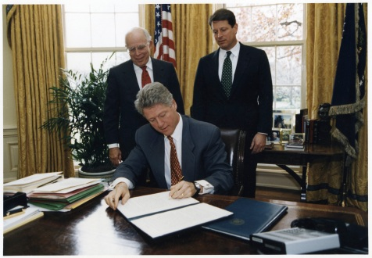
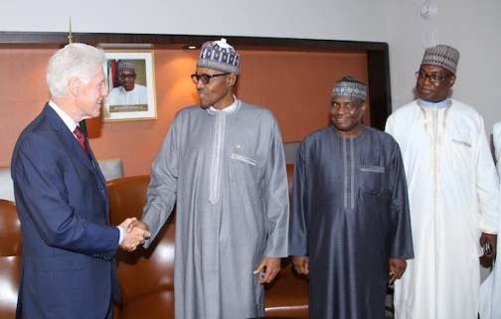
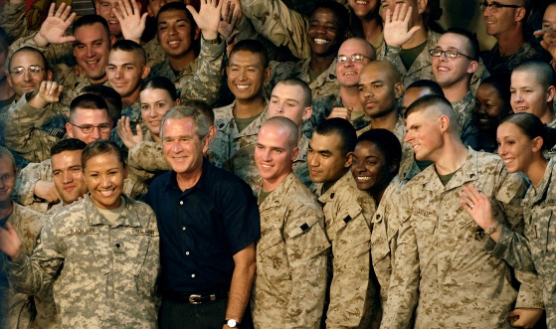
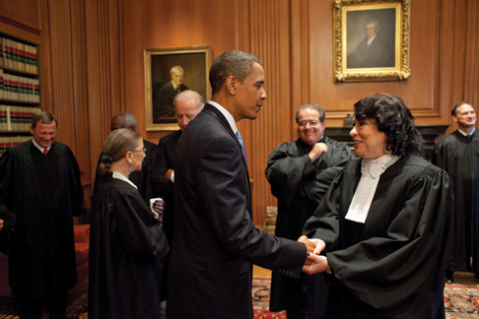
Category types of Presidential Power
Executive Power
Diplomatic Power
Military Power
Legislative Power
Judicial Power

Slide 4
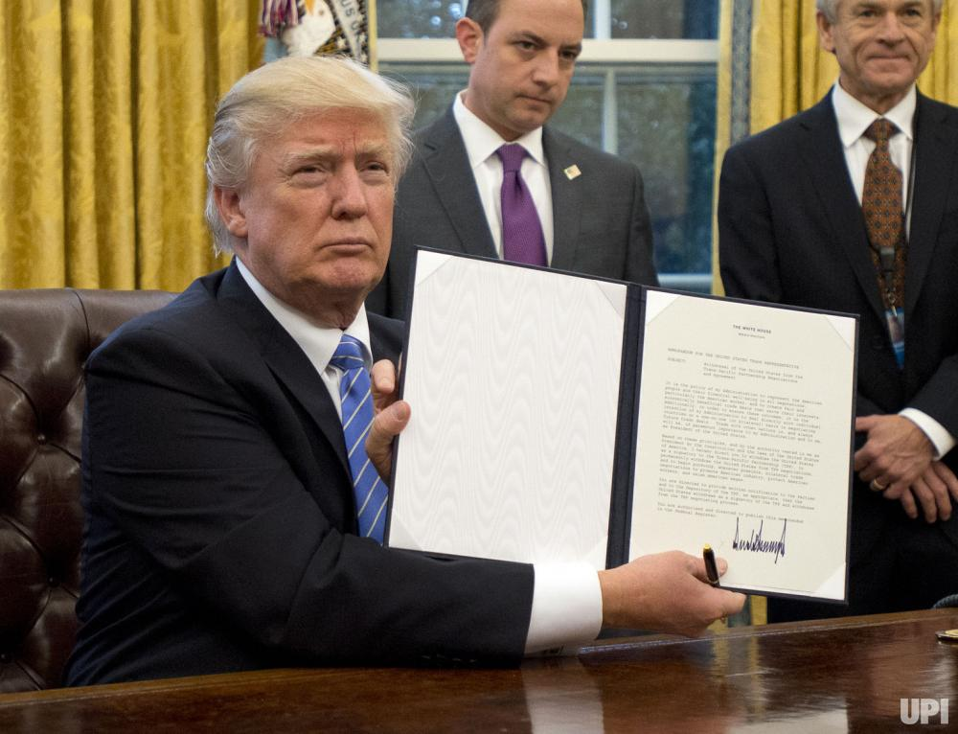
Executive Powers
EXECUTING THE LAW
Enforces, administers, & carries out
ORDINANCE POWER-
The power to issue executive orders given to the president by the Constitution and acts of Congress
EXECUTIVE ORDER
a directive, rule, or regulation that has the effect of law
https://www.youtube.com/watch?v=JUDSeb2zHQ0

Slide 5
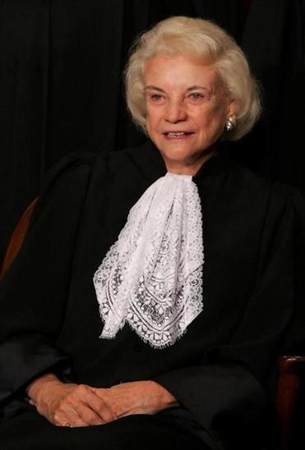
Appointment Power Senate must approve
Ambassadors and other diplomats.
Cabinet Heads (Secretaries)
Heads of independent agencies
Environmental Protection Agency
NASA
Supreme Court Justices & federal judges
All officers in the armed forces
Sandra Day O’Connor – 1st woman appointed
to the Supreme Court by Ronald Reagan

Slide 6
Diplomatic Powers
THE POWER TO MAKE TREATIES
a formal agreement between two or more sovereign states
Need 2/3 Senate approval
Carried over to future Presidents
EXECUTIVE AGREEMENTS
a pact between the President and the head of foreign states
Does not require Senate approval
Does not carry over to the next office holder
THE POWER OF RECOGNITION
To recognize the legitimate standing of a nation in the world.
Declare an ambassador persona non grata
Repeal or expel ambassadors
Notes:
The president also has the power of recognition. This means he has the power to recognize the legitimacy or legality of governments in other countries. This is huge because it can either help or hinder the success of other governments.

Slide 7
Military Powers
COMMANDER IN CHIEF
Final authority over and responsibility for all military matters
The War Power Resolution passed in 1973 to limit the power of the President
The president upon sending troops must notify congress within 48hrs
Troops can only be used for 60 days without Congressional approval. Can be extended 30 more days
Congress may end the combat by passing a concurrent resolution to that effect

Slide 8
Legislative Power
NATION’S CHIEF LEGISLATOR
Proposes legislative agenda during three major speeches
State of the Union Speech
The President’s Budget Message
Annual Economic Report
Signing Power
Veto Power
*The President does not have line-item veto power anymore

Slide 9
Judicial Powers
“shall have Power to Grant Reprieves and Pardons for Offenses against the United States, except in Cases of Impeachment”
Reprieve- the delay of a sentence
Pardon- legal forgiveness of a crime
-commutation- reduce a sentence or a fine imposed by the courts
-amnesty- a pardon offered to a group of law violators
Clemency- mercy or leniency (only involves federal offenses)

