Slide 1
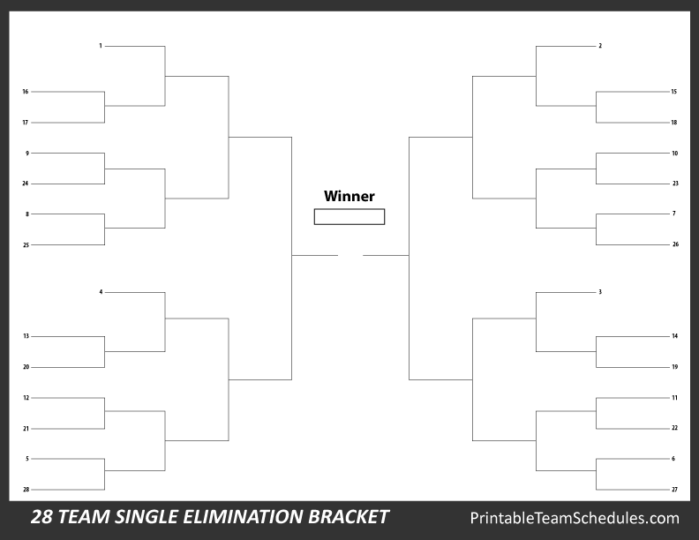
Lincoln
Washington
Coolidge
Taft
Garfield
B. Harrison
Madison
Jackson
W.H. Harrison
Fillmore
McKinley
Polk
Tyler
Harding
Jefferson
T. Roosevelt
Grant
Cleveland
Hayes
Taylor
John Q. Adams
John Adams
Van Buren
Arthur
Wilson
Monroe
Johnson
Pierce

