Slide 1
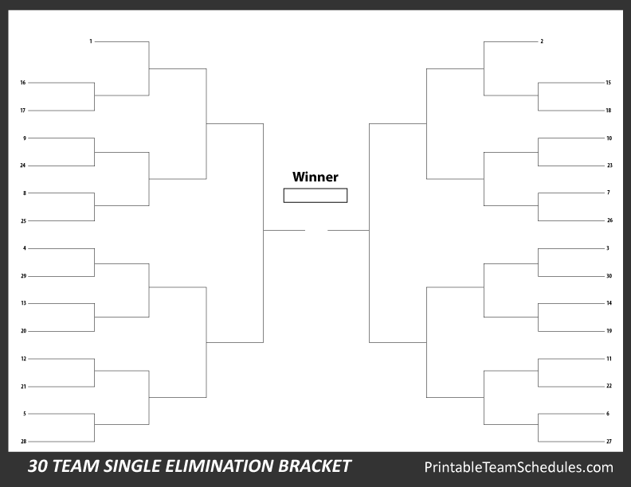
Lincoln
Washington
Taft
Cleveland
Coolidge
Garfield
Madison
Jackson
Fillmore
Arthur
McKinley
Polk
W.H. Harrison
Tyler
Jefferson
T. Roosevelt
Johnson
Buchanan
Grant
Cleveland
Taylor
B. Harrison
John Q. Adams
John Adams
Hayes
Van Buren
Wilson
Monroe
Pierce
Harding

