Slide 1
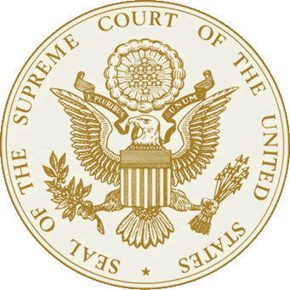
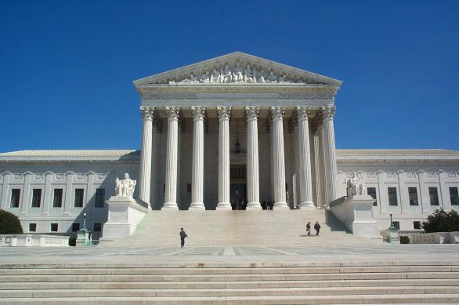
The Judicial Branch: the federal courts

Slide 2
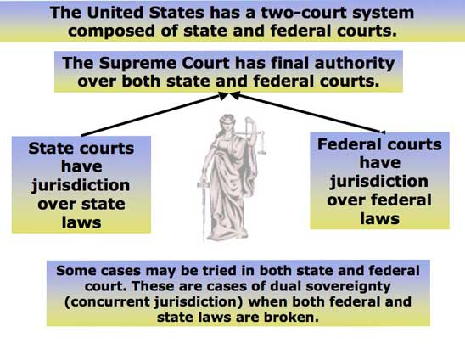
Dual Court System
There are really two court systems in the United States
  National judiciary that extends over all 50 States
  Court systems found in each State (most cases are heard here)
We are going to be focusing mainly on one part of the national judiciary, the Supreme Court

Slide 3
Constitutional Courts (regular courts)
Types of Federal Courts
  Examples
    District Courts (94 of them)
    Courts of Appeal (12 of them)
    U.S. Supreme Court (only 1)
    Court of International Trade
  Most Federal Cases are heard in one of these courts

Slide 4
Special Courts
(Legislative courts)
Types of Special Courts
  Examples
    Appeals for the Armed Forces
    Veterans Appeals
    Claims Court
    Tax Court
    Court for Washington DC.

Slide 5
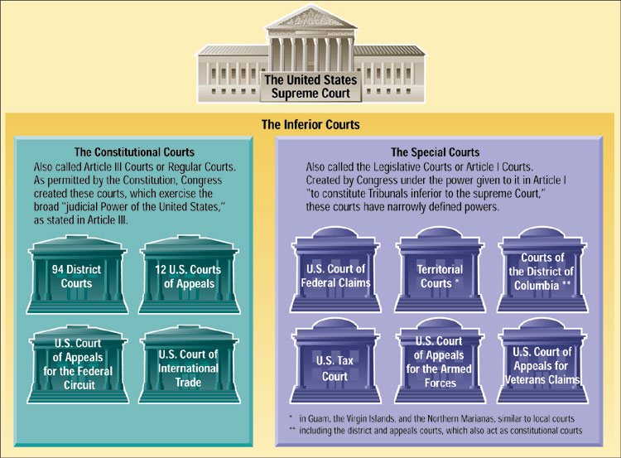

Slide 6
We will get to SCotUS in a moment…
First, some vocab…

Slide 7
Plaintiff v. Defendant
The one who brings a case/lawsuit is the Plaintiff.
The one being charged/sued in a case is the Defendant.

Slide 8
How do we decide where cases go?
    State or Federal?

Slide 9
Jurisdiction
Definition: The right to hear a case
Types of Jurisdiction:
  Exclusive (only federal)
  Concurrent (state or federal)
  Original (case started there)
  Appellate (rules on appeal of original decision)
Federal courts can hear cases for two reasons:
  Subject Matter (certain topics)
  Parties Involved (certain people/organizations)

Slide 10
Exclusive Jurisdiction
Cases only heard in federal court
Would include cases involving
  The USA or its officials
  Ambassadors
  Disputes between states
  Disputes between citizens of separate states
  US citizens suing foreign citizens or foreign countries
  Citizens of the same state suing about property in another state.

Slide 11
11th Amendment
Federal courts are limited and restricted from hearing lawsuits against any state's government that are brought by citizens of another state or foreign country.
  Known as “Sovereign Immunity”
    Immune from civil suit or criminal prosecution
  Chisholm v. Georgia
    Citizen of SC sued GA government for repayment of a debt.

Slide 12
Concurrent Jurisdiction
A case that may be tried in either the state or federal court system.
Disputes between parties of different states involving $50,000 or more are usually tried in Federal District Court!

Slide 13
Original Jurisdiction
Where a case originally was heard
Local Courts (part of state system), Federal District Courts, and the Supreme Courts (state and U.S.) are all courts of original jurisdiction!

Slide 14
Appellate Jurisdiction
Case taken on appeal from a lower court to a higher court
The Federal and State Courts of Appeal and the Supreme Courts all have appellate jurisdiction!
Can uphold, modify, or overrule a decision

Slide 15
Now that we’re done with the basic intro to the court system…
  What is the Supreme Court?
  What does it do?
  How does it work?

Slide 16
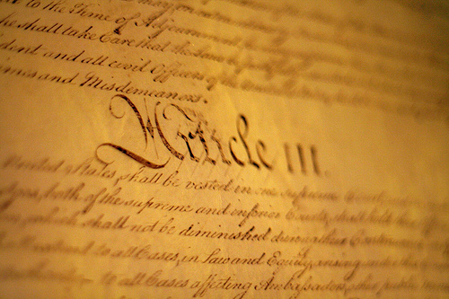
Where in the Constitution is the Supreme Court?
Article III of the Constitution sets up the Supreme Court
The Supreme Court was designed be as powerful as Congress or the President (checks and balances!).
The Supreme Court is the FINAL authority on law in the United States.

Slide 17
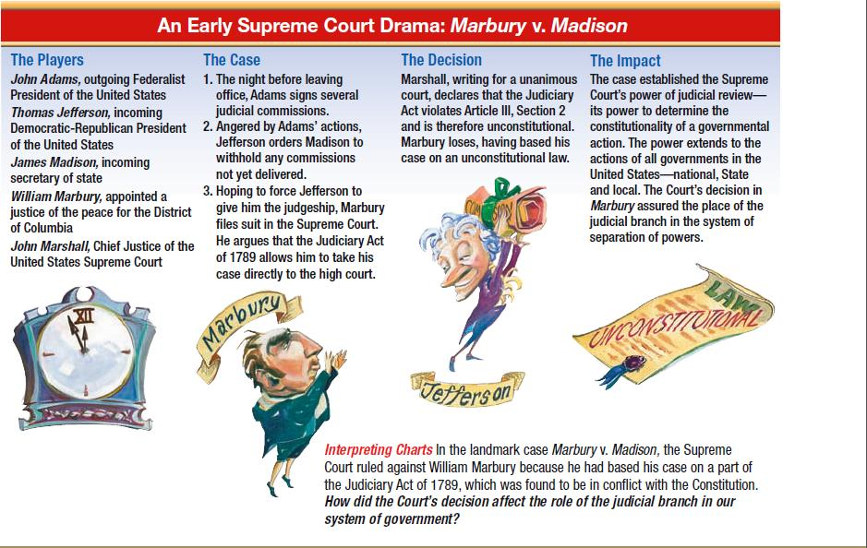
Judicial Review – (1 of the six principles)
The Supreme Court has the final say on what the Constitution actually means.
This ability to interpret the Constitution, and thusly declare laws constitutional or unconstitutional, is known as judicial review.
This power of judicial review is NOT written in the Constitution. It was established in the 1803 case Marbury v. Madison.

Slide 18
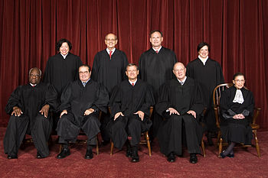
So, who makes up the supreme court?
The Supreme Court is made up of nine judges, who are called by the title “Justice”
  The number of Justices is not specified in the Constitution.
  One Chief Justice
  Eight Associate Justices
These Justices are appointed by the President. These appointments must be approved by the Senate.
Justices serve a life term.

Slide 19
Pay and Retirement
Chief Justice of the USA $258,100/year
Associate Judges $246,800/year
Retire with full pay after 15 years at age 65 or after 10 years at age 70.
Justices may lose their position for reasons like death, impeachment, resign, retire

Slide 20
Who are the justices??
Clarence Thomas – 2013: Spoke during arguments for the first time in 7 years
Sonia Sotomayor – First Latina SC Justice
Ruth Bader Ginsburg – “Notorious RBG”
Antonin Scalia (deceased) – Loved opera and was good friends with Ginsburg
  This seat is now vacant. Pres. Obama has nominated Merrick Garland, but the Senate is refusing to confirm him because they say that the new President should have the right to replace this vacancy.
Anthony Kennedy – Swing vote in critical cases
Samuel Alito – Pres. Bush appointee
Elena Kagan – Pres. Obama’s second appointee (first time 3 women on SC)
Stephen Breyer – First time up for appointment, he lost to RBG
CJ = John Roberts – won 25 cases at the SC before becoming CJ

Slide 21
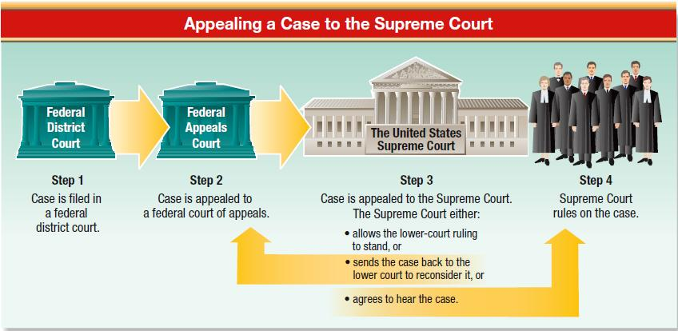
How do court cases reach the supreme court?
Most court cases reach the Supreme Court through what is called writ of certiorari.
  This writ is an order by the Supreme Court for a lower court to send up the records on a given case for review. (Appellate Jurisdiction)
  The Supreme Court decides what cases it will hear.

Slide 22
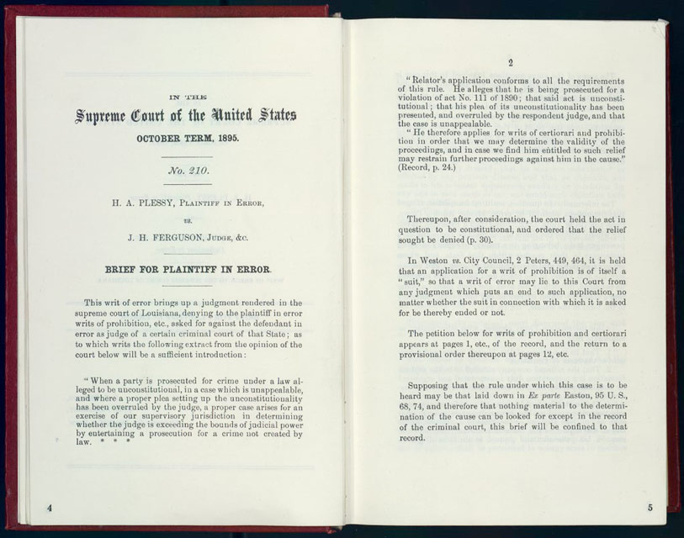
How does the Supreme court operate?
Step One: Briefs
  No, we’re not talking about the Justices’ choice in underwear.
  Briefs are written documents filed with the court before arguments begin.
  They state one side’s argument.
  They are filed by the lawyers on each side of the case.

Slide 23
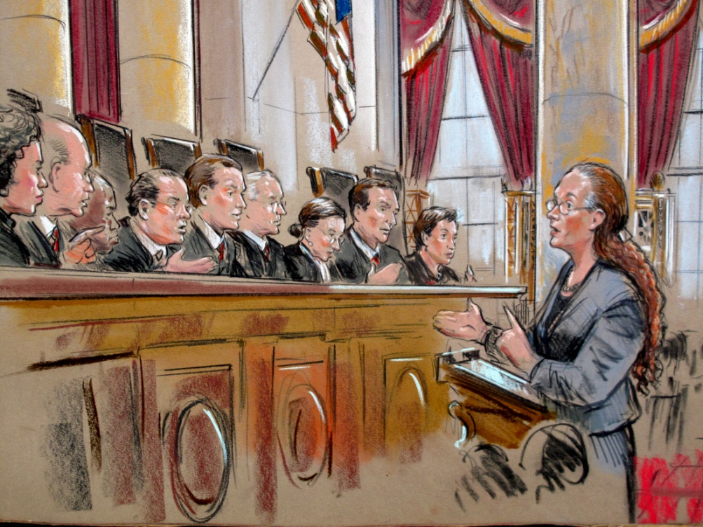
Step Two: Oral Arguments
  Lawyers for both sides argue their case to the Justices.
  Their presentations are limited to 30 minutes.
  These arguments happen in two week cycles from October to early May.

Slide 24
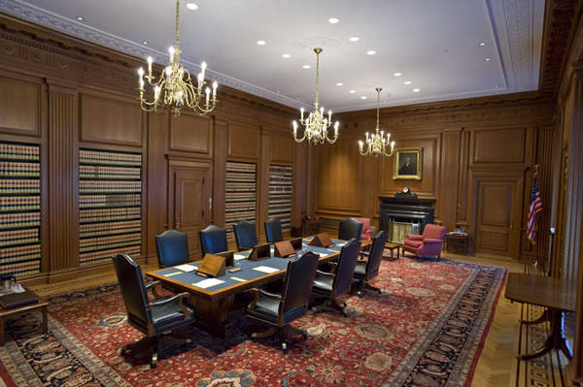
Step Three: Conference
  Conferences start off by the Chief Justice stating how he feels about a case.
  Following this, each Associate Justice summarizes their viewpoints. This is done in order of seniority.
  After each Justice has spoken, they take a “poll” and then debate the case.

Slide 25
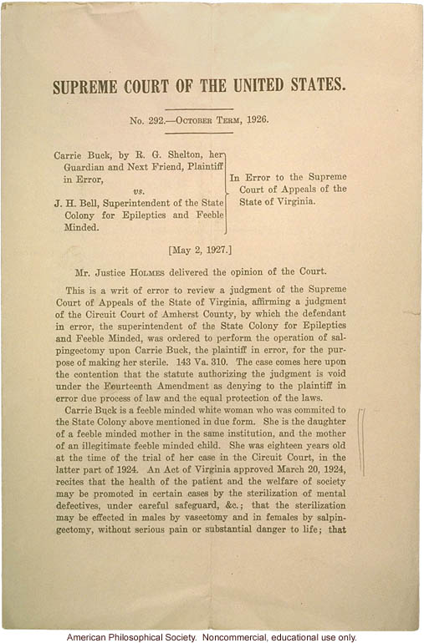
Step Four: Making Decisions
  About a 1/3 of the decisions are unanimous. However, many Supreme Court decisions are split, due to the fact that the easy cases rarely make it up to the Supreme Court.
  When the Supreme Court makes their decisions, they are split into three types, and are written out.

Slide 26
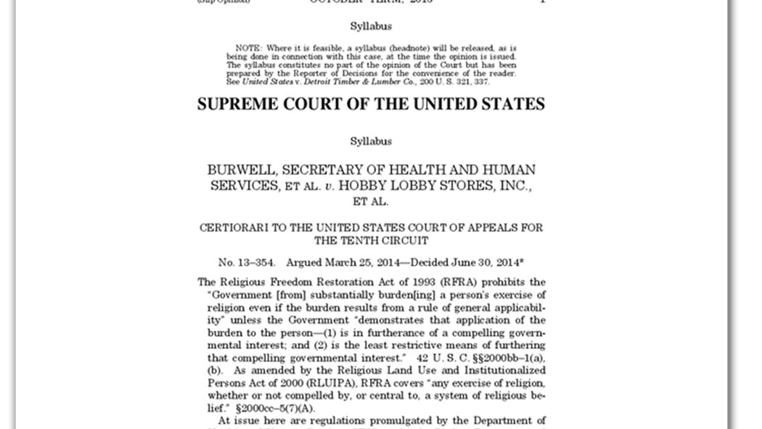
Step 4(cont.): SC Decisions
The Three types of SC decisions are:
    Majority opinion: this is the decision that the most Justices sided with
      5-4; 6-3; 7-2; 8-1; 9-0
    Concurring opinion: this is for Justices for agree with the majority opinion, but for a different reason than stated.
    Dissenting opinion: this is the decision written by the Justices who do not agree with the majority opinion.

Slide 27
So, that’s how SCotUS operates, but the justices are human, so they do have their own personal beliefs…
  Does that ever come into play in their decisions?

Slide 28
Judicial Philosophies of Judges
2 Types:
1.) Judicial Activism
  The court should play a more active role in creating national policies and answering questions of conflict in society
2.) Judicial Restraint
  The court should operate strictly within the limits of the Constitution and only answer questions if a clear violation of the Constitution is present. Policy making should be left up to the executive and legislative branches.

Slide 29
How do you get a position on the Supreme Court?
  There are no listed qualifications in the Constitution.

Slide 30
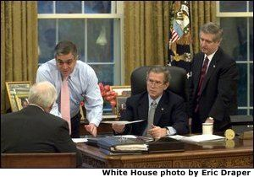
U.S. Supreme Court Confirmation Process
Stage 1
Presidential Nomination
White House staff reviews candidates and submits a short list to the president
FBI background investigation
Candidates submit financial disclosure forms
ABA grades candidates
Interest groups weigh in on candidates
President selects nominee

Slide 31
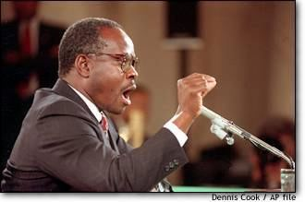
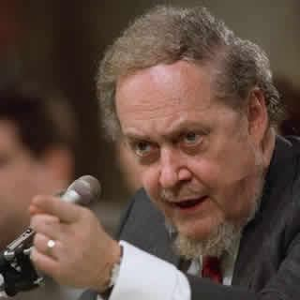

U.S. Supreme Court Confirmation Process
Stage 2
Senate Judiciary Committee Hearings
Senate Judiciary members and their staffs review candidate’s background (may conduct own investigation)
Interest groups may conduct campaigns for or against nominee (including TV ads)
Intense media attention to Senate hearings
Senate Judiciary Committee questions candidate on judicial philosophy, stands on key issues, etc.
Judiciary Committee votes up or down on nominee and sends recommendation to full Senate

Slide 32
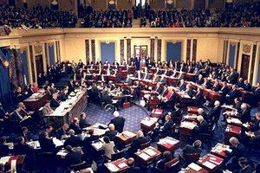
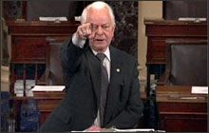
U.S. Supreme Court Confirmation Process
Stage 3
Full Senate Vote
Floor debate on nominee
Confirmation vote by full Senate
  Only needs 51 votes

Slide 33
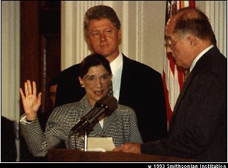
U.S. Supreme Court
Confirmation Process
Stage 4
Oath of Office
If confirmed by the Senate, nominee sworn in, usually by Chief Justice
Once on the Court, justices often make decisions on the bench very different from what the nominating President had anticipated
independent
judiciary

Slide 34
Judicial Branch Videos
Judicial Branch Overview: https://www.youtube.com/watch?v=9oLrXFmYQBo
SCOTUS Process/Overview: https://www.youtube.com/watch?v=7sualy8OiKk&index=3&list=PLeURCQR8L83NtMwEZYXxy3sfvIDxcC6ad

