Slide 1
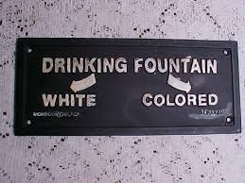
Segregation and Discrimination

Slide 2
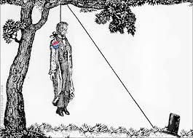
Ida B. Wells
“…This is what opened my eyes to what lynching really
was. An excuse to get rid of Negroes who were
acquiring wealth and property and thus keep the race
terrorized…”

Slide 3
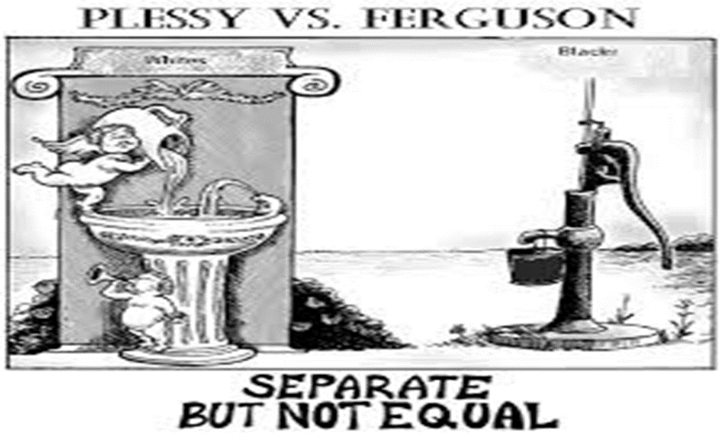

Slide 4
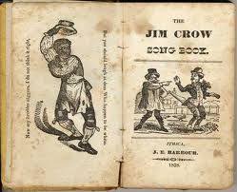
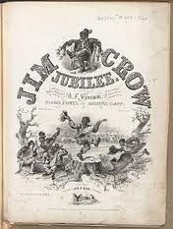
Jim Crow Laws
Southern states passed racial segregation laws
Segregation: separation of white and black people in public and private facilities
these laws became known as the “Jim Crow Laws”

Slide 5
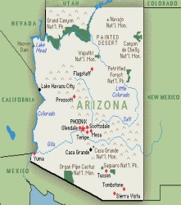
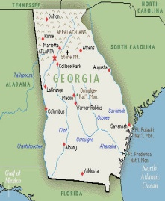
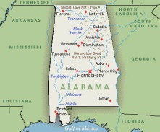
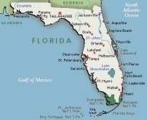
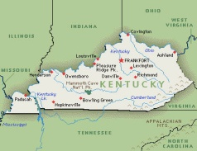
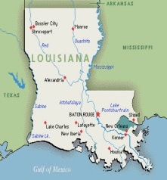
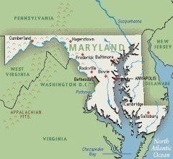
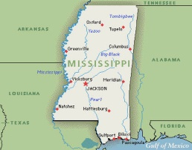
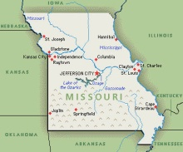
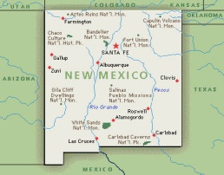
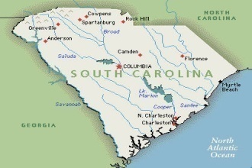
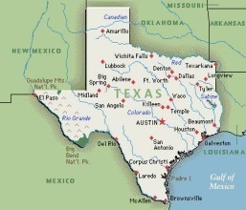
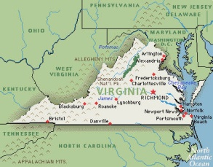
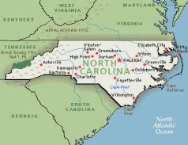
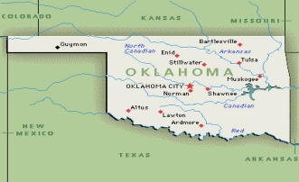
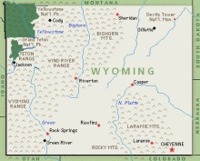
Jim Crow Laws
Alabama Arizona Florida Georgia Kentucky
Louisiana Maryland Mississippi Missouri New Mexico
North Carolina Oklahoma South Carolina Texas Virginia
Wyoming see sample “Jim Crow Laws” among states

Slide 6
Jim Crow Laws
Nurses: No person or corporation shall require any white female nurse to nurse in wards or rooms in hospitals, either public or private, in which Negro men are placed.
Buses: All passenger stations in this state operated by any motor transportation company shall have separate waiting rooms or space and separate ticket windows for white and colored races.
Railroads: The conductor of each passenger train is authorized and required to assign each passenger to the car or the division of the car, when it is divided by a partition, designated for the race to which such passenger belongs.
Restaurants: It shall be unlawful to conduct a restaurant or other place for the serving of food in the city, at which white and colored people are served in the same room, unless such white and colored persons are effectively separated by a solid partition extending from the floor upward to a distance of seven feet or higher, and unless a separate entrance from the street is provided for each compartment.
Pool and Billiard Rooms: It shall be unlawful for a Negro and white person to play together or in company with each other at any game of pool or billiards.
Toilet Facilities, Male: Every employer of white or Negro males shall provide for such white or Negro males reasonably accessible and separate toilet facilities.

Slide 7
Jim Crow Laws
Intermarriage: All marriages between a white person and a Negro person or between a white person and a person of Negro descent to the fourth generation inclusive, are hereby forever prohibited.
Cohabitation: Any Negro man and white women, or any white man and Negro woman, who are not married to each other, who shall habitually live in and occupy in the nighttime the same room shall each be punished by imprisonment not exceeding twelve (12) months, or by fine not exceeding five hundred ($500.00) dollars.
Education: The schools for white children and the schools for Negro children shall be conducted separately.
Juvenile Delinquents: There shall be separate buildings, not nearer than one fourth mile from each other, one for white boys and one for Negro boys. White boys and Negro boys shall not, in any manner, be associated together or worked together.
Mental Hospitals: The Board of Control shall see that proper and distinct apartments are arranged for said patients, so that in no case shall Negroes and white persons be together.
Intermarriage: It shall be unlawful for a white person to marry anyone except a white person. Any marriage in violation of this section shall be void.
Barbers: No colored barber shall serve as a barber [to] white women or girls.

Slide 8
Jim Crow Laws
Burial: The officer in charge shall not bury, or allow to be buried, any colored persons upon ground set apart or used for the burial of white persons
Amateur Baseball: It shall be unlawful for any amateur white baseball team to play baseball on any vacant lot or baseball diamond within two blocks of a playground devoted to the Negro race, and it shall be unlawful for any amateur colored baseball team to play baseball in any vacant lot or baseball diamond within two blocks of any playground devoted to the white race.
Parks: It shall be unlawful for colored people to frequent any park owned or maintained by the city for the benefit, use and enjoyment of white persons. and unlawful for nay white person to frequent any park owned or maintained by the city for the use and benefit of colored persons.
Wine and Beer: Any person licensed to conduct the business of selling beer or wine. shall serve either white people exclusively or colored people exclusively and shall not serve to the two races within the same room at any time.
Circus Tickets: All circuses, shows and tent exhibitions, to which the attendance of more than one race is invited or expected to attend shall provide for the convenience of its patrons not less than two ticket offices with individual sellers, and not less than two entrances to the said performance, with individual ticket takers and receivers, and in the case of outside or tent performances, the said ticket offices shall not be less than twenty-five feet (25) apart.

Slide 9
Jim Crow Laws
Housing: Any person. who shall rent any part of any such building to a Negro person or a Negro family when such building is already in whole or in part in occupancy by a white person or white family, or vice versa when the building is in occupancy by a Negro person or Negro family, shall be guilty of a misdemeanor and on convictions thereof shall be punished by a fine of not less than twenty-five ($25) nor more than one hundred ($100.00) dollars or be imprisoned not less than 10, or more than 60 days, or both such fine and imprisonment in the discretion of the court.
The Blind: The board of trustees shall maintain a separate building, on separate grounds for the admission, care, instruction, and support of all blind persons of the colored or black race.
Hospital Entrances: There shall be maintained by the governing authorities of every hospital maintained by the state for the treatment of white and colored patients separate entrances for white and colored patients and visitors, and such entrances shall be used by the race only for which they are prepared.
Prisons: The warden shall see that the white convicts shall have separate apartments for both eating and sleeping from the Negro convicts.
Textbooks: Books shall not be interchangeable between the white and colored schools, but shall be continued to be used by the race first using them.
Libraries: The state librarian is directed to fit up and maintain a separate place for the use of the colored people who may come to the library for the purpose of reading books or periodicals.

Slide 10
Jim Crow Laws
Militia: The white and colored militia shall be separately enrolled, and shall never be compelled to serve in the same organization. The organization of colored troops shall not be permitted where white troops are available, and colored troops shall be under the command of white officers.
Transportation: The Utilities Commission is empowered and directed to require the establishment of separate waiting rooms at all stations for the white and colored races.
Teaching: Any instructor who shall teach in any school, college or institution where members of the white and colored race are received and enrolled as pupils for instruction shall be deemed guilty of a misdemeanor, and upon conviction thereof, shall be fined in any sum not less than ten dollars ($10.00) not more than fifty dollars ($50.00) for each offense.
Fishing, Boating, Bathing: The Conservation Commission shall have the right to make segregation of the white and colored races as to the exercise of rights of fishing, boating and bathing.
Mining: The baths and lockers for the Negroes shall be separate from the white race, but may be in the same building.
Telephone Booths: The Corporation Commission is hereby vested with power and authority to require telephone companies to maintain separate booths for white and colored patrons when there is a demand for such separate booths. That the Corporation Commission shall determine the necessity for said separate booths only upon complaint of the people in the town and vicinity to be served after due hearing as now provided by law in other complains filed with the Corporation Commission.
Lunch Counters: No persons, firms, or corporations, who or which furnish meals to passengers at station restaurants or station eating houses, in times limited by common carriers of said passengers, shall furnish said meals to white and colored passengers in the same room, or at the same table , or at the same counter.

Slide 11
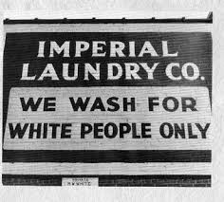
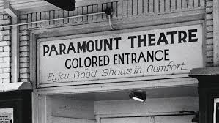
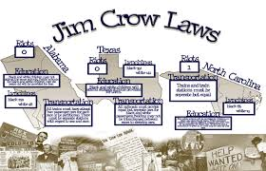
Jim Crow Laws
Child Custody: It shall be unlawful for any parent, relative, or other white person in this State, having the control or custody of any white child, by right or guardianship, natural or acquired, or otherwise, to dispose of, give or surrender such white child permanently into the custody, control, maintenance, or support of a Negro.
Theaters: Every person operating any public hall, theater, opera house, motion picture show or any place of public entertainment or public assemblage which is attended by both white and colored persons shall separate the white and colored race and shall set apart and designate certain seats therein to be occupied by white persons and a portion thereof, or certain seats therein, to be occupied by colored persons.

Slide 12
Jim Crow Laws Activity
Group One and Five: You are a black resident of Smallsville, Alabama. Compose a letter to your state government protesting Jim Crow laws. (Letters may include such issues as: poverty situation, blacks are
citizens too but have no rights, government should protect rights)
Group Two and Six: You are a white resident of Smallsville, Alabama. Compose a letter to your state government supporting the need for Jim Crow laws. (Letters may include such issues as: well known that
blacks are inferior, we need these laws so blacks do not take over society and steal jobs, white
women in danger and need protection)
Group Three and Seven: You are a black resident of Bigsville, Georgia. Compose a letter to your neighbor trying
to gather support to oppose Jim Crow laws. (Letters may include: need to organize and
band together, may meet in secret, nothing will change unless they make it change, need
our rights)
Group Four: You are a white resident in Bigsville, Georgia. Compose a letter to your fellow townspeople gathering
support for Jim Crow laws. (Letters may include: need these laws to protect whites from blacks,
without the laws whites would lose their lifestyle and jobs, women would be unprotected)
Directions: Write your name and position on the top of the paper. You may use evidence as cited in discussion and
the Jim Crow laws for support.

Slide 13
Jim Crow Activity
When you are finished with the letter, answer the following
concluding questions on your own half sheet of paper.
I’ll collect them when you exit the classroom.
Restate what a “Jim Crow” law is.
Restate the social, political, and economic causes of the Jim Crow Laws.
Name the geographic region most affected by these laws.

