Slide 1
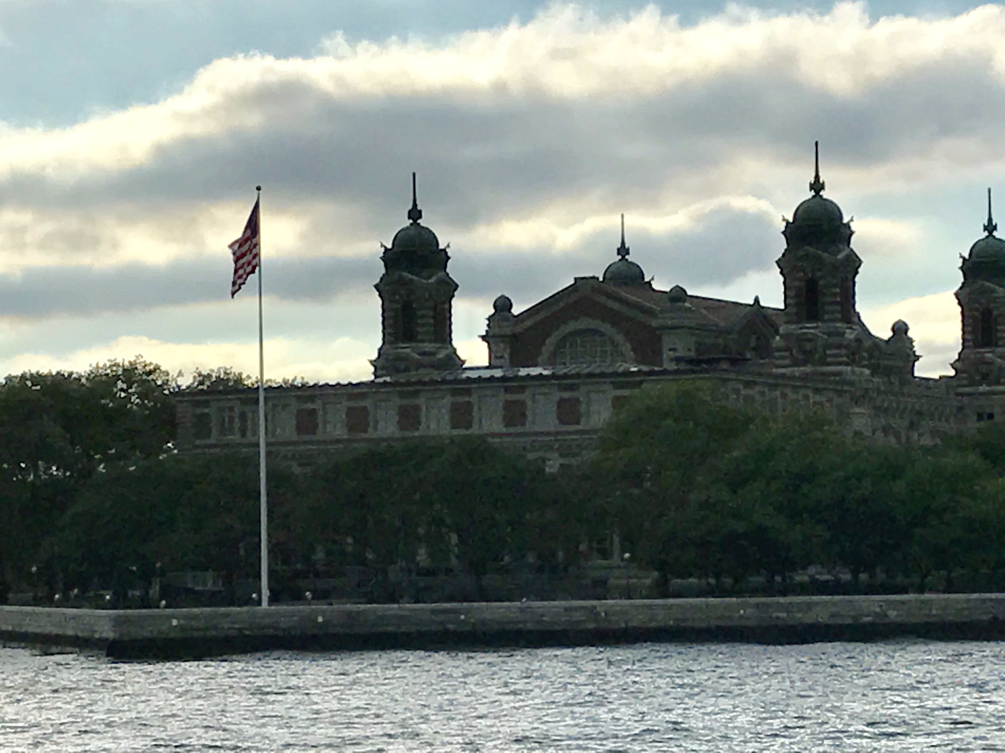
Immigration Simulation
Isle of Hope, Isle of Tears

Slide 2
-Students will be able to analyze the social, political, and economic effects of immigration.
-Students will be able to understand and discuss the difficulties immigrants in the United States faced during the late 19th early 20th century.

Slide 3
-Every group will receive a packet.
-Chose one note taker for the group.
-Write down the immigrant’s name and any details pertaining to the immigrant.
-Take notes of the discussion your group is discussing.
-Once completed, as a group decide whether or not the immigrant would be allowed into the US. Provide reasons why or why not.

Slide 4
Group 1:
Group 2:
Group 3:
Group 4:
Group 5:

Slide 5
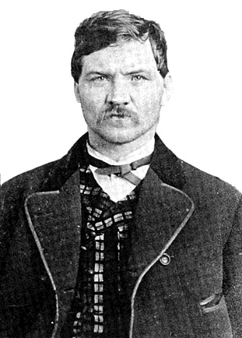
1
Thomas O’Donnell
No $
Church sponsorship
Healthy
Headed to New York
From Ireland

Slide 6
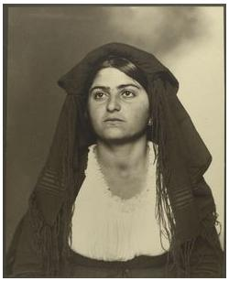
2
Sophia Ferrari
$25
Swollen eyelids
Passed Literacy Test
Headed to Boston
From Italy

Slide 7
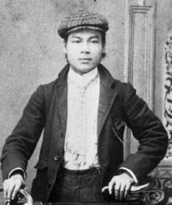
3
Lem Wong
$150
Arrived 1884
Passed Literacy Test
Healthy
From China
Headed to Oakland

Slide 8
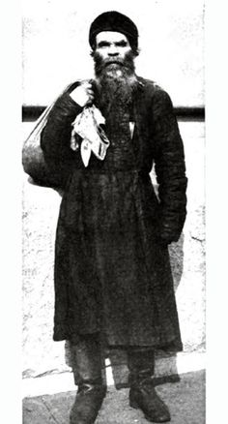
4
Stasha Mikov
$25
Broken Arm
From Russia
No Destination

Slide 9
5
Petry Farking
$50
Healthy
From England
Headed to Chicago
Criminal Record

Slide 10
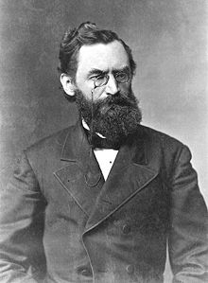
6
Gottlieb Felher
Successful businessman searching for new opportunity
Passed Literacy Test
Signs of dehydration
From Germany
Headed to New York

Slide 11
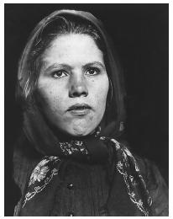
7
Marina Piatowski
Spent last $ on ticket for trip over
Passed Literacy Test
Healthy
Polish
Headed to Milwaukee

Slide 12
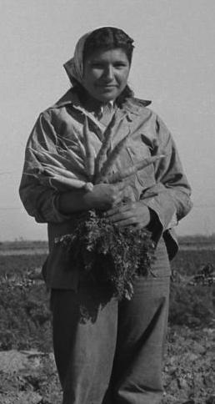
8
Maria Lucia
No $
Possible heart condition
Refugee of Mexican Revolution
From Mexico

