Slide 1
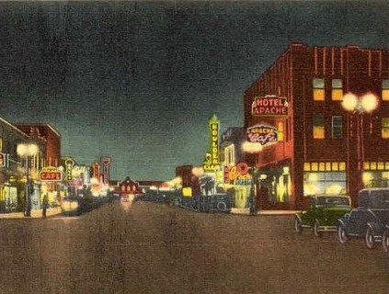
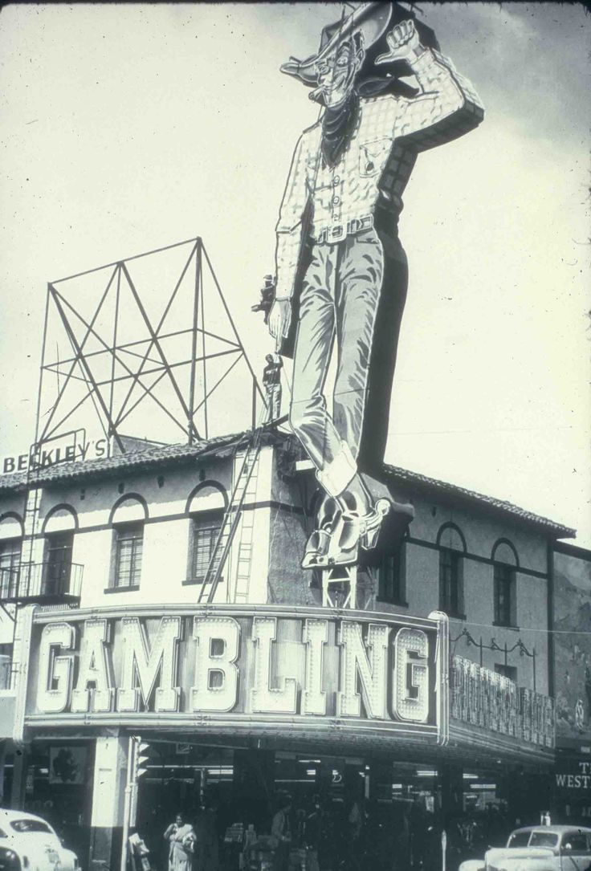
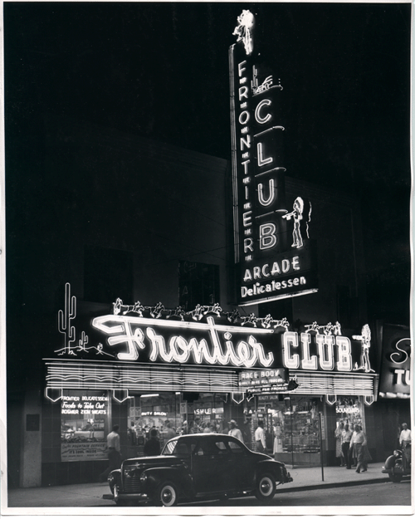
Las Vegas
A total of 21,000 men worked on building the dam over the course of its construction (around 5,000 at any one time) and the region’s growing population turned Las Vegas from a sleepy town to a bustling city

Slide 2
Bet It ALL
While traveling through Las Vegas you find a $10 Casino Chip & you decide to bet it all on Roulette in the hopes of increasing your money. Choose which color you would bet on. Write the corresponding # on your Travel Log.
1: Red
2: Black
3: Green

Slide 3
Bet It ALL
Red:
You won enough money to get to CA!
Note on your Travel Log the outcome of your bet. Did you win or Lose
Black:
You Lose!
Green:
You win enough to get a good meal

Slide 4
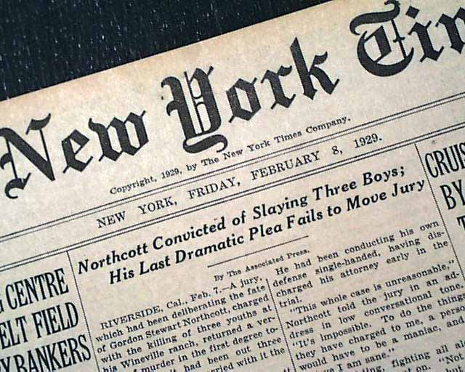
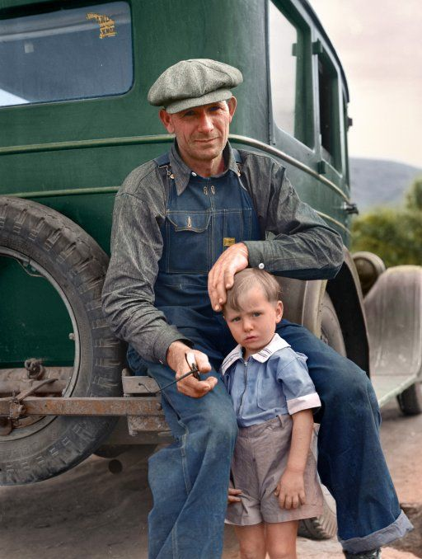
Finally Reach California and settle in the newly named town of Mira Loma

Slide 5
Okies in California
Migrant workers become source of cheap labor
Okies were not welcomed as they added to the job competition of the area

Slide 6
New Struggles
The corporate owned, larger, and more modernized farms of CA; along with the crops were unfamiliar
Life for migrant workers was hard
paid by the quantity of fruit and cotton picked
Earnings ranging from seventy-five cents to $1.25 a day
Out of that, they had to pay twenty-five cents a day to rent a tar-paper shack with no floor or plumbing
In larger ranches, they often had to buy their groceries from a high-priced company store

Slide 7
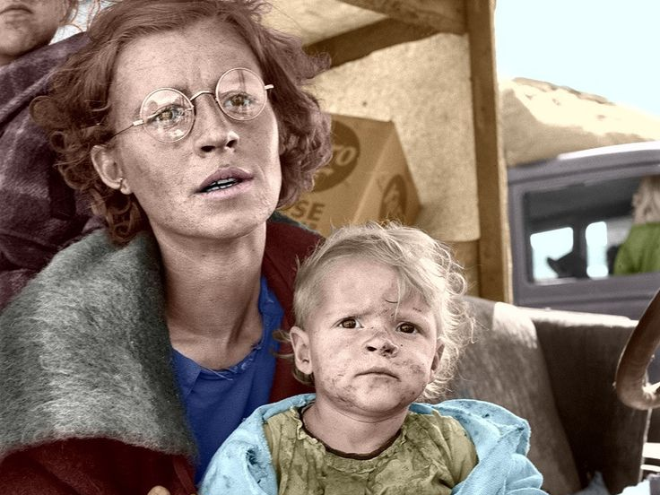
Hopefully the new President, Franklin Roosevelt will be able to pull us out of this mess
Hopefully thing will get better with the new President FDR

Slide 8
FDR
Hoover was not re-elected President
Franklin D Roosevelt is elected in 1932
Though the relief and reform measures put into place by President Franklin D. Roosevelt helped lessen the worst effects of the Great Depression in the 1930s, the economy would not fully turn around until after 1939, when World War II kicked American industry into high gear

Slide 9
How Does your story end?
Add up all your numbers & record the sum on your sheet

Slide 10
How Does your story end?
ODD #- For the rest of the 1930s you work inconsistent farm jobs & eventually HUSBAND gets drafted for WWII
On your TRAVEL LOG note how your journey ends
1. EVEN #- For the rest of the 1930s you are lucky and get hired by the PWA & WPA (government job programs). When the war starts both spouses will work in the factories

