Slide 1
Dust Bowl Causes
1. drought
3. overproduction of crops
2. high winds
4. Loss of prairie grasses due to over plowing

Slide 2
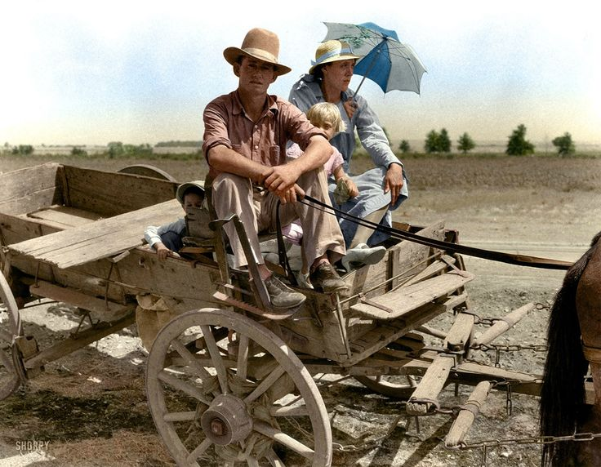
Uncle, why did the Bank man say we have to leave?

Slide 3
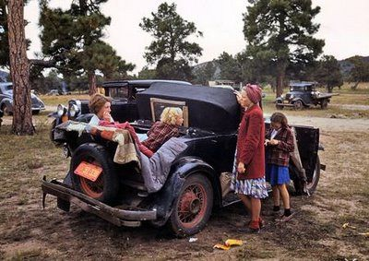
Okies
Road trip to California
Many Midwestern farmers and Great Plains farmers lost their farms.
60 percent of the population left the region
Many families moved west to California hoping to find a better life

Slide 4
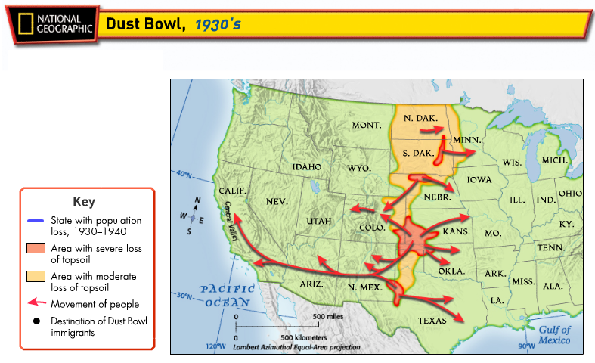

Slide 5
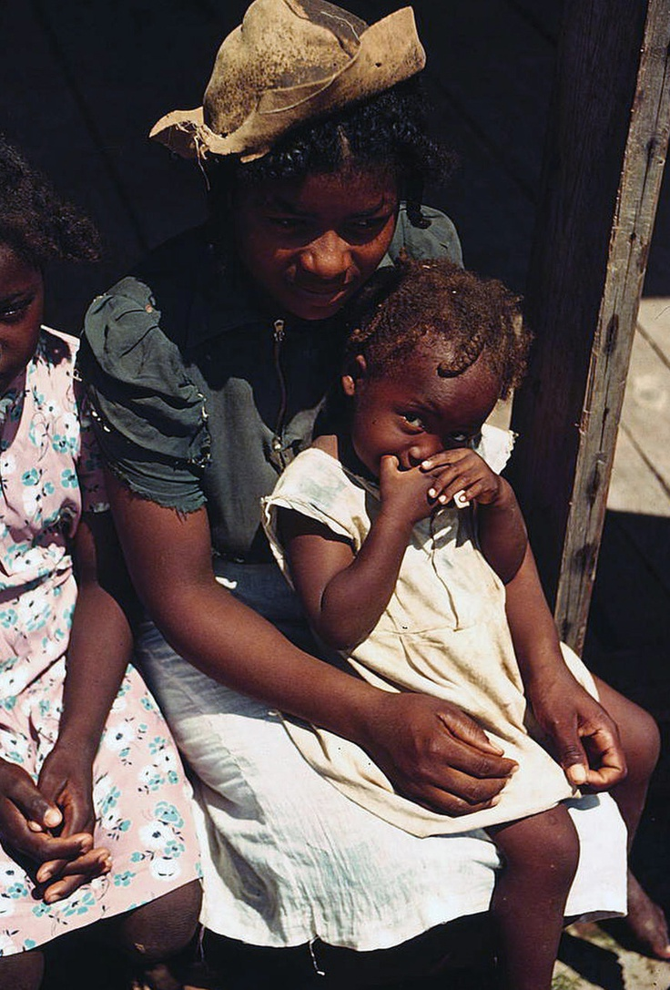
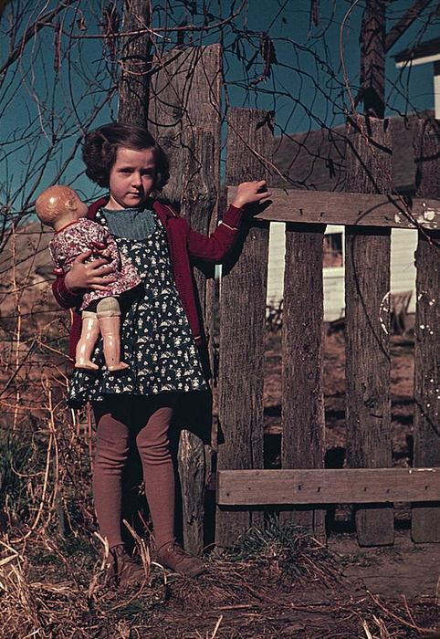
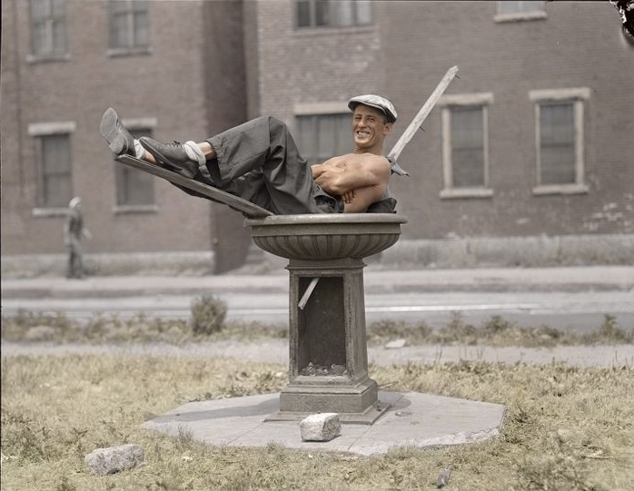
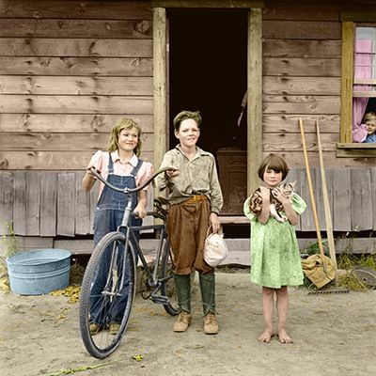
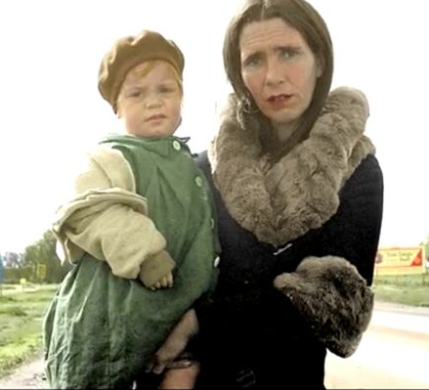
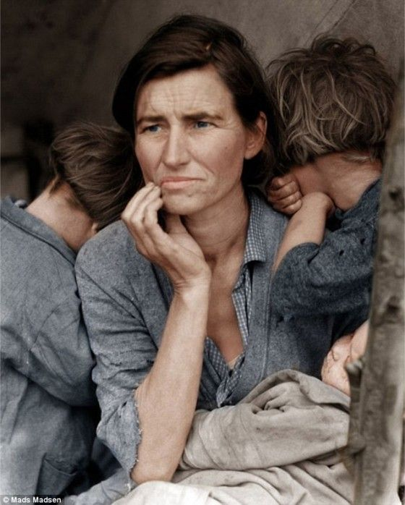
Some of the sights along the way

Slide 6
Road Problem
1
2
Choose one of the #s & write the # on your Travel Log to find out what road issue you encountered
3
4

Slide 7
Road Problem
1- Ran out of gas & had to beg for spare change
2- Ran out of food so you had to dig through trash cans along the way
On your Travel Log note what problem you encountered
3- Engine problems resulted in you not traveling for a week until you found the part you needed
4- With car troubles you turned your car into a HOOVER WAGON

Slide 8
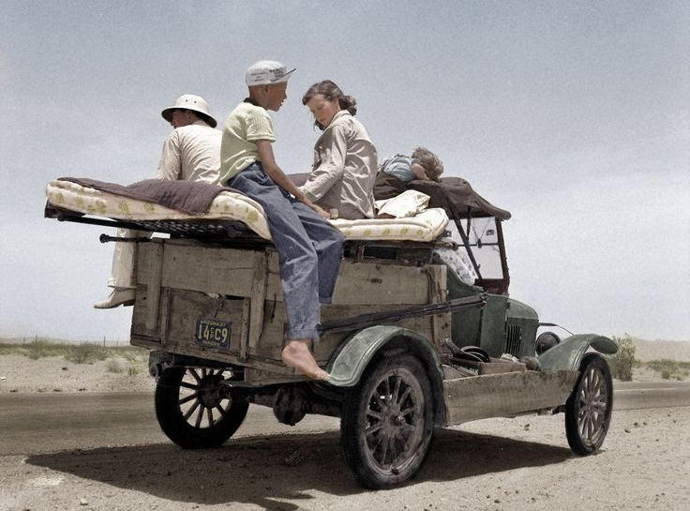
Finally, back on the Road
At least we found this mattress as a result

Slide 9
You stop the car to view the amazing construction of the
Boulder Dam

Slide 10
Hoover Dam
Hoover successfully organized and authorized the construction of the Boulder Dam (Now called the Hoover Dam)
The $700 million project was the world’s tallest dam (726 feet) and the second largest (1,244 feet long)
The dam currently provides electricity, flood control and water for 7 western states

Slide 11
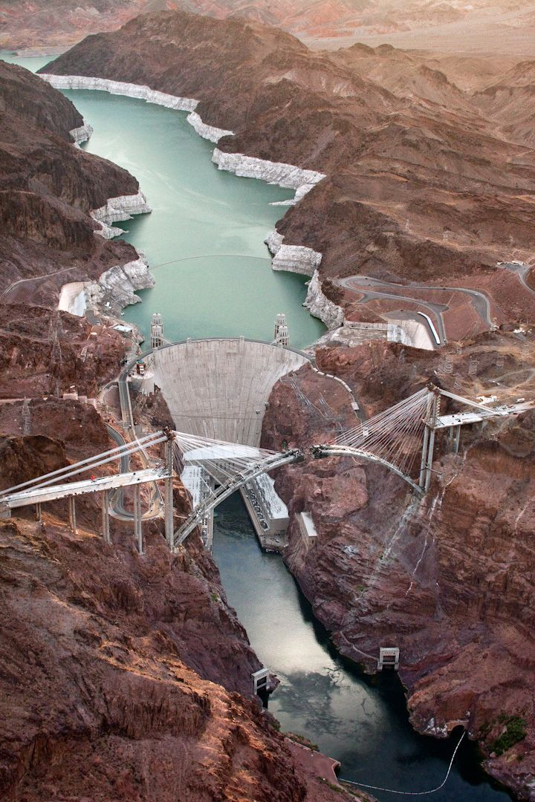
Building Hoover Dam required more than 5 million barrels of concrete. The finished dam contains enough concrete (4.5 million cubic yards) to build a two-lane highway from Seattle, Washington to Miami, Florida.

