Slide 1
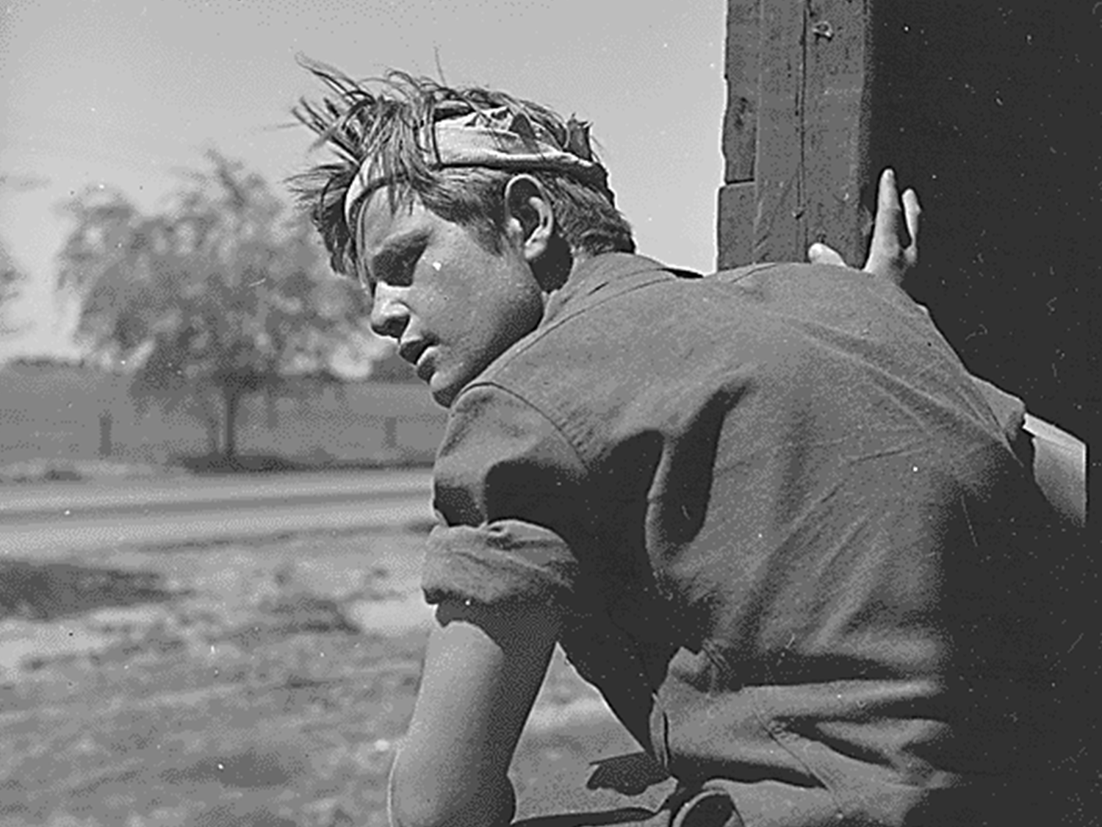
Hobos, or homeless Americans who wandered around hitching rides on railroad cars, searched for work and a better life.
HOBOs

Slide 2
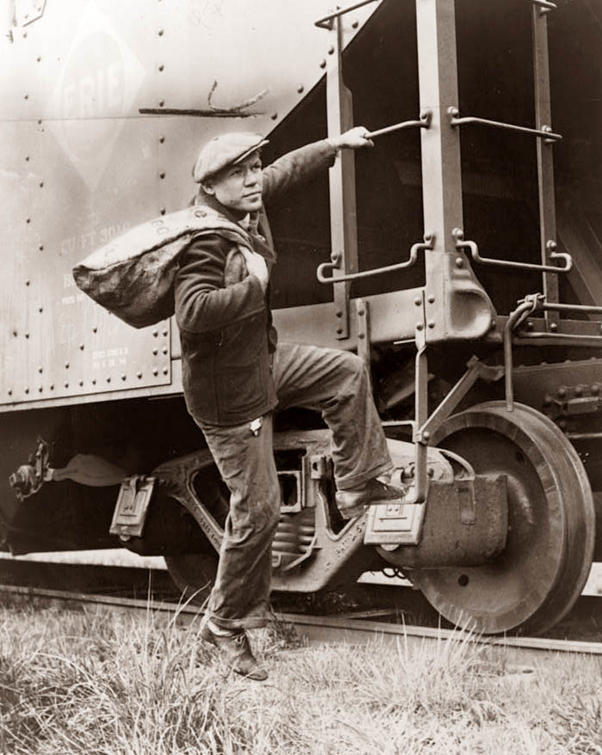
Riding the Rails
During the Great Depression some people, primarily men and teenage boys, took advantage of their homelessness and rode the rails across the United States.

Slide 3
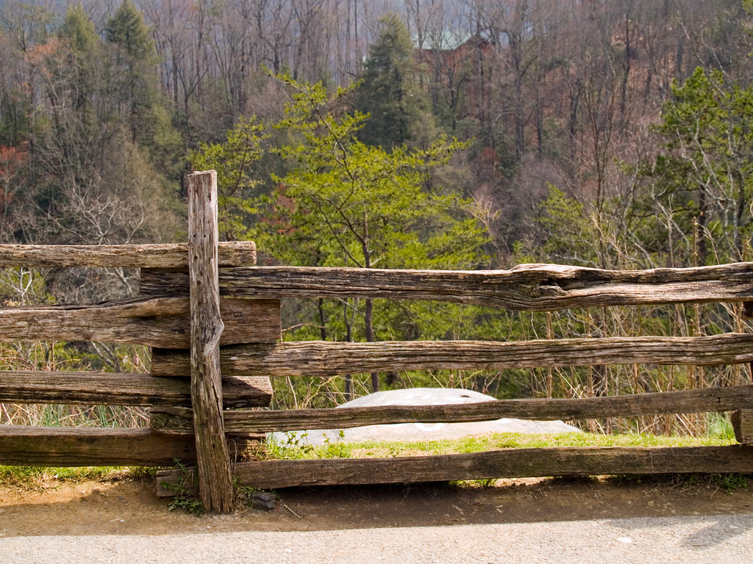
Hobo Markings
Since people reacted in different ways to these homeless “hobos”, these wanderers began to use markings to help fellow hobos who came after them.
These might be left in chalk on a fencepost, on the side of building, or some other place that would be visible to other hobos who came along later.

Slide 4
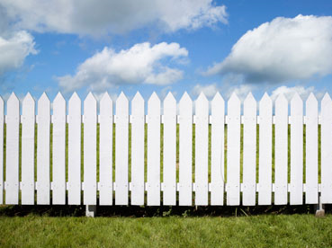
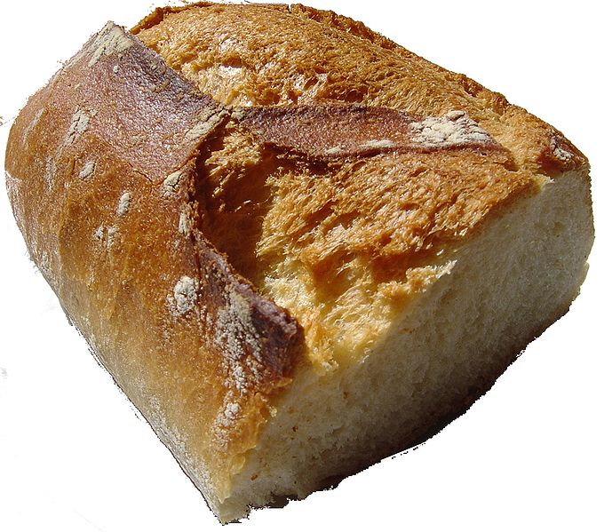
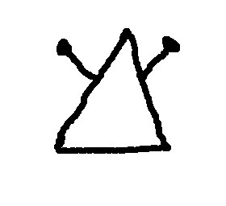
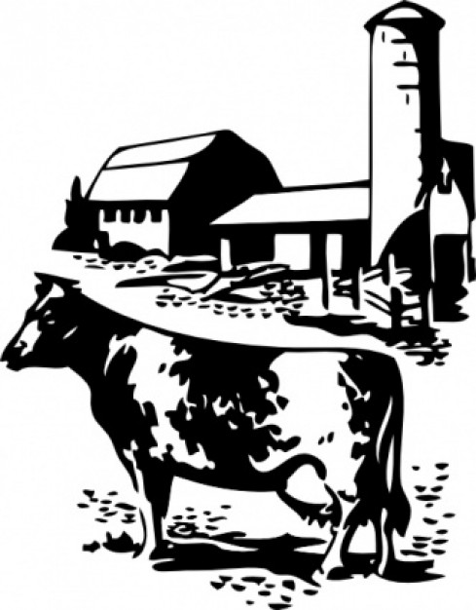
You jump off the train in Kentucky when it slows down at a small town crossing. After wandering through town, you stop at a small, cozy-looking farm just outside the town. The smell of freshly baked bread wafts toward your from the open kitchen window. You are about to go try to sneak some of the bread when you notice the marking below in white chalk on the side of the fencepost.
What Would You Do?
1. Steal the bread
2. Keep Walking
Write down the # you choose on your handout

Slide 5
Hopefully you chose #2 to keep walking. This sign means “Man With a Gun”. If you had tried to steal the bread you might have been shot.
Drawn the symbol & the meaning on your handout

Slide 6
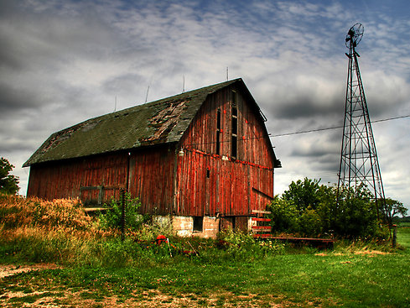
You keep walking until you see another farmhouse and an old barn. You think you’ll try to sneak into the barn and sleep there for the night but notice the marking below carved into a nearby fence post. Based on this marking, do you:
What Would You Do?
1. Go to the farmhouse & ask for food
2. Keep Walking
Write down the # you choose on your handout

Slide 7
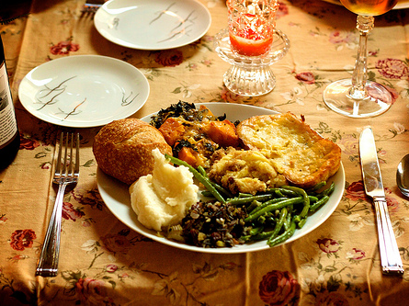
If you chose to keep walking then you missed a free meal. This sign means “Good for a handout”
Drawn the symbol & the meaning on your Travel Log

Slide 8
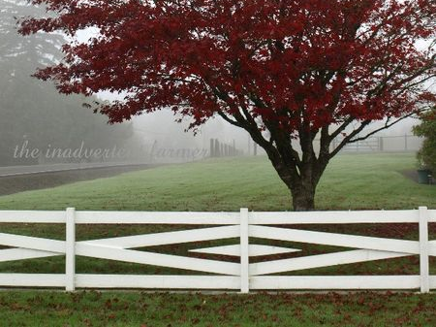
The next day you are walking by a small house when you notice that they have a large apple tree with plenty of juicy, ripe apples on some low branches. You think about hopping the fence and grabbing a few for dinner but see the marking below marked on the fence. Based on the marking, do you:
1. Jump the fence & steal the apples
2. Keep Walking
Write down the # you choose on your Travel Log

Slide 9
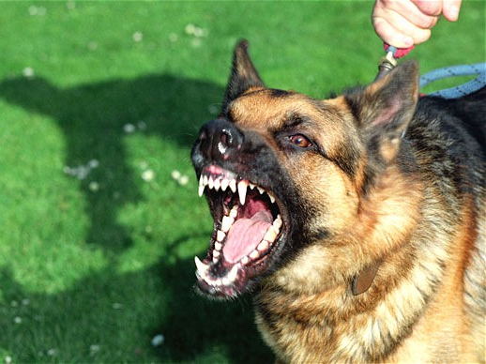
Drawn the symbol & the meaning on your Travel Log
Hopefully you either went to the door and asked or kept walking. If you had hopped the fence you might be in some pain.
This sign means “Mean Dog Here”

Slide 10
More Hobo Signs

Slide 11
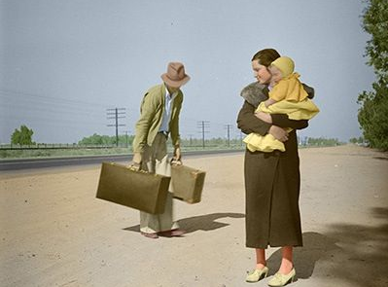
I’m hungry!
Lets go find a breadline or soup kitchen

Slide 12
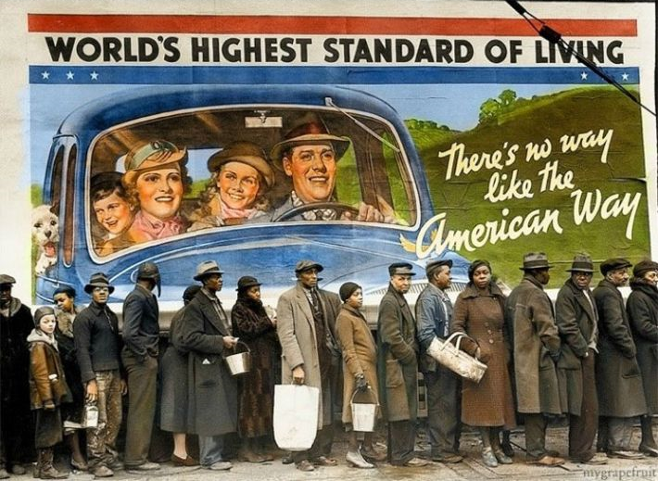
You are here
Getting a free handout in the breadline

Slide 13
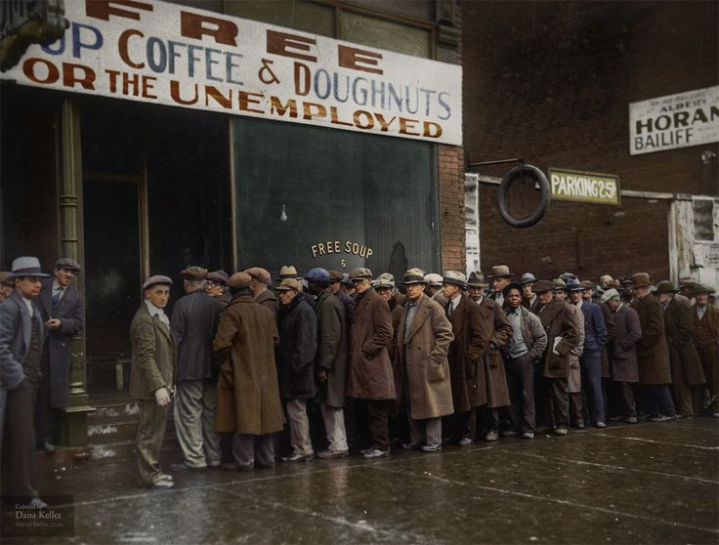
Then you head over to the Soup Kitchen

Slide 14
Soup kitchens in America started around 1929
When soup kitchens first appeared, they were run by churches or private charities.
Al Capone opens the first soup kitchen
By the mid-1930s, state and federal governments also were operating them.
Soup kitchens served mostly soup and bread. Soup was economical because water could be added to serve more people, if necessary
Soup Kitchens

Slide 15
Soup Kitchen Meal
1
2
Choose one of the #s & write the # on your Travel Log to find out what you ate
3
4

Slide 16
Soup Kitchen Meal
On your Travel Log note what you ate
1- They ran out. NO SOUP FOR YOU!
2- Beef Stew & Sweet Roll
3- Potato & Carrot Soup w/ French Roll
4- Cabbage &Tomato Soup w/ bread slice

Slide 17
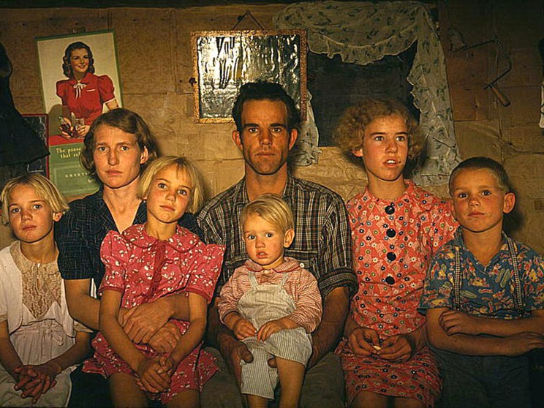
You arrive in Oklahoma
Your sister is taking you in

Slide 18
Soon after you arrive severe Dust Storms continue to plague the area

Slide 19
Dust Bowl
AKA Black Blizzard
The Dust Bowl was the name given to the Great Plains region devastated by drought in 1930s depression
The 150,000-square-mile area, encompassing the Oklahoma and Texas panhandles and neighboring sections of Kansas, Colorado, and New Mexico
During the 1920s, farmers were struggling to get by and they continued to plant more and more, using top soil and farming areas that had been grassland.
When a drought struck from 1934 to 1937, the soil lacked the stronger root system of grass as an anchor, so the winds easily picked up the loose topsoil and swirled it into dense dust clouds, choking cattle and farm lands
One storm in 1934 picked up millions of tons of dust and carried it to the East Coast

Slide 20
