Slide 1
Reduction in Purchasing
Between 1928-1932, the U.S. Gross National Product (GNP) – the total output of a nation’s goods & services – fell nearly 50% from $104 billion to $59 billion

Slide 2
Reduction in Purchasing
In 1930, Congress tried to protect American businesses by passing the Hawley-Smoot Tariff Act
Largest tariff in history
Tried to protect Americans from foreign competition
Had opposite effect
Other countries wouldn’t buy our goods
Our businesses couldn’t buy materials from other countries
Many countries retaliated
Within a few years – world trade falls 40%

Slide 3
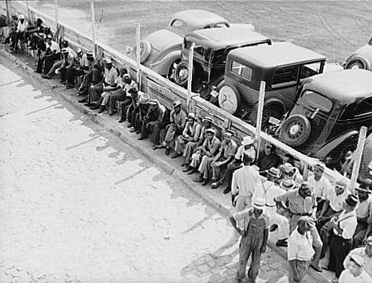
No Work
By 1933 thousands of banks and closed and millions of Americans were unemployed
90,000 businesses went bankrupt
Unemployment leaped from 3% in 1929 to 25% in 1933
14 million are jobless- 1933
Notes:
Unemployed workers often stood at bread lines to receive free food or at soup kitchens where private charities gave a free meal to the poor.

Slide 4
New Ways to Make a Living
1
4
With the loss of our job we need to find new ways to save & make money. Choose one of the #s & write the # on your Travel Log
2
5
3
6

Slide 5
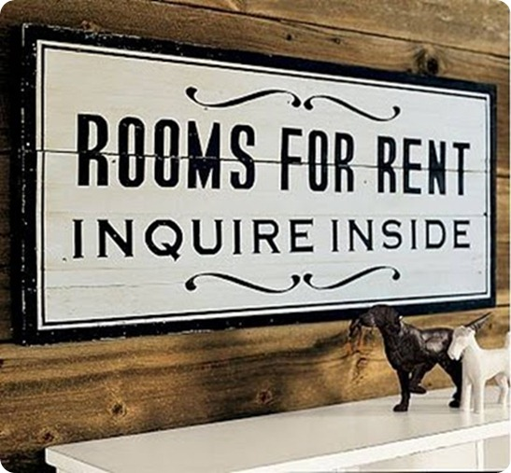
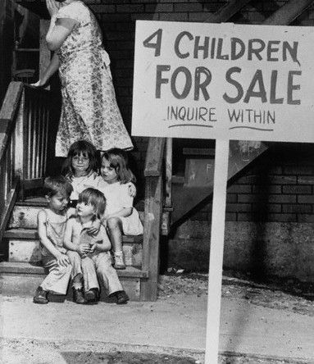
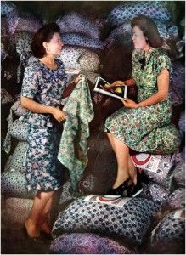
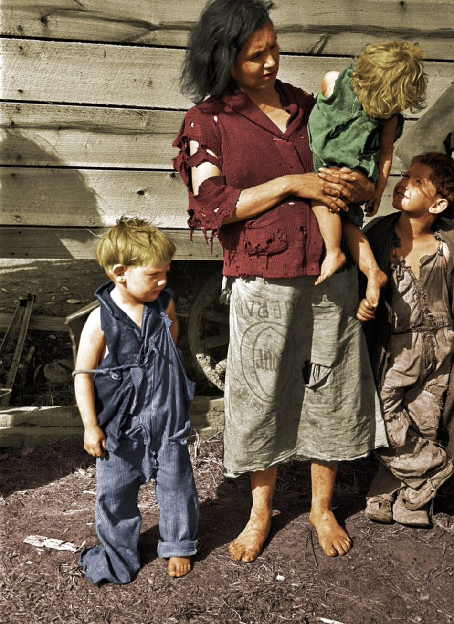
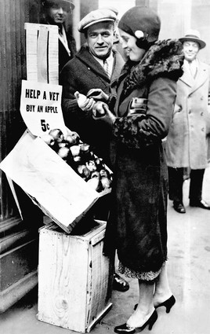
New Ways to Make a Living
1- Take in tenants
4- sell all of your furniture
On your Travel Log note what new ways your family resorted to, to make extra money
2- Put your child up for adoption
5- Beg on the corner
3- Make your clothing out of flour sacks
6- Sell Apples
Notes:
Depression Era: when they realized women were using their sacks to make clothes for their children, the mills started using flowered fabric for their sacks. The label was designed to wash out.

Slide 6
Your Home
It wasn’t enough to save your house!

Slide 7
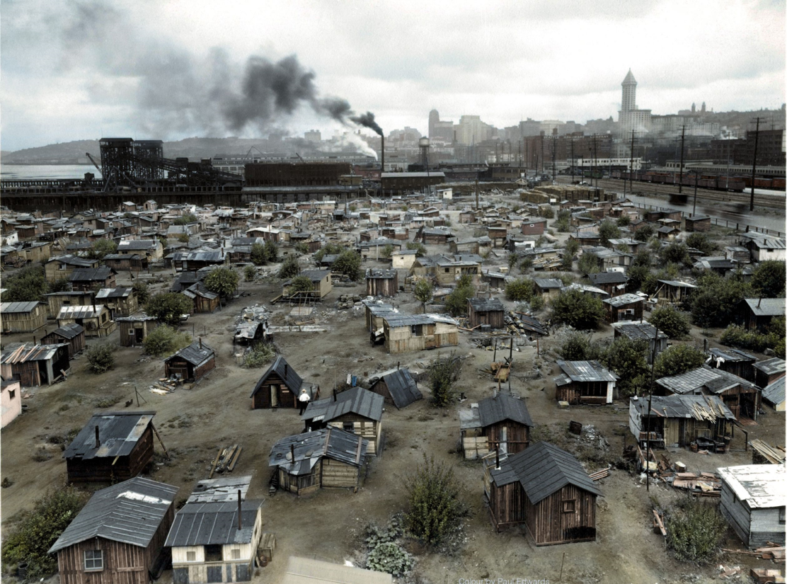
With no home, you move to a Hooverville in Washington DC

Slide 8
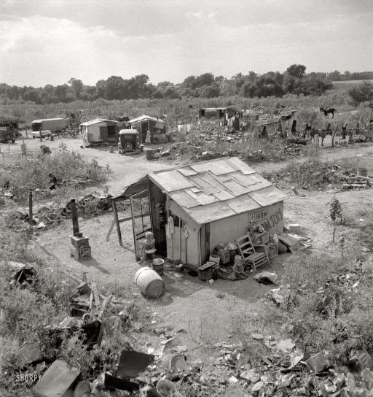
HOOVERVILLES
A "Hooverville" or shanty town was a community of houses or “shantys” made from scraps they could find
By calling them “Hoovervilles” people conveyed their disgust and disappointment with Hoover.

Slide 9
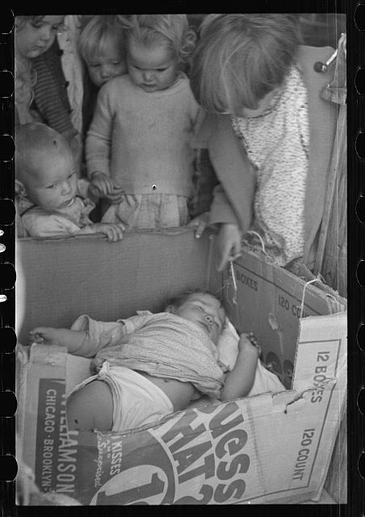
Life Has Changed A lot

Slide 10
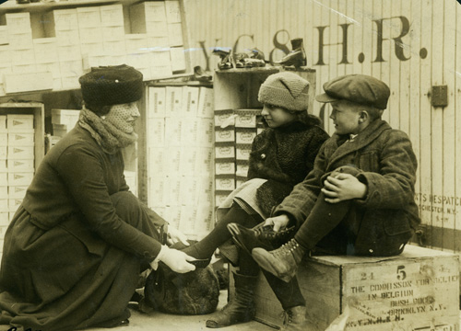
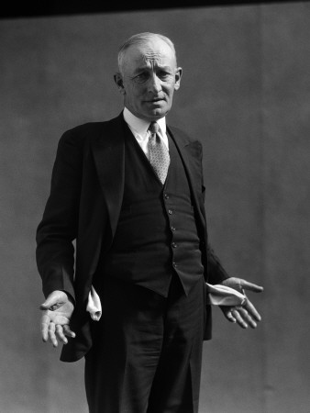
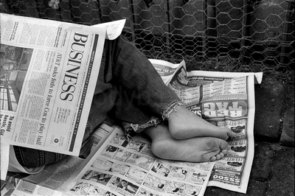
In addition to the term “Hooverville,” President Hoover’s name was used mockingly in other ways during the Great Depression.
When soles wore out of shoes, the cardboard used to replace them was dubbed “Hoover Leather”
“Hoover Flags”
“Hoover Wagon”
“Hoover Blankets”

Slide 11
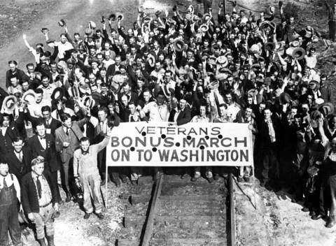
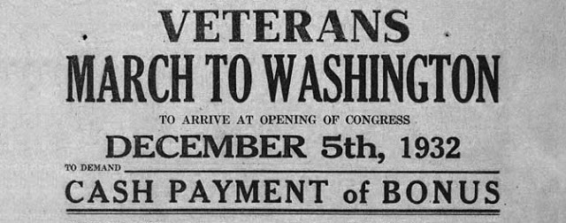
Part of the reason you came to DC to set up your Shanty was to show your support for the passage of the PATMAN BILL. If Congress passes the PATMAN BILL it would be VERY beneficial for WWI Veterans like yourself.

Slide 12
Bonus Army
Spring of 1932 about 15,000 World War I vets arrived in Washington to support the passage of the proposed Patman Bill
If the bill passed WWI Vets would be issued a $1000 bonus immediately instead of waiting until its scheduled date of 1945

Slide 13
Putnam Bill Rejected
On June 17, 1932 the Senate voted down the Putnam Bill
Hoover called the Bonus marchers, “Communists and criminals”

Slide 14
Marchers Clash with Soldiers
Hoover told the Bonus marchers to go home– most did
2,000 refused to leave
Hoover sent a force of 1,000 soldiers under the command of General Douglas MacArthur and his aide Dwight Eisenhower
MacArthur’s 12th infantry gassed more than 1,000 marchers, including an 11-month old baby, who died
Burned down Shantys
Two vets were shot and scores injured
Americans were outraged with Hoover

Slide 15
BONUS MARCHERS
1- Your baby died as a result of the gas
4- Your Shanty & belongings burned down
On your sheet note what happened to you or your family
2- You were hospitalized & now have medical bills
5- You left crying before the troops came
3- Arrested for rioting

