Slide 1
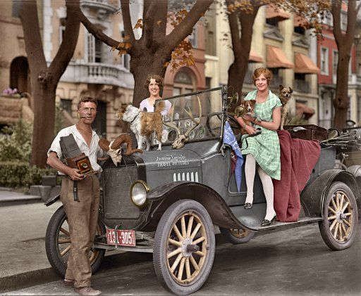
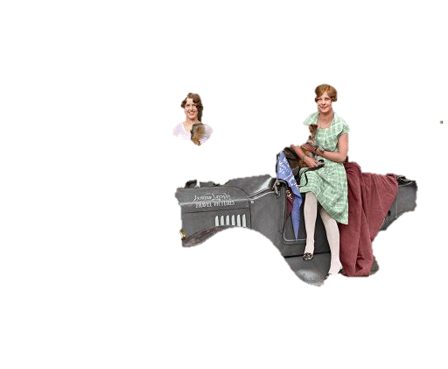
Journey Through Your Life
During the
Great Depression

Slide 2
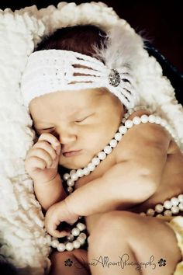
Congratulations
It’s 1929 and you are loving life.
In the past year you got married and had a baby girl.

Slide 3
Your Home
You want to make sure your family has the best things in life and a future of prosperity.
You feel so confident in America’s financial security you decide to invest a huge portion of your savings into the stock market to start your new family off in the right direction

Slide 4
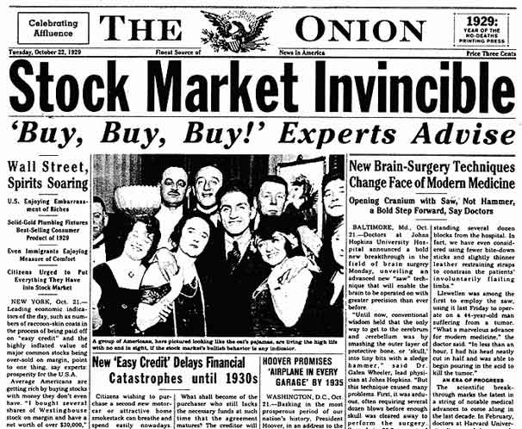

Slide 5
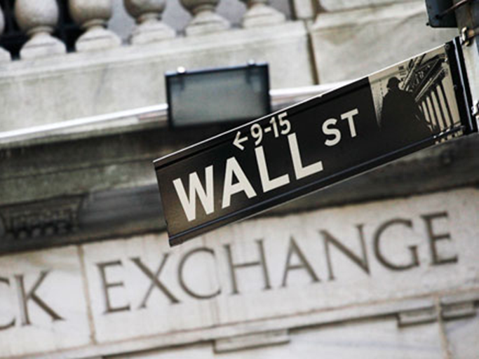
Stocks to Invest In:
1: Tel-Tone Telephone Company
4: Gotham Bank
Choose one of the stocks to invest your life savings into. Write the # associated with your stock on your Travel Log
2: Radio Corporation
5: Ford Motors
3: Mammoth Oil
6: Kansas & Pacific Railroads

Slide 6
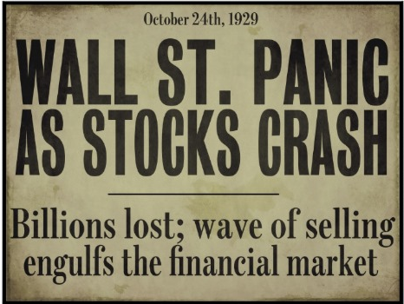

Slide 7
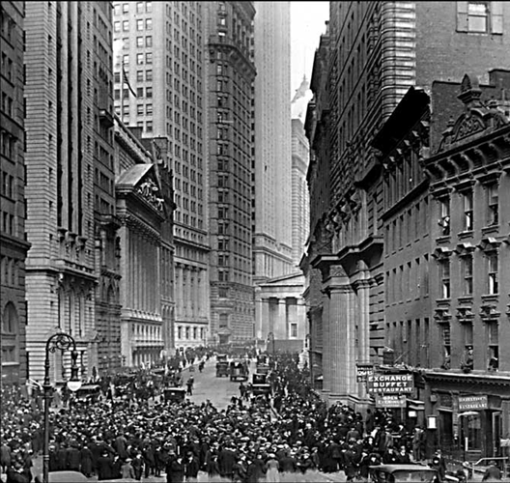
The Great Crash
By late 1929, a lack of new investors in the stock market caused stock prices to drop
Too much speculation
On October 29, 1929, stock prices fell drastically on Black Tuesday, resulting in a $10 to $15 billion loss in value. While this did not cause the Great Depression, it did undermine the economy’s ability to hold out against its other weaknesses.
Farmers didn’t benefit from the boom of the 1920s
People lived on credit –spent more than they could afford
Uneven distribution of income

Slide 9
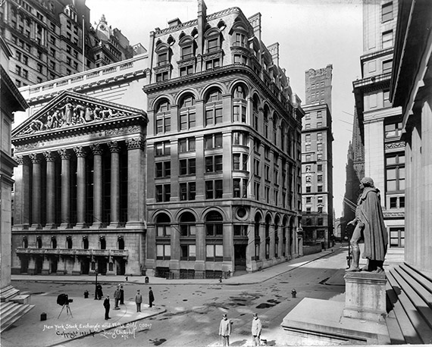
The Great Depression Begins
The Stock Market crash signaled the beginning of the Great Depression
The Great Depression is generally defined as the period from 1929 – 1940 in which the economy plummeted and unemployment skyrocketed

Slide 10
Worth of Your Stocks
1: TEL-TONE TELEPHONE COMPANY- This stock declined in value by 50%- You just lost ½ of your life savings. You put what you have left in the bank.
4: GOTHAM BANK- This stock declined in value by 90%. You just lost 90% of your life savings
2: RADIO CORPORATION-YOU got lucky! This stock remained the same so you pull your money out and put it in the bank for safe keeping.
5: FORD MOTORS- This stock declined in value by 50%- You just lost ½ of your life savings
On your Travel Log note what happened to your stock
3: MAMMOTH OIL- This stock is worthless & you now owe $ because you bought it on the margin
6: KANSAS & PACIFIC RAILROADS- This stock declined in value by 90%. You just lost 90% of your life savings

Slide 11
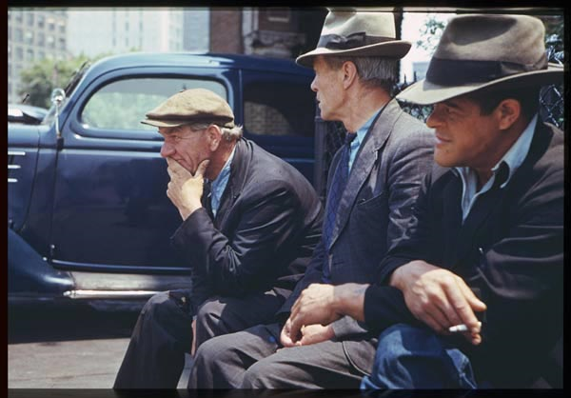
You are now in despair as you and your family are barely hanging on to hope.
With most of your savings depleted you cannot afford for anything more to go wrong so you look to president Hoover for answers

Slide 12
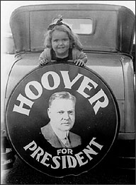
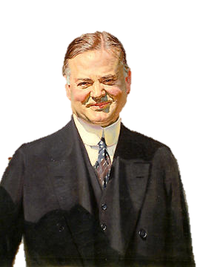
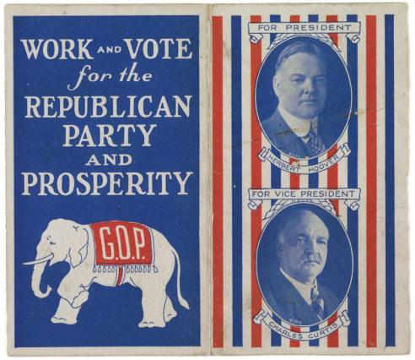
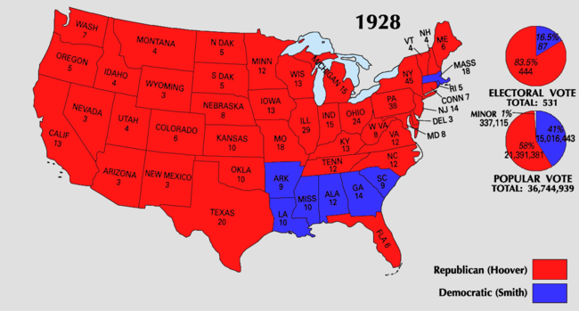
Hoover Elected in 1928
-Republican Herbert Hoover ran against Democrat Alfred E. Smith in the 1928 election
-Hoover emphasized years of prosperity under Republican administrations
-Hoover won an overwhelming victory

Slide 13
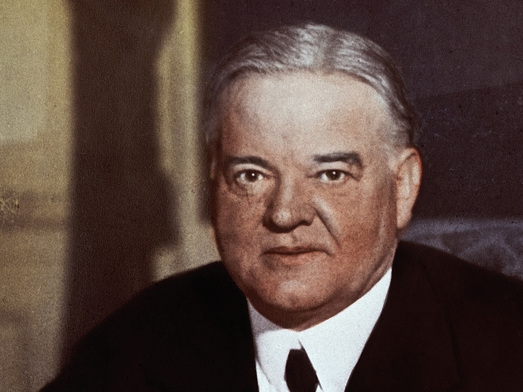
I believe in “Rugged Individualism”…the idea that people succeed through their own efforts. People should take care of themselves, not depend on governmental hand-outs
He said people should “pull themselves up by their bootstraps”
After the stock market crash, President Hoover tried to reassure Americans
He said, “Any lack of confidence in the economic future . . . Is foolish”
He recommended business as usual
H. Hoover

Slide 14
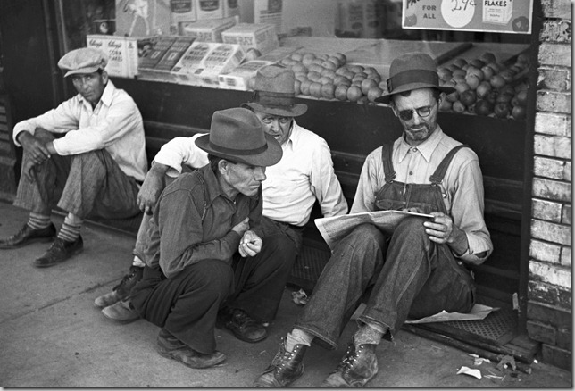
This article says that Hoover doesn’t believe it is the government’s job to fix the economy or provide financial assistance. Well… Thanks for nothing Hoover.
Well thanks for nothing Hoover

Slide 15
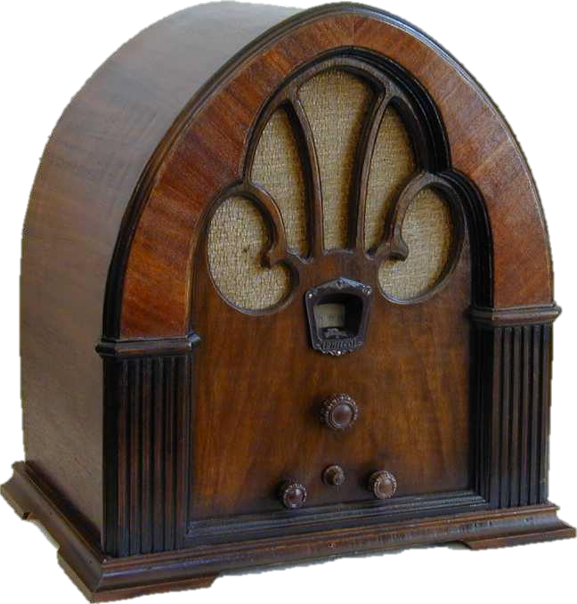
RADIO ANNOUNCEMENT
As a result of the stock market crash it appears many people are not able to repay their loans to the bank. The banks may run out of money if this continues

Slide 16
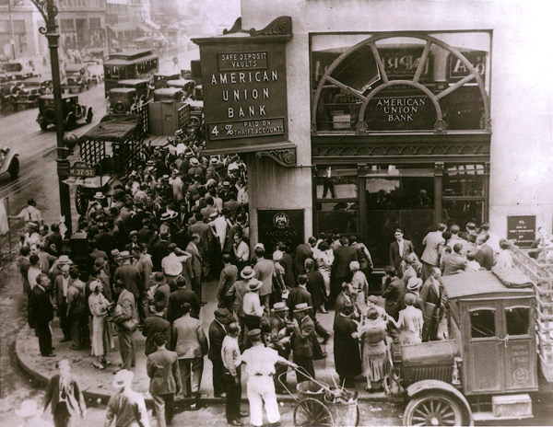
Bank Run
You rush to your bank to pull
out all of your money

Slide 17
Bank Failures
After the crash, many Americans panicked and withdrew their money from banks
In addition as a result of the crash many people were not able to repay their loans to the banks.
Banks had invested in the Stock Market and lost money
In 1929- 600 banks fail
By 1933 – 11,000 of the 25,000 banks nationwide had collapsed
When the banks collapsed depositors lost their savings
Notes:
https://www.youtube.com/watch?v=EOzMdEwYmDU

Slide 18
Bank Run
Choose one of the #s & write the # on your Travel Log
1
2
3
4

Slide 19
Bank Run
On your Travel Log note what happened to your savings
1- You pushed your way to the front but the teller was only able to give $50
2- The mob of people was too overwhelming. The bank ran out of money before you could withdraw anything
3- You are arrive at the bank first thing in the morning but most of the money was withdrawn the day before so the most they can give you is $65
4- The mob of people was too overwhelming. The bank ran out of money before you could withdraw anything

Slide 20
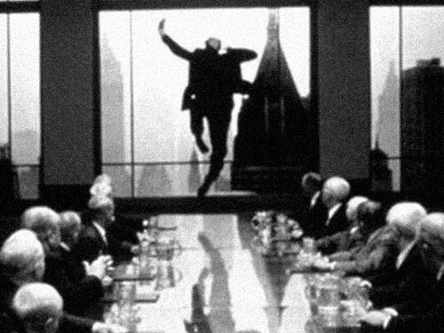
Suicide
STOP! Mr. Robinson. It’s not worth it!

Slide 21
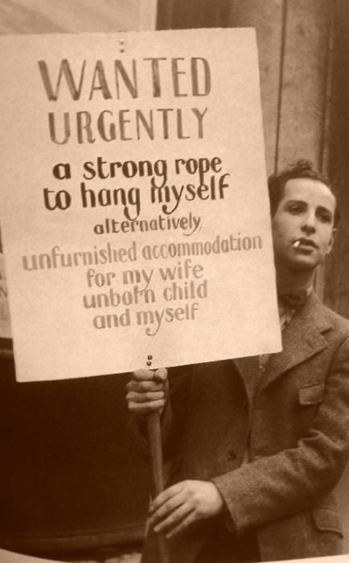
With the loss of so much so quickly many people unfortunately committed suicide
The suicide rate climbed 30 percent between 1929 and 1932

Slide 22
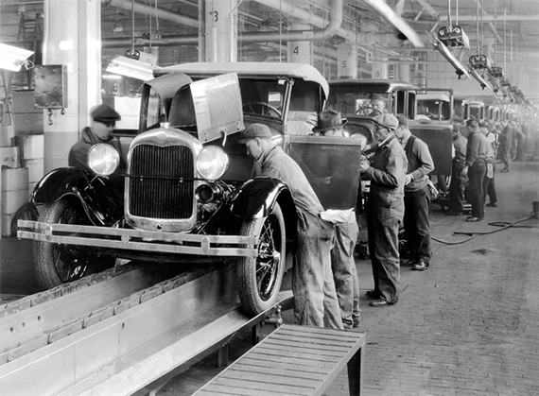
But at least you still have your job

Slide 23
