Slide 1
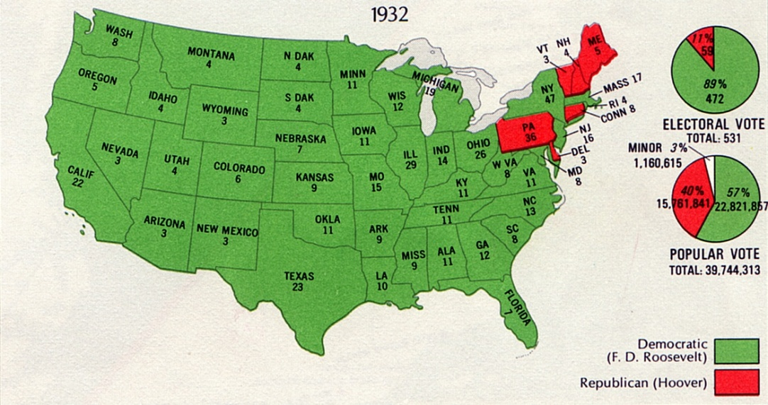
AMERICANS GET A NEW DEAL
The Presidential Election of 1932
Republicans run Hoover knowing he has little shot at winning.
Democrats run Franklin Delano Roosevelt
Roosevelt won an overwhelming victory
23 million votes to Hoover’s 16 million
Democrats claimed a nearly two
thirds majority in the Senate
Democrats also controlled almost three-fourths of the House
Election showed Americans were ready for a change!

Slide 2
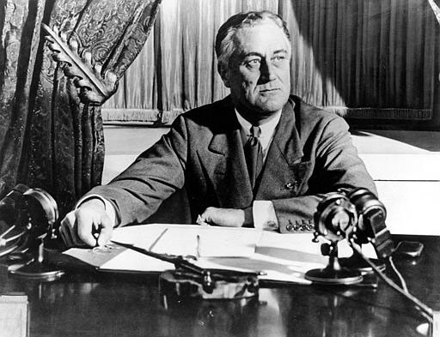
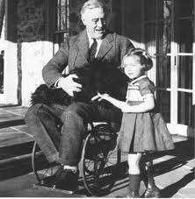
FRANKLIN ROOSEVELT
Two term governor from New York
Distant cousin of Teddy Roosevelt
Had a “can do” attitude that attracted voters
Was very compassionate
Effective, reform minded leader
Partially paralyzed from the waist down due to polio
Age 38
Was not often photographed in his wheelchair
Made a point of standing during his speeches
The media helped to hide his disability

Slide 3
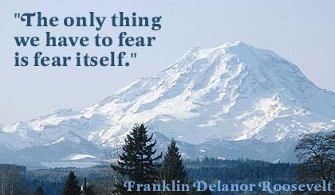
WAITING FOR ROOSEVELT TO TAKE OVER
Four months between Roosevelt’s election and inauguration (Hoover’s “lame duck” period)
Roosevelt formed his “Brain Trust”
Carefully picked group of advisors
Began to formulate what we know as “The New Deal”

Slide 4
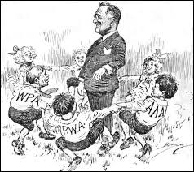
THE HUNDRED DAYS
Lasted from March 9th to June 6th, 1933
During this period, Congress passed more than 15 pieces of major New Deal legislations that expanded government’s role in the nation’s economy
Roosevelt’s first day in office,
he persuaded Congress to pass
the Emergency Banking Relief Act,
which authorized the Treasury
Department to inspect the
nation’s banks

Slide 5
A NEW DEAL FIGHTS THE GREAT DEPRESSION
The New Deal Centered Around Three R’s:
Relief
Relief checks and jobs programs to lower unemployment
Recovery
Programs to stimulate agriculture, industry, and the economy to end the depression
Reform
Programs to correct problems in the economy and prevent future depressions

Slide 6
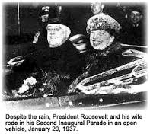
THE SECOND HUNDRED DAYS
By 1935, Roosevelt was looking for ways to build on The Hundred Days
Gains not as great as expected
Unemployment still high
Production still lagged

Slide 7
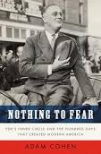
THE SECOND HUNDRED DAYS
Roosevelt decided to launch a second burst of activity in which he asked Congress to provide more extensive relief for both farmers and workers
Commonly referred as “The Second New Deal”; was also called “The Second Hundred Days”

Slide 8
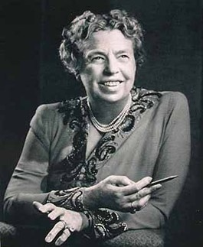
ELEANOR ROOSEVELT
Roosevelt’s wife who helped remind him of the suffering of the average American
She acted as his “eyes and ears” since he couldn’t get out and about easily
Social reformer who combined her deep humanitarian impulses with great political skills

Slide 9
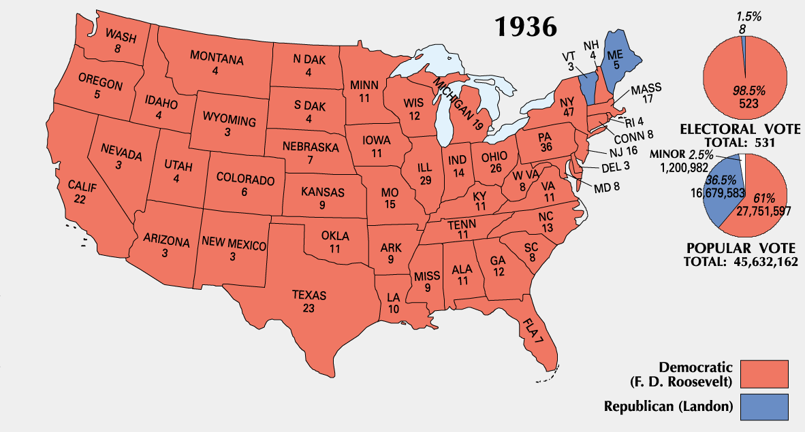
ELECTION OF 1936
Roosevelt easily defeats Alfred Landon
Roosevelt draws votes from a wide variety of groups
Significant because it was the first time that African Americans voted Democratic instead of Republican

Slide 10
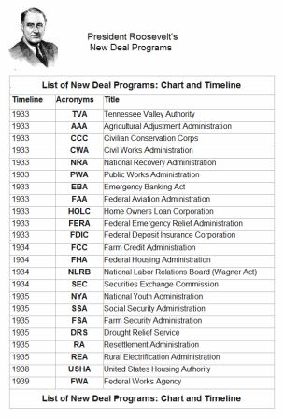
Complete the matching activity with the New Deal Programs and what they were created to do.

Slide 11
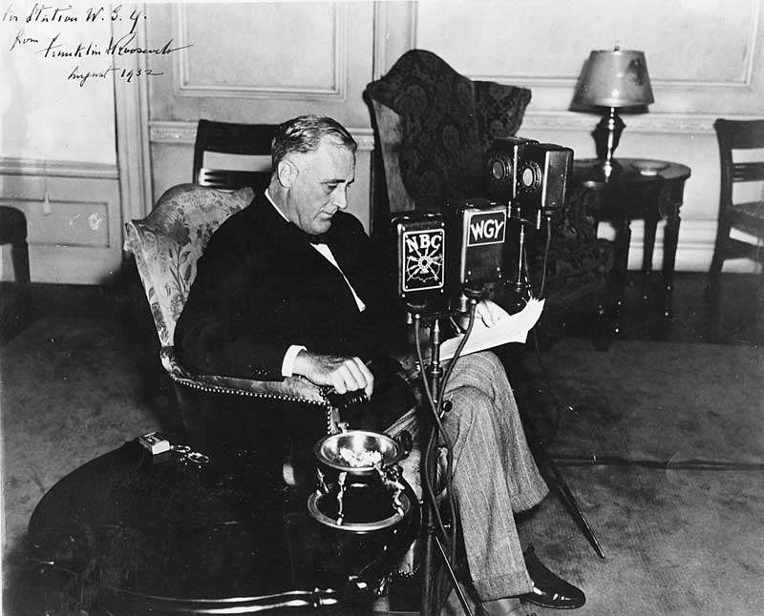
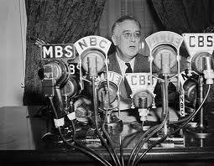
FIRESIDE CHATS
Radio talks about issues of public concern given by President Roosevelt
First one explained why the nation’s welfare depended on public support of the government and the banking system
These fireside chats made Americans feel as if the president was talking directly to them
They helped to inspire hope

