Slide 1
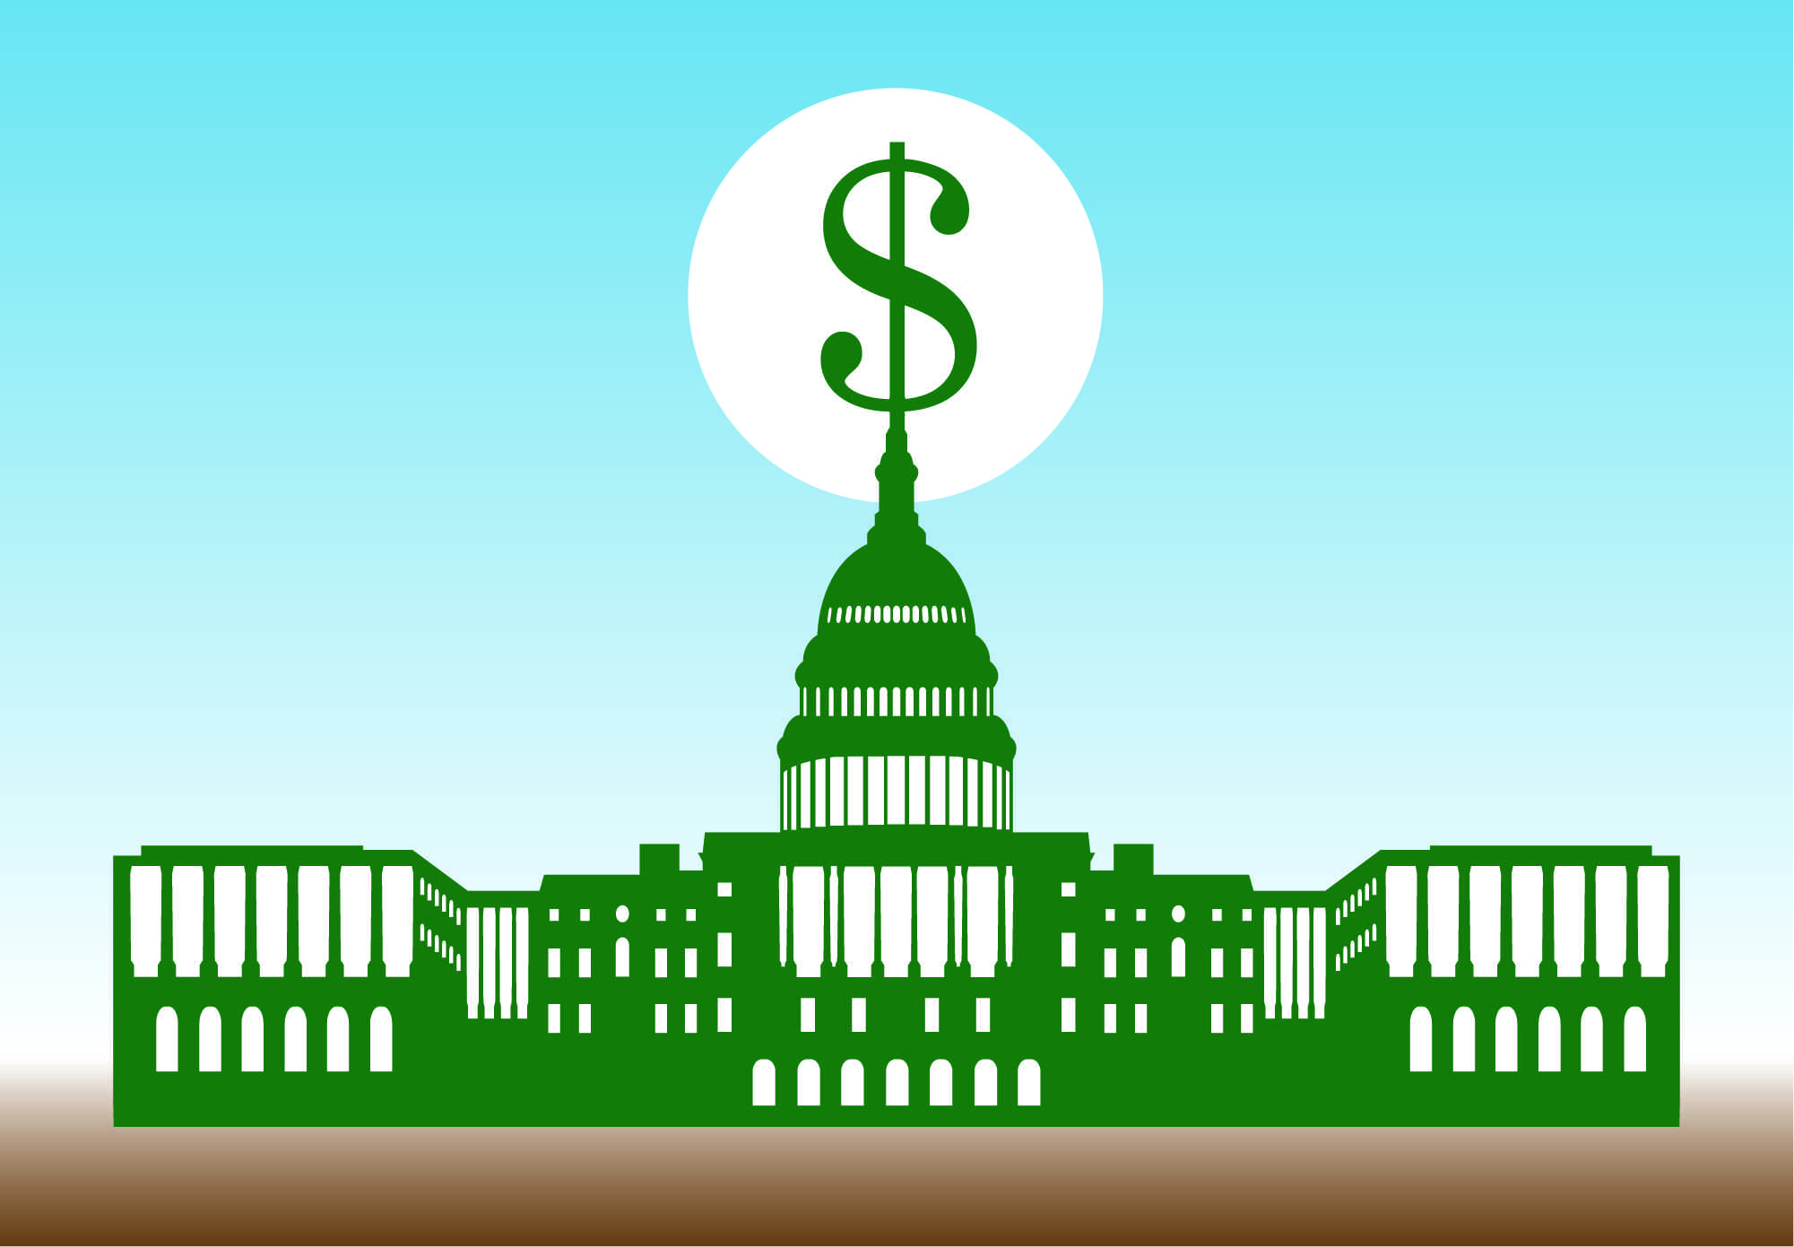
7.3
Government Intervention

Slide 2
Objectives
Discuss major antitrust legislation in the United States.
Understand the need for limited government regulation.
Explain the value of the public disclosure.
Discuss the modifications to our free enterprise economy.

Slide 3
Vocab
Trust
Price Discrimination
Cease and Desist Order
Public Disclosure

Slide 4
Intro
Today the government has power to encourage competition and regulate monopolies that exists for the public welfare.
In some cases, government has taken over certain economic activities and runs them as government owned monopolies.
In other cases, the US gov even makes estimates in order to carry out its legal and social obligations.

Slide 5
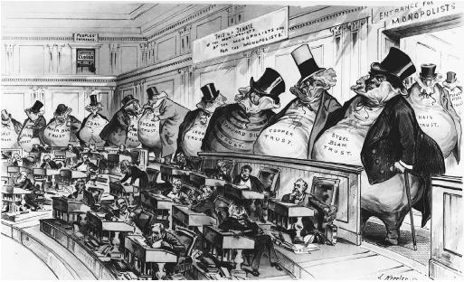
Antitrust Legislation
Antitrust laws prevent or break up monopolies
Prevents market failures due to inadequate competition
Sherman Antitrust Act (1890)-first US law against monopolies
Clayton Antitrust Act (1914)- outlawed price discrimination

Slide 6
The Federal Trade Commission (FTC, 1914)was empowered to issue cease and desist orders, requiring companies to stop unfair business practices.
Robinson-Patman Act (1936)- outlawed special discounts to some customers

Slide 8
Gov Regulation
Government’s goal in regulating is to set the same level of price and service that would exist if a monopolistic business existed under competition.
The gov uses the tax system to regulate businesses with negative externalities, preventing market failures.

Slide 9
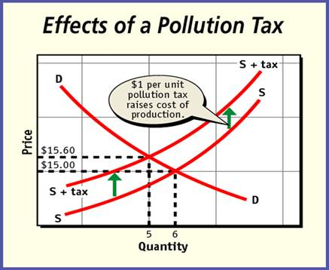

Slide 10
Public Disclosure
Public disclosure requires businesses to reveal information about their products or services to the public.
The purpose is to provide adequate information to prevent market failures
Corporations, banks, and other lending institutions must disclose certain information.
Also “truth-in-advertising” laws that prevent sellers from making false claims about their products

Slide 11
Indirect Disclosure
Indirect disclosure includes government’s support of the Internet and the availability of government documents on government Web sites.
Businesses post information about their own activities on their own Web sites.

Slide 12
Modified Free Enterprise
Government intervenes in the economy to encourage competition, prevent monopolies, regulate industry, and fulfill the need for public goods.
Today’s U.S. economy is a mixture of different market structures, different kinds of business organizations, and varying degrees of government regulation.

