Slide 1
7.1
Competition and Market Structures

Slide 2
Objective
Explain the characteristics of perfect competition
Understand the nature of monopolistic competition
Describe the behavior and characteristics of the oligopolistic
Identify several types of monopolies

Slide 3
Vocab
Laissez-faire
Market structure
Perfect competition
Imperfect competition
Monopolistic competition
Product differentiation
Nonprice competition
Oligopoly
Collusion
Price-fixing
Monopoly
Natural monopoly
Economies of scale
Geographic monopoly
Technological monopoly
Government monopoly

Slide 4
Introduction
When Adam Smith published An Inquiry into the Nature and Causes of the Wealth of Nations in 1776, the average factory was small, and business was competitive.
Laissez-faire, philosophy that government should not interfere with commerce or trade, dominated Smith’s writing
French for “allow them to do”

Slide 5
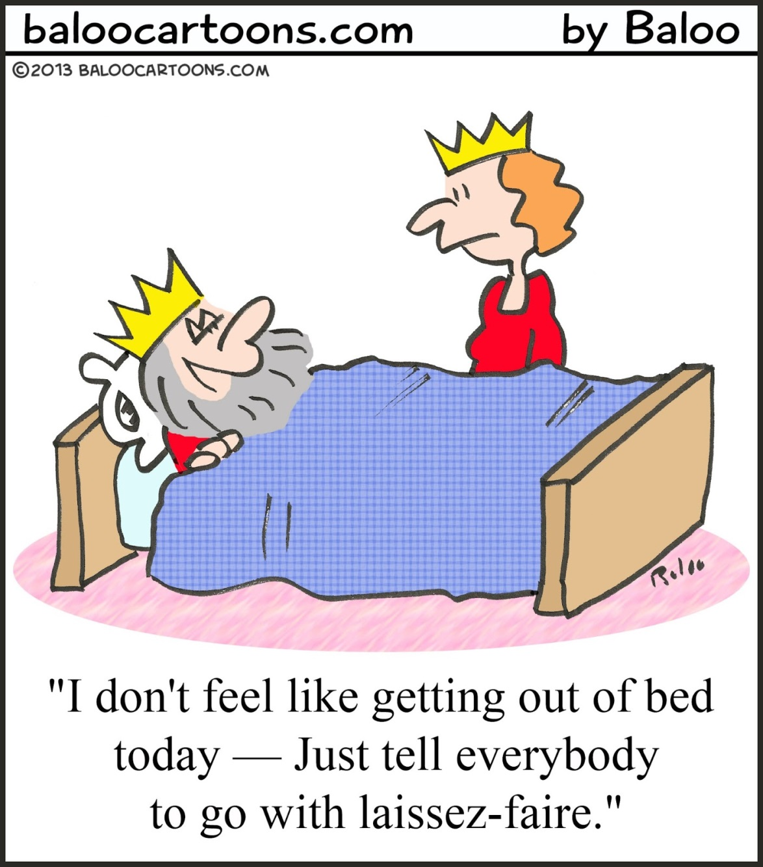

Slide 6
Under Smith’s train of thought, the role of government is confined
Protecting private property
Enforcing contracts
Settling disputes
Protecting businesses against increased competition from foreign goods

Slide 7
By the late 1800’s competition was weakening.
As industries developed (supply side of the market, producers) the nature of competitive markets changed.

Slide 8
Today, economists classify markets according to conditions that prevail in them.
They ask questions such as
How many buyers and suppliers are there?
How large are they?
Does either have any influence over price?
How much competition exists between firms?
What kind of product is involved-is everyone trading the exact same product, or are they simply similar?
Is it easy or difficult for new firms to enter the market?

Slide 9
The answers to these questions help determine market structure, or the nature and degree of competition among firms operating in the same industry.
Economists group industries into four different market
Perfect competition
Monopolistic competition
Oligopoly
Monopoly

Slide 10
Perfect Competition
Perfect competition is when a large number of buyers and sellers exchange identical products under 5 conditions.
1)There should be a large number of buyers and sellers
2)The products should be identical
3)Buyers and sellers should act independently
4)Buyers and sellers should be well informed
5)Buyers and sellers should be free to enter, conduct, and get out of business

Slide 11
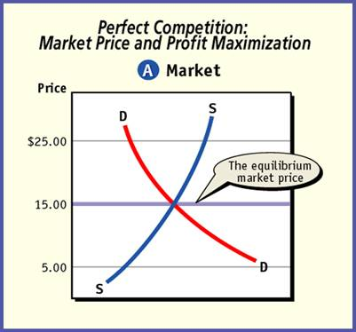
Under perfect competition, supply and demand set the equilibrium price, and each firm sets a level of output that will maximize its profits at that price.
Imperfect competition refers to market structures that lack one or more of the five condition of perfect competition.

Slide 12
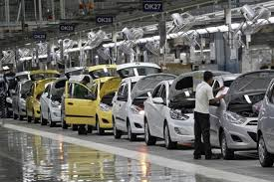
Monopolistic Competition
Monopolistic competition meets all conditions of perfect competition except for identical products.
Monopolistic competitors use product differentiation—the real or imagined differences between competing products in the same industry.

Slide 13
Monopolistic competitors use nonprice competition, the use of advertising, giveaways, or other promotional campaigns to differentiate their products from similar products in the market.
Monopolistic competitors sell within a narrow price range but try to raise the price within that range to achieve profit maximization.

Slide 14
Oligopoly
Oligopoly is a market structure in which a few very large sellers dominate the industry.
Oligopoly is further away from perfect competition (freest trade) than monopolistic competition.
Oligopolists act interdependently by lowering prices soon after the first seller announces the cut, but typically they prefer nonprice competition because their rival cannot respond as quickly.

Slide 15
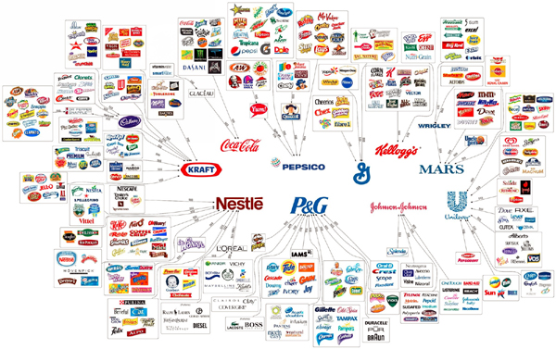

Slide 16
Oligopolists may all agree formally to set prices, called collusion, which is illegal (because it restricts trade).
Two forms of collusion include
price-fixing, which is agreeing to charge a set price that is often above market price
dividing up the market for guaranteed sales.

Slide 17
Oligopolists can engage in price wars, or a series of price cuts that can push prices lower than the cost of production for a short period of time.
Oligopolists’ final prices are likely to be higher than under monopolistic competition and much higher than under perfect competition.

Slide 18
Monopoly
A monopoly is a market structure with only one seller of a particular product
The United States has few monopolies because Americans prefer competitive trade, and technology competes with existing monopolies.
Natural monopoly occurs when a single firm produces a product or provides a service because it minimizes the overall costs (public utilities).
Geographic monopoly occurs when the location cannot support two or more such businesses (small town drugstore).

Slide 19
Technological monopoly occurs when a producer has the exclusive right through patents or copyrights to produce or sell a particular product (an artist’s work for his lifetime plus 50 years).
Government monopoly occurs when the government provides products or services that private industry cannot adequately provide (uranium processing).
The monopolist is larger than a perfect competitor, allowing it to be the price maker versus the price taker.

