Slide 1
Ch. 1 Section 2
Basic Economic Concepts

Slide 2
Objective
Explain the relationship among scarcity, value, utility, and wealth.
Understand the circular flow of economic activity.

Slide 3
Vocab
Good
Consumer Good
Durable Good
Nondurable Good
Service
Value
Paradox of Value
Utility
Wealth
Market
Factor Market
Product Market
Economic Growth
Productivity
Human Capital
Division of Labor
Specialization
Economic Independence

Slide 4
Goods, Services, and the Consumers
Goods are items that are economically useful or satisfy an economic want
Classified as consumer/capital and durable/nondurable
Services=work performed for someone and are tangible
Consumers use goods and services to satisfy wants and needs

Slide 5
Value, Utility, and Wealth
Value= Worth expressed in $
Scarcity by itself is not enough to create value, must have utility
Utility= A good’s or service’s capacity to provide satisfaction
Varies with the needs and wants of each person
Wealth= Accumulation of goods that are tangible, scarce, useful, and transferable
Doesn’t include services

Slide 6
Paradox of Value
-Situation where some necessities are worth less than non-necessities
-Water is a need, but has a low value, while diamonds isn’t a need but has a very high value

Slide 7
https://www.youtube.com/watch?v=e7S8jWh6AEs

Slide 8
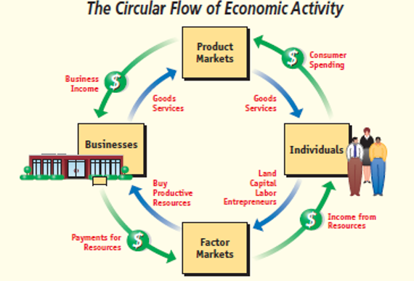
Circular Flow of Economic Activity
- The wealth an economy generates is made possible by the circular flow

Slide 9
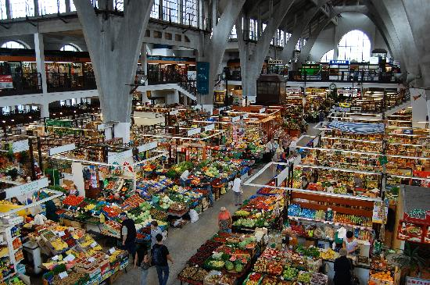
The key feature to the circular flow is the Market
Market= Locations/mechanisms for buyers and sellers to trade
Classified as local, regional, national, global, and cyberspace
Where the trade is taking place

Slide 10
A factor market is where people earn incomes
Centered on the 4 factors of production
The factors are bought and sold
Product market is where people use income to buy from producers
Center on goods and services

Slide 11
https://www.youtube.com/watch?v=mN5HPJYJzus

Slide 12
Productivity and Economic Growth
Economic growth= Increase in a nation’s total output of goods and services over time
Circular flow becomes larger
Productivity is the measure of the amount of output produced by the amount of inputs within a certain time
The most important factor to economic growth

Slide 13
Investing in human capital improves productivity because when people’s skills, abilities, health, and motivation advance, productivity increases
Ex. Educational investments

Slide 14
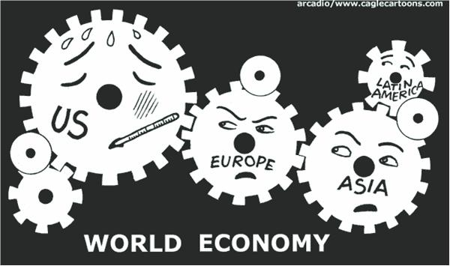
Productivity can also be increased by division of labor and specialization
Both help to make things more proficient and creates greater economic interdependence
Economic interdependence= the economic reliance on others and their reliance on you to provide goods and services

