Slide 1
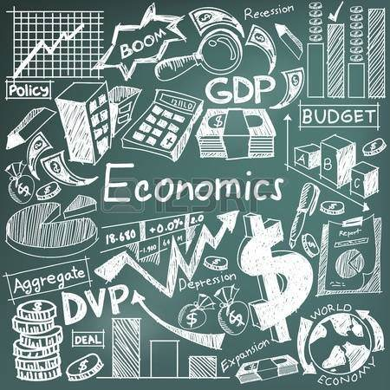
Ch. 1
What is Economics?

Slide 2
Brainstorm what you think economics is.
Share what you believe with someone near by.

Slide 3
1.1
Scarcity and the Science of Economics

Slide 4
Objective
Explain the fundamental economic problem.
Examine the 3 basic economic questions every society must decide.

Slide 5
Vocab
Scarcity
Economics
Need
Want
Factors of production
Land
Capital
Capital good
Labor
Entrepreneur
Gross Domestic Product (GDP

Slide 6
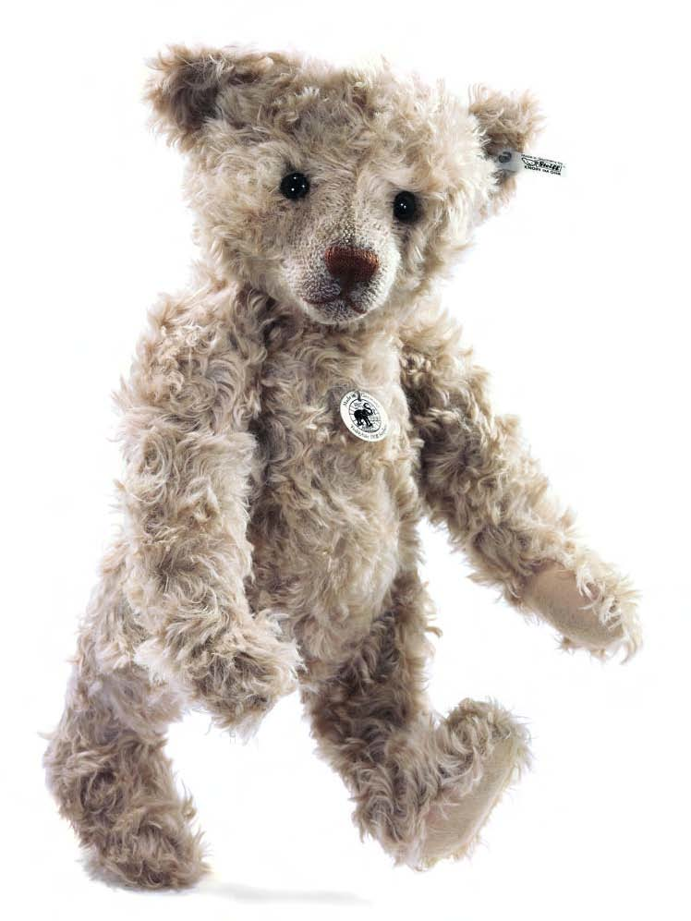
The Fundamental Economic Problem
The fundamental economic problem is scarcity
Scarcity=condition where unlimited human wants face limited resources
Ex. Each year’s hot new toy (teddy bear-1906, tickle me Elmo-1996, hatchimals-2017)
Ex. Jordan, Supreme releases

Slide 7
Scarcity affects just about every decision society makes
Where economics comes into play
Economics is the study of how people satisfy their wants with scarce resources

Slide 8
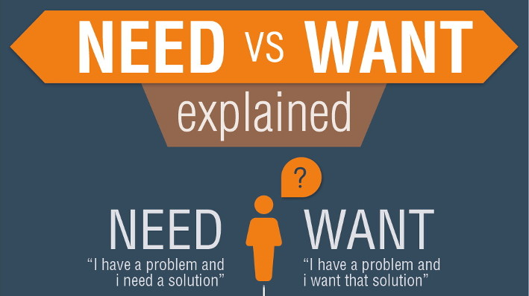
Need vs Want
A need is a basic requirement for survival
Food, clothing, shelter
A want we would like to have, but not necessary for survival
Any food meets our necessity for survival, our preference for food is a want

Slide 9
Why do you think scarcity is an issue with the rich as well as the poor?

Slide 10
3 Basic Questions
Because of scarce resources we ask ourselves 3 questions about how we use resources
1) What to Produce
2) How to Produce
3) For Whom to Produce

Slide 11
What should be produced?
Society must chose based on need
How should we produce?
Society must choose based on its resources
For whom should we produce?
Society must choose based on its population and other available markets

Slide 12
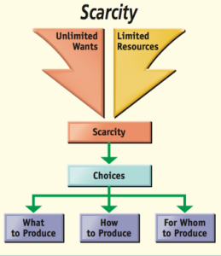

Slide 13
How might the economic decisions of a mountainous island society differ from those of a mountainous landlocked society?

Slide 14
The Factors of Production
Factors of production are resources needed to produce what people want and need
Consists of land, capital, labor, and entrepreneurs

Slide 15
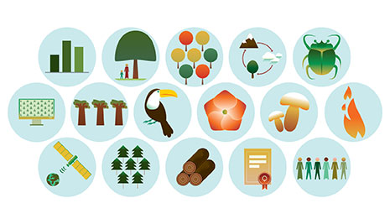
Land
A society’s limited resources
Landforms, minerals, vegetation, animal life, climate

Slide 16
Capital
Means by which something is produced
Money, tools, equipment, machinery, factories

Slide 17
Labor
Workers who apply their efforts, abilities, and skills to production

Slide 18
Entrepreneurs
Risk takers who combine the land, labor, and capital into new products
Ex. Shark Tank

Slide 19
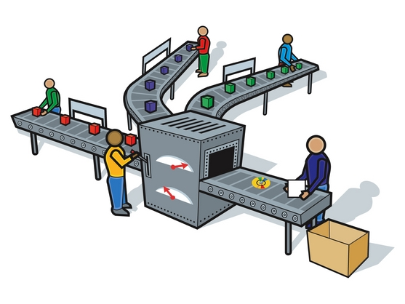
Production
Creating goods and services
The result of land, capital, labor, and entrepreneurs
All are pieces to the puzzle

Slide 20
Why are entrepreneurs an economy’s driving force?

Slide 21
The Scope of Economics
Since economics is a study of human efforts to satisfy unlimited and competing wants though the use of relatively scarce resources, it is considered a social science.
It deals with the behavior of people as they deal with this issue
4 key elements
Description
Analysis
Explanation
Prediction

Slide 22
Description
We need things to describe the economic activity
Ex. GDP, unemployment rate, government spending, tax rates
Analysis
Looks at “why” and “how” of the activity
Explanation
Refers to how economists communicate knowledge of the economy and its activites to the society’s population
Prediction
Refers to how yesterday’s and today’s activities advise uf of the potential future

