Slide 1
1968

Slide 2
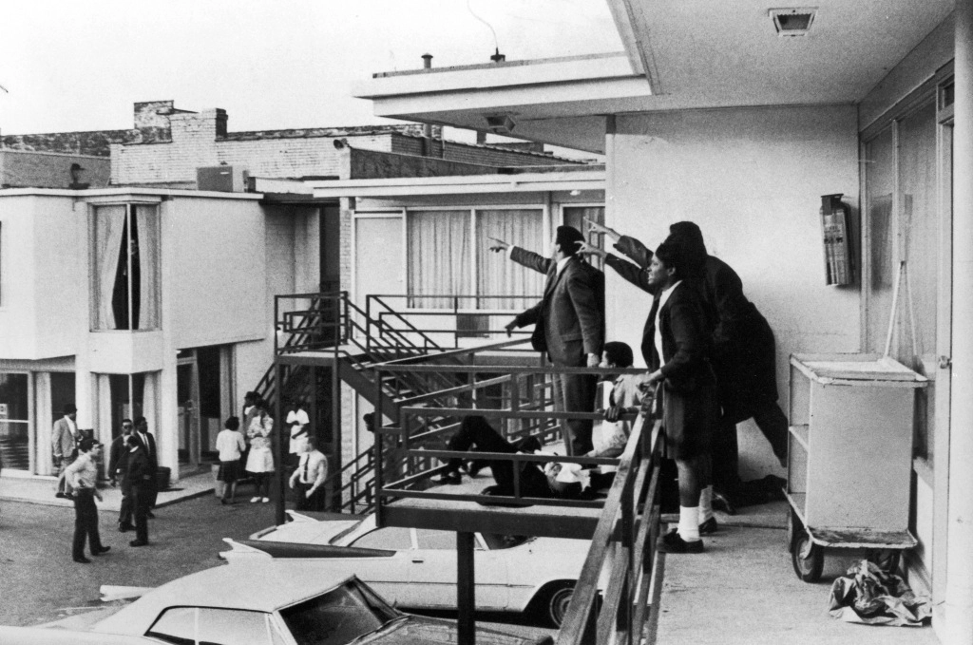
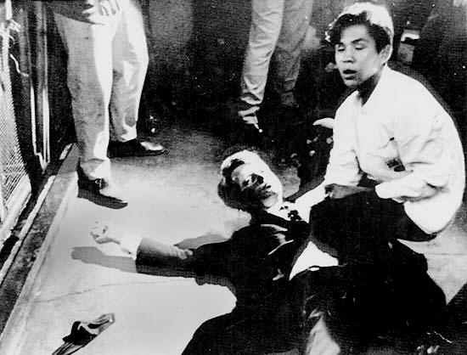
Major Deaths in 1968
*April 4th- MLK Jr
*After a tension filled speech in Memphis Tenn the night before, MLK Jr stepped out of his motel room and was shot by James Earl Ray
*June 5th- Robert Kennedy
*Robert Kennedy was on the campaign trail and was a favorite for both the Democratic nomination and Presidency with his young energy and popularity of his family name. After a speech in a California hotel, he was shot by Palestinian Sirhan Sirhan

Slide 3
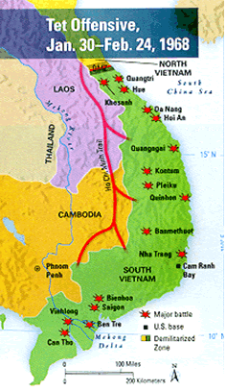
Aggression from N. Vietnam
*The Tet offensive was a defining moment in the Vietnam War
*It marked the change in the tide of the war from American aggression to Vietcong advancements
*The Vietcong snuck weapons and soldiers south during an armistice in honor of the holiday Tet.
*Once all forces and weapons were in place, the Vietcong attacked over 100 towns and cities in the South

Slide 4
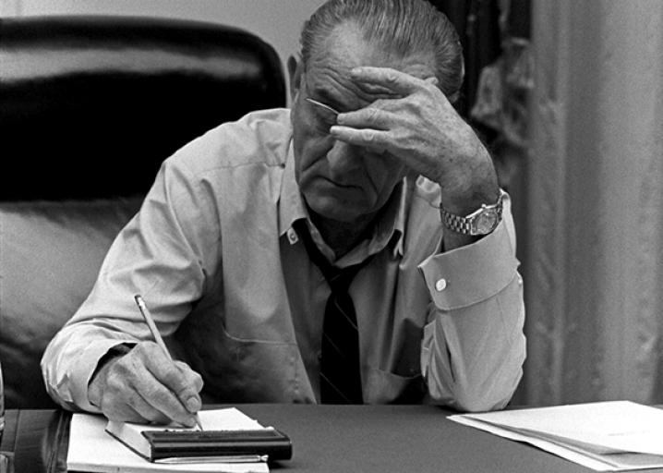
Impact from the Tet Offensive
*Americans at home began to question the notion that Vietnam was drawing close to its conclusion (This is what the Johnson Administration was claiming)
*Public opinion was beginning to even out between pro-war and pro-peace camps
*Robert McNamara steps down from Secretary of State position and President Johnson’s approval rating plummeted to below 40%

Slide 5
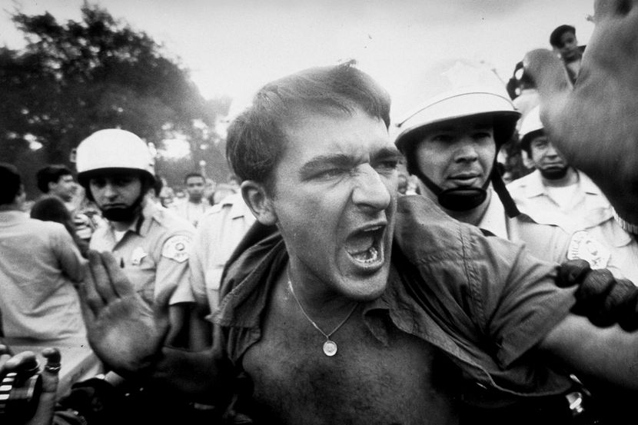
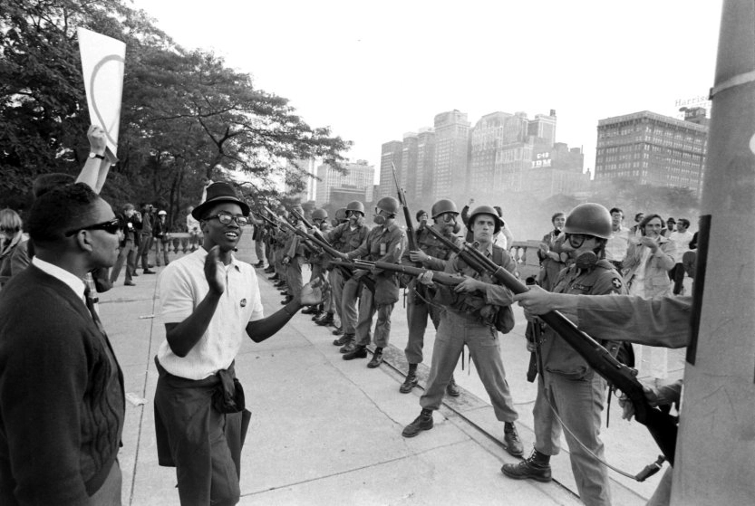
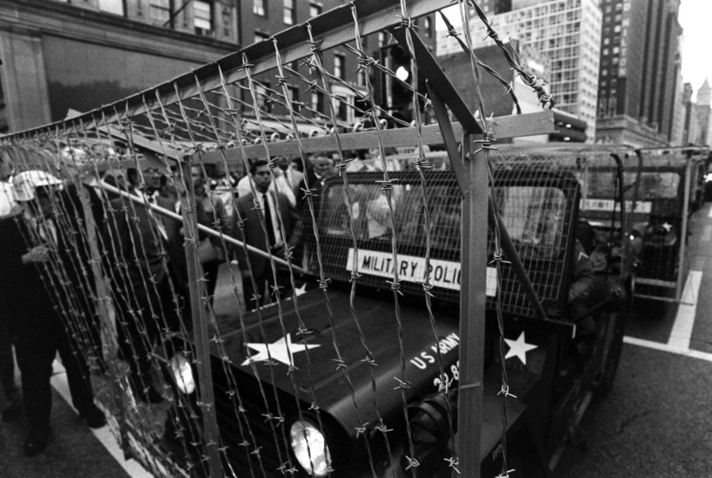
Johnson Steps Down
*President Johnson decided to not seek reelection in the 1968 Presidential Election, this sent American politics into a whirlwind
*This rise in National tension surrounding American politics lead to the protests at the Democratic National Convention in 1968
*With the apparent nomination of Hubert Humphrey (Pro-War VP behind LBJ) the 10,000 protesters began to become more riled up and Chicago Richard Daley mobilized 12,000 Chicago Police to break it up

Slide 6
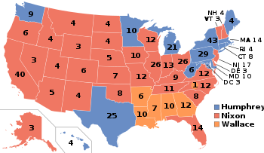
Nixon Inherits Vietnam
*To add to the stresses that the Democratic Party from the 1968 Democratic Nation, former Alabama Governor George Wallace will run as an independant and take away the Southern Democrats from voting for Humphrey
*This will pave the way for the fourth Vietnam President, Richard Nixon, to take office in 1969
*This is after the loss to Kennedy for President in 1960 and the loss for California Governor in 1962.

Slide 7
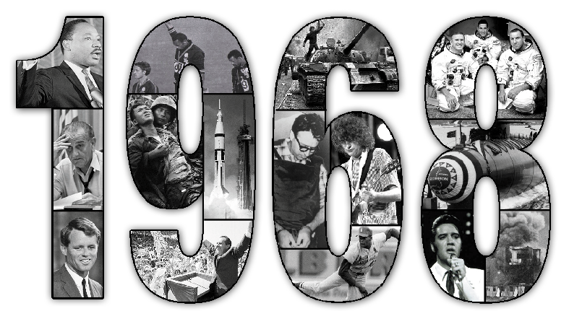
Essential Question
What was the most influential event in 1968? Defend your claim.

