Slide 1
America Fracturing

Slide 2
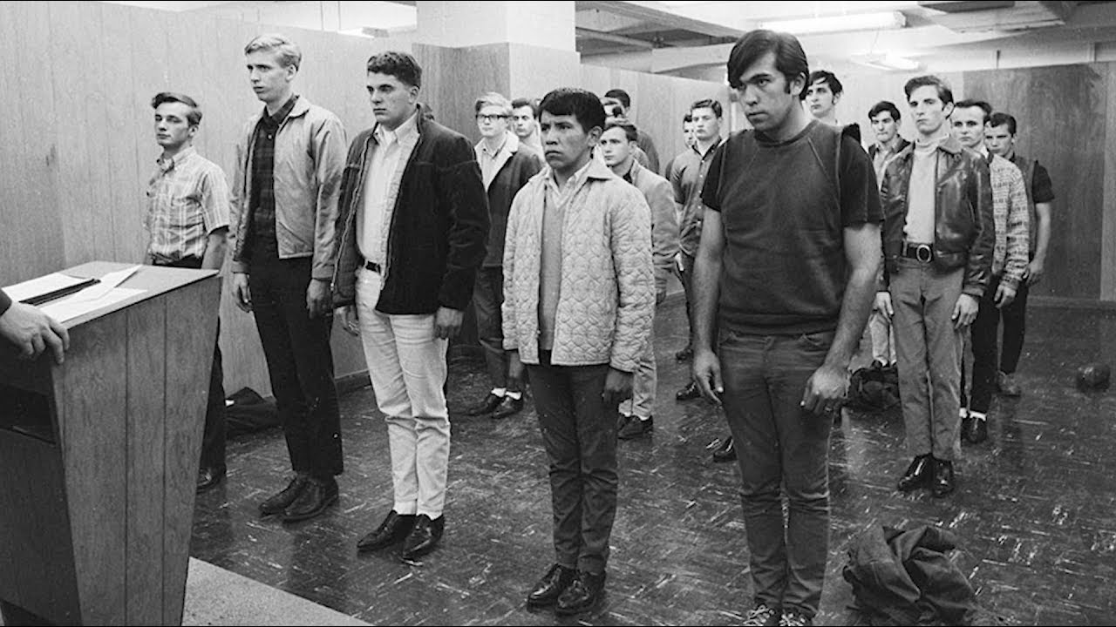
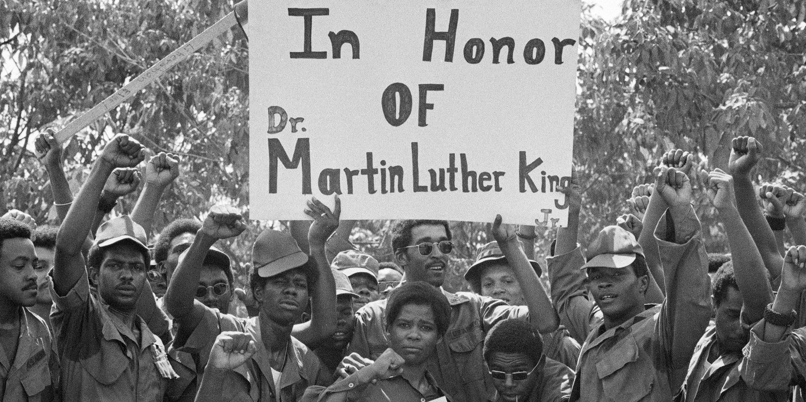
The Draft
*Due to the increasing need for soldiers and the lower and lower number of American men entering the military, the U.S. Government utilized the draft
*American citizens looking to avoid getting drafted found many ways to become ineligible to be drafted
*There was also a very disproportionate number of African Americans drafted into the conflict as a result of the Civil Rights Movement

Slide 3
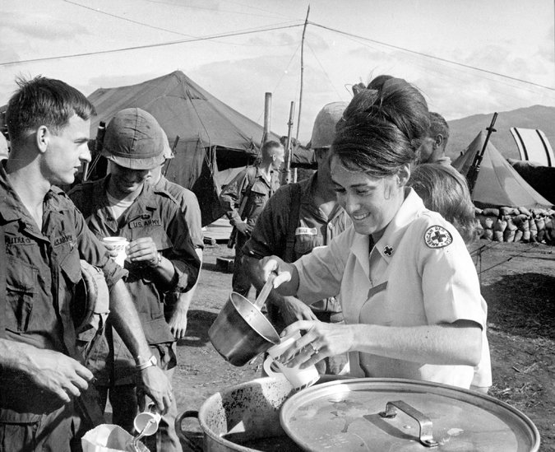
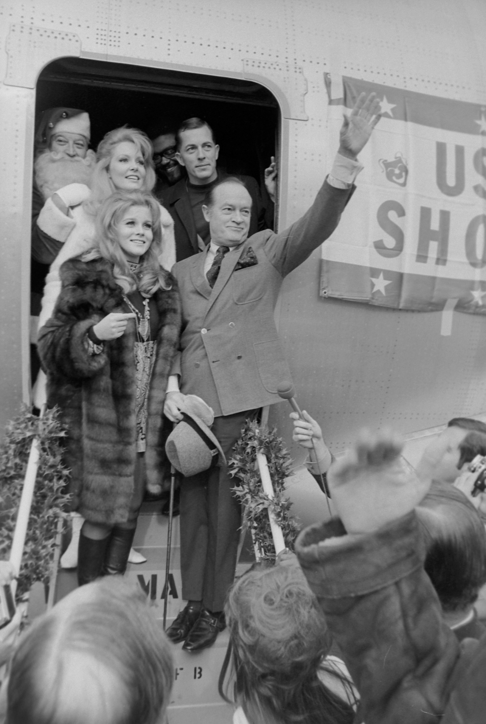
Women in Vietnam
*Women joined the war effort in non-combatant roles as nurses in non-front line posts
*Many women also volunteered as entertainment and sources of hospitality (American Red Cross/ USO)

Slide 4
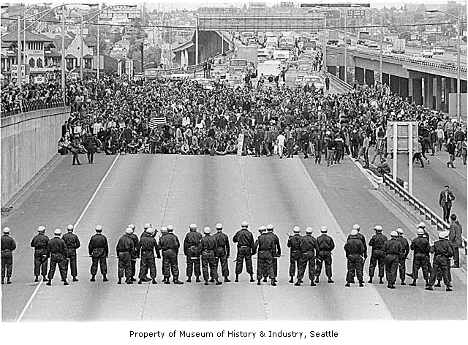
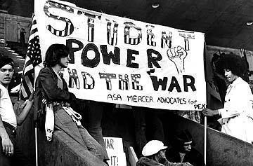
Anti-War Movement- Students Speak Up
*The largest sources of push back to the war effort were found on college campuses across the country
*Young people (the main group being drafted into the war) found ways to march and protest across the country.
*The New Left movement helped set the stage for the Students for a Democratic Society (SDS) and Free Speech movements to be formed

Slide 5
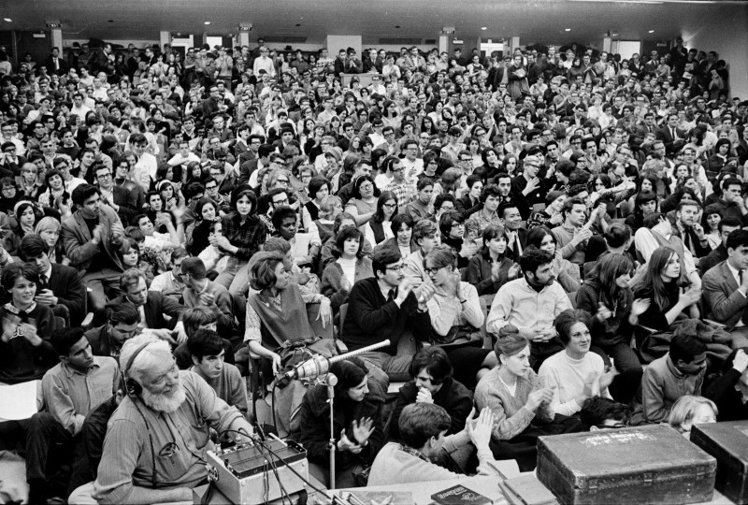
“Teach Ins”
*On many college campuses, staff and students participated in a type of protest called a “teach in”.
*The first teach in begin in March of 1965 when staff of the University of Michigan refused to teach for 24 hours
*Instead of not doing anything for 24 hours, staff and students decided to open up discussions about the Vietnam War and the repercussions over the night of March 24th into the 25th

Slide 6
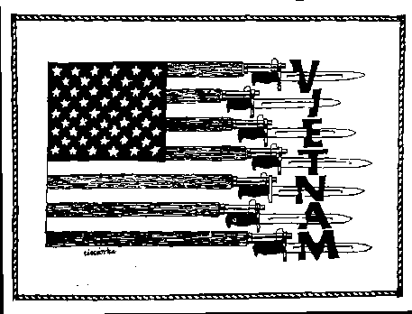
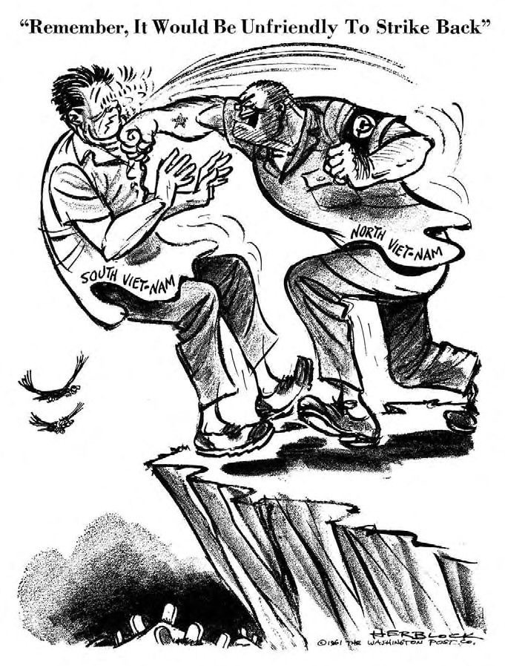
Doves v Hawks
*The fracture within the country focuses on where you stand on the Vietnam War. Do you support it? Or do you oppose it?
*These competing views divided the country into two different groups: doves and hawks
*Even with the rising levels of dissatisfaction with the Vietnam War, public opinion (over 70%) stated that protests against the war was disloyalty to the country

