Slide 1
Cabinet Departments Analogy
Disney Princesses

Slide 2
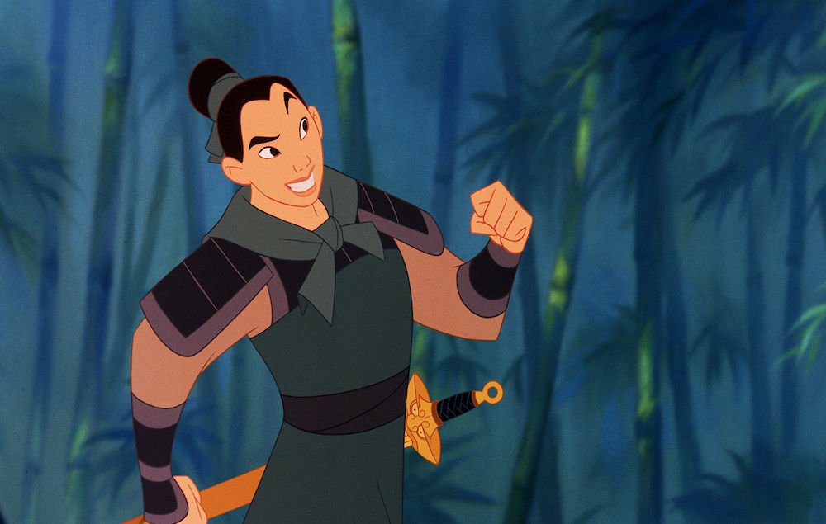
Secretary of Defense
Provides the military forces needed to deter war and to protect the security of the United States. The Army, Navy, Air Force, Marines, Coast Guard, and Reserve Forces are part of this Department.
I chose Mulan as my Secretary of Defense. She has extensive military experience due to the fact that she was trained as a member of the Imperial Army of Japan. Her combat experience found her going toe to toe the ruthless Huns. She was instrumental in leading a group of soldiers who prevented the assassination attempt on the Emperor’s life.
Mulan

