Slide 1
Mexico
Central America
Caribbean
Intro

Slide 2
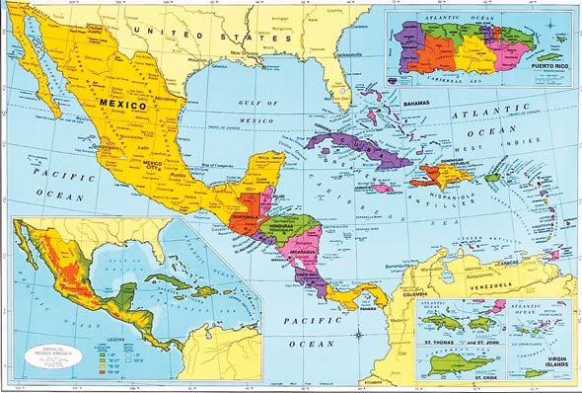
Region Overview
-South of the United States
-Inbetween the Pacific Ocean and the Atlantic Ocean
-Caribbean sits in the Caribbean Sea,, west of the Gulf of Mexico

Slide 3
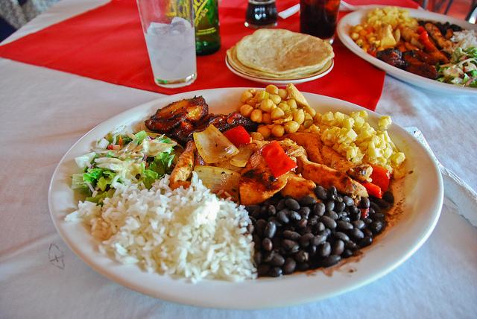
-Large Spanish influence throughout
-Mountain ranges and fertile valleys
-Largely Catholic
-Music: salsa, cumbia, mariachi, reggae, calypso
-Food: varies from country to country, typically maize based and spicey
-Sports: baseball and futbol (soccer)
-Climate: tropical humid

Slide 4
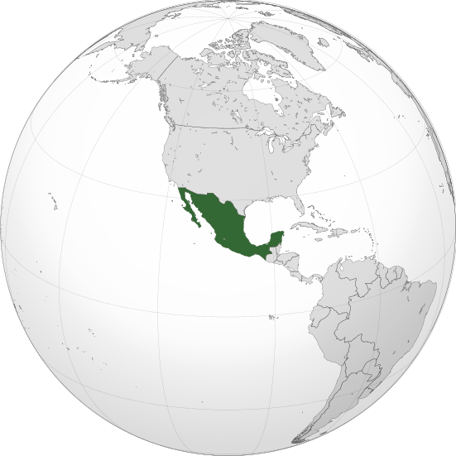
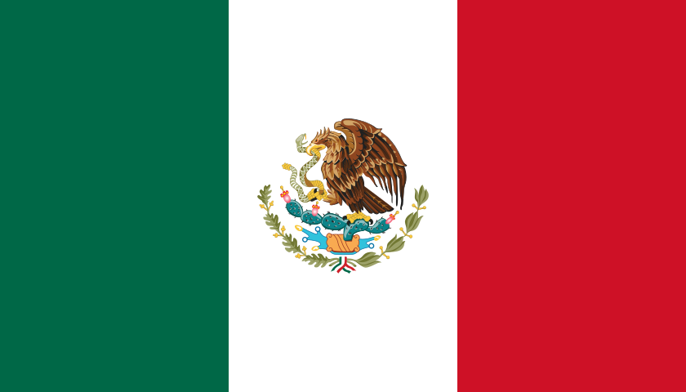
Mexico
Capital: Mexico City
Neighbors the United States to its north

Slide 5
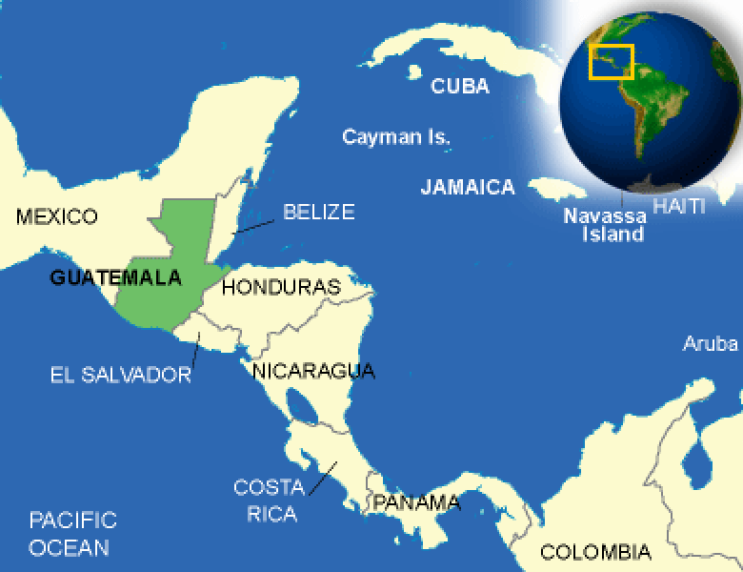
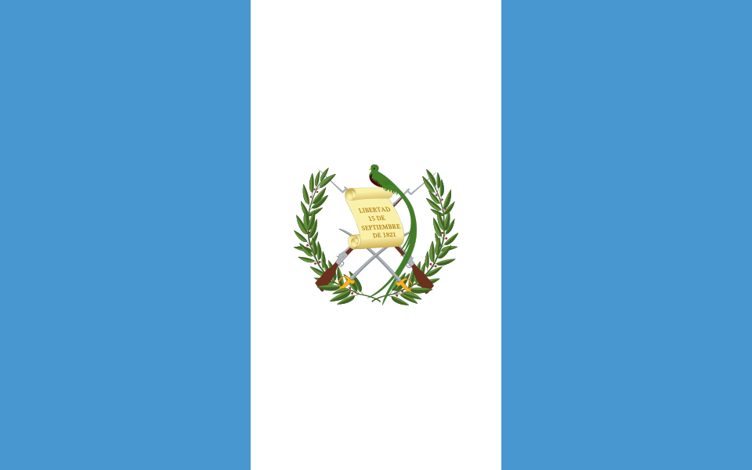
Guatemala
Capital: Guatemala
Slightly smaller than Tennessee

Slide 6
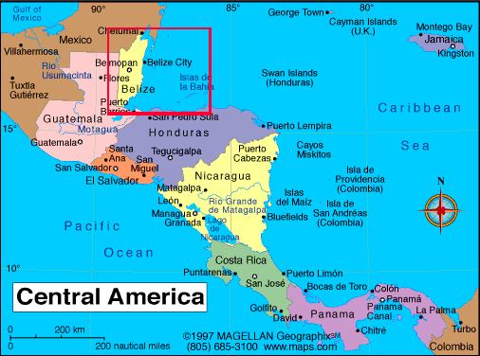
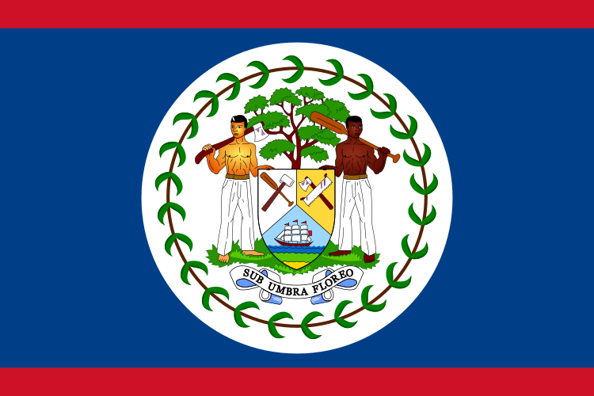
Belize
Capital: Belmopan
Roughly the size of Massachusetts

Slide 7
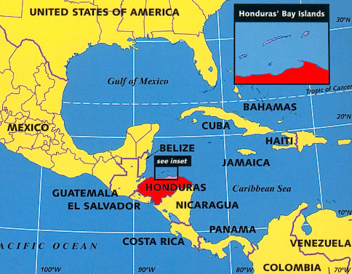
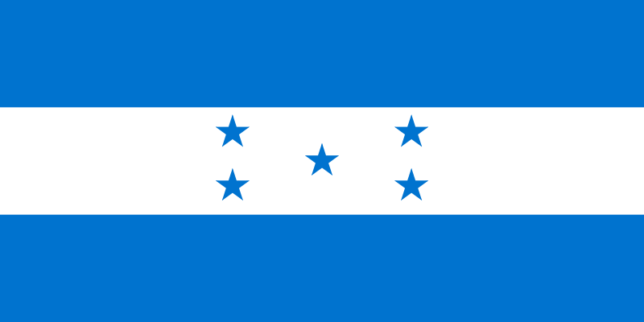
Honduras
Capital: Tegucigalpa
Slightly larger than Tennessee

Slide 8
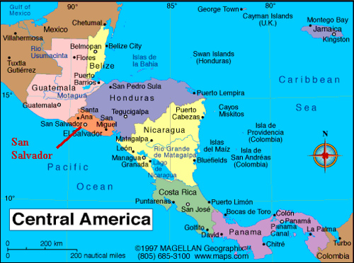
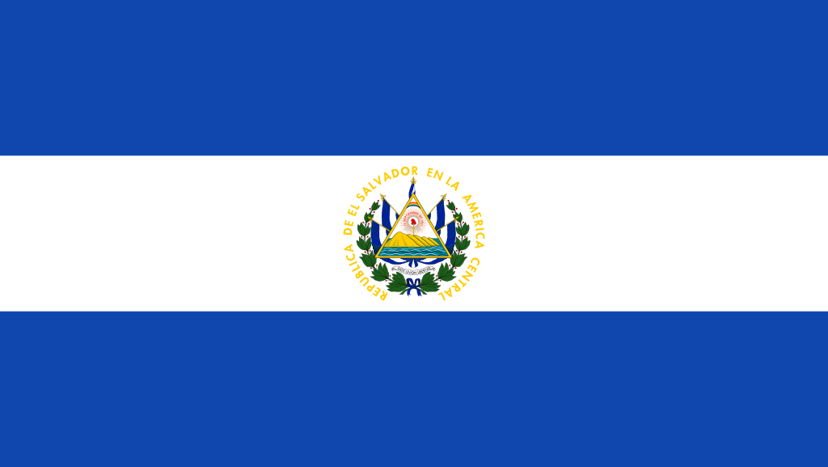
El Salvador
Capital: San Salvador
Smallest country in Central America

Slide 9
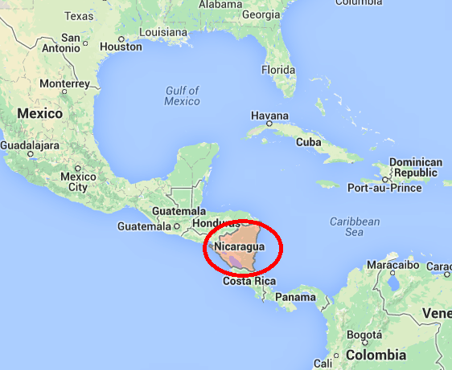
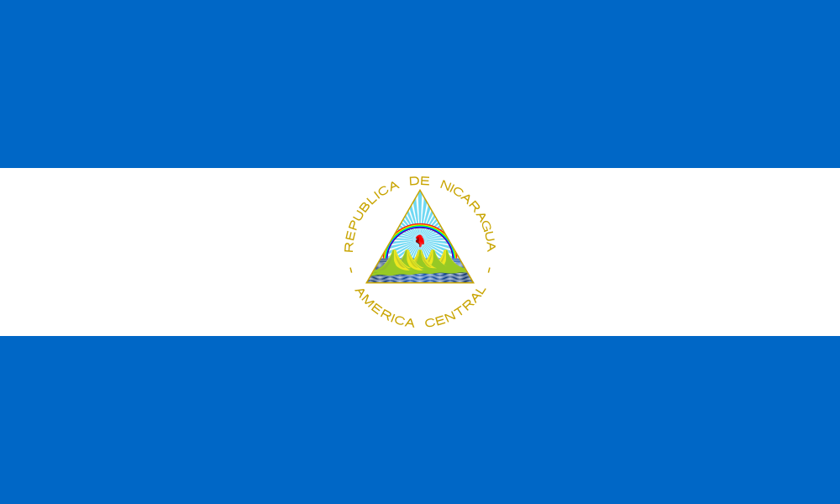
Nicaragua
Capital: Managua
About the size of the state of New York

Slide 10
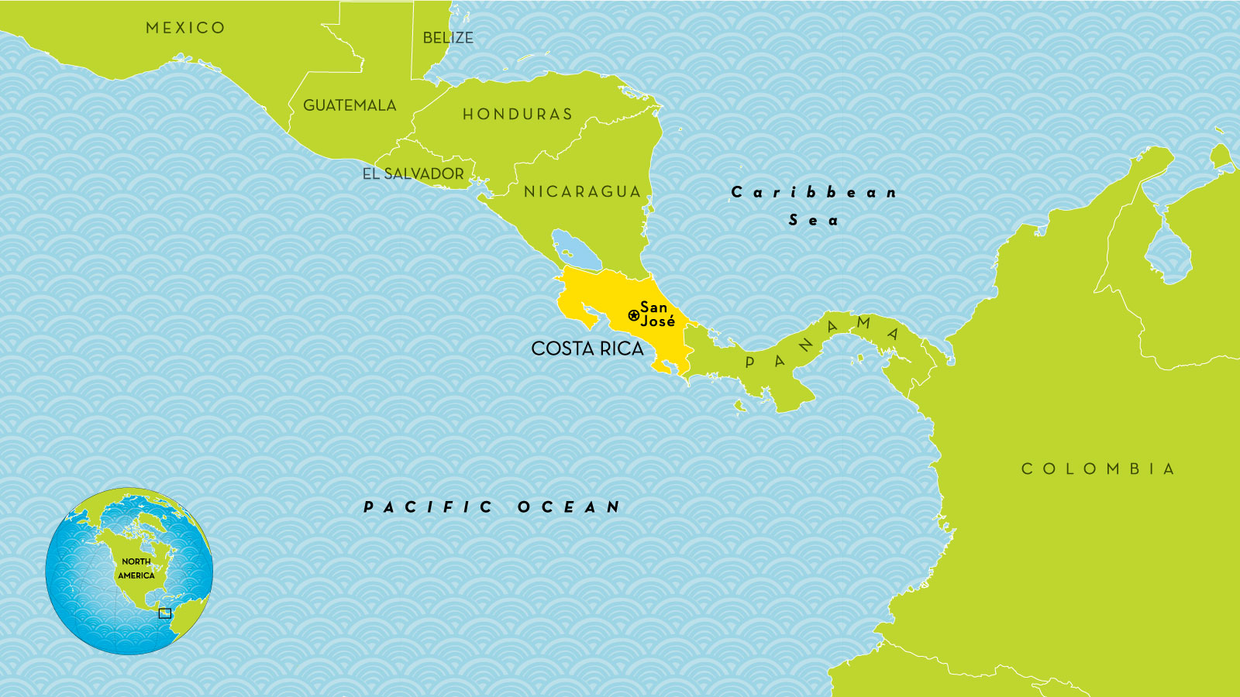
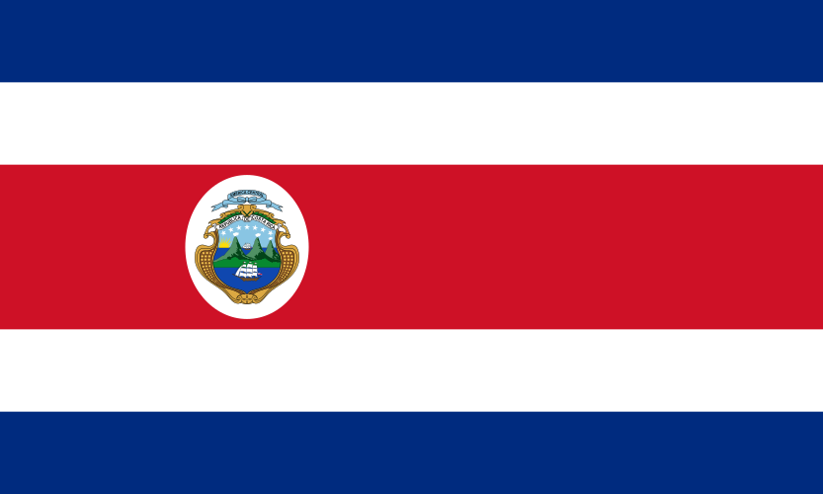
Costa Rica
Capital: San Jose
Slightly smaller than West Virginia

Slide 11
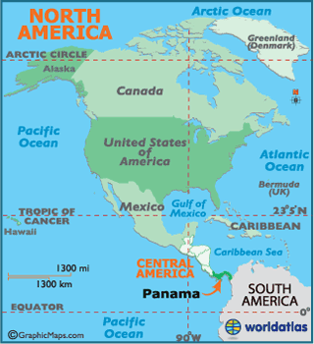
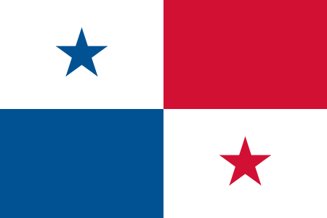
Panama
Capital: Panama City
About the size of South Carolina

Slide 12
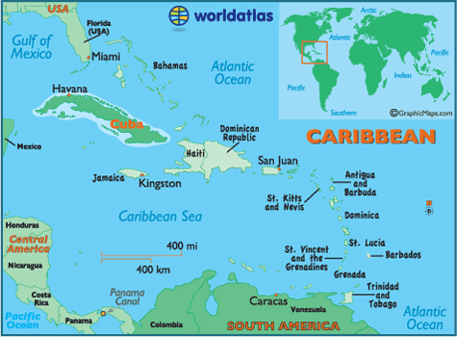
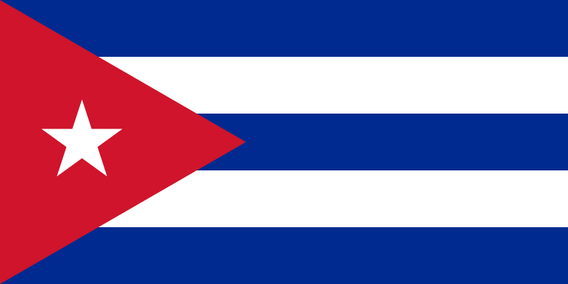
Cuba
Capital: Havana
Largest in the Caribbean

Slide 13
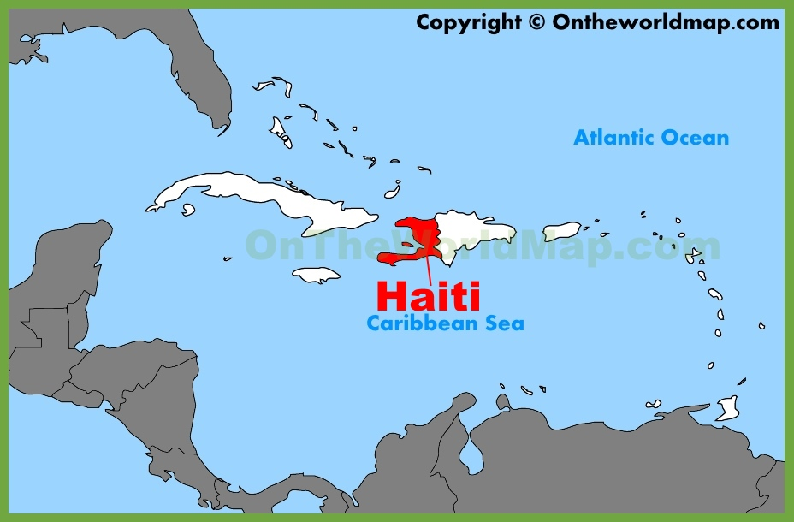
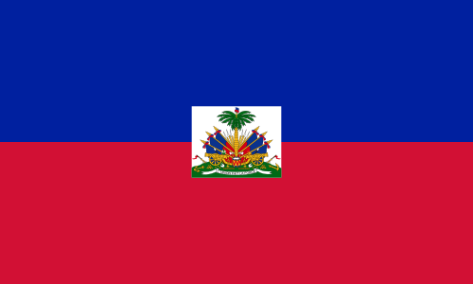
Haiti
Capital: Port-au-Prince
One half of the island of Hispaniola

Slide 14
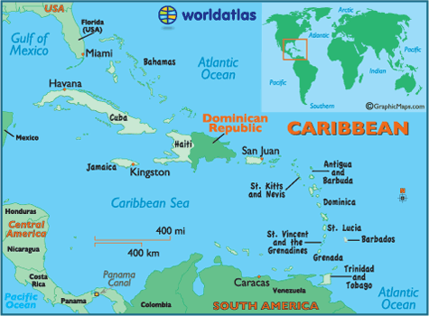
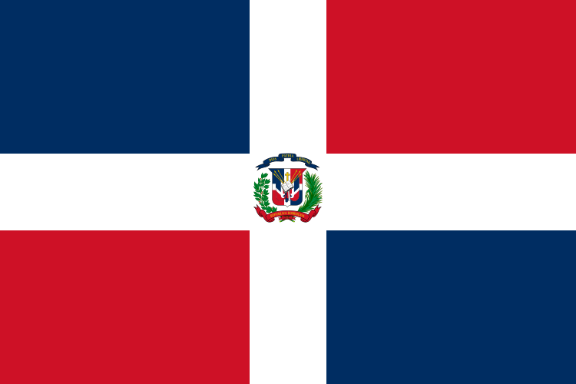
Dominican Republic
Capital: Santo Domingo
One half of the island of Hispaniola

Slide 15
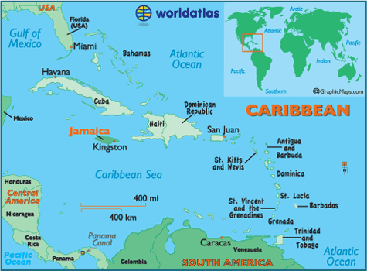
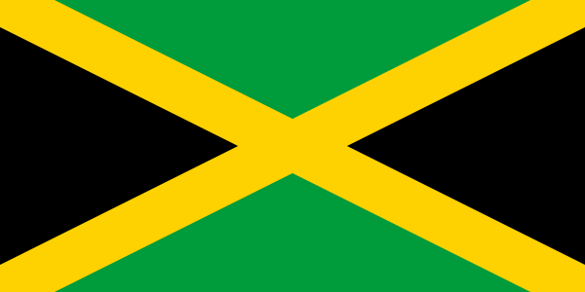
Jamaica
Capital: Kingston
One half of the island of Hispaniola

Slide 16
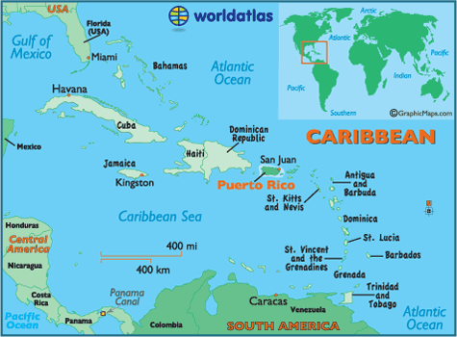
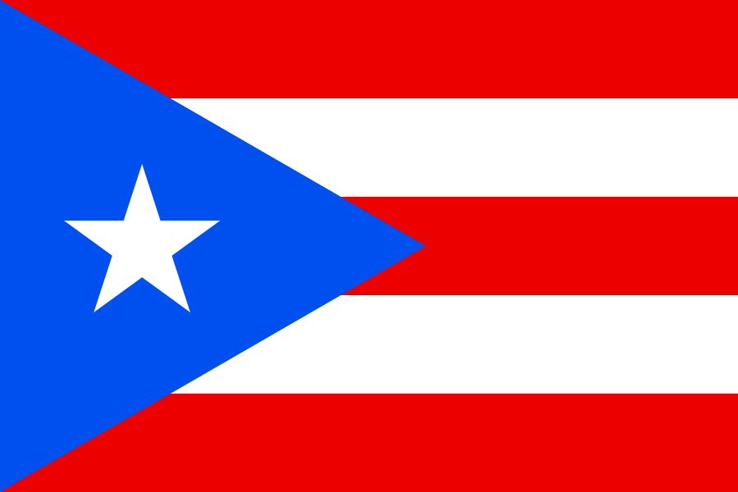
Puerto Rico
Capital: San Juan
A US territory

Slide 17
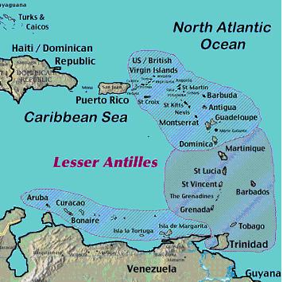
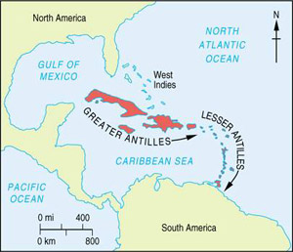
Lesser Antilles

