Slide 1
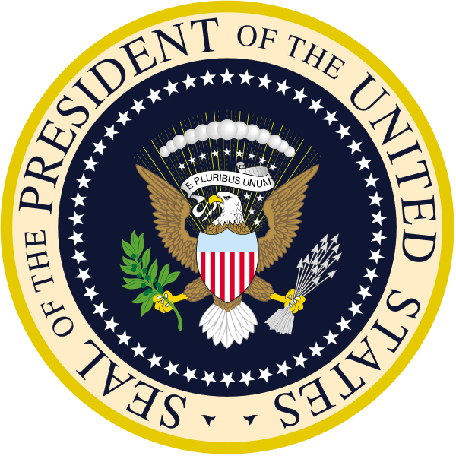
The Presidency

Slide 2
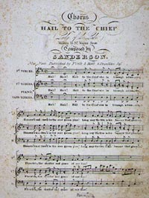
Let’s Get Into a Patriotic Mood, Shall We?
The song, “Hail to the Chief,” is heavily associated with the President. Many consider it his theme music.
https://www.youtube.com/watch?v=JW8AJds1CzI
Lyrics: https://www.youtube.com/watch?v=LkO16tqYjk4&list=RDLkO16tqYjk4

Slide 3
Formal Qualifications
Take a minute and think back to our unit on the Legislative Branch. What are the formal qualifications for someone to serve in the House of Representatives?
The Senate?
What do you think the formal qualifications are in order to be the President of the United States (PotUS)?

Slide 4
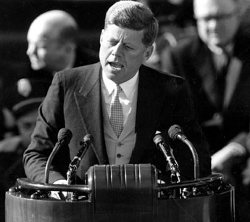
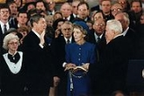
Formal Qualifications to be President
There are three formal qualifications to be President.
Be a “natural born Citizen… of the United States.”
Be at least 35 years old.
“[H]ave been fourteen years a Resident within the United States.”
Over 100 million Americans fulfill these qualifications today!

Slide 5
The President’s Term
The President serves a four year term.
The Framers considered a variety of limits on a president’s term, including one six or seven year term.
Hamilton liked the idea of a four year term, as it was long enough for a President to “have gained experience, demonstrated his abilities, and established stable policies.”
Originally, there were no limits on how many terms a President could serve.
Starting with Washington, Presidents refused to seek more than two terms.
This “no third term tradition” became an unwritten rule.

Slide 6
What President was the first to break “no third term tradition?”
What year did he break this tradition?

Slide 7
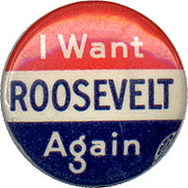
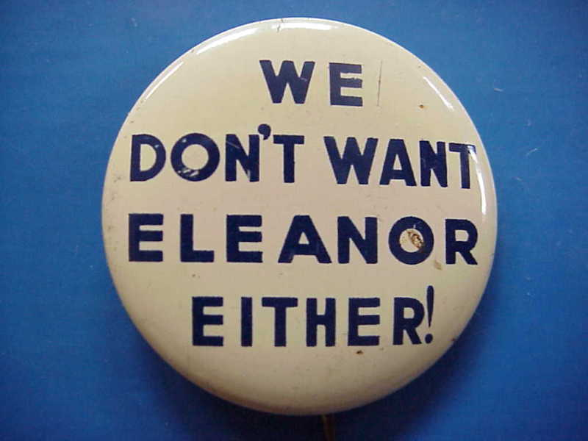
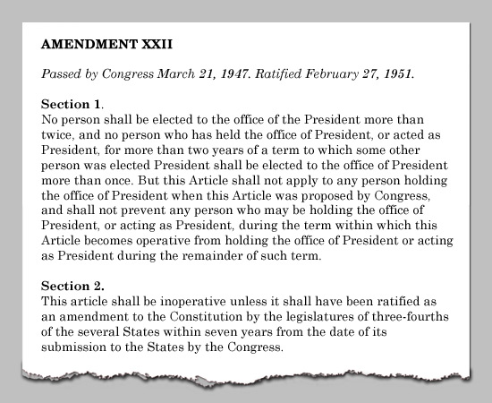
Adding Term Limits
In 1940, Franklin Delano Roosevelt broke tradition by seeking, and winning, a third term. He won a fourth term in 1944.
The 22nd Amendment, passed in 1951, limits a President to being elected twice, and a President cannot serve for more than ten years.
Some Presidents, including Presidents Truman, Eisenhower, and Reagan have called for a repeal of this amendment.

Slide 8
Perks???
So we talked about the qualifications to be President…but what does he/she get out of the deal?
Well…besides the theme song and cool looking seal…

Slide 9
Presidential Pay
Who do you think sets the President’s salary?
What do you think the President’s salary should be?
Congress determines the President’s yearly salary.
In 1789, it was $25,000.
Since 2001, it is $400,000 a year
The President is also given a $50,000 expense allowance. He may spend this money however he wants (yes, he is taxed on this money).

Slide 10
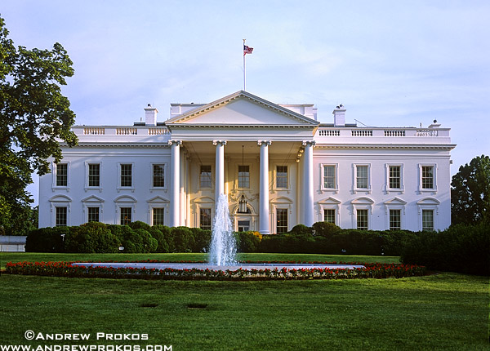
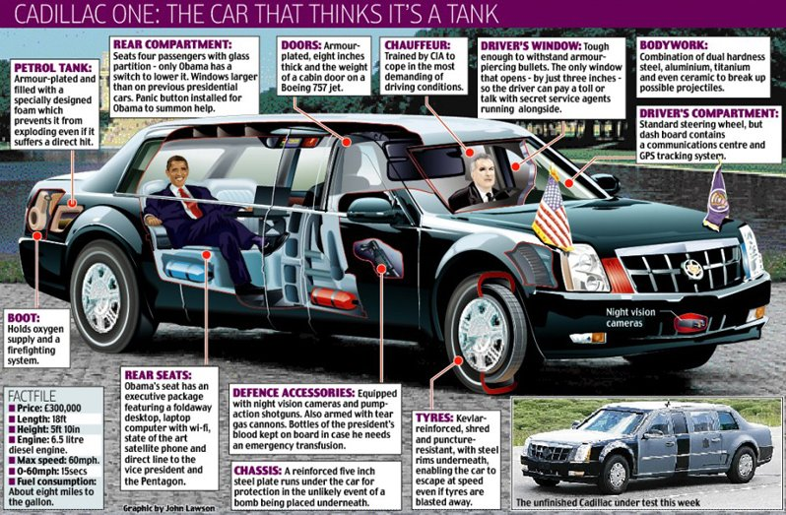
Benefits of Being the President
The White House (132 room mansion situated on 18.3 acres of prime Washington, D.C. real estate).
https://www.youtube.com/watch?v=mPuQEG19BIM
A fleet of automobiles (President Obama’s limousines are Cadillacs).
https://www.youtube.com/watch?v=YeSPlCRcpds

Slide 11
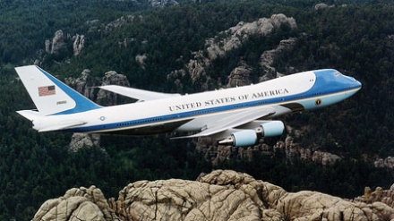
Benefits of Being the President
Air Force One (custom Boeing 747-200).
Currently the only 747-200 flown (went into service in 1991).
The Pentagon is planning on replacing the current AF-1.
Camp David (resort hideaway in Maryland)

Slide 12
Air Force One Video:
https://www.youtube.com/watch?v=DD7QuVB3Grk
Camp David:
https://www.youtube.com/watch?v=OiMHhmXnKhE

Slide 13
Benefits of being the President
Secret Service
The best armed and most well trained bodyguards in the history of the world.
Marine One
The President’s Personal Helicopter
https://www.youtube.com/watch?v=orOgtankPLM

Slide 14
So, we’ve talked about what it takes to be President, and the benefits of being the President, but what exactly is his job?

Slide 15
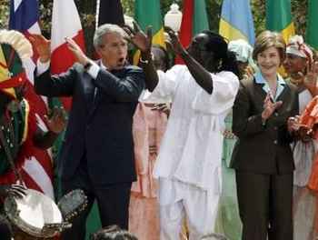
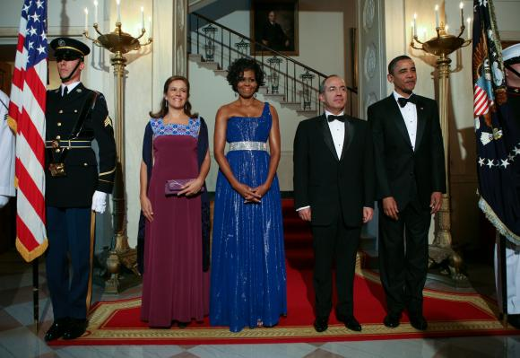
The President’s Roles
Chief of State: The President is the ceremonial head of the government of the United States. He is the symbol of the people of the nation.
Ex: Patriotic rallies, 4th of July, etc.

Slide 16
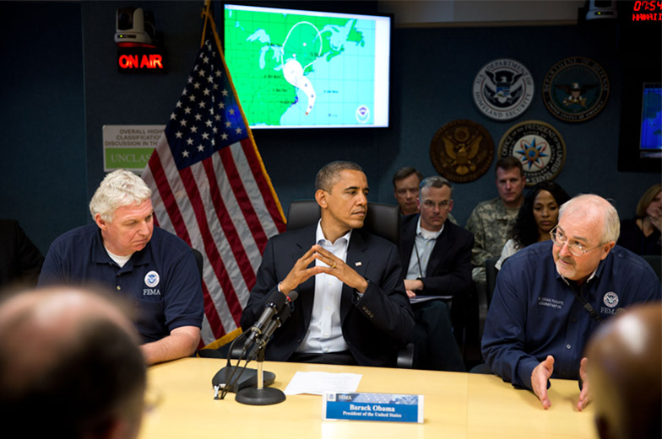
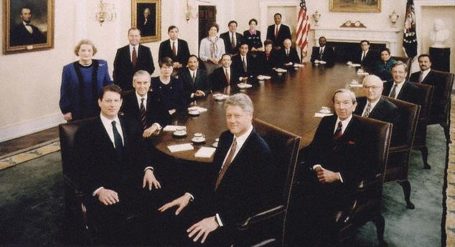
President’s roles…
Chief Executive: The President has “the executive power” of the United States. He holds “the most powerful office in the world.”
Ex: He’s the boss; hold cabinet meetings; appoints leaders of departments, etc.

Slide 17
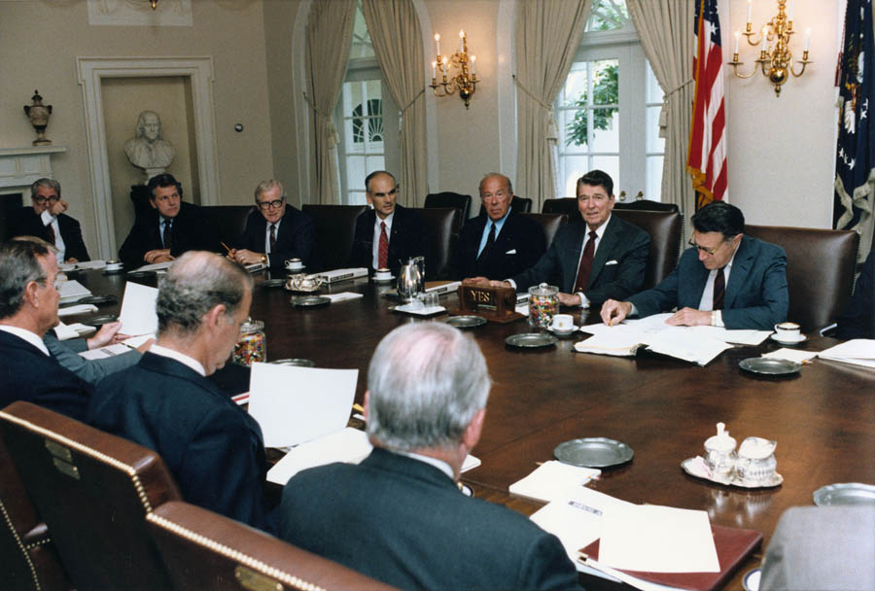
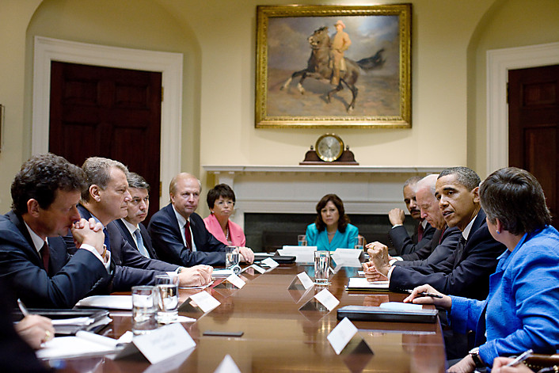
President’s roles…
Chief Administrator: The President is the director of the executive branch. He directs an administration that employs more than 2.5 million people and spends over 3 trillion dollars a year!

Slide 18
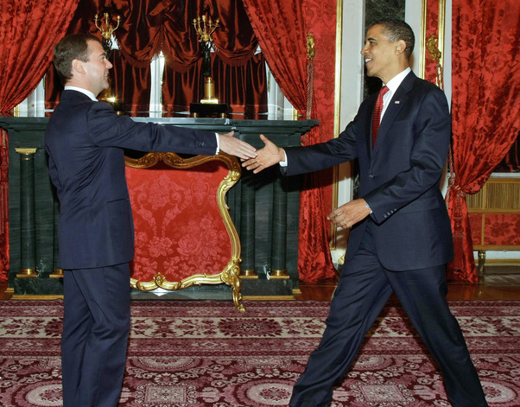
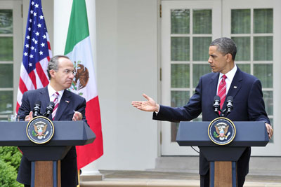
President’s roles…
Chief Diplomat: The President is the main architect of American foreign policy and the nation’s chief spokesperson to the rest of the world.
Ex: Greets foreign leaders, treaties, etc.

Slide 19
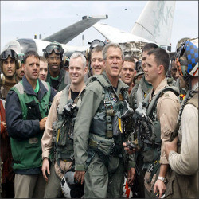
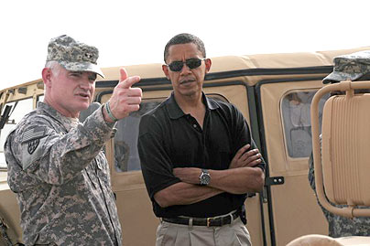
The President’s Roles…
Commander in Chief: The President is in charge of the 1.4 million people in the military, as well as the nation’s military arsenal (weapons).
Ex: Leader of the armed forces, etc.

Slide 20
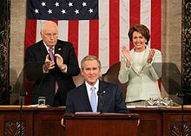
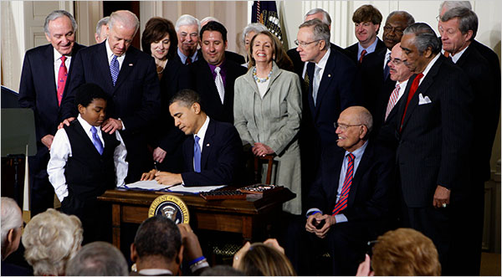
The President’s Roles…
Chief Legislator: The President is the main architect of the nation’s public policies. He sets the shape of Congress’ agenda.
Ex: Signs bills, proposes bills, etc.

Slide 21
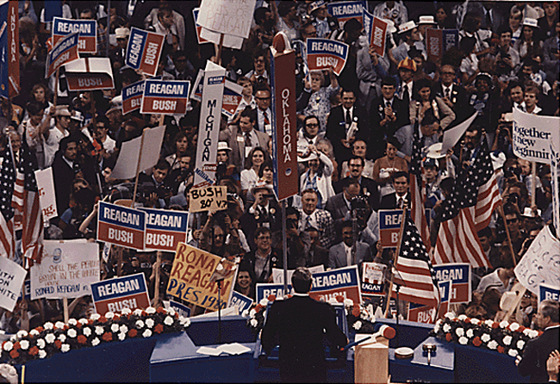
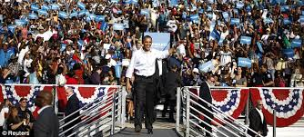
The President’s Roles…
Chief of Party: The President is the acknowledged leader of the political party that controls the executive branch.

Slide 22
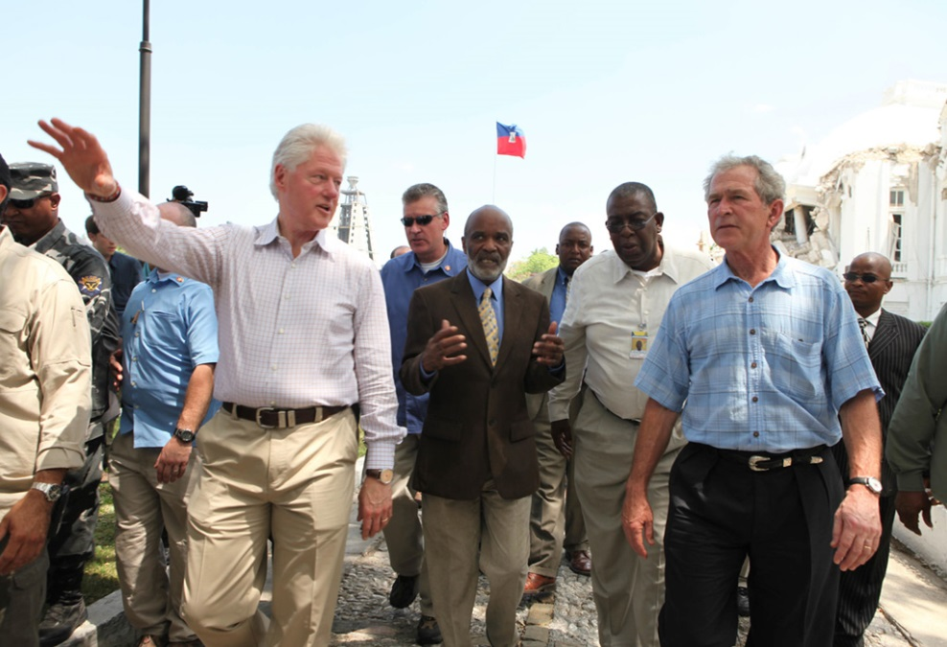
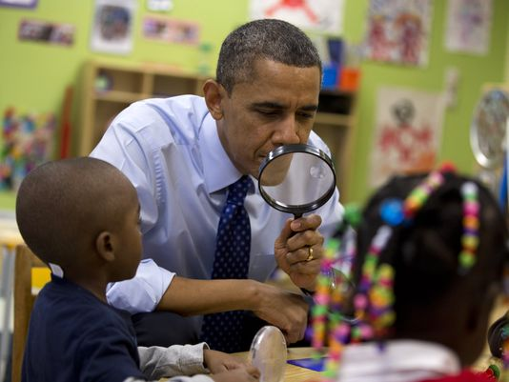
The President’s Roles…
Chief Citizen: The President is expected to be “the representative of all the people.” He is supposed to represent the public against private interests.

Slide 23
Vp, Succession and the electoral college

Slide 24
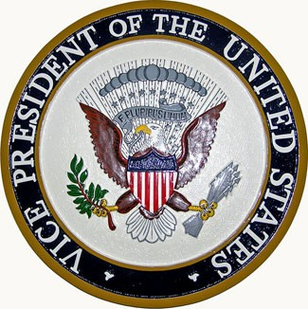
Office of Vice-Presidency
Duties
To preside over the Senate
To help decide the question of presidential disability
Virtually a “president in waiting”
Picked by President to “balance the ticket”
"I do not propose to be buried until I am dead."
— Daniel Webster, turning down the vice presidency in 1839.
"The vice president has two duties. One is to inquire daily as to the health of the president, and the other is to attend the funerals of Third World dictators. And neither of those do I find an enjoyable exercise.“
- Presidential candidate John McCain (2000)
“Once there were two brothers: one ran away to sea, the other was elected Vice-President - and nothing was ever heard from either of them again”
-Thomas R. Marshall

Slide 25
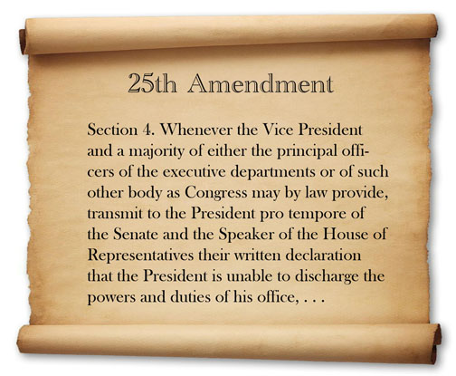
Presidential Succession: 25th Amendment - 1967
Section I – If the Pres. is removed, dies, or resigns, the Vice-President becomes President
Section II – A vacancy in the office of Vice-President; President will nominate and Congress will confirm with majority vote
Section III & IV – Disability Gap – President informs Congress in writing or Vice and Cabinet determine inability, President may resume if Vice objects Congress has 21 days to decide.

Slide 26
Presidential Succession Act of 1947
Fixes the order of succession after the Vice-President.
Vice President (Joe Biden)
Speaker of House (Paul Ryan)
President Pro Tempore (Orrin Hatch)
Secretary of State (John Kerry)
Each of the other 14 heads of Cabinet Depts. In the order in which they were created.
For fun….. Let’s try and put the rest in order….
Treasury, Defense, Attorney General, Interior, Agriculture, Commerce, Labor, HHS, HUD, Transportation, Energy, Education, Veterans Affairs, Homeland Security

Slide 27
Videos
Pres. Succession Song - https://www.youtube.com/watch?v=s4MF_aE0ZG0
Pres. Succession Video - https://www.youtube.com/watch?v=bn8e-WzKK9Y

Slide 28
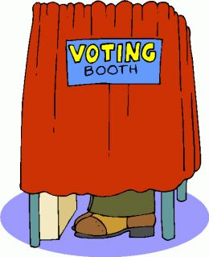
Presidential Selection The Framers’ Plan
Presidential electors chosen (wisest citizens)
Selection of electors determined by states
Electors cast two votes
Votes opened and counted by Congress
Highest # of votes becomes President
2nd highest becomes Vice-President
Could have a Pres. of one party and VP of another
In the case of a tie, House would decide
Senate would decide tie for Vice-President

Slide 29
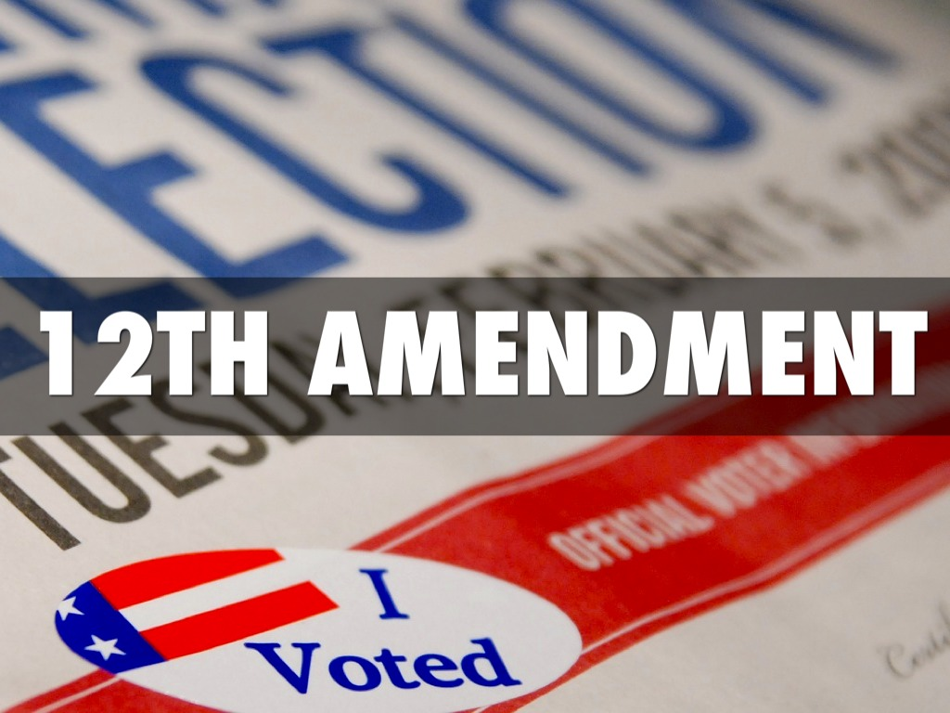
12th Amendment - 1804
Changed the Framers Plan in only one way
Electors would now cast separate ballots
One for President
One for Vice President

Slide 30
Electoral College
Electors are now chosen by the parties in each state
# of Reps + # of Senators = # of electors
Illinois currently has 20 - Need 270/538 to win. (DC has 3)
Electors are voted for by the popular vote in each state
Each elector then casts the official vote for the President and VP.
Electoral votes are counted by Pres. of Senate in a joint session of Congress on January 6.

Slide 31
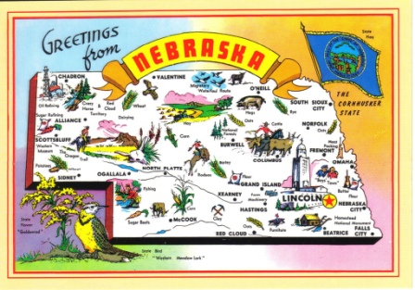
Winner Takes All Approach
48 states and DC use this approach
Only Nebraska and Maine use a different method.
The popular vote determines who will take all of the state’s electoral votes
Example: Illinois –
2008 Vote: 3 million - Obama to 2.9 million - McCain
Obama gets all 21 electoral votes

Slide 32
What’s wrong with this system?
So, if the Framers set out our government this way, then it’s the best way, right???

Slide 33
1st Major Flaw in Electoral College
Winner of Popular Vote May Not Win
This has happened 4 times:
1824 - Jackson won popular vote; but tHoR chose JQ Adams
1876 - Tilden won popular vote, but Hayes won EC (185 to 184)
1888 - Cleveland won popular vote, but Harrison won EC (233 to 168)
2000 – Gore won popular vote, but Bush won EC (271 to 267)
Winning candidate gets all of the electoral votes. The voice of the others is not heard
Distribution of electoral votes gives 2 extra to each state regardless of population.

Slide 34
2nd Major Flaw of Electoral College
Electors are not REQUIRED to vote in accord with the popular vote
Called “Faithless Electors”
Hasn’t had a bearing on the outcome of a presidential election but the potential is there.
Nothing in the Constitution requires that an elector follow the popular vote.
Some electors have broken their pledge to vote the party line 11x.

Slide 35
3rd Major Flaw in Electoral College
Always the possibility of an election being decided by the House
Only happened twice in 1800 and 1824
1800 – Jefferson and Burr tied
1824 – Jackson and Adams tied
Third party candidates make this possible

Slide 36
Proposals to Reform Electoral College
Only way to change is through constitutional amendment
Have been proposed in every term of Congress since 1789.

Slide 37
The District Plan
2 of the electoral votes would represent the popular vote of the state
Each of the remaining electoral votes would represent the popular vote within each district.
Provides a more accurate reflection of the popular vote
Doesn’t eliminate the possibility of the loser of the national popular vote still gaining the majority of the electoral vote

Slide 38
The Proportional Plan
Electoral votes would be divided based on the popular vote
If 60% of the people vote for Obama then Obama gets 60% of the electoral votes
Cures winner takes all and faithless electors problems
Loser of popular vote could still win presidency
Helps the third party candidates

Slide 39
Direct Popular Election
Abolish the electoral college
Simpler process & each vote counts equally
Winner would always be the majority or plurality choice.
Smaller states lose their advantage
Candidates have to campaign in every state
States lose power thus weakening federalism
Could lead to ballot box stuffing and voting fraud

Slide 40
National Popular Vote Plan
No change to Constitution required
Proposed in 2006
All of the State’s electoral votes are to be awarded to the winner of the national popular vote

Slide 41
Defense of the Electoral College
Only 2 elections have actually gone to the House
Loser of popular vote has only won the presidency 4 times in 56 elections
Known process – each reform may have its own defects that are unknown until used
Identification of winner is quick and certain

Slide 42
Electoral college videos
Electoral College explained:
https://www.youtube.com/watch?v=OUS9mM8Xbbw
Electoral College and Elections:
https://www.youtube.com/watch?v=Sl4Pb5Ypbho
Explain the Electoral College and one election that was impacted by it.

