Slide 1
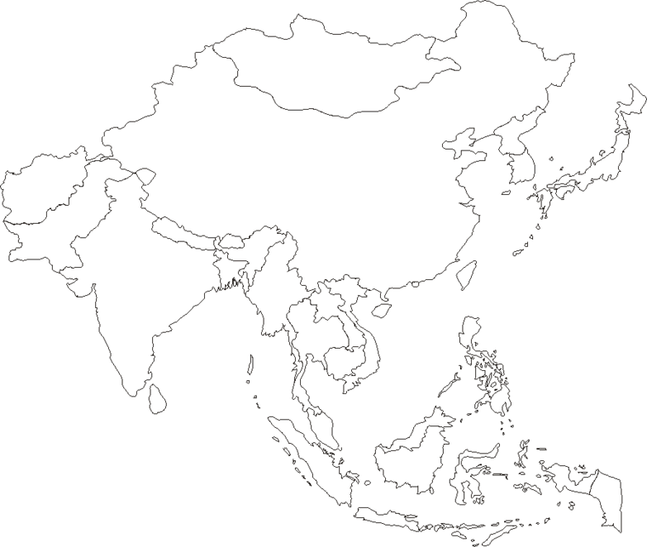
Name:_______________
Label the following water ways:
Indian Ocean
Pacific Ocean
Sea of Japan
Bay of Bengal
Label the following countries and the capitals:
Japan
South Korea
North Korea
Mongolia
China
India
Nepal
Bhutan
Sri Lanka
Bangladesh
Burma
Laos
Vietnam
Cambodia
Thailand
Malaysia
Indonesia
Papua New Guinea
East Timor
Philippines

