Slide 1
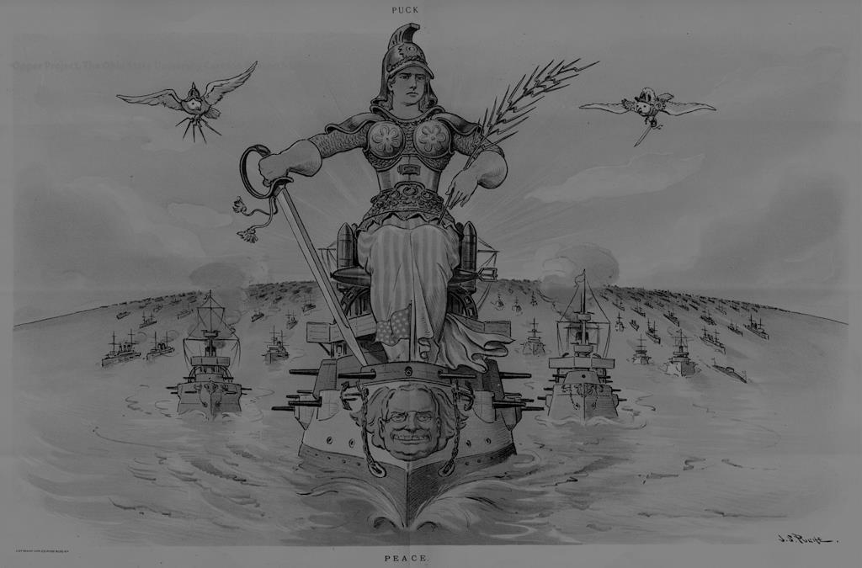
American Imperialism
What is Imperialism?
The policy in which stronger nations extend their economic, political, or military control over weaker territories.
Is expansion a common theme in American History?
What is the term associated with this?
Should we consider the removal of Native Americans as an act of Imperialism?
Or is it only imperialism when we have to get on a boat?

Slide 2
Historical Causes of Imperialism
Monroe Doctrine
1817- Tells Europe to stay out of the Western Hemisphere
Suggests that Latin America is a vital US interest
Manifest Destiny
American Democracy is best form of government
“The flag follows trade, Soldiers follow the flag”
Alfred T. Mahan
Father of the modern US Navy
Argued in favor of aggressive expansion in the Pacific
Teddy Roosevelt
Progressive Champion at home
Imperialist aggressor abroad
Great White Fleet – sent newly built Navy ships around the world to show U.S. strength
GQ: Explain the historical causes of American Imperialism.

Slide 3
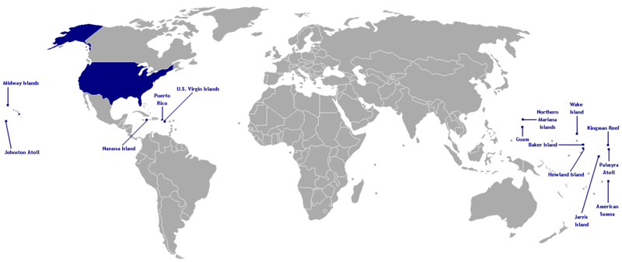
Virgin Islands Wake Island
Kingman Reef Midway Islands
Johnston Atoll
American Samoa Baker Island Guam Howland Island Jarvis Island
Navassa Island Northern Mariana Islands Palmyra Atoll Puerto Rico

Slide 4
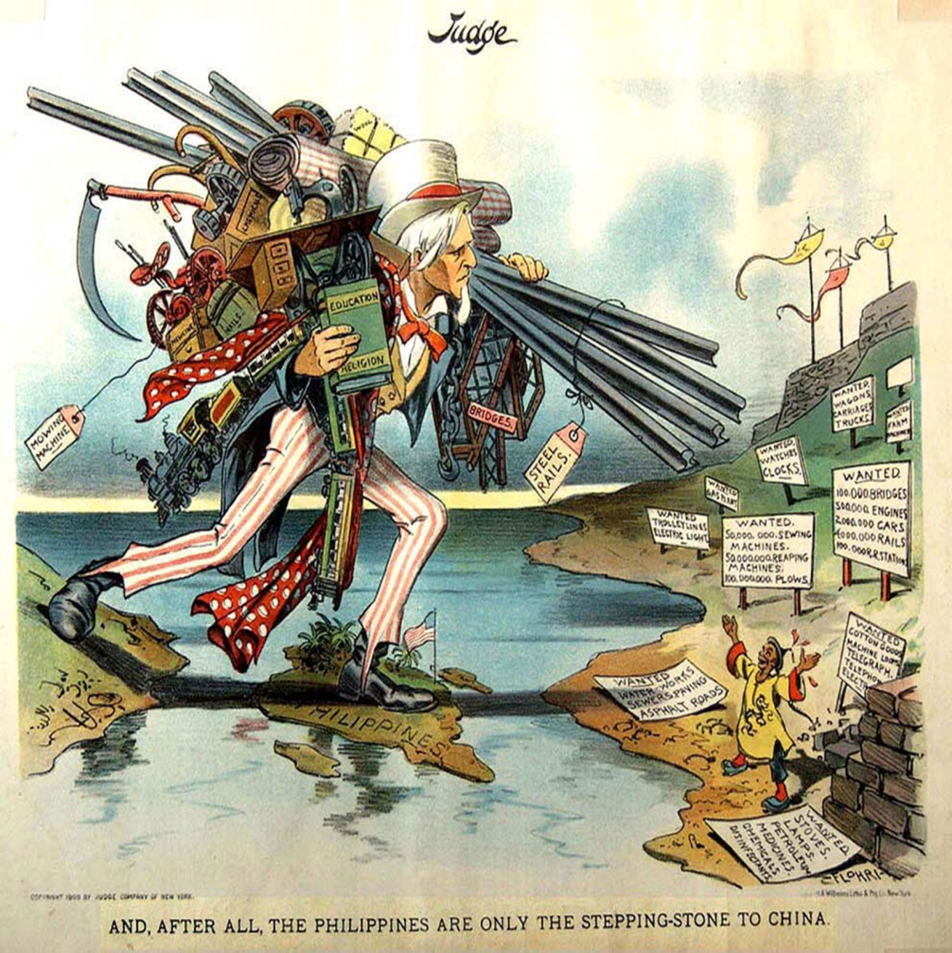
Global Competition
European Nations had been establishing colonies for centuries.
In the late 19th century, Africa was their prime target.
Imperialists also competed for territory in Asia, especially China.
Most Americans gradually accepted the idea of expansion overseas. This stemmed from the idea of manifest destiny.
Three factors fueled the new American Imperialism
Desire for military strength
Thirst for new markets
Belief in cultural superiority.
GQ: Explain the three reasons behind American Imperialism.

Slide 5
Military Superiority
America prided itself as being above the petty wars of Europe—citizen army vs. professional army
Alfred T. Mahan—Influence of Sea Power on World History 1660-1783
Build a canal in Latin America
Build modern and powerful navy
Acquire islands in the pacific as naval bases
The construction of the Maine, Oregon and several other large modern battleships transformed the U.S. into the world’s 3rd largest naval power.
GQ: Explain the three reasons behind American Imperialism.

Slide 6
New Markets
Industrial Age enabled farms and factories to produce more than U.S. consumers could consume.
This left the U.S. in need of raw materials for its factories and new markets for its goods.
Is Foreign Trade the answer?
In order to keep so many Americans working in the factories and in order to keep improving their working conditions via Progressivism, Imperialism would be necessary.
GQ: Explain the three reasons behind American Imperialism.

Slide 7
What does American Imperialist Action teach us about America’s Economic Philosophy?
The US Economy Relies on Growth
If an area is closed to U.S. products, ideas or people, U.S. survival is threatened.
The US has the right to intervene in any country to keep markets open
GQ: Explain the three reasons behind American Imperialism.

Slide 8
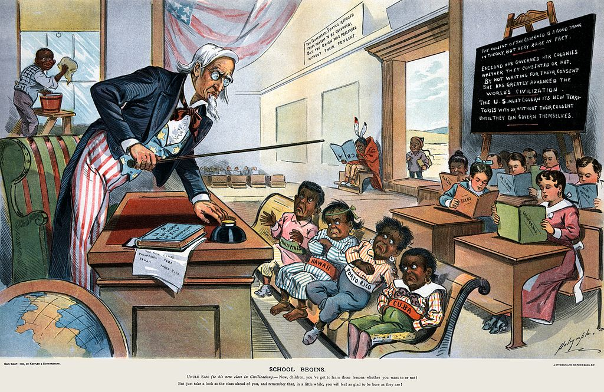
Cultural Superiority
Cultural factors were also used to justify imperialism.
Combined Social Darwinism (survival of the fittest) with the belief in racial superiority of Anglo-Saxons.
They argued that the United States had a responsibility to spread Christianity and “civilization” to the “inferior people” of the world
GQ: Explain the three reasons behind American Imperialism.

Slide 9
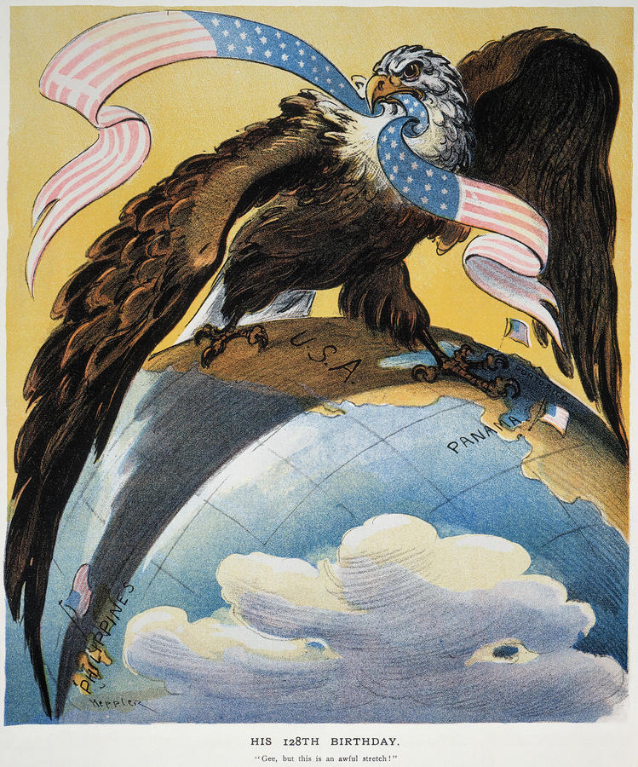
Roosevelt Corollary to Monroe Doctrine
"Any country whose people conduct themselves well can count upon our hearty friendship. Chronic wrongdoing, however, . . . may force the United States to exercise an international police power."
“There is a homely adage which runs, "Speak softly and carry a big stick; you will go far." If the American nation will speak softly and yet build and keep at a pitch of the highest training a thoroughly efficient navy, the Monroe Doctrine will go far.”

Slide 10
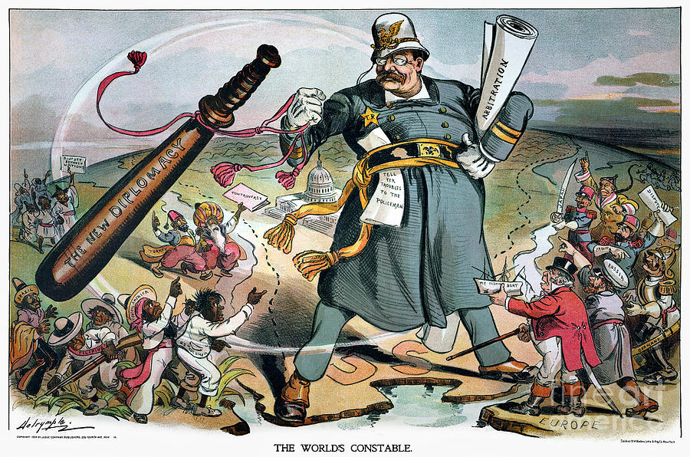
Roosevelt Corollary
US could interfere in Latin America to preserve law & order
Made US a police power
Nicknamed “Gun Boat Diplomacy”
GQ: How did Roosevelt assert American power?

Slide 11
Expansion of U.S.
Alaska:
1867 - Bought Alaska from Russia for 2 cents an acre ($7.2 million)
Wanted for Lumber, Wildlife
Americans found gold, silver, oil, & made $
Hawaii:
1898 – Annexed: Queen Liliukalani gives up territory completely in 1900
Good for crops like sugar, pineapple, & coconuts

Slide 12
A “Splendid Little War”
Spanish-American War:
Cuba is close to the U.S.
U.S. has economic investments on the island
Cuba was looking for freedom from Spain
U.S.S. Maine –
February 15, 1898: The U.S.S. Maine exploded in the harbor of Havana
US Newspapers blame the Spanish for sinking the ship
Yellow Journalism - sensationalist news reporting meant to sway public opinion
Hearst and Pulitzer had been trying to lure and enrage readers by writing exaggerated news
Led McKinley to ask Congress to declare war
GQ: How did the U.S. gain control of former Spanish Colonies?

Slide 13
A “Splendid Little War”
Spanish-American War:
A global war: Fought physically in – the Philippines, Guam, Puerto Rico & Cuba
Treaty of Paris (1898):
Ends Spanish-American War
Freed Cuba from Spain
Guam and Puerto Rico given to the United States
Philippines sold to the U.S. for $20 million
GQ: How did the U.S. gain control of former Spanish Colonies?

Slide 14
 | Puerto Rico | Cuba | The Philippines | China
Relationship
Control would lead to:
Laws/policies
Violent action

Slide 15
 | Puerto Rico | Cuba | The Philippines | China
Relationship | Colony/US Territory | Protectorate: similar to colony, sort of Independ. | Colony/US territory | “Trading Partner”
Control would lead to: | Location to the US=strategic importance | Protect US business interest | Provide the US with raw materials and new markets | Establish and protect new markets for us products
Laws/policies | Treaty of Paris Foraker Act | Platt Amendment | Treaty of Paris/ “removal policies" | Open Door Policy
Violent action | Spanish American War | Spanish American War/ 3 uprisings that led to US occupation | Spanish -American War Philippine-American War | Boxer Rebellion

Slide 16
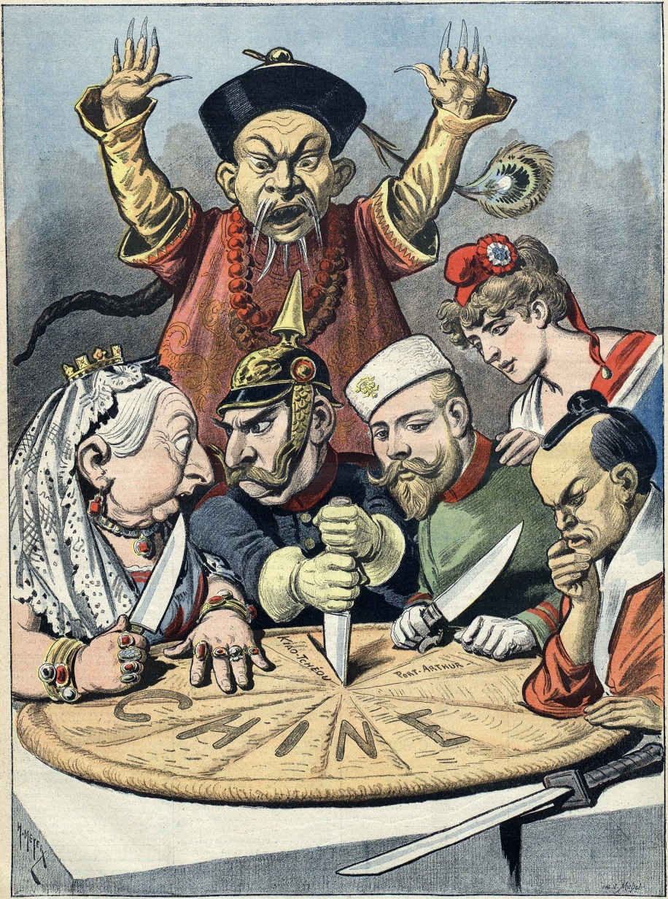
What is the Open Door Policy?
Based on US Secretary of State John Hay’s Open Door Notes where he suggests to the Imperialist countries of Europe that instead of competing in China, they all need to work together to exploit China.
That way all the nations of Europe can make money.

