Slide 1
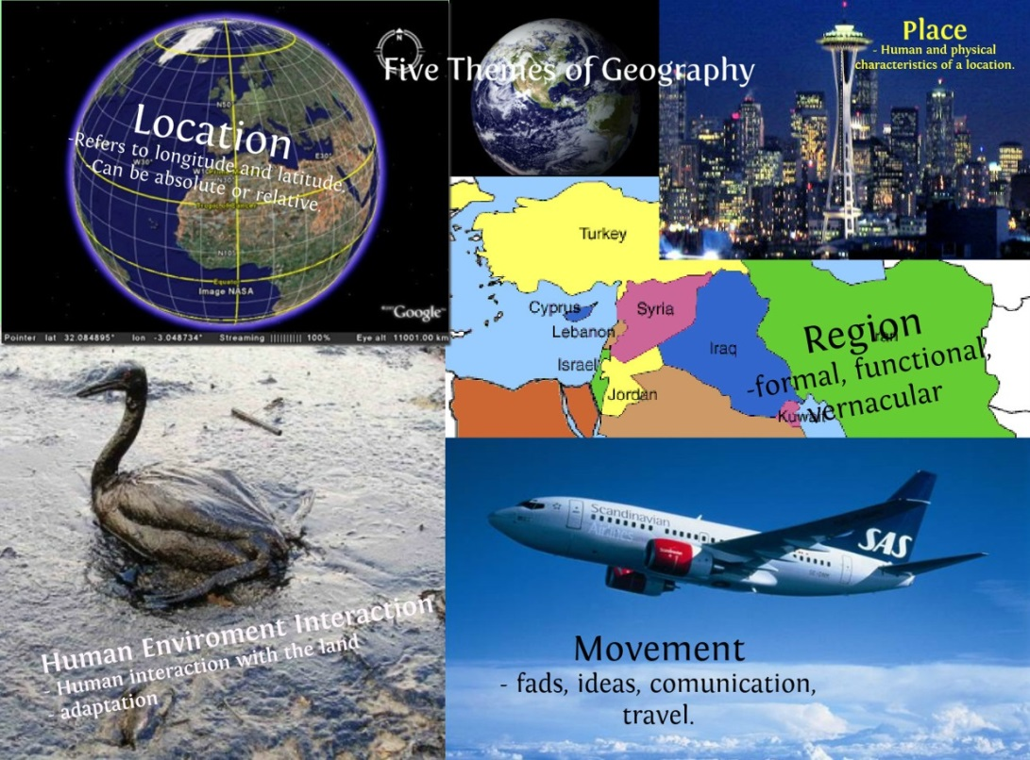
5 Themes of Geography

Slide 2
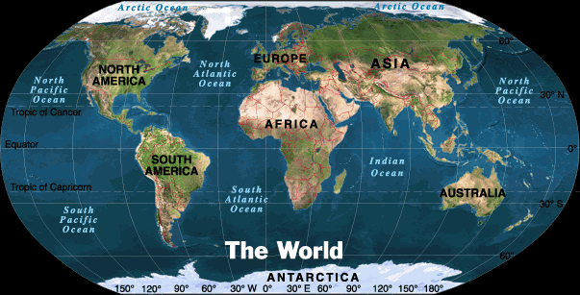
Geography
According to Webster’s dictionary is a science that deals with description, distribution, and interaction of the diverse physical, biological, and cultural features of the earth’s surface.

Slide 3
5 Themes
Location
Place
Interaction
Movement
Region

Slide 4
Location
Describes where something is on earth
2 types
Absolute location
Relative location

Slide 5
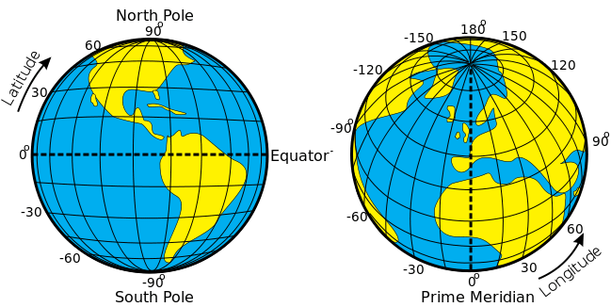
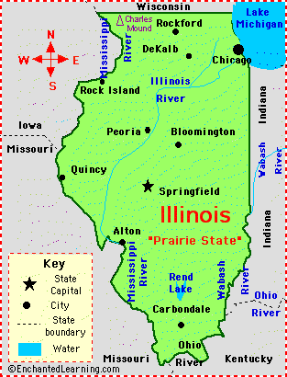
Absolute
The exact location
Given in longitude/latitude, or address
Relative
Relation to another place
Near, far, next to
Described by landmarks, time, direction, or distance from one place to another

Slide 6
Where is the place (longitude, latitude, continent, hemispheres)?
How far away from home is it (travel time by plane, distance in miles or kilometers)?
What countries are neighbors of the country?

Slide 7
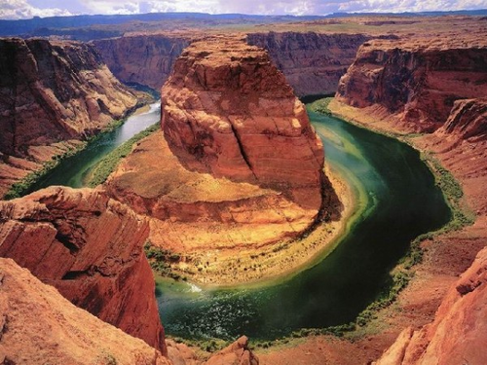
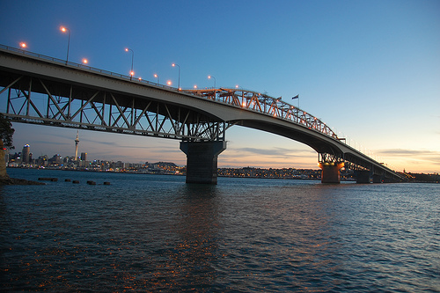
Place
Describes the physical and human characteristics of a place
Physical characteristics- terrain, height above sea level, landforms, and climate
Human characteristics- population, infrastructure, culture, language, and beliefs

Slide 8
Describe the place (size, shape).
What is the climate (temperature, rainfall)?
What kinds of physical features are there (mountains, rivers, deserts)?
Describe the people who live there (nationalities, traditions, etc.).

Slide 9
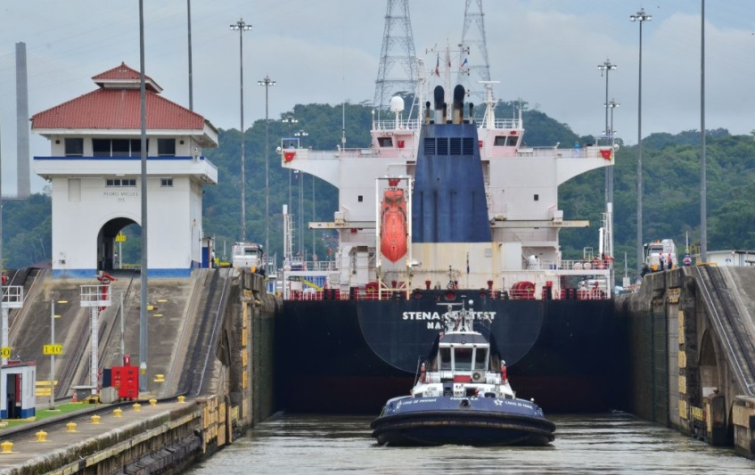
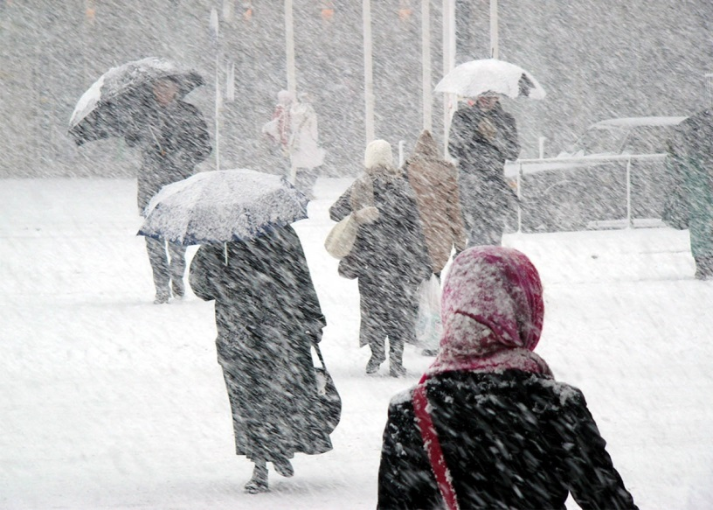
Human-Environment Interaction
Describes how humans have changed a particular place, and how humans adapt to the environment around them

Slide 10
We depend on the environment
People depend on rivers for water and transportation
We adapt to the environment
We adapt to the environment by wearing different clothes in the summer vs the winter
We modify the environment
People modify their environment by heating and cooling buildings for comfort

Slide 11
How do people use the land (farming, herding, mining, industry)?
How have people changed the land?
Where do most people live (near a river or coastline, in the mountains)?
Why do you think people settled there (water, safety, food, natural beauty)?

Slide 12
Movement
Describes how people, goods, information, and culture got to a particular place

Slide 13
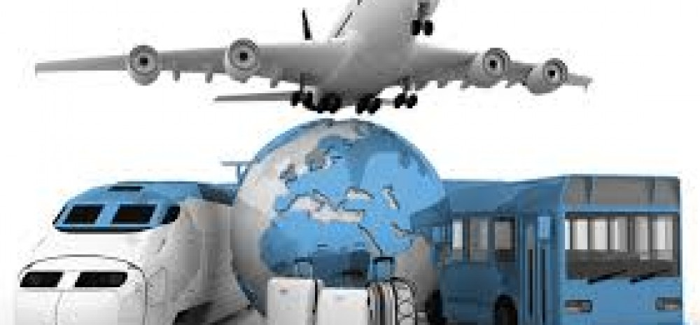
Movement of people
Cars, trucks, trains, planes
Movement of products
Cars, trucks, trains, planes
Movement of info/ideas
Phones, email, mail
TV, radio, social media

Slide 14
How will you travel to the place (route, drive, fly, walk)?
Does the country export goods to other places? If so, what and where?
Does the country import goods from other places? If so, what and from where?
Why would people leave or move to the country (jobs, family, climate, war)?

Slide 15
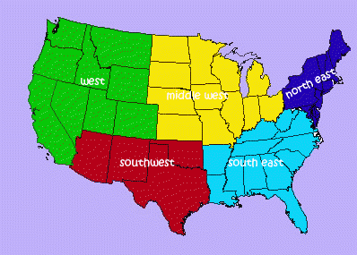
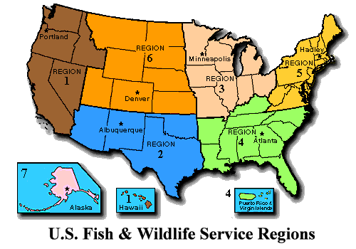
Regions
Describes similarities you may find in a place
Language, culture, and similar historical backgrounds
Can be defined by both physical and human characteristics
People divide the world into regions to help understand and interpret info

Slide 16
What language(s) do people speak?
What are the political divisions of the country (states, provinces, republics)?
How is the country similar to any of its neighbors (traditions, language, climate)?

Slide 17
Mr. Help
M- Movement
R- Regions
HE- Human Environment Interaction
L- Location
P- Place

Slide 18
