Slide 1
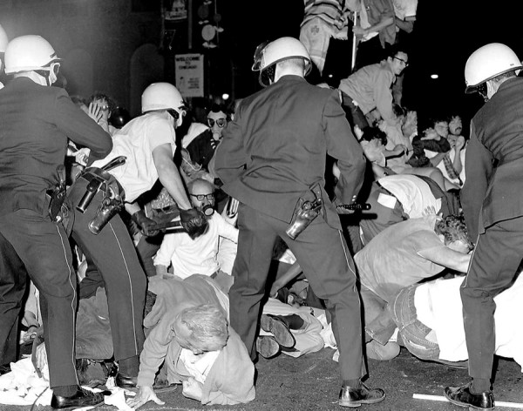
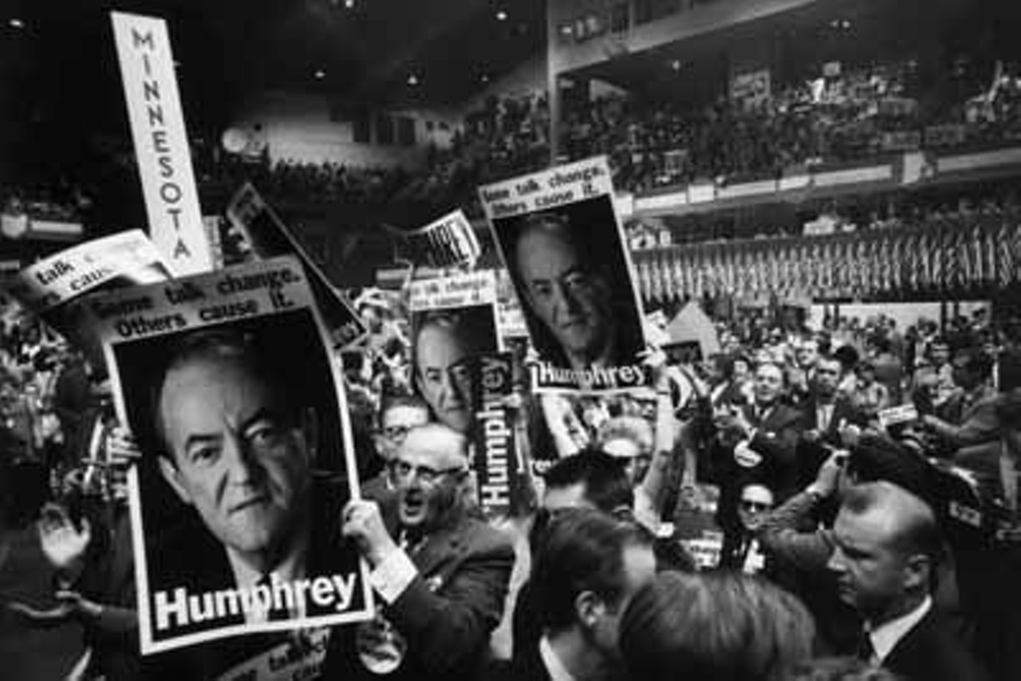
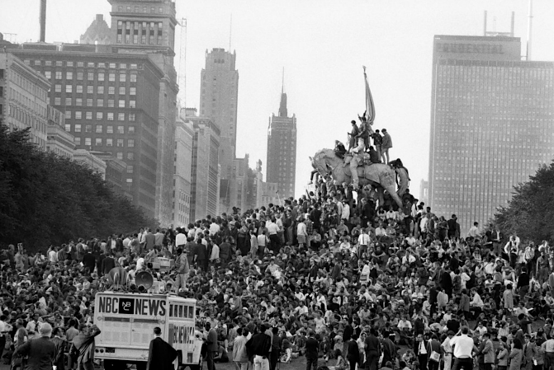
22.4 Tier 2

Slide 2
Instructions
-You will watch a series of clips about the 1968 Democratic National Convention from the Ken Burns The Vietnam War series.
-You should be jotting down notes as you watch the clips.
-After watching the clips you will be responsible for writing a letter as one of the given roles looking back on the events of the convention.
-The letter should be at least 10 sentences long.

Slide 3
Clips
https://illinois.pbslearningmedia.org/resource/87bc23ef-db48-4957-a878-f4e3f1c307f5/the-1968-democratic-national-convention-clip-the-vietnam-war/#.Wt3RNU2ouUl
https://illinois.pbslearningmedia.org/resource/161b73cd-8e6a-4540-a5a0-14d0d6fc0e6c/delegates-and-demonstrators-ken-burns-the-vietnam-war/#.Wt3ROE2ouUk
https://illinois.pbslearningmedia.org/resource/d6d13ec8-dcfa-4965-ab66-893977bd9315/the-whole-world-is-watching-clip-the-vietnam-war/#.Wt3ROk2ouUl
https://illinois.pbslearningmedia.org/resource/bd84be04-0413-4325-abbd-93854d66fa5e/a-convention-in-chaos-clip-the-vietnam-war/#.Wt3RO02ouUl

Slide 4
Letter
-Write a letter about the convention to a friend or family member from the viewpoint of one of the following persons:
● A Chicago police officer
● A demonstrator at the convention
● A delegate to the convention
● An ordinary person watching the convention on TV
-Be sure to write your letter from the frame of reference of the person you’re assigned. ( Frame of reference refers to a set of values or ideas that shape your thinking about a particular event.)
-Write your letter in “letter style.” That is, make sure you have a salutation (“Dear …”) and conclude your letter with something like, “Sincerely yours.” Make sure your letter is free of spelling or grammatical errors.

