Slide 1
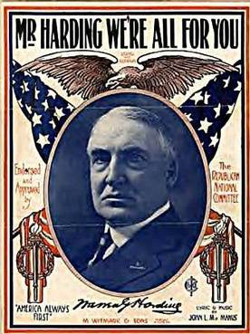
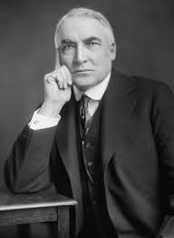
Chapter Twelve Politics of the Roaring Twenties Section 2 The Harding Presidency

Slide 2
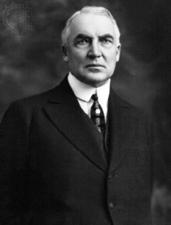
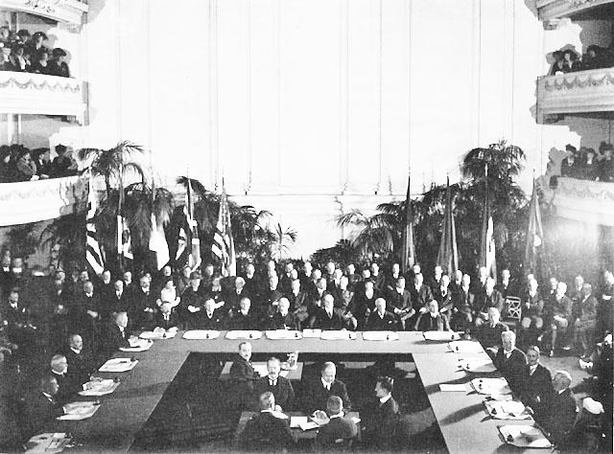
Harding Struggles for Peace
Warren G. Harding President
good looking, good natured, and calming
not the best, the smartest, nor the most exciting, but Americans loved him.
Americans were tired of progress, and wanted normalcy.
In 1921 Harding invited several major powers to the Washington Naval Conference; excluded Russia because of its Communist government
The world’s naval powers agreed to disarm their naval forces; first time in history

Slide 3
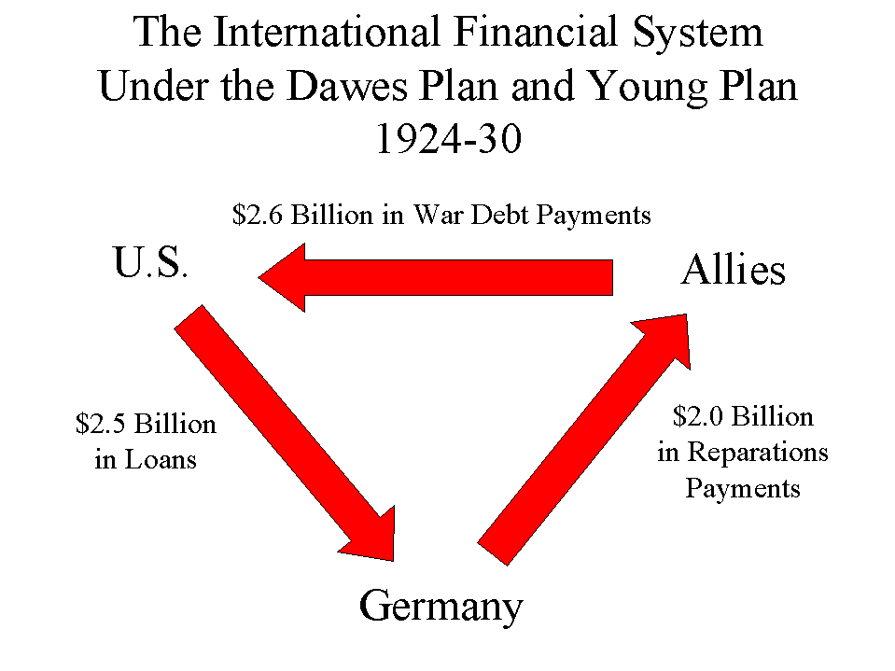
Harding Struggles for Peace
Settling War Debts
France and Britain could not repay loans to the U.S.($10 billion)
Britain and France looked to Germany to pay their debts (Germany was experiencing inflation, so they couldn’t pay)
Dawes Plan: U.S. investors loaned Germany $2.5 billion to repay Britain and France
Britain and France then used this money to pay back the U.S.
the United States was essentially being repaid with its own money
this deal caused resentment all around
EQ: What was the flaw of the Dawes Plan?

Slide 4
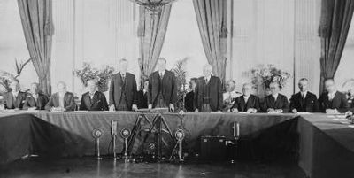
Harding Struggles for Peace
1928 Kellogg-Briand Pact
fifteen countries signed
2. weak agreement to renounce war as a national policy
3. had no way of enforcing

Slide 5
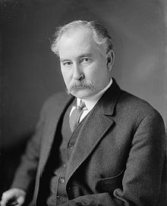
Scandal Hits Harding’s Administration
Charles Evans Hughes was appointed Harding’s Secretary of State (good); eventually becomes Chief Justice of Supreme Court
Other Cabinet appointments came from “The Ohio Gang”
Harding’s old supporters and poker playing cronies (not so good)
the Ohio gang caused a great deal of embarrassment.
Harding did not understand many issues, which allowed his cabinet members to take advantage of the situation.
corrupt friends use government position to get rich (GRAFT!)

Slide 6
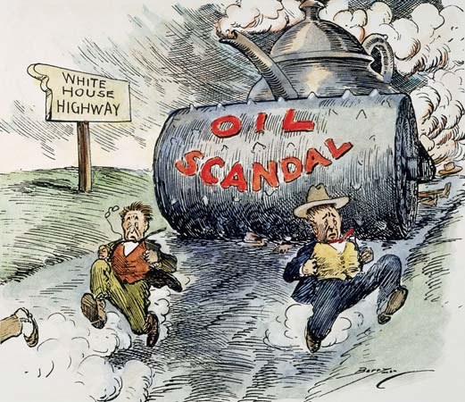
Scandal Hits Harding’s Administration
Teapot Dome Scandal
Government set aside oil-rich public lands for the use of the United State’s Navy
Albert Fall, the Secretary of the Interior, actually sold U.S. owned oil reserve land to private companies and pocketed the money!
Fall was eventually convicted of taking more than $400,000 in bribes (first Cabinet member convicted of a felony while holding a Cabinet position).
Harding stated, “I have no trouble with my enemies… But my… friends…, they’re the ones that keep me walking the floor nights!”
EQ: Describe the Teapot Dome Scandel.

Slide 7
Essential Question
Summarize President Harding’s scandals while in office.
Answer the question in three complete sentences in your summary section

Slide 8
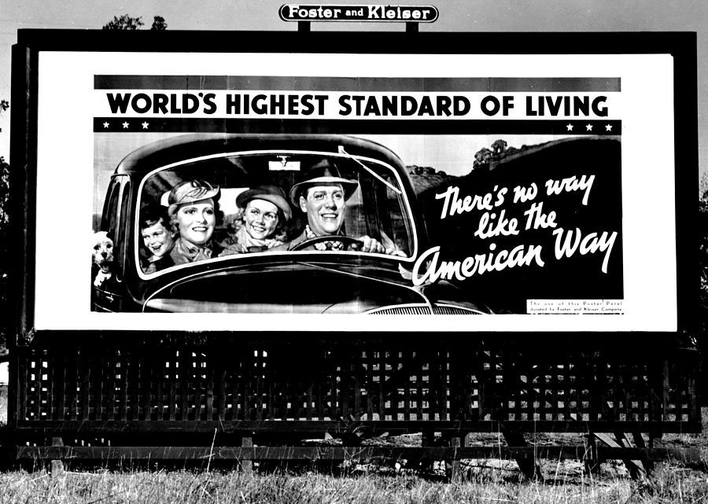
Chapter Twelve Politics of the Roaring Twenties Section 3 The Business of America

Slide 9
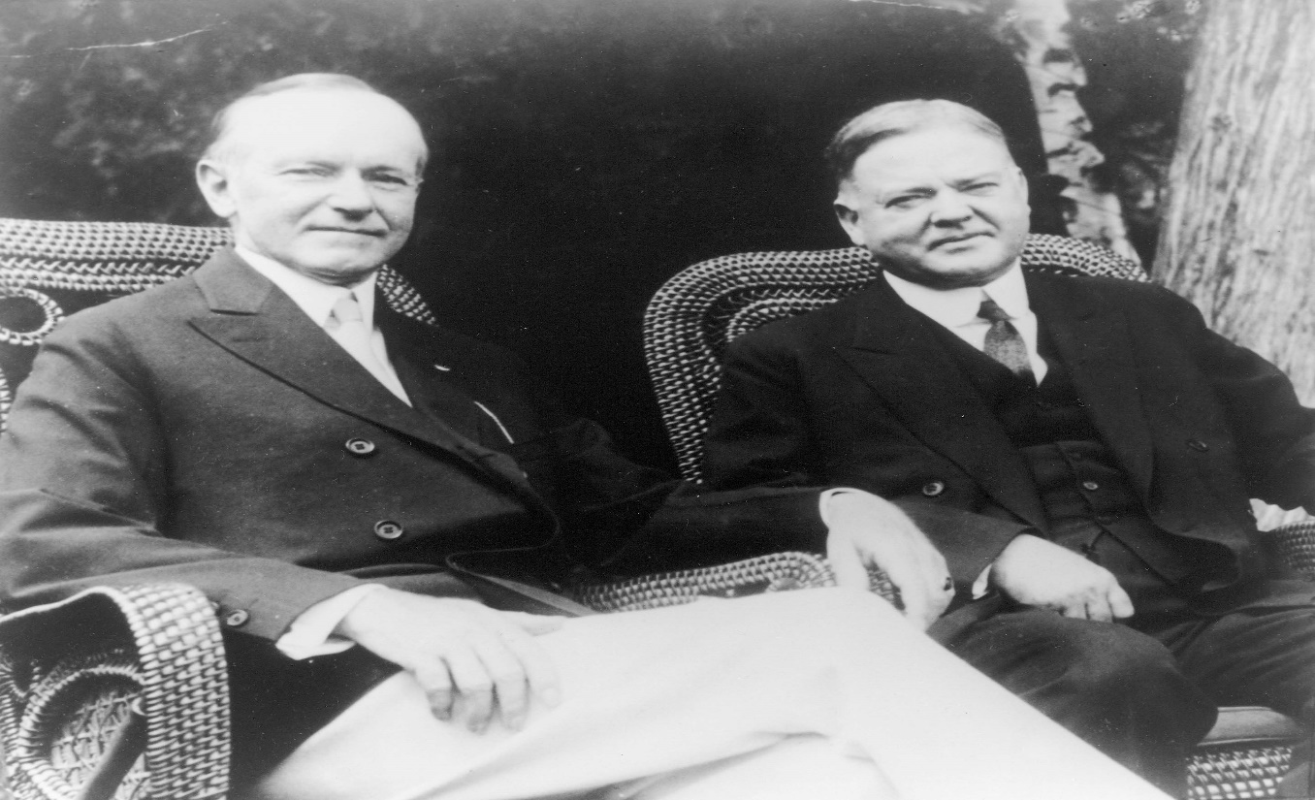
American Industries Flourish
Presidents Coolidge and Hoover favored policies that would keep taxes down and profits up
They wanted to keep government involvement in business to a minimum
For most of the 1920s, their approach seemed to work

Slide 10
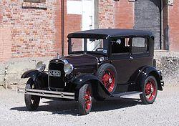
American Industries Flourish
Impact of the Automobile
Literally changed the American landscape
construction of new paved roads (Route 66)
Changed architectural styles
Gas stations, motels, etc.
2. Liberated isolated rural families (they can now travel to cities)

Slide 11
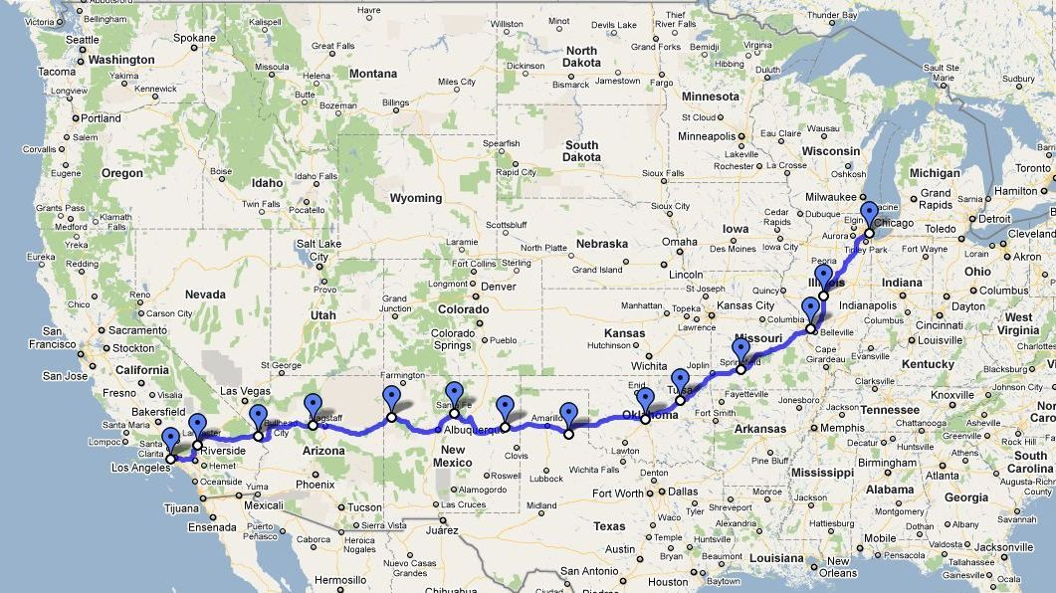
American Industries Flourish
1. Allowed for greater independence for young people
2. Created the urban sprawl (workers can live further away from their jobs)
3. Cars become a status symbol, yet still affordable enough that they were attainable by many
EQ: How did the automobile influence American lives?

Slide 12
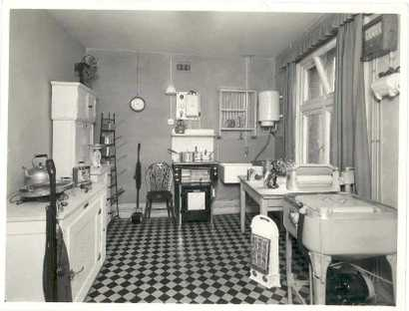
America’s Standard of Living Soars
Americans owned 40% of the world’s wealth.
Average income up 35% (from $522 to $705 average salary)
People found it easy to spend their increased income.
Advances in alternating current allowed the power grid to extend out to many more people.
New electric machines
Some had irons, refrigerators, ranges, toasters, washing machine, vacuum cleaners, etc.
EQ: How do you think most Americans lives changes?

Slide 13
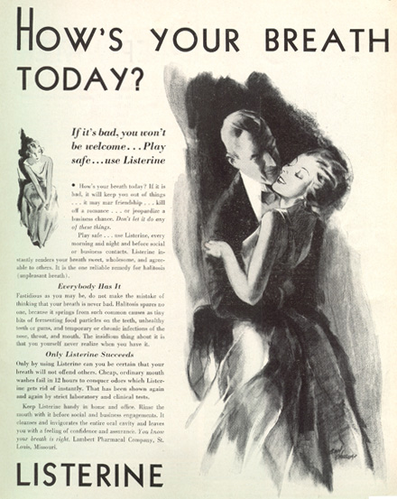
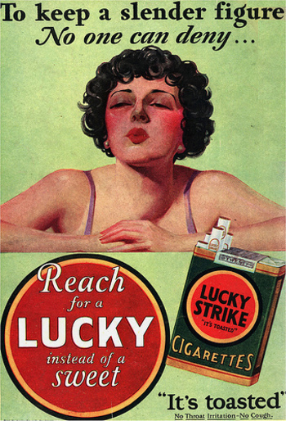
America’s Standard of Living Soars
Modern Advertising
Psychologists were consulted to help focus appeal on people’s desire for youthfulness, beauty, health, and wealth
Brand names became familiar and luxury items were made to seem like necessities
Business people applied the power of advertising to other areas of American life

Slide 14
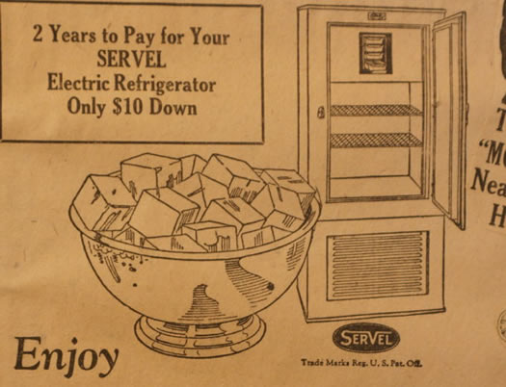
America’s Standard of Living Soars
Advertising made people want things
Installment plans (paying a little each month, with interest rates low) allowed people to buy goods they otherwise couldn’t.
Advertisers pushed the idea of installment plans.
“You furnish the girl, we’ll furnish
the home!”
“Enjoy while you pay!”

Slide 15
America’s Standard of Living Soars
** Prosperity of the 1920s was superficial
1. major industries like steel, automobiles, and
home construction were suffering
2. the number of products purchased on credit
rose substantially
3. more than 80% of the American people
earned less than $3,000 per year, yet they
continued to spend lavishly
4. farms were producing more food than needed and drove down the price of food ***

Slide 16
A Superficial Prosperity
The Paradox
Coolidge stood for economy and a frugal way of life, but he was favored by people who “lived in the now.”
Problems on the horizon
Some economists thought buying on credit could get out of hand.
Growing income gap between workers and managers
Oversupply in some industries drove down prices (and profits!)
Still, life seemed easier and more enjoyable for hundreds of thousands of Americans
EQ: How could credit potentially be a problem for the economy?

Slide 17
Marketing Advertisement
How would you use modern advertising to market these items? Create an advertisement for one of the items below:
Double Boiler: $1.19
Coffee Pot: $1.19
Western Electric Clothes Washer: $125.00
Electric Toaster Green: $6.75
Aluminum Coffee Percolators: 98¢
Electric Table Stoves: $1.95 to $12.50
Wind up Gramophone: (phonograph) $85
Gas Ranges: $88
**($100 in 1920 = about $1000 today)**

Slide 18
Essential Question
How did changes in technology in the 1920s influence American life?
Explain.
Answer the question in three complete sentences in your summary section

