Slide 1
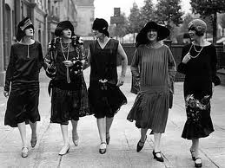
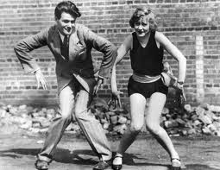
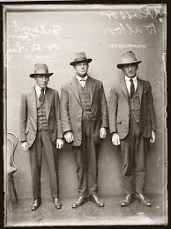
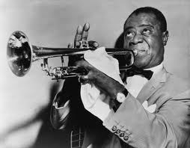
RETURN TO NORMALCY (1920 - 1929) CHAPTER TWELVE AND CHAPTER THIRTEEN

Slide 2
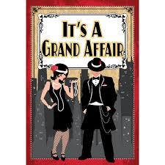
Chapter Twelve Politics of the Roaring Twenties Section One Americans Struggle with Postwar Issues

Slide 3
Americans Struggle with Postwar Issues
Postwar Trends
World War I left much of the American public exhausted
debate over the League of Nations divided America
Progressive Era caused wrenching changes in American’s lives
the economy had difficulty adjusting to modern times
unemployment
returning soldiers needed work
women / minorities lost jobs to those returning soldiers
cost of living doubled
farmers and factory workers suffered as wartime orders diminished

Slide 4
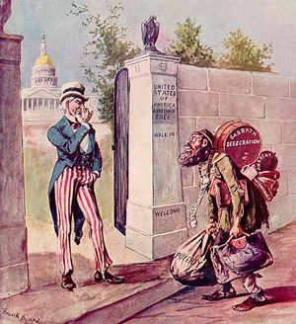
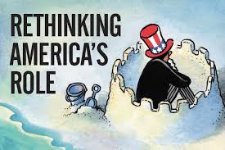
Postwar Trends
Americans wanted to return to “normalcy,” which was a reactionary result of the progressives’ changes
The 1920s Involved Three Major Trends:
renewed isolationism
resurgence of nativism
political conservatism (people were burned out on change)
EQ: What are the 3 major trends of the 1920s?

Slide 5
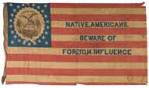
Postwar Trends
Isolationism: a policy of pulling away from involvement in world affairs
Nativism: prejudice against foreign-born people
EQ: Define Isolationism and Nativism.

Slide 6
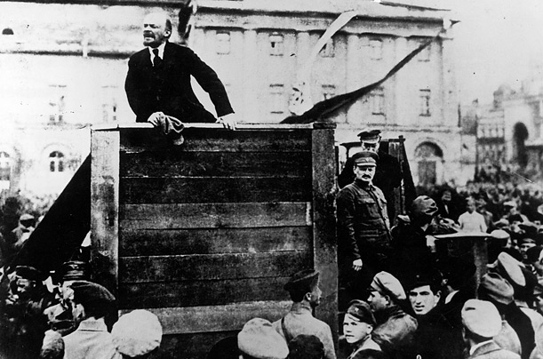
Fear of Communism
U.S. sends troops to assist the “Whites” against the “Reds”
Communists take over Russia and rename it the Soviet Union
The Soviets were not happy with the United States

Slide 7
Fear of Communism
factory workers are a natural supporter of this new Communist movement (“have nots”)
big business owners natural enemy (“haves”)
radicals mail bombs to government and business leaders, which caused the government to combat the Communist movements

Slide 8
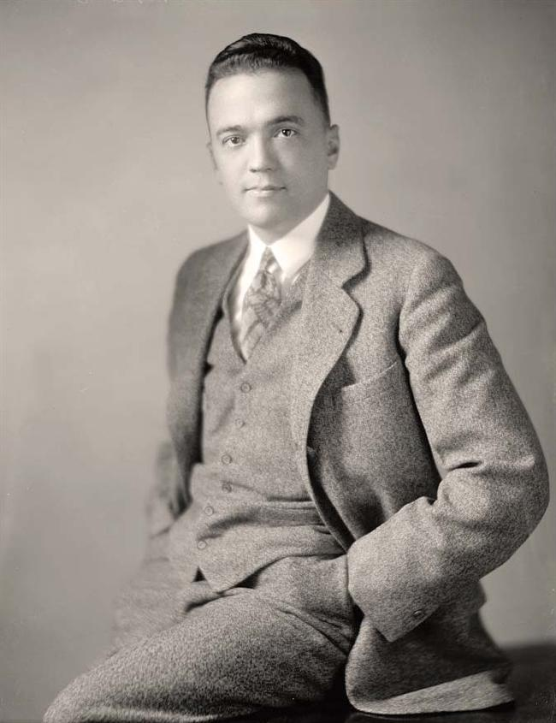
Fear of Communism
Attorney General A. Mitchell Palmer takes action against “The Reds”
J. Edgar Hoover was appointed as director of new “anti-radical” division of the Justice Department.
Purpose is to hunt down suspected communists and radicals - Civil Rights Violations?
Eventually known as the FBI
(Federal Bureau of Investigation)

Slide 9
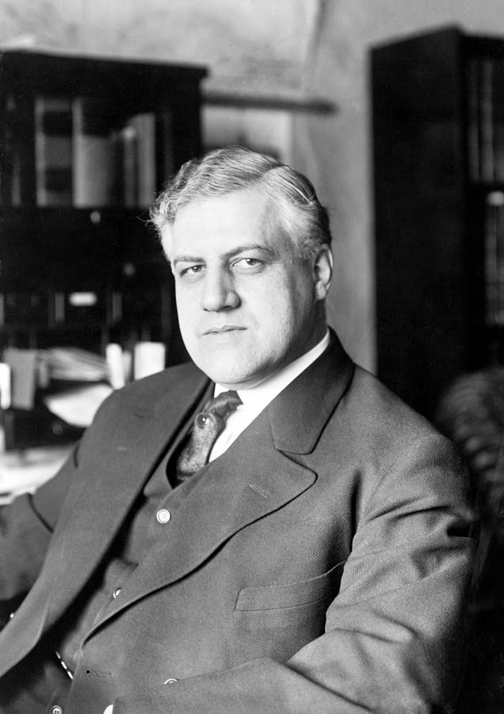
Fear of Communism
According to A. Mitchell Palmer, the Attorney General, what was “eating its way into the homes of the American working man, its sharp tongues… licking at the alters of our churches…” was Communism and Radicalism
Palmer believed in protection from political radicals
Palmer staged raids, but no evidence of a revolutionary conspiracy was ever found in the United States

Slide 10
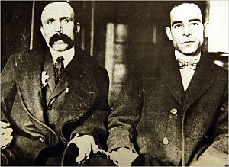
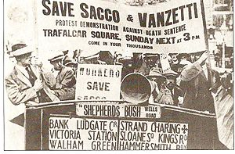
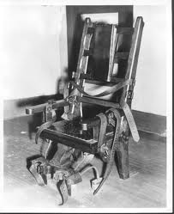
Fear of Communism
Sacco and Vanzetti
both were immigrants from Italy
known communists/ anarchists
they were arrested for the crimes of murder and robbery
the case against them was based on circumstantial evidence (suspects “looked Italian”)
they were not given a fair trial (they had alibis and the judge made prejudicial statements)
still, a jury found them guilty, and sentenced them to death
they were electrocuted on August 23rd, 1927
EQ: Who were Sacco and Venzetti?

Slide 11
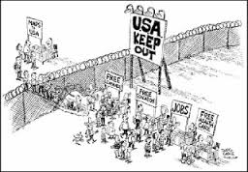
Limiting Immigration
“Keep America for Americans” becomes the prevailing attitude in the United States

Slide 12
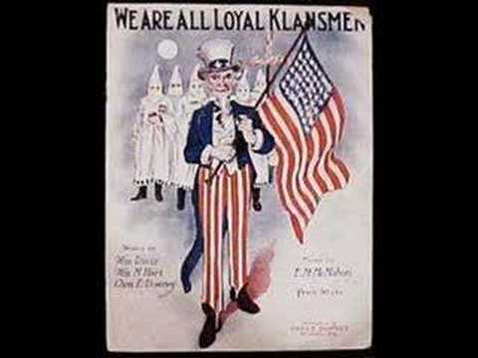
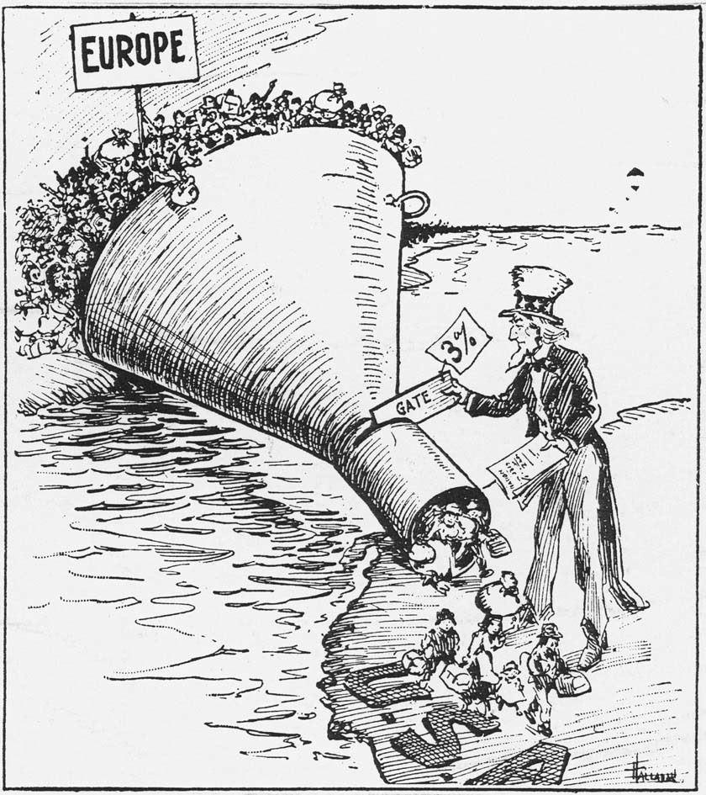
Limiting Immigration
Two Key Events Happen
KKK rises again
> devotion to 100% Americanism
> wanted to keep African Americans
“in their place,” destroy saloons,
oppose unions, and drive
Catholics, Jews, and foreigners out
of the country
Quota System
> established the maximum number
of people who could enter the U.S.
from a foreign country
(discriminated against specific
countries) – stopped Japanese
immigration

Slide 13
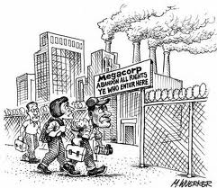
A Time of Labor Unrest
postwar conflict festered between labor and management.
during the war, workers could not strike; nothing could interfere with the war effort.
1919: more than 3,000 strikes
4,000,000 workers walked off the job
Workers wanted more money and the ability to join unions.
Three Main Strikes
The Boston Police Strike
The Steel Mill Strike
Coal Miner’s Strike

Slide 14
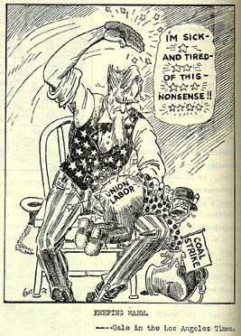
A Time of Labor Unrest
in spite of limited gains, the 1920s hurt the labor movement badly.
union membership dropped dramatically from five to 3.5 million people
work force consisted of immigrants willing to work in poor conditions
language barriers led to difficulty in organizing
previous farmers were used to depending on themselves
most unions excluded African Americans
EQ: How were labor movements hurt by the 1920s?

Slide 15
Essential Question
Do you think Americans were justified in their fear of radicals and foreigners in the decade following World War I?
Justify your answer.
Answer the question in three complete sentences in your summary section

