Slide 1
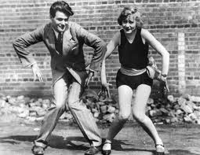
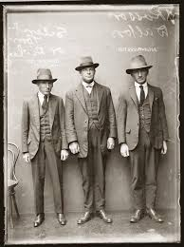
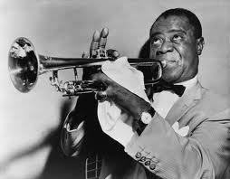
RETURN TO NORMALCY (1920 - 1929) CHAPTER TWELVE AND CHAPTER THIRTEEN

Slide 2
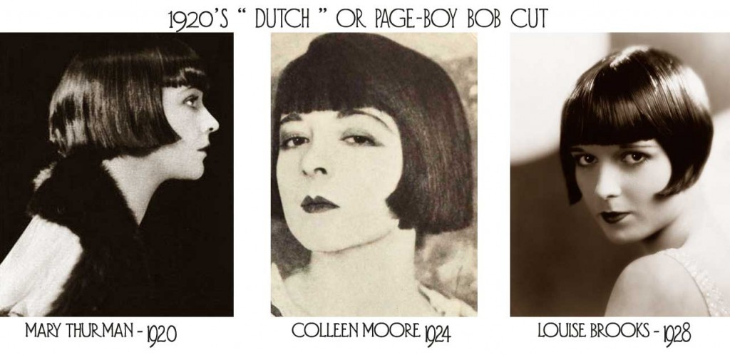
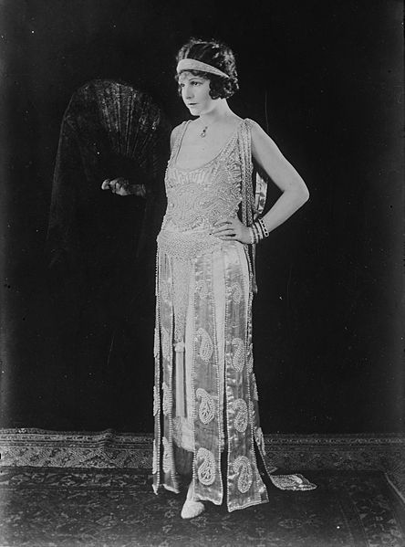
Young Women Change the Rules
Flappers
become a symbol of a free young woman
who embraced new fashion and urban attitudes
Style
Skirts above the knee!
Short, boyish hair
Wore “kiss-proof” lipstick

Slide 3
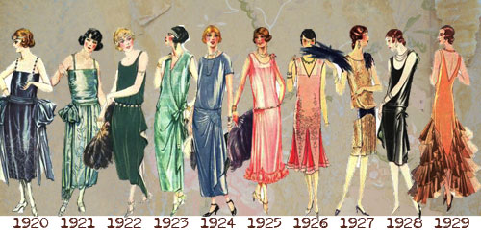
Young Women Change the Rules
Women become more assertive (began smoking and drinking in public, more willing to talk about sex)
The Double Standard
Women were expected to observe stricter standards of behavior than men
Casual dating increased, but men only officially “courted” women who they would marry

Slide 4
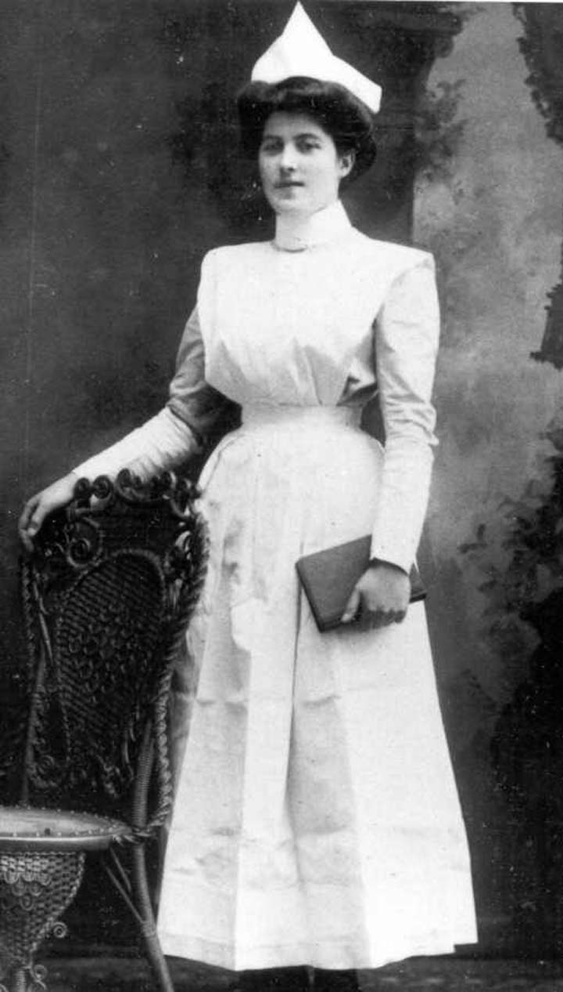
Women Shed Roles
New work opportunities
Nurses, teachers, secretaries, librarians, social workers
Unequal treatment and wages
Male view that women really belonged in the home
The Changing Family
Lower birthrate from increased birth control information
Marriages from personal choice rather than family
Teenagers spent more time with other kids their age, and less with family
Child labor laws limit house income

Slide 5
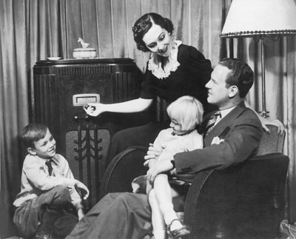
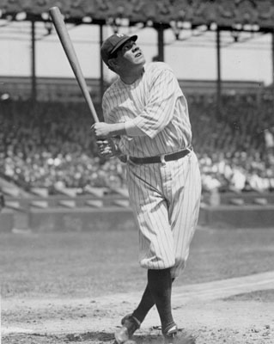
Education and Popular Culture
Popular Culture
Newspaper and mass circulation magazines rose in circulation
Radio was most powerful communication method in the 1920s (allowed the shared national experience of hearing news live)
Babe Ruth was glorified as a superhero

Slide 6
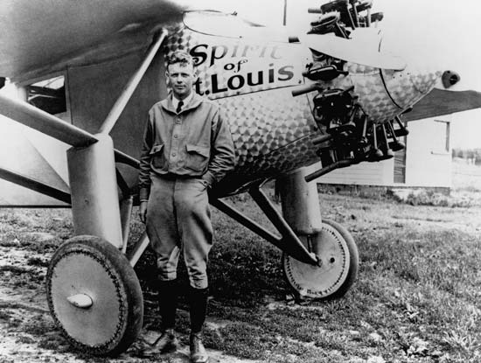
Education and Popular Culture
Charles Lindbergh completed the first nonstop solo flight across the Atlantic Ocean
movies begin to appear with sound in them
it is one of the richest eras in American literature

Slide 7
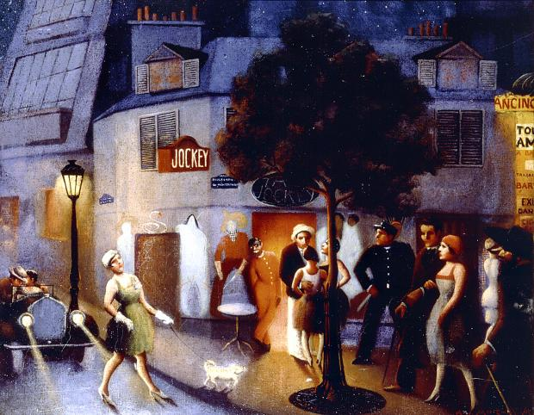
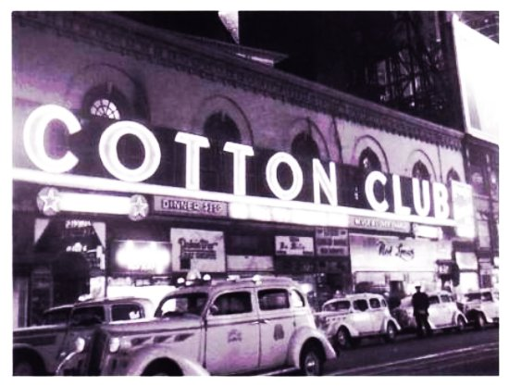
The Harlem Renaissance
The Harlem Renaissance was a literary and artistic movement celebrating African-American culture.
African-American ideas, politics, art, literature, and music flourished in Harlem (and elsewhere)
Politics: Marcus Garvey
Writers: Claude McKay, Langston
Hughes
Performers: Paul Robeson
Musicians: Louis Armstrong, “Duke” Ellington, Bessie Smith

Slide 8
Essential Question
During the 1920s, a double standard required women to observe stricter codes of behavior than men. Do you think that some women of this decade made real progress towards equality? Support your answer.
Answer the question in three complete sentences in your summary section

