Slide 1
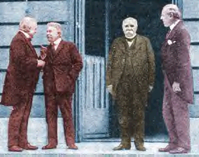
WILSON’S FOURTEEN POINTS AND THE TREATY OF VERSAILLES

Slide 2
WORLD WAR I ENDED IN 1918
As a result of its role in World War I, the United States emerged as a dominant global power.
President Woodrow Wilson wanted to make World War I the war to end all wars.
He went to France to help write the peace treaty.

Slide 3
VERSAILLES CONFERENCE
Wilson came to the peace conference at Versailles with suggestions for a fair and equitable peace treaty.
These suggestions were called Wilson’s Fourteen Points.

Slide 4
Wilson’s Fourteen Points
I. No more secret treaties
II. Freedom of navigation upon the seas
III. Freedom of trade across borders
IV. Reduction of military and arms of all nations consistent with domestic safety.
V. Colonies should rule themselves
VI. Germany needs to get out of Russia, and Russia should rule herself
VII. Germany needs to get out of Belgium and Belgium should rule herself
VIII. All French territory should be freed, France liberated, and France should be allowed to recover Alsace-Lorraine
IX. All Italians are to be allowed to live in Italy
X. Self-determination should be allowed for all those living in Austria-Hungary
XI. Self-determination and guarantees of independence for the Balkan states and its borders re-drawn; Rumania, Serbia, and Montenegro should be evacuated; occupied territories restored; Serbia accorded free and secure access to the sea
XII. The Turks should rule Turkey
XIII. Poland should become independent
and given a safe and free access to the sea
XIV. A League of Nations should be formed with all nations as members, great and small states alike

Slide 5
Casualties of the War http://www.nv.cc.va.us/home/cevans/Versailles/greatwar/casualties.html
Total casualties: 37 million
Total killed in WWI: 10-11 million
1 in 8 young men in France died
62% of all European men fought at some point in the war.
Total wounded in WWI: 30 million
Total amount spent directly on the war: $180,000,000,000

Slide 6
“THE BIG FOUR”
David Lloyd George-Great Britain
Woodrow Wilson-United States
Goerges Clemenceau-France
Emanuele Orlando-Italy

Slide 7
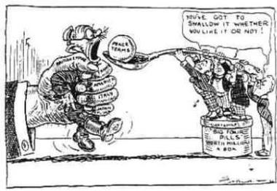
WHAT THE TREATY SAID ABOUT GERMANY
Army reduced to 100,000 men, no longer allowed to draft men
Reduce the navy to 6 warships , no submarines
Destroy all of its air force.
Give up land to Belgium, France, Denmark and Poland
Hand over all of its colonies.
Agree to pay reparations to the Allies
Put no soldiers or military equipment within 30 miles of the east bank of the Rhine.
Accept all of the blame for the war, the "War Guilt Clause"

Slide 8
THE TREATY CHANGES THE MAP
The Treaty established nine new nations
Poland, Lithuania, Latvia, Estonia and Finland were formed from land lost by Russia. Czechoslovakia and Hungary were formed out of the Austro-Hungarian Empire.
The boundaries of other nations were shifted
Some areas of Turkish territory carved out and given to France and Britain as mandates or temporary colonies. (Iraq, Syria, Lebanon and Palestine)

Slide 9
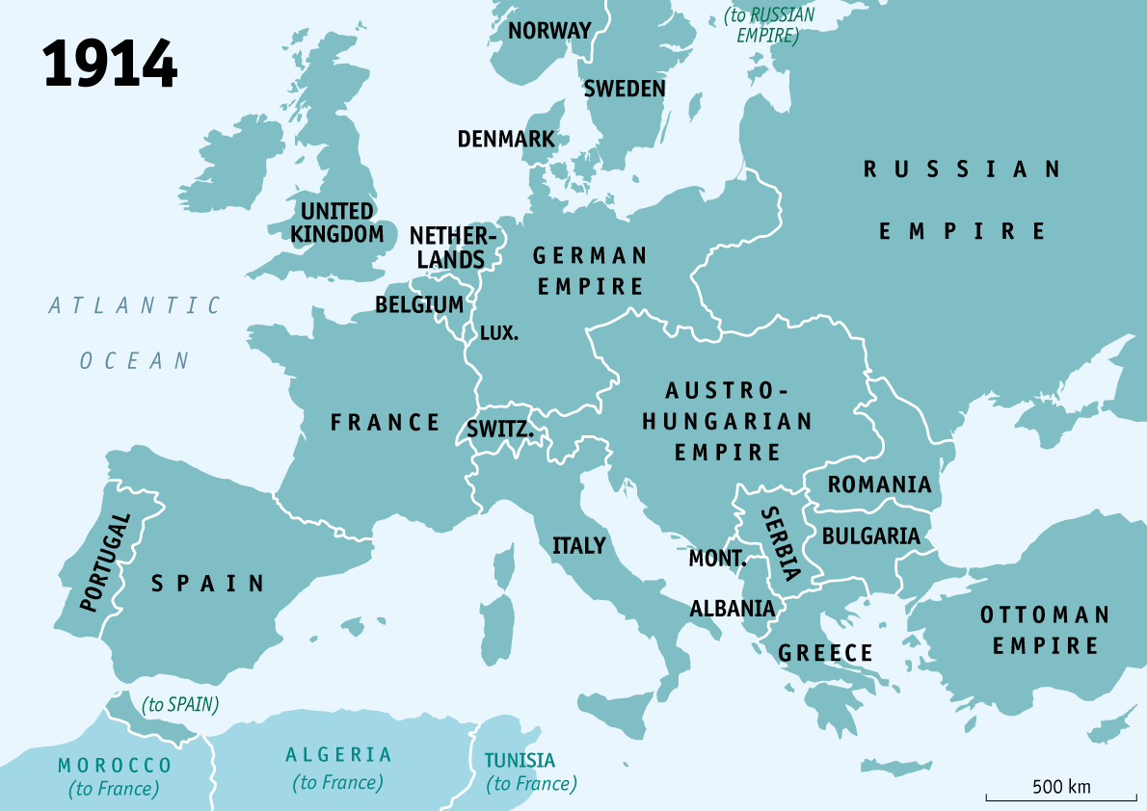
Europe 1914 When War Began

Slide 10
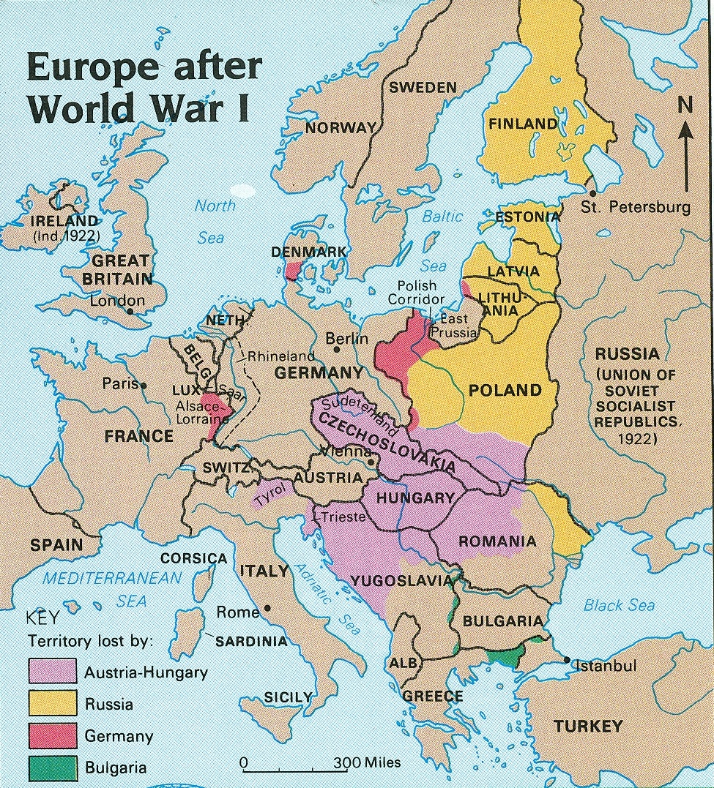
Europe after the Treaty of Versailles

Slide 11
GERMANY IS GIVEN A NEW GOVERNMENT
The Allies also gave Germany a new form of government based on proportional representation.
It was intended to prevent Germany being taken over by a dictatorship
Led to the creation of more than thirty political parties; none big enough to form a government on its own.

Slide 12
GERMANY’S REACTION TO THE TREATY
Germans were horrified
Not been allowed to attend the peace conference, but had to accept the guilt
Many Germans did not believe that the German army had actually been defeated in 1918 because Germany had not been invaded.
Several of the clauses of the treaty were thought to be very harsh.
How could Germany be the only country to blame?
Germany as the scapegoat

Slide 13
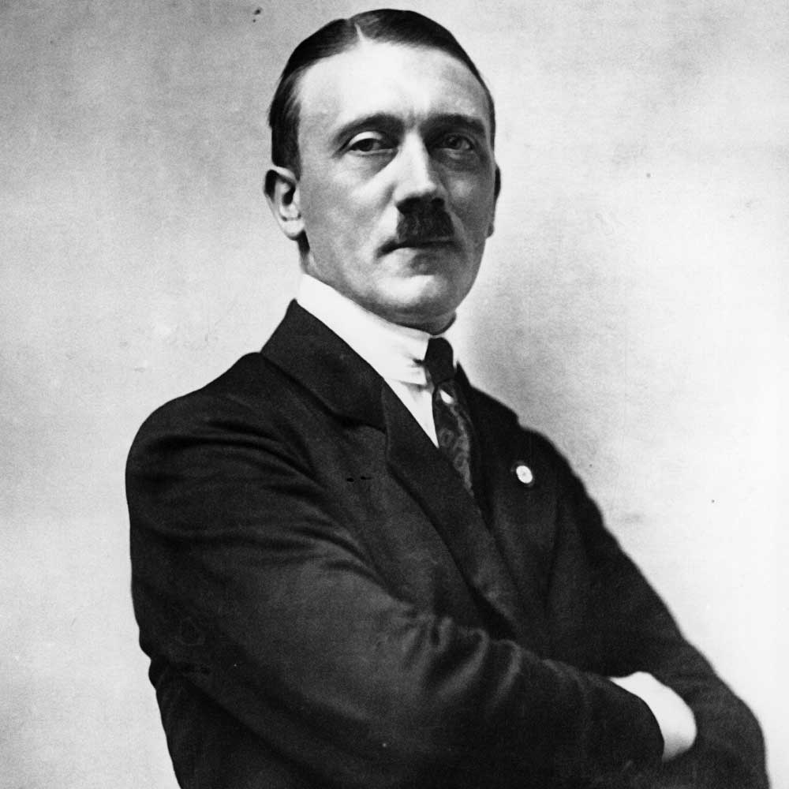
THE TREATY WILL BE A MAJOR CAUSE 0F THE RISE OF HITLER
Led to a great deal of unrest in Germany in the years from 1919 to 1922.
Power struggle takes place throughout Germany between many different groups
A number of extremist political parties were set up, including the German Workers' Party, which Adolf Hitler took over in 1921. He based his support upon the hatred that many Germans felt for the Treaty of Versailles.

Slide 14
STRENGTHS OF THE TREATY OF VERSAILLES
It ended World War I.
The League of Nations was formed.
Poland was reconstructed.
The Austria-Hungary Empire, the German Empire and the Ottoman Empire were divided into modern countries.
Estonia, Latvia and Lithuania were recreated from Russian territory.

Slide 15
Weaknesses of the Treaty
The Treaty of Versailles was written up by the allied powers without any input from the Germans.
It failed to create a lasting peace.
Harsh treatment of Germany. “War- guilt clause” forced the Germans to accept all responsibility for damages caused to any of the allied countries during the war.
It forced demilitarization of the Rhine, an elimination of the German air force and near elimination of the German navy, and a maximum allowance of 100,000 troops in the German army.
The Germans were forced to give up the territories of Alsace and Lorraine to France, and a great deal of Prussian territory went to the new state of Poland.
To be given the opportunity of signing a peace treaty at all, the Germans were forced to accept a democratic government.

Slide 16
THE TREATY’S WEAKNESSES
The War Guilt Clause caused all Germans to hate the treaty, and opposition to the treaty was one reason for the rise to power of Hitler.
Russia lost more land than Germany and became determined to regain as much of its former territory as possible.
Ho Chi Minh, a young Vietnamese man, asked Wilson’s help to allow Vietnam to form its own government instead of being controlled by France. Ho was denied his request, so he founded the Indochina Communist Party and led the fight during the Vietnam War.

Slide 17
EUROPE AND THE UNITED STATES DIFFER OVER THE TREATY
The European leaders were not interested in a just peace. They were interested in retribution. Over Wilson's protests, they ignored the Fourteen Points one by one. Germany was to admit guilt for the war and pay unlimited reparations.
German colonies were handed in trusteeship to the victorious Allies.
No provisions were made to end secret diplomacy or preserve freedom of the seas.
New nations’ borders did not reflect self determination.
Wilson did gain approval for his proposal for a League of Nations.

Slide 18
UNITED STATES DOES NOT SIGN THE TREATY
Wilson presented the Treaty of Versailles to the Senate.
Met with stiff opposition.
Republican leader of the Senate, Henry Cabot Lodge, was very suspicious of Wilson and his treaty. Article X of the League of Nations required the United States to respect the territorial integrity of member states. (Goes against imperialism)
Many believed the League was the sort of entangling alliance the United States had avoided since George Washington's Farewell Address.
Lodge sabotaged the League covenant by declaring the United States exempt from Article X. He attached reservations, or amendments, to the treaty to this effect. Wilson, bedridden from a debilitating stroke, was unable to accept these changes. He asked Senate Democrats to vote against the Treaty of Versailles unless the Lodge reservations were dropped. Neither side budged, and the treaty went down to defeat.

